Slide 1
Intermage Progress
Perkedel Technologies

Slide 2
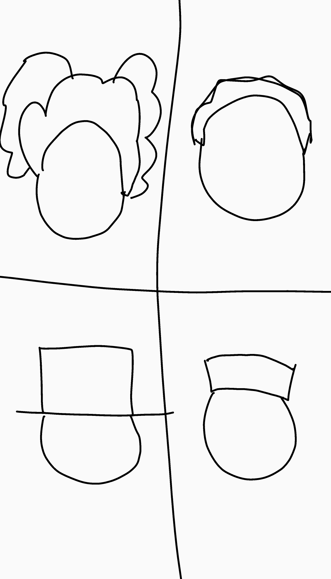

Slide 3

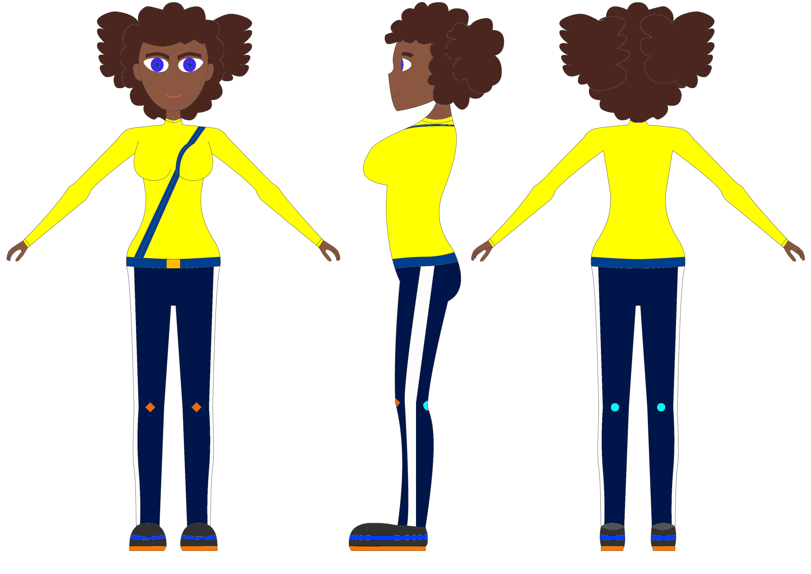

Slide 4
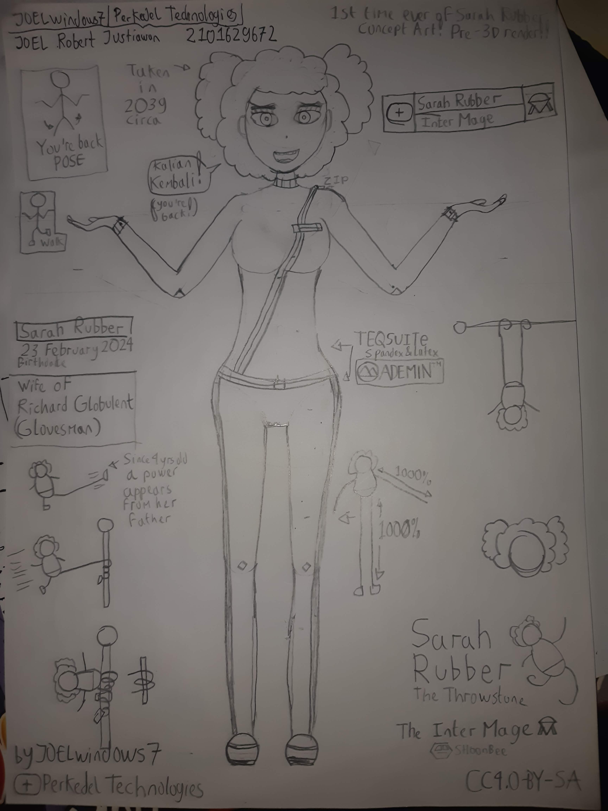
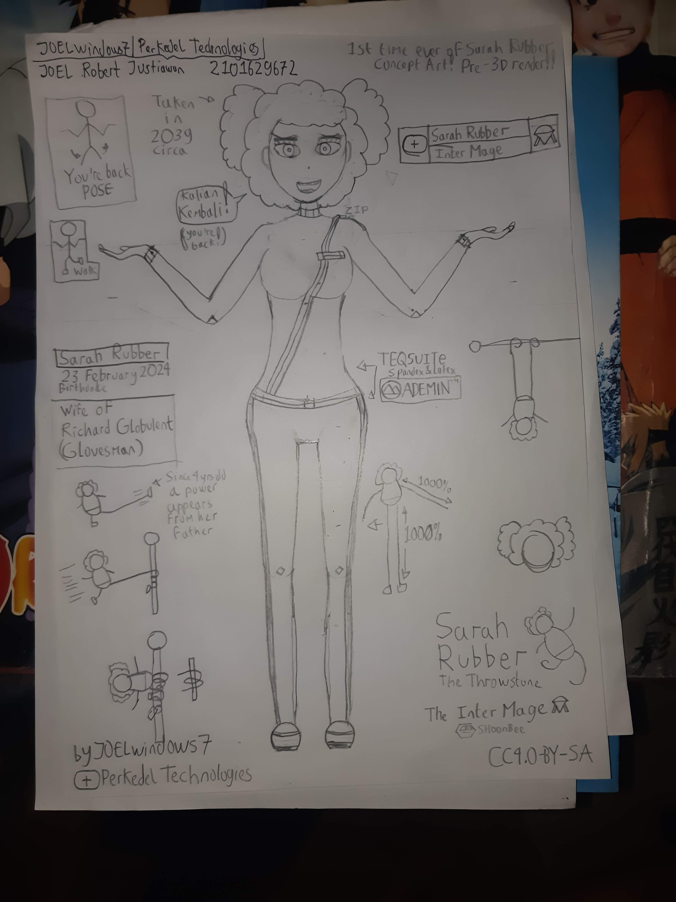

Slide 5





Slide 6



Slide 7


