Slide 1
Attributive Clause（完整版本）

Slide 2
所以，当先行词为“人”的时候，我们如何选择关系代词/引导词呢？
关系代词当主语时：
who, that
关系代词当宾语时：
who, that, whom, 不填
先行词为人
关系代词当表语时：
that, 不填
关系代词当定语时：
whose

Slide 3
所以，当先行词为“物”的时候，我们如何选择关系词呢？
关系词当主语时：
which, that
关系词当宾语时：
which, that, 不填
先行词为物
关系词当表语时：
that, 不填
关系词当定语时：
whose

Slide 4
定语从句
that, who, which, whom, whose，
when, where, why (给我记住这些引导词)
that, who, which, whom, whose 从句中缺成分了选它们
when, where, why 从句中不缺成分了选它们

Slide 5
I still remember the day ______ you hugged me gently.
I still remember the place ______ we saw the sky together.
I still remember the reason ______ you love me.
when, where, why 从句中不缺成分了选它们

Slide 6
特殊情况1：（只能用that!!!）
先行词为：不定代词指物
As we all know, all _____ can be done has been done.
先行词是
all, any, few, little, none, anything,
everything, nothing, someting. 等等等等

Slide 7
特殊情况1：（只能用that!!!）
先行词被：the only（这个最常见！）, the very, the right, the last 修饰的时候！
It is the only word ________ I don’t know in the passage.

Slide 8
特殊情况1：（只能用that!!!）
先行词即有人又有物
The characters and events _______ the author described in his book are very interesting.

Slide 9
特殊情况1：（只能用that!!!）
先行词前：序数词（the first）, 形容词最高级！(the best, the biggest....)
He was the first _______ gave us some useful advice.
It is the best film _____ shows us courage and love.

Slide 10
特殊情况1：（只能用that!!!）
当主句以 who 或 which开头时，定语从句
的关系词用 that, 而不用 which 或 who.
Who is the girl _______ spoke to you just now?
Which is the pen _______ you lost ?

Slide 11
先行词为：不定代词指物
先行词被：the only, the very, the right, the last 修饰
先行词即有人又有物
先行词前：序数词, 形容词最高级
当主句以 who 或 which开头时

Slide 12
特殊情况2：（只能用who/whom!!!）
先行词为：those, people
Those _______ want to go there come here please.

Slide 13
特殊情况2：（只能用who/whom!!!）
先行词为：不定代词指人
Anyone _______ is against us is our enemy.
先行词是
all, any, few, little, none, anyone,
everybody, nobody, everyone, no one等等等等

Slide 14
先行词为：those, people
先行词为：不定代词指人

Slide 15
1. I’ve never heard of the people and things ________ you talked about just now.
2. Say all ________ you know.
3.The first one _____ stands up is a little boy.
4.Many people _______ are struggling with COVID-19 are our examples.

Slide 16
5. Is there anything ________ you want to buy in the town.
6. Does the teacher know everybody _____ planted the trees.
7.This is the first gift _________ my parents bought me.

Slide 17
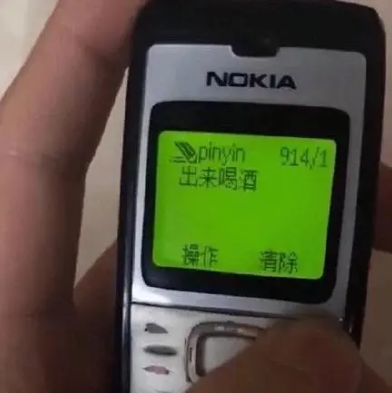
定语从句中的主谓一致
The telephone that _______ been already given to me is home-made. (have)

Slide 18

定语从句中的主谓一致
I, who ____ your classmate, will give a French kiss to you. ( be )

Slide 19
Learn to practice
are
1. Tom is one of the boys that _________(be) from the USA.
is
2. Tom is the only boy that_______(be) from the USA.
one of +复数名词作先行词时----从句的谓语动词用复数形式。
one前有 the (only)/ the( just)/the(very)修饰时，从句的谓语动词用单数形式

Slide 20
Learn to practice
He is one of the students who ______ made great progress.
Mr Wang is the only one of my friends who ____ been invited to have dinner with us.
(have)
have
has

Slide 21
所以，当先行词为“人”的时候，我们如何选择关系代词/引导词呢？
关系代词当主语时：
who, that
关系代词当宾语时：
who, that, whom, 不填
先行词为人
关系代词当表语时：
that, 不填
关系代词当定语时：
whose

Slide 22
所以，当先行词为“物”的时候，我们如何选择关系词呢？
关系词当主语时：
which, that
关系词当宾语时：
which, that, 不填
先行词为物
关系词当表语时：
that, 不填
关系词当定语时：
whose

Slide 23
先行词为：不定代词指物
先行词被：the only, the very, the right, the last 修饰
先行词即有人又有物
先行词前：序数词, 形容词最高级
当主句以 who 或 which开头时

Slide 24
先行词为：those, people
先行词为：不定代词指人

Slide 25
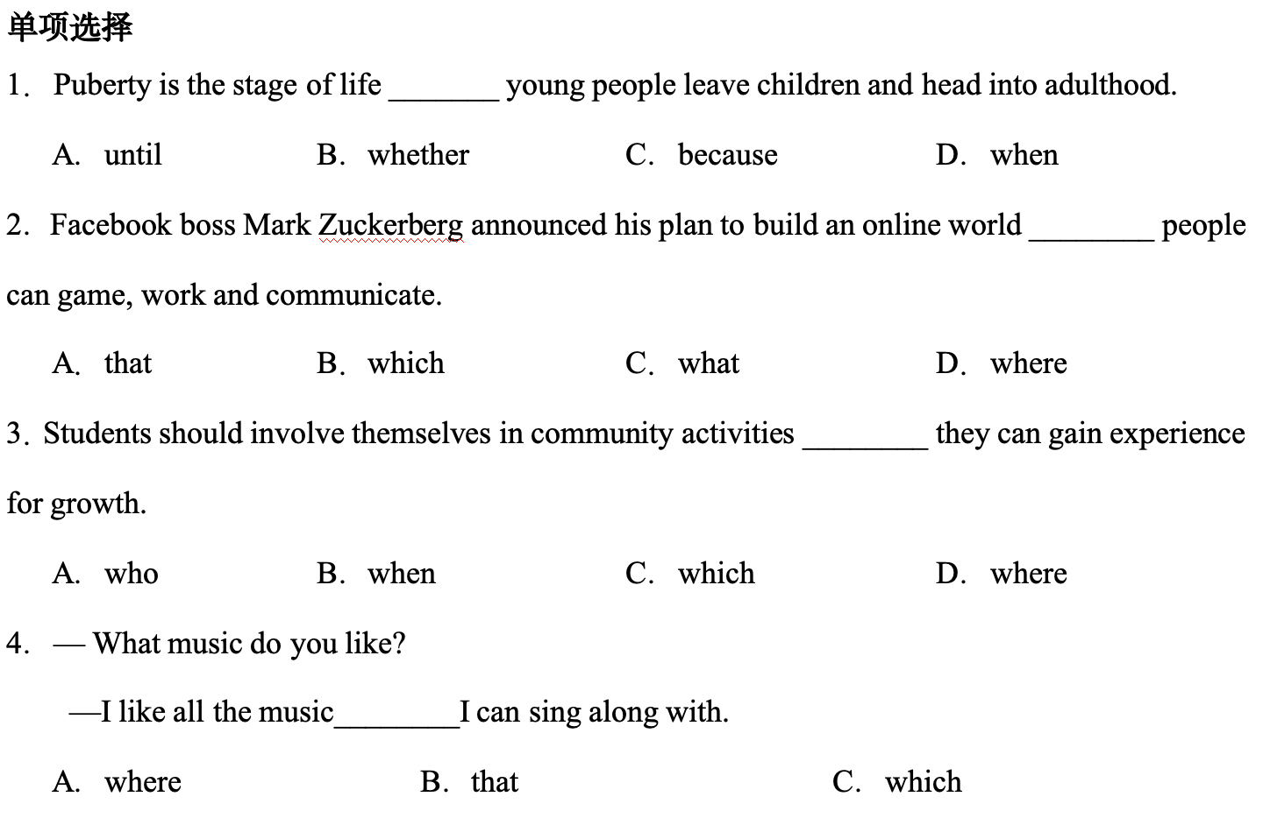

Slide 26
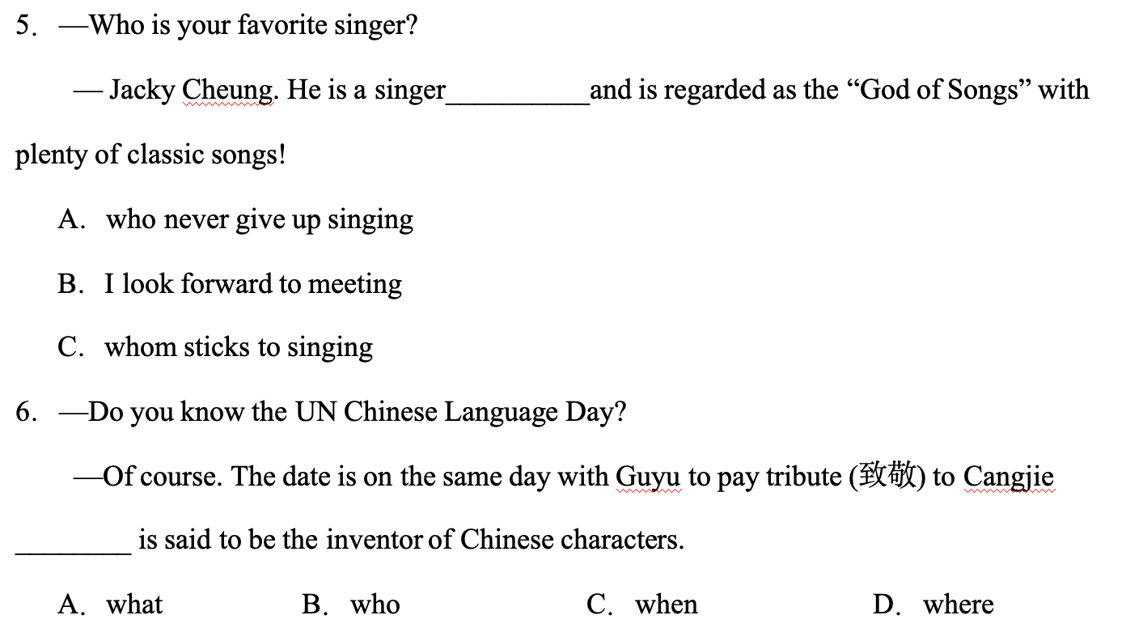

Slide 27
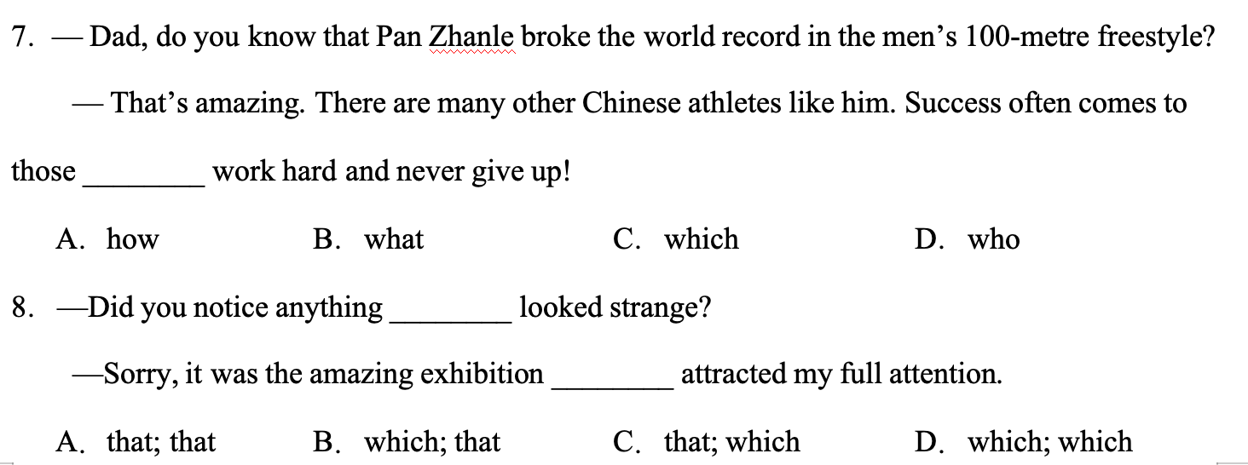

Slide 28
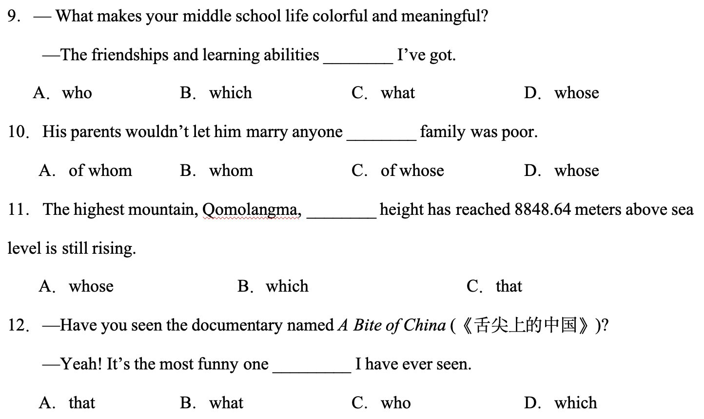

Slide 29
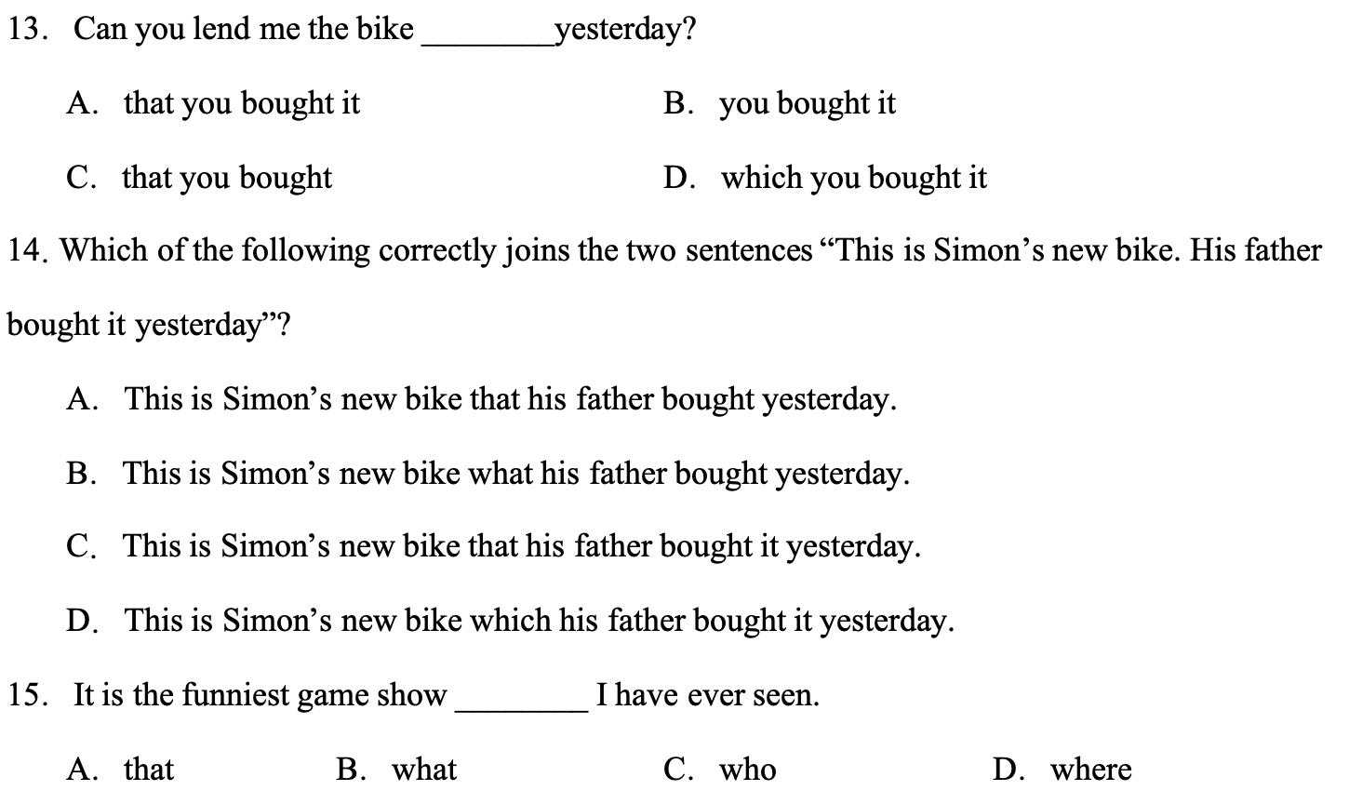

Slide 30
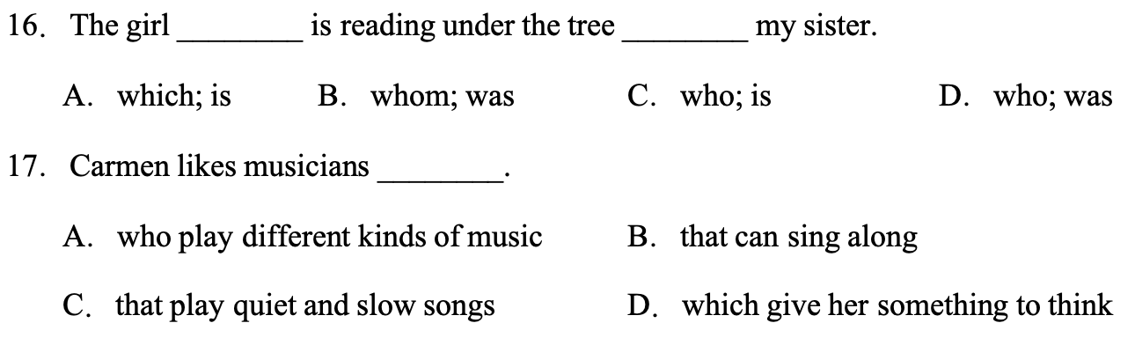

Slide 31
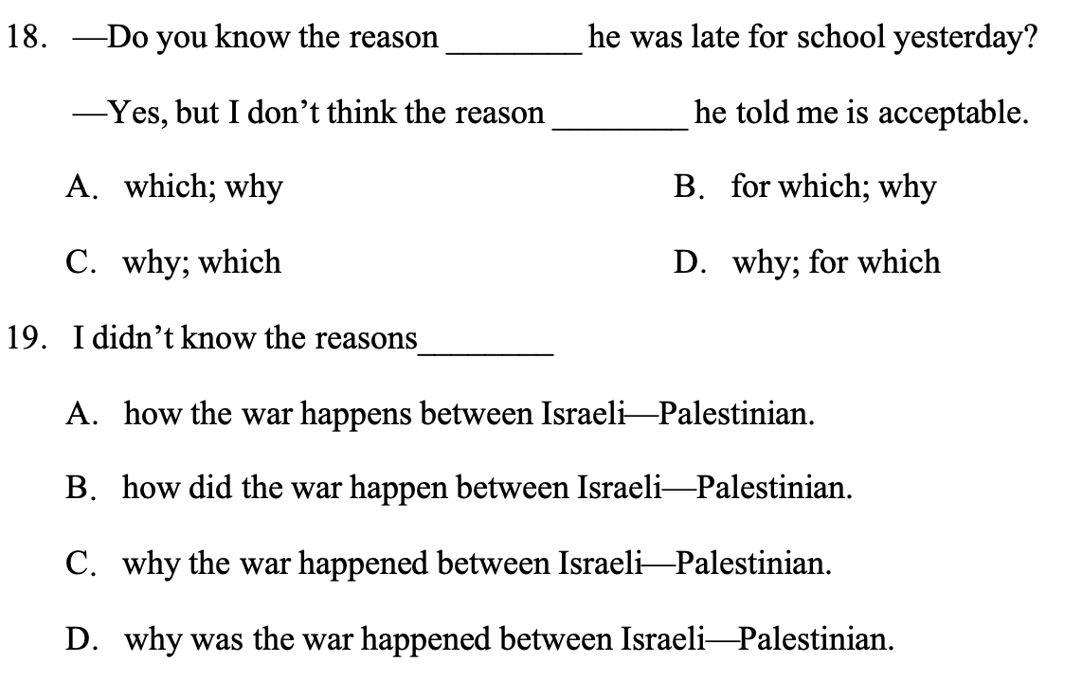

Slide 32
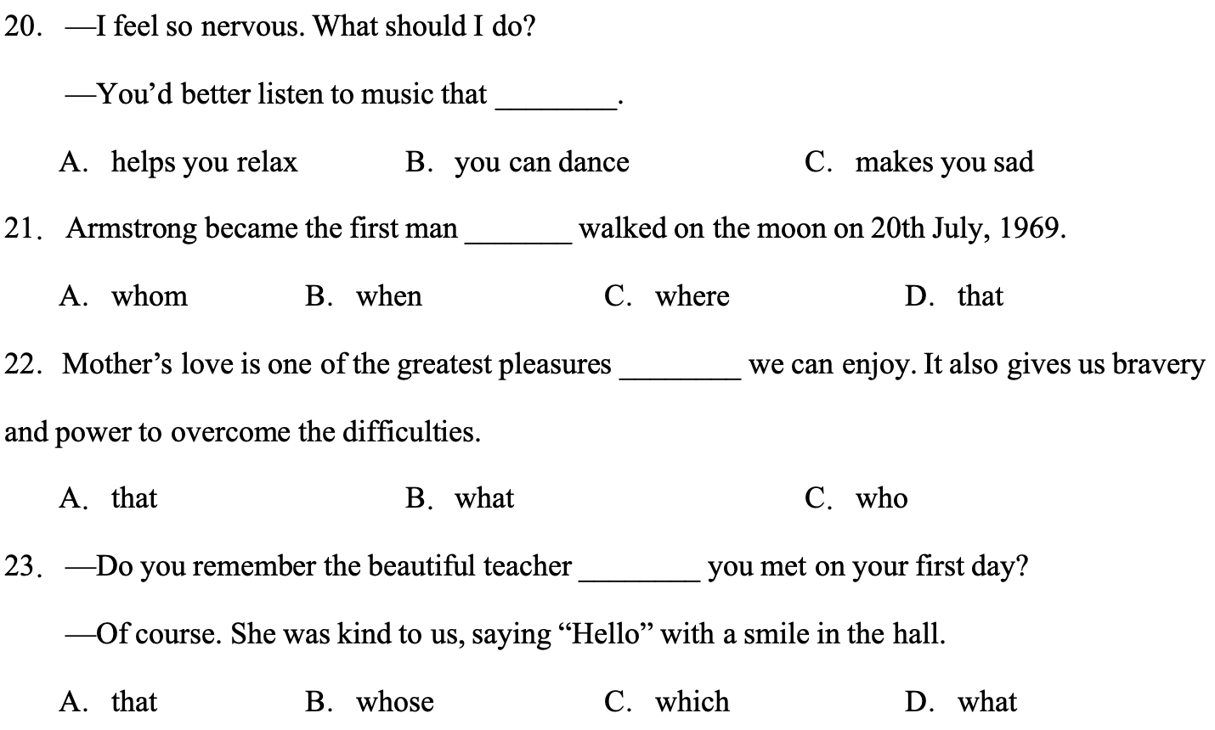

Slide 33
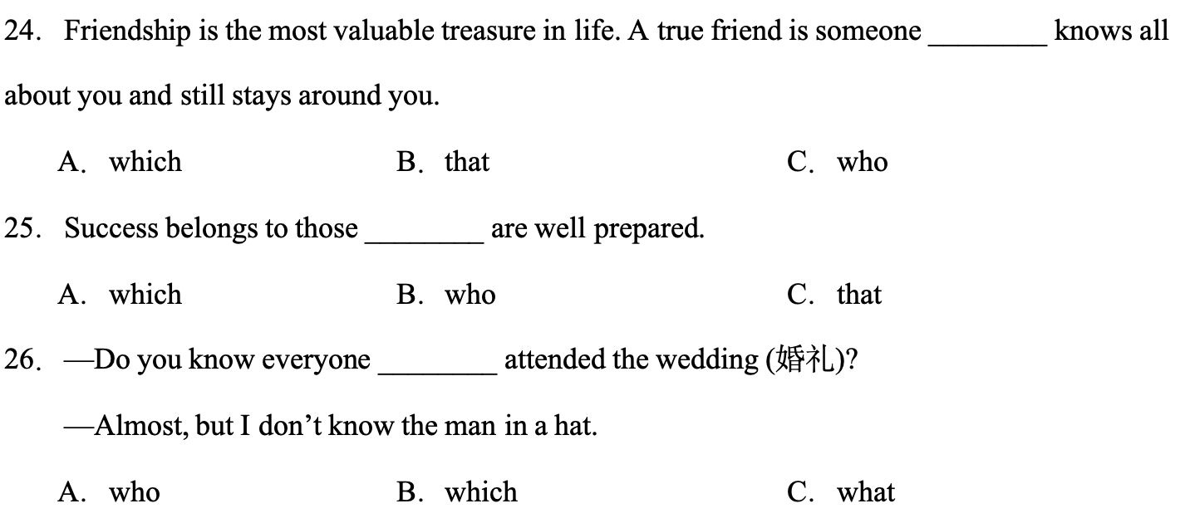

Slide 34
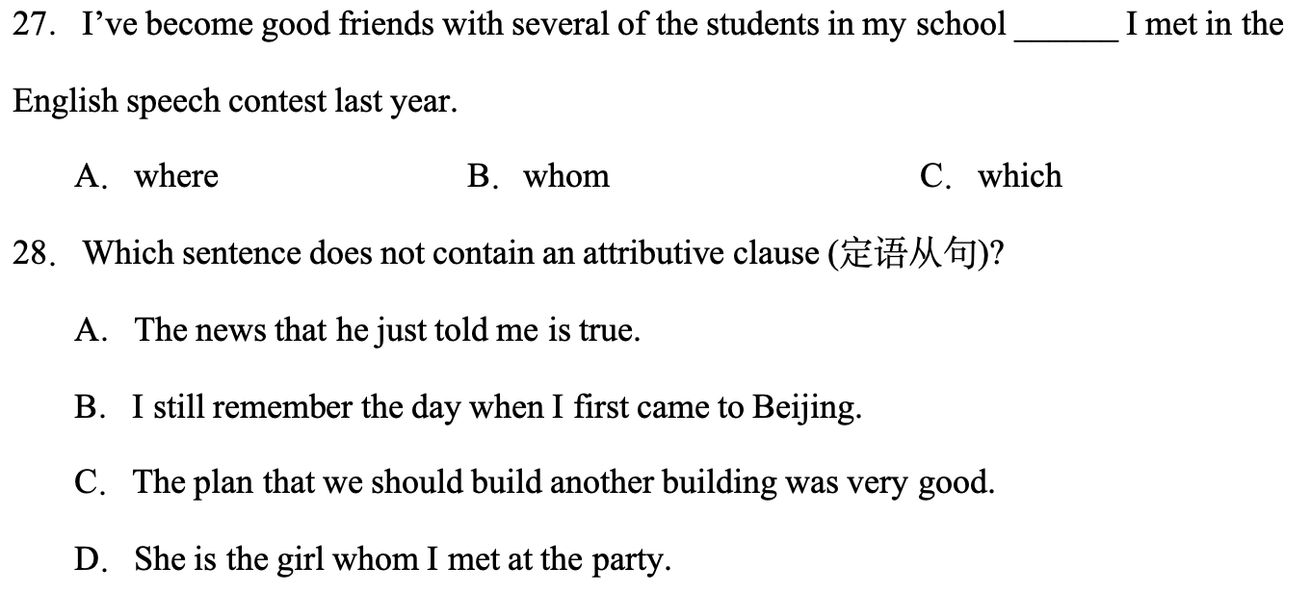

Slide 35
