Slide 1
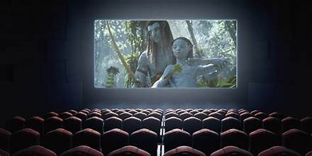
film
Box Office Success: Data-Driven Insights
For
Launching a Winning Movie Studio

Slide 2

OVERVIEW
1-Project goals
Main objectives are to ensure
data-backed decisions
on film production,
Budgeting
marketing

Slide 3

2-METHODOLOGY
Methodological measures used are
correlation of the dependent variables
Drawing of the Bar graphs checking the
highest film productions
Plotting of the yearly films trends
Scatter plotting

Slide 4


3-KEY OUTCOMES
Best movie studio
The best movie studio was BV, with the highest domestic gross income
Highest ordered movie
The highest movie ordered was Golesly Metas, with the writer Kevin Mcleod,
Movie counts popularity
Region with the highest number of Movie counts is "US", MOVIE-Jurassic World 3D

Slide 5

BUSINESS UNDERSTANDING
Movie genre with highest ratings and popularity
The studio with the highest movies and writers
Movie genre budgeting and market returns
Movie regional popularity and orders
The Best film Directors and writers

Slide 6

DATA UNDERSTANDING
DATA SOURCE
DESCRIPTION
The source of our data is from the GITHUB ACCOUNT. https://github.com/learn-co-curriculum/dsc-phase-2-project-v3
From our data ,we have used 4 files
Movie_gross.csv
Movie_budget.csv
Movie_popularity
Im_db(database file)

Slide 7
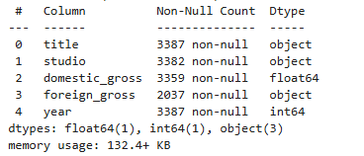
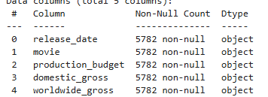
Film Data types
Movie gross.csv
Movie budget.csv

Slide 8
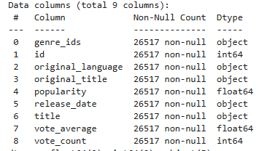
Movie Popularity
Im.db(database)
It has the following tables
Persons
Principals
Writers
Directors
Movie ratings
Movie akas
Movie basics

Slide 9

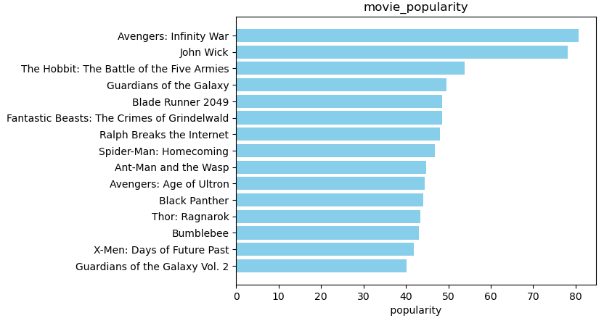

MOVIE POPULARITY
Description
The most popular movie is Avengers :infinity war

Slide 10
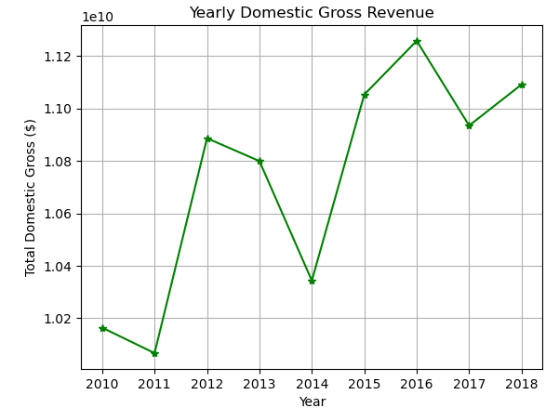
Movie yearly domestic gross trend
TRACTION
This matrix provides a snapshot of various success metrics Domestic gross revenue for company from 2020 to 2018

Slide 11
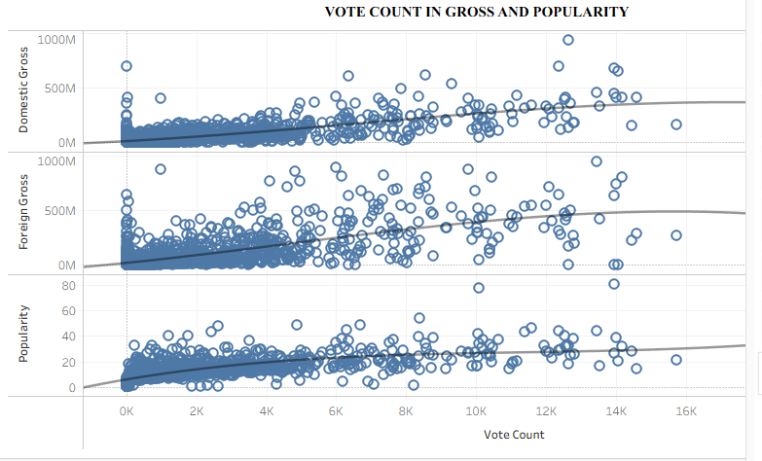
Gross Correlation To Vote Count

Slide 12
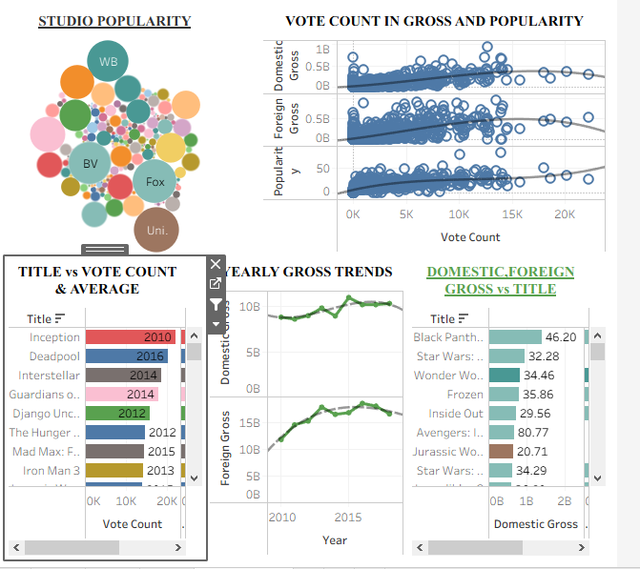
DASH BOARDING
DESCRIPTION
The dash boarding includes the following insights
Studio popularity
Vote count in Gross and popularity
Title vs Vote count and average
Year gross tress
Domestic , Foreign gross vs Title

Slide 13
RECOMMENDATION
Focus on High-Grossing Genre
Action/Adventure/Sci-Fi films like Inception
Documentaries can achieve high average ratings
Leverage Top Talent
Directors: Collaborate with top directors like Liz Salvato
Writers: Engage experienced writers such as Frank Appache
Composers: Work with renowned composers like Kevin MacLeod
Production and Budget Strategy
Budget Allocation
Audience Engagement
Focus on producing films that achieve high audience ratingsCompetitive Analysis
Competitive Analysis
Studio Partnerships: Analyze successful studios like BV

Slide 14

NEXT STEP
Conduct Market & Audience Research
Secure Key Talent & Partnerships by hiring top directors, writers, and composers
Budget & Funding Strategy by Setting a production budget range
Production & Release Plan by priotising high-gross genres
Performance Tracking & Iteration by gathering audience feedback

Slide 15

THANK YOU
for your time and attention
JOHN ONGUKA
https://github.com/JOHN-ANALYST-dt/FILMS_PROJECT
ONGUKAJOHN98@GMIAL.COM
www.linkedin.com/in/onguka

