Slide 1
BITSConnect
CampusHub BITS
A Role-Based Campus Attendance & Record Management System
Laravel 10 Web Portal • Flutter Mobile App • Shared REST API
System Demonstration

Slide 2
Agenda
BITSConnect — CampusHub BITS
• Overview & Tech Stack
• Architecture & Authentication (Sanctum bearer tokens)
• Laravel Web Portal — Admin, Event Manager, Scanner, Reporting
• Flutter Mobile App — Student, Scanner, Alumni modules
• Key Features Highlight (QR, Face, Geofence, Reports)
• Q&A / Closing
2

Slide 3
Overview & Tech Stack
One backend, two front-ends
Laravel Backend
Flutter Mobile App
• PHP 8.1+ / Laravel 10
• MySQL database
• Laravel Sanctum (API tokens)
• Excel / Word / PDF report exports
• Geofence + Haversine server-side distance
• Face recognition & embedding services
• Blade + Bootstrap 5 + Vite (web)
• Flutter / Dart
• Provider state management
• mobile_scanner, camera, image_picker
• geolocator (GPS geofence)
• flutter_secure_storage (tokens)
• dio / http for APIs
• Role modules: Student, Scanner, Alumni
3

Slide 4
Architecture & Data Flow
Shared REST API + MySQL
Flutter App (BITSConnect)
HTTPS / Bearer token
Laravel Web Portal (Blade)
Session + CSRF
Laravel 10 Back-end
Controllers: Api\Mobile, Admin, Student, Scanner, Alumni, EventManager
Services: GeofenceService, Face services
Middleware: Role guards + PreventMobileAccess
MySQL
users, roles, events, attendance_logs,
face_data, year_books, work_experiences
4

Slide 5
Laravel Web Portal — Login & Role Redirect
Access the web dashboard at http://127.0.0.1:8000
• Role-based dashboards after login:
• Admin → /admin
• Student → /student
• Scanner → /scanner
• Alumni → /alumni
• Event Manager → /event-manager
• Seeded accounts — Admin / Student / Scanner / Alumni (password)
5

Slide 6
Admin — Dashboard, Users & Roles
/admin
• Dashboard counts: total admins, students, scanners, alumni.
• User Management (/admin/usersmanagement):
• – List with pagination + search filters (name, year, role, section, gender, semester)
• – Create / edit / delete users, store profile photos, block duplicate emails
• Role Management (/admin/roles):
• – Create, edit, delete roles and default URLs
• Event Management (/admin/events):
• – Create events with attendance windows (login/logout datetime), academic year, semester
6

Slide 7
Event Manager — Attendance & Reporting
/event-manager
• List events with attendance counts; filter by name, academic year, semester, date.
• View attendance logs per event; filter by student ID / name / course / year / section.
• Export reports to Excel (.xlsx), Word (.docx), and PDF.
• Grouped views: By Student and By Year & Section.
• Uses Maatwebsite Excel, DomPDF, and PhpOffice PhpWord under the hood.
7

Slide 8
Scanner & Geofence (Web)
/scanner • /admin/geofence • /scanner/patrol
• Scanner dashboard: select event, submit/scan student QR → records Login/Logout.
• Admin configures checkpoints & patrols at /admin/geofence.
• Geofence: Haversine distance computed server-side.
• Verification accepted only inside checkpoint radius within accuracy & capture-time bounds.
• Every accepted/rejected attempt stored in checkpoint_verifications.
8

Slide 9
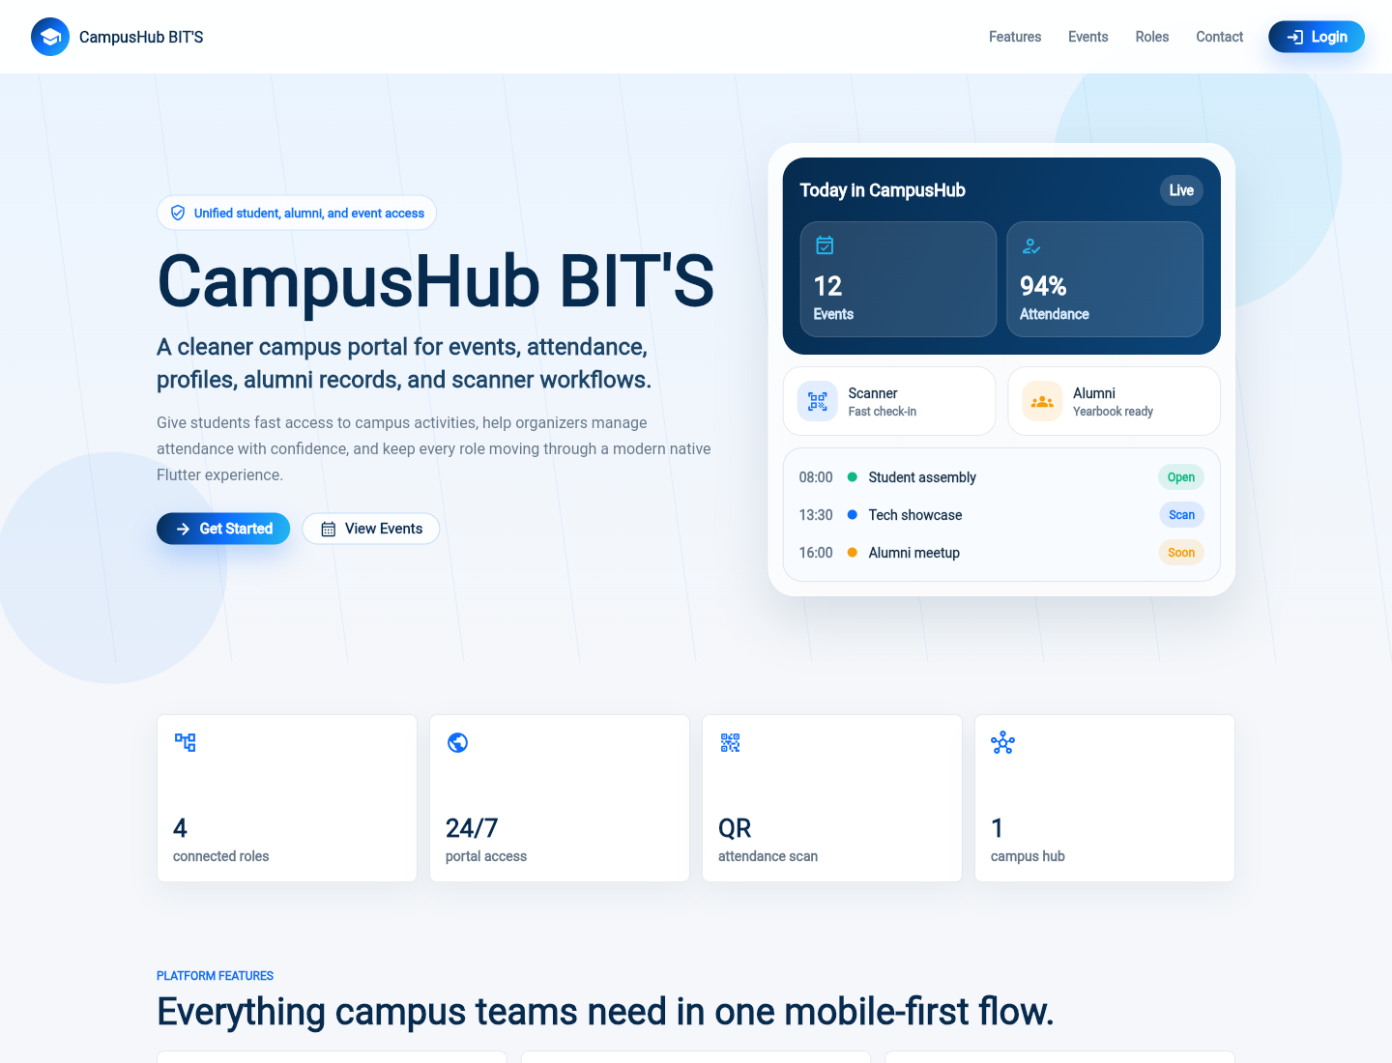
Flutter App — Launch & Landing Page
flutter run • https://bitsorg.info/api/
Splash → Landing Page
Sections: Hero, Stats, Features, Roles,
Events, Operations, About, Footer.
Login opens in a modal dialog.
9

Slide 10
Mobile Login & Secure Token
POST /api/mobile/login
• Login returns a Bearer token stored in secure storage.
• Protected requests send Authorization: Bearer <token> and Accept: application/json.
• Role determines destination:
• – Student → Student Dashboard
• – Alumni → Alumni Dashboard
• – Scanner → Scanner Dashboard
• Same credentials work on web and mobile — one shared backend.
10

Slide 11
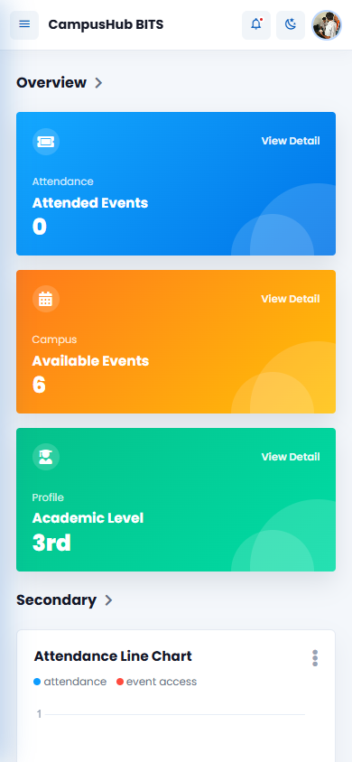
Student Module — Dashboard
GET /api/mobile/student/dashboard
• Stat cards: Attended Events, Available Events, Academic Level.
• Attendance line chart + user activity.
• Upcoming Events + Announcements.
• Student QR Code card (downloadable).
• Profile summary: ID, course, name, email, academic year, semester.
11

Slide 12
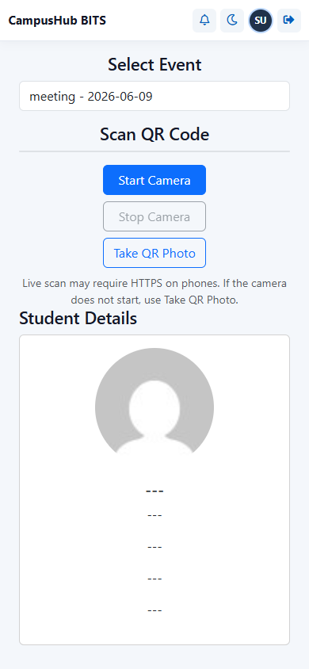
Student Module — Events & QR Attendance
GET /events • POST /attend • POST /logout-attendance
• Event cards: name, description, date, login/logout times, badges.
• Attend (login) and Logout buttons.
• Attendance window rules enforced server-side.
• GPS geofence checked before attendance is recorded.
• Duplicate login for same event is blocked.
12

Slide 13
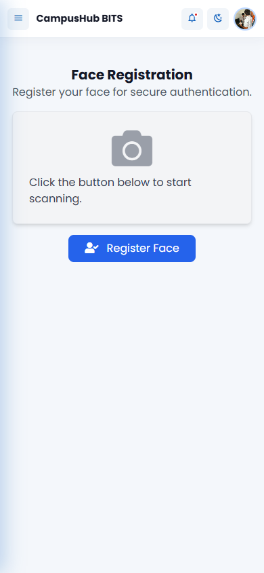
Student Module — Face Registration & Attendance
GET /face/status • POST /face/register • POST /attendance/face
• Face Registration: requests camera, captures face image, uploads.
• Face Attendance: liveness capture → verify + geofence → record attendance.
• Face data stored for recognition by scanners.
13

Slide 14
Student — Profile, Password, Notifications & Penalties
/student
• Profile: Account, Academic, Personal & Photo tabs; completion status pill.
• Change Password with validation of current password.
• Notifications + Mark All Read.
• Penalties (attendance penalties).
14

Slide 15
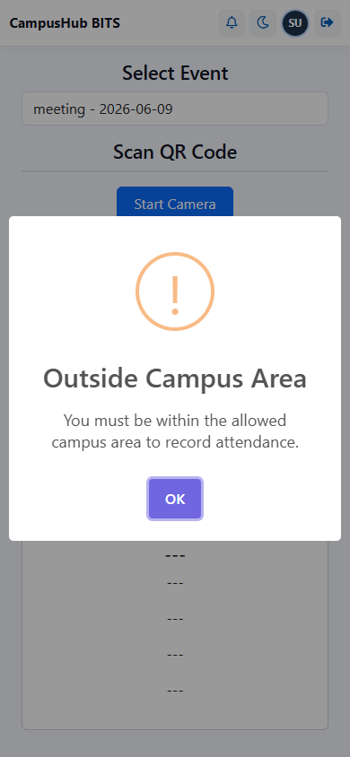
Scanner Module (Mobile) — QR & Face Verify
GET /scanner/dashboard • POST /scanner/scan • POST /scanner/face-verify
• Scanner dashboard: Events, Today, Total Scans, Recent Scans.
• QR Attendance: select event → start camera → scan student QR.
• Validates geofence (GPS) + event window; records Login/Logout.
• QR void with reason + manual fallback.
• Scan History + Face Verification (with confidence).
15

Slide 16
Alumni Module (Mobile)
Dashboard / Profile / Records / Yearbook / Work Experience
• Dashboard: profile overview + announcements.
• Profile: account + extended profile, photo upload, completion status.
• Records: graduation/yearbook & work history summary.
• Yearbook: graduation picture, motto, graduation year/date.
• Work Experience: add/edit/delete positions, companies, dates, currently-working flag.
16

Slide 17
Key Features Highlight
Powering campus operations
• Role-Based Access Control (Admin, Student, Scanner, Alumni, Event Manager).
• QR Attendance with geofence (GPS) — server-side Haversine authority.
• Face Recognition registration + live verification (liveness).
• Attendance Windows with duplicate-login protection.
• Notifications and Penalties for students.
• Reporting — export attendance to Excel, Word, PDF.
• Alumni records — yearbook + work experience.
• Patrol / Checkpoint geofencing for guard workflows.
• One shared API across web and mobile.
17

Slide 18
Security, Monitoring & Audit
Single source of truth
• Sanctum token auth on API.
• Role middleware: IfAdmin, IfStudent, IfScanner, IfAlumni.
• Server-side geofence recomputation — client distance never trusted.
• Rate-limited scanner verification (12/min).
• Audit logs: interaction_logs, checkpoint_verifications, face logs, mobile audit logs.
• PreventMobileAccess middleware for web pages.
18

Slide 19
Demo Recap
One backend, two clients
Laravel Web Portal
Flutter Mobile App
• /admin — Users, Roles, Events, Geofence
• /event-manager — Attendance + Exports (xlsx, docx, pdf), By-Student/Section
• /scanner — QR entry, patrol
• Student: dashboard, events, QR + face attendance, profile, notifications, penalties
• Scanner: dashboard, QR scan, face verify, history
• Alumni: dashboard, profile, yearbook, work experience
19

Slide 20
Thank You!
Questions?
BITSConnect • CampusHub BITS

