Slide 1
Collection API
2

Slide 2
Agenda
9. ArrayList
o Differences between ArrayList and Vector ?
o Getting synchronized version of ArrayList object LinkedList
Vector
Stack
The 3 cursors of java
0. Enumeration
Iterator
2. ListIterato
o Compression of Enumeration , Iterator and ListIterator ? Set interface
HashSet
LinkedHashSet
Diff b/w HashSet & LinkedHashSet
SortedSet
TreeSet
o Null acceptance
Comparable interface
compareTo() method analysis
Comparator interface
Compression of Comparable and Comparator ?
Introduction
Limitations of Object[] array
Differences between Arrays and Collections ?
4. 9(Nine) key interfaces of collection framework
i. Collection
ii. List iii. Set
iv. SortedSet
v. NavigableSet
vi. Queue
vii. Map
viii. SortedMap
ix. NavigableMap
5. What is the difference between Collection and Collections ?
6. In collection framework the following are legacy characters
7. Collection interface
8. List interface
2

Slide 3
Compression of Set implemented class objects
Map
Entry interface
HashMap
o Differences between HashMap and Hashtable ?
o How to get synchronized version of HashMap
LinkedHashMap
IdentityHashMap
WeakHashMap
SortedMap
TreeMap
Hashtable Properties
1.5v enhancements
o Queue interface
o PriorityQueue
1.6v Enhancements
o NavigableSet
o NavigableMap Utility classes :
o Collections class
▪ Sorting the elements of a List
▪ Searching the elements of a List
▪ Conclusions o Arrays class
▪ Sorting the elements of array
▪ Searching the elements of array
▪ Converting array to List
3

Slide 4
Limitations of Object[] array:
3

Slide 5
Arrays are fixed in size that is once we created an array there is no chance of increasing (or) decreasing the size based on our requirement hence to use arrays concept compulsory we should know the size in advance which may not possible always.
Arrays can hold only homogeneous data elements.
Example: Student[] s=new Student[10000];
s[0]=new Student();//valid
s[1]=new Customer();//invalid(compile time error)
Compile time error:
Test.java:7: cannot find symbol
Symbol: class Customer
Location: class Test
s[1]=new Customer();
3) But we can resolve this problem by using object type array(Object[]).
4

Slide 6
Example:
Object[] o=new Object[10000];
o[0]=new Student();
o[1]=new Customer();
4) Arrays concept is not implemented based on some data structure hence ready-made methods support we can't expect. For every requirement we have to write the code explicitly.
To overcome the above limitations we should go for collections concept.
1. Collections are growable in nature that is based on our requirement we can increase (or) decrease the size hence memory point of view collections concept is recommended to use.
2. Collections can hold both homogeneous and heterogeneous objects.
3. Every collection class is implemented based on some standard data structure hence for every requirement ready-made method support is available being a programmer we can use these methods directly without writing the functionality on our own.
4

Slide 7
Differences between Arrays and Collections ?
4

Slide 8
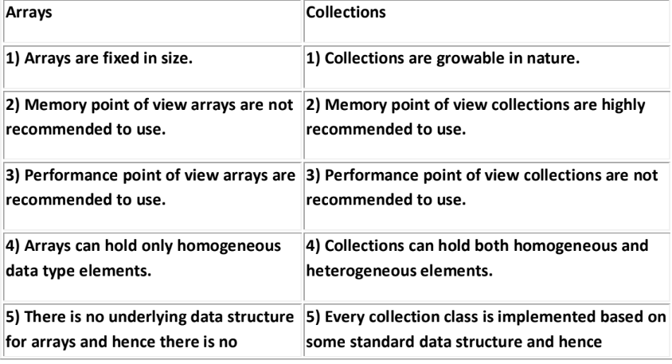
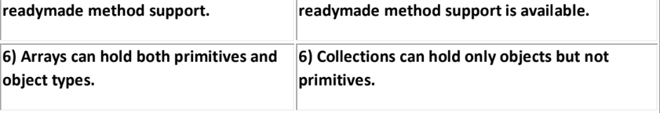
4

Slide 9
Collection:
5

Slide 10
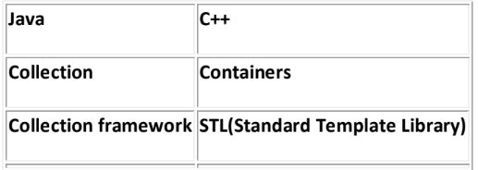
If we want to represent a group of objects as single entity entity then we should go for
collections.
Collection framework:
It defines several classes and interfaces to represent a group of objects as a single entity.
5

Slide 11
9(Nine) key interfaces of collection framework:
5

Slide 12

1. Collection
2. List
3. Set
4. SortedSet
5. NavigableSet
6. Queue
7. Map
8. SortedMap
9. NavigableMap
5

Slide 13
Collection:
5

Slide 14
1. If we want to represent a group of "individual objects" as a single entity then we should go for collection.
2. In general we can consider collection as root interface of entire collection
framework.
3. Collection interface defines the most common methods which can be applicable for any collection object.
4. There is no concrete class which implements Collection interface directly.
5

Slide 15
List:
6

Slide 16
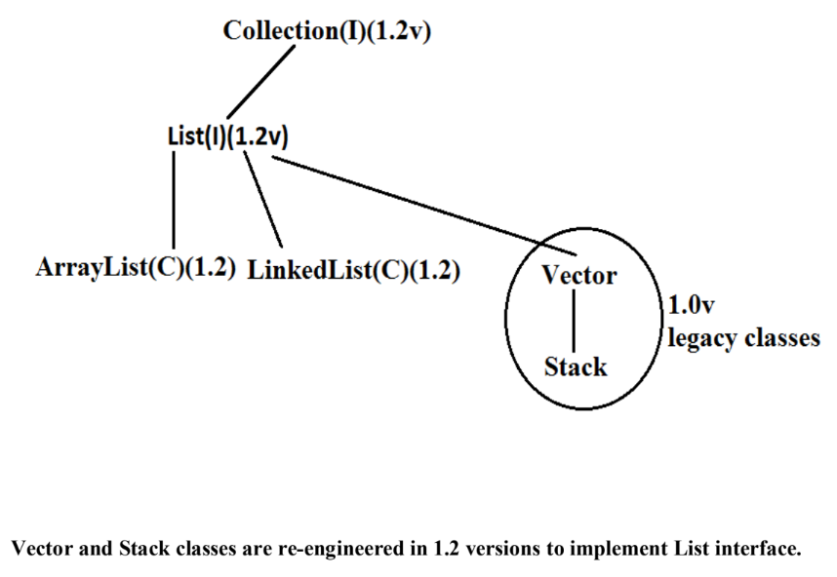
1. It is the child interface of Collection.
2. If we want to represent a group of individual objects as a single entity where
"duplicates are allow and insertion order must be preserved" then we should go
for List interface.
Diagram:
6

Slide 17
Set:
6

Slide 18
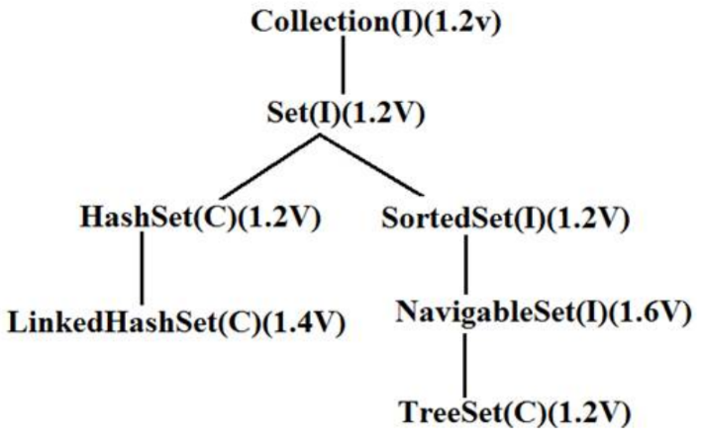
1. It is the child interface of Collection.
2. If we want to represent a group of individual objects as single entity "where duplicates are not
allow and insertion order is not preserved" then we should go for Set interface.
Diagram:
7

Slide 19
SortedSet:
7

Slide 20
1. It is the child interface of Set.
2. If we want to represent a group of individual objects as single entity "where
duplicates are not allow but all objects will be insertion according to some sorting
order then we should go for SortedSet.
(or)
3. If we want to represent a group of "unique objects" according to some sorting
order then we should go for SortedSet.
7

Slide 21
NavigableSet:
7

Slide 22
1. It is the child interface of SortedSet.
2. It provides several methods for navigation purposes.
7

Slide 23
Queue:
7

Slide 24
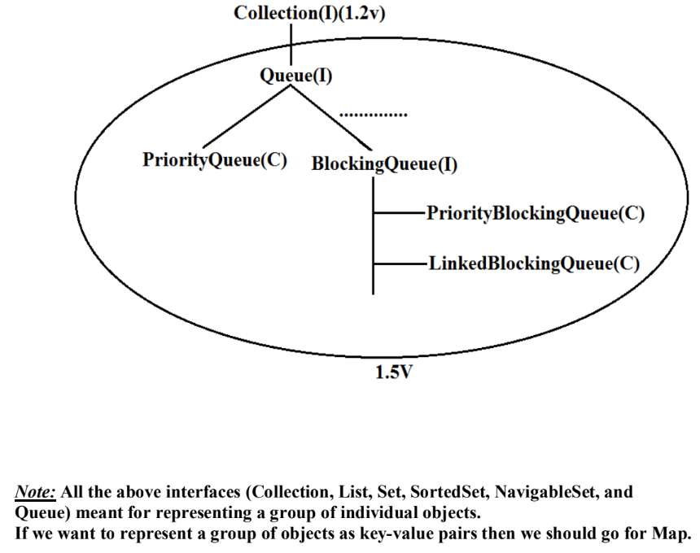
It is the child interface of Collection.
2. If we want to represent a group of individual objects prior to processing then we
should go for queue concept.
Diagram:
8

Slide 25
Map:
8

Slide 26
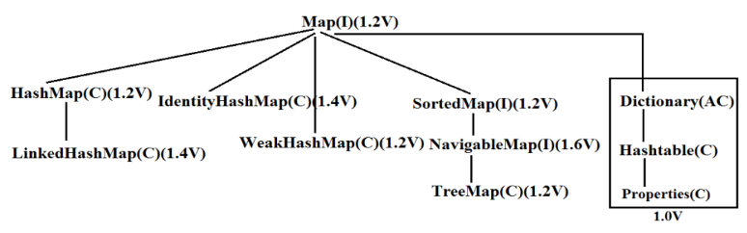
1. Map is not child interface of Collection.
2. If we want to represent a group of objects as key-value pairs then we should go for
Map interface.
3. Duplicate keys are not allowed but values can be duplicated.
Diagram:
8

Slide 27
SortedMap:
9

Slide 28
1. It is the child interface of Map.
2. If we want to represent a group of objects as key value pairs "according to some
sorting order of keys" then we should go for SortedMap.
9

Slide 29
NavigableMap:
9

Slide 30
1) It is the child interface of SortedMap and defines several methods for navigation purposes.
What is the difference between Collection and Collections ?
"Collection is an "interface" which can be used to represent a group of objects as a
single entity. Whereas "Collections is an utility class" present in java.util package to
define several utility methods for Collection objects.
Collection--------------------interface
Collections------------------class
In collection framework the following are legacy characters.
1. Enumeration(I)
2. Dictionary(AC)
3. Vector(C)
4. Stack(C)
5. Hashtable(C)
6. Properties(C)
9

Slide 31
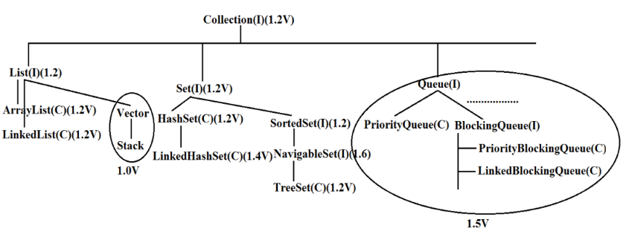
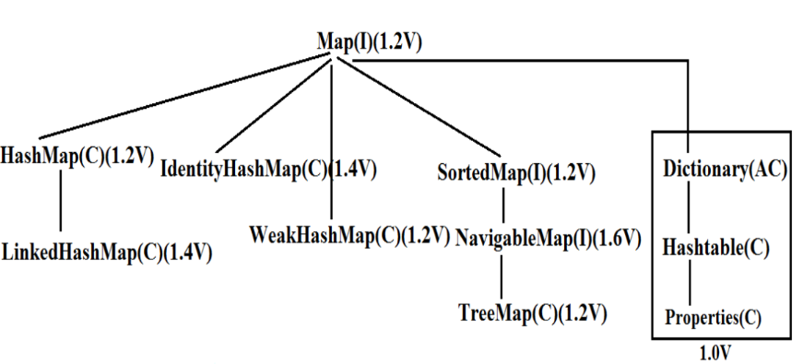
Diagram:
Diagram:
10

Slide 32
Collection interface:
10

Slide 33
• If we want to represent a group of individual objects as a single entity then we should go
for Collection interface. This interface defines the most common general methods which
can be applicable for any Collection object.
• The following is the list of methods present in Collection interface.
boolean add(Object o);
2. boolean addAll(Collection c);
3. boolean remove(Object o);
4. boolean removeAll(Object o);
5. boolean retainAll(Collection c);
To remove all objects except those present in c.
6. Void clear();
7. boolean contains(Object o);
8. boolean containsAll(Collection c);
9. boolean isEmpty();
10. Int size();
11. Object[] toArray();
12. Iterator iterator();
There is no concrete class which implements Collection interface directly.
10

Slide 34
List interface:
10

Slide 35
• It is the child interface of Collection.
• If we want to represent a group of individual objects as a single entity where duplicates are allow and
insertion order is preserved. Then we should go for List.
• We can differentiate duplicate objects and we can maintain insertion order by
means of index hence "index play very important role in List".
List interface defines the following specific methods.
1. boolean add(int index,Object o);
2. boolean addAll(int index,Collectio c);
3. Object get(int index);
4. Object remove(int index);
5. Object set(int index,Object new);//to replace
6. Int indexOf(Object o);
Returns index of first occurrence of "o".
7. Int lastIndexOf(Object o);
8. ListIterator listIterator();
11

Slide 36
ArrayList:
11

Slide 37
1. The underlying data structure is resizable array (or) growable array.
2. Duplicate objects are allowed.
3. Insertion order preserved.
4. Heterogeneous objects are allowed.(except TreeSet , TreeMap every where heterogenious
objects are allowed)
5. Null insertion is possible.
Constructors:
ArrayList a=new ArrayList();
Creates an empty ArrayList object with default initial capacity "10" if ArrayList reaches its max
capacity then a new ArrayList object will be created with
New capacity=(current capacity*3/2)+1
2) ArrayList a=new ArrayList(int initialcapacity);
Creates an empty ArrayList object with the specified initial capacity.
3) ArrayList a=new ArrayList(collection c);
Creates an equivalent ArrayList object for the given Collection that is this constructor
meant for inter conversation between collection objects. That is to dance between
collection objects.
11

Slide 38
Demo program for ArrayList:
import java.util.*;
class ArrayListDemo
{
public static void main(String[] args)
{
ArrayList a=new ArrayList();
a.add("A");
a.add(10);
a.add("A");
a.add(null);
System.out.println(a);//[A, 10, A, null]
a.remove(2);
System.out.println(a);//[A, 10, null]
a.add(2,"m");
a.add("n");
System.out.println(a);//[A, 10, m, null, n]
}
}
• Usually we can use collection to hold and transfer objects from one tier to another tier. To provide
support for this requirement every Collection class already implements Serializable and
Cloneable interfaces.
12

Slide 39
• ArrayList and Vector classes implements RandomAccess interface so that any random element
we can access with the same speed. Hence ArrayList is the best choice of “retrival operation”.
• RandomAccess interface present in util package and doesn't contain any methods.
It is a marker interface.
Example :
ArrayList a1=new ArrayList();
LinkedList a2=new LinkedList();
System.out.println(a1 instanceof Serializable ); //true
System.out.println(a2 instanceof Clonable); //true
System.out.println(a1 instanceof RandomAccess); //true
System.out.println(a2 instanceof RandomAccess); //false
12

Slide 40
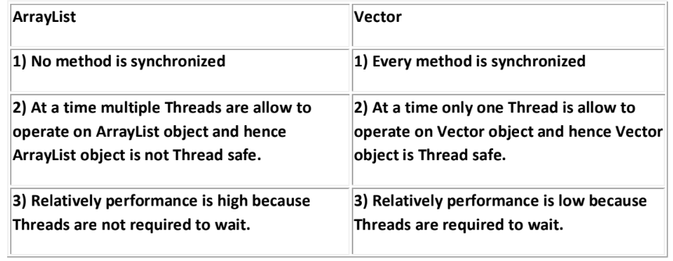
Differences between ArrayList and Vector ?
Getting synchronized version of ArrayList object:
• Collections class defines the following method to return synchronized version of
List.
Public static List synchronizedList(list l);
13

Slide 41
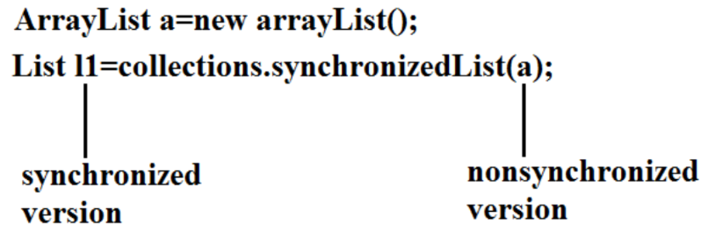
• Example:
• Similarly we can get synchronized version of Set and Map objects by using the
following methods.
1) public static Set synchronizedSet(Set s);
2) public static Map synchronizedMap(Map m);
• ArrayList is the best choice if our frequent operation is retrieval.
• ArrayList is the worst choice if our frequent operation is insertion (or) deletion in
the middle because it requires several internal shift operations.
13

Slide 42
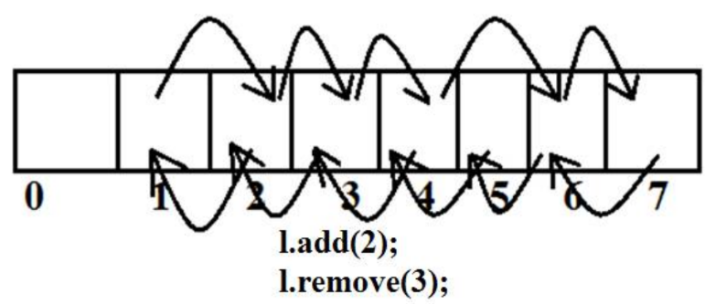
Diagram:
13

Slide 43
LinkedList:
13

Slide 44
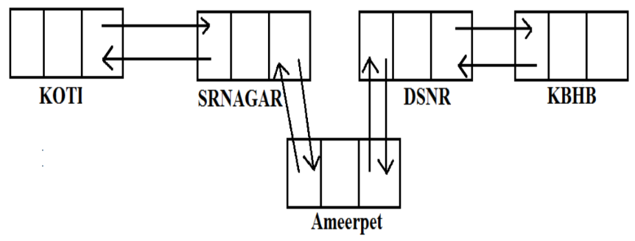
1. The underlying data structure is double LinkedList
2. If our frequent operation is insertion (or) deletion in the middle then LinkedList is
the best choice.
3. If our frequent operation is retrieval operation then LinkedList is worst choice.
4. Duplicate objects are allowed.
5. Insertion order is preserved.
6. Heterogeneous objects are allowed.
7. Null insertion is possible.
8. Implements Serializable and Cloneable interfaces but not RandomAccess.
Diagram:

Slide 45
Usually we can use LinkedList to implement Stacks and Queues.
To provide support for this requirement LinkedList class defines the following 6 specific
methods.
1. void addFirst(Object o);
2. void addLast(Object o);
3. Object getFirst();
4. Object getLast();
5. Object removeFirst();
6. Object removeLast();
We can apply these methods only on LinkedList object.
Constructors:
1. LinkedList l=new LinkedList();
Creates an empty LinkedList object.
2. LinkedList l=new LinkedList(Collection c);
To create an equivalent LinkedList object for the given collection.
14

Slide 46
Example:
import java.util.*;
class LinkedListDemo
{
public static void main(String[] args)
{
LinkedList l=new LinkedList();
l.add("ashok");
l.add(30);
l.add(null);
l.add("ashok");
System.out.println(l);//[ashok, 30, null , ashok]
l.set(0,"software");
System.out.println(l);//[software, 30, null , ashok]
l.set(0,"venky");
System.out.println(l);//[venky, 30, null, ashok]
l.removeLast();
System.out.println(l);//[venky, 30, null]
l.addFirst("vvv");
System.out.println(l);//[vvv, venky, 30, null]
}
}
15

Slide 47
Vector:
15

Slide 48
1. The underlying data structure is resizable array (or) growable array.
2. Duplicate objects are allowed.
3. Insertion order is preserved.
4. Heterogeneous objects are allowed.
5. Null insertion is possible.
6. Implements Serializable, Cloneable and RandomAccess interfaces.
Every method present in Vector is synchronized and hence Vector is Thread safe.
Vector specific methods:
To add objects:
1. add(Object o);-----Collection
2. add(int index,Object o);-----List
3. addElement(Object o);-----Vector
15

Slide 49
To remove elements:
1. remove(Object o);--------Collection
2. remove(int index);--------------List
3. removeElement(Object o);----Vector
4. removeElementAt(int index);-----Vector
5. removeAllElements();-----Vector
6. clear();-------Collection
To get objects:
1. Object get(int index);---------------List
2. Object elementAt(int index);-----Vector
3. Object firstElement();--------------Vector
4. Object lastElement();---------------Vector
Other methods:
1. Int size();//How many objects are added
2. Int capacity();//Total capacity
3. Enumeration elements();
16

Slide 50
Constructors:
1. Vector v=new Vector();
o Creates an empty Vector object with default initial capacity 10.
o Once Vector reaches its maximum capacity then a new Vector object will be
created with double capacity. That is "newcapacity=currentcapacity*2".
2. Vector v=new Vector(int initialcapacity);
3. Vector v=new Vector(int initialcapacity, int incrementalcapacity);
4. Vector v=new Vector(Collection c);
Example:
import java.util.*;
class VectorDemo
{
public static void main(String[] args)
{
Vector v=new Vector();
System.out.println(v.capacity());//10
for(int i=1;i<=10;i++)
{
v.addElement(i);
16
}

Slide 51
System.out.println(v.capacity());//10
v.addElement("A");
System.out.println(v.capacity());//20
System.out.println(v);//[1, 2, 3, 4, 5, 6, 7, 8, 9, 10,
A]
}
}
16

Slide 52
Stack:
17

Slide 53
1. It is the child class of Vector.
2. Whenever last in first out(LIFO) order required then we should go for Stack.
Constructor:
It contains only one constructor.
Stack s= new Stack();
Methods:
1. Object push(Object o);
To insert an object into the stack.
2. Object pop();
To remove and return top of the stack.
3. Object peek();
To return top of the stack without removal.
4. boolean empty();
Returns true if Stack is empty.
5. Int search(Object o);
Returns offset if the element is available otherwise returns "-1"
17

Slide 54
Example:
import java.util.*;
class StackDemo
{
public static void main(String[] args)
{
Stack s=new Stack();
s.push("A");
s.push("B");
s.push("C");
System.out.println(s);//[A, B, C]
System.out.println(s.pop());//C
System.out.println(s);//[A, B]
System.out.println(s.peek());//B
System.out.println(s.search("A"));//2
System.out.println(s.search("Z"));//-1
System.out.println(s.empty());//false
}
}
17

Slide 55
The 3 cursors of java:
If we want to get objects one by one from the collection then we should go for cursor.
There are 3 types of cursors available in java. They are:
1. Enumeration
2. Iterator
3. ListIterator
18

Slide 56
Enumeration:
18

Slide 57
1. We can use Enumeration to get objects one by one from the legacy collection
objects.
2. We can create Enumeration object by using elements() method.
public Enumeration elements();
Enumeration e=v.elements();
using Vector Object
Enumeration interface defines the following two methods
1. public boolean hasMoreElements();
2. public Object nextElement();
18

Slide 58
Example:
import java.util.*;
class EnumerationDemo
{
public static void main(String[] args)
{
Vector v=new Vector();
for(int i=0;i<=10;i++)
{
v.addElement(i);
}
System.out.println(v);//[0, 1, 2, 3, 4, 5, 6, 7,
8, 9, 10]
Enumeration e=v.elements();
while(e.hasMoreElements())
{
Integer i=(Integer)e.nextElement();
if(i%2==0)
System.out.println(i);//0 2 4 6 8 10
}
18

Slide 59
System.out.print(v);//[0, 1, 2, 3, 4, 5, 6, 7, 8,
9, 10]
}
}
Limitations of Enumeration:
1. We can apply Enumeration concept only for legacy classes and it is not a universal cursor.
2. By using Enumeration we can get only read access and we can't perform remove operations.
3. To overcome these limitations sun people introduced Iterator concept
in 1.2v.
19

Slide 60
Iterator:
19

Slide 61
1. We can use Iterator to get objects one by one from any collection object.
2. We can apply Iterator concept for any collection object and it is a universal cursor.
3. While iterating the objects by Iterator we can perform both read and remove
operations.
We can get Iterator object by using iterator() method of Collection interface.
public Iterator iterator();
Iterator itr=c.iterator();
Iterator interface defines the following 3 methods.
1. public boolean hasNext();
2. public object next();
3. public void remove();
19

Slide 62
Example:
import java.util.*;
class IteratorDemo
{
public static void main(String[] args)
{
ArrayList a=new ArrayList();
for(int i=0;i<=10;i++)
{
a.add(i);
}
System.out.println(a);//[0, 1, 2, 3, 4, 5, 6, 7, 8, 9, 10]
Iterator itr=a.iterator();
while(itr.hasNext())
{
Integer i=(Integer)itr.next();
if(i%2==0)
System.out.println(i);//0, 2, 4, 6, 8, 10
else
itr.remove();
19

Slide 63
}
System.out.println(a);//[0, 2, 4, 6, 8, 10]
}
}
Limitations of Iterator:
1. Both enumeration and Iterator are single direction cursors only. That is we can always move only forward direction and
we can't move to the backward direction.
2. While iterating by Iterator we can perform only read and remove operations and
we can't perform replacement and addition of new objects.
3. To overcome these limitations sun people introduced listIterator concept.
20

Slide 64
ListIterator:
20

Slide 65
ListIterator is the child interface of Iterator.
2. By using listIterator we can move either to the forward direction (or) to the backward direction that is it is a bi-directional cursor.
3. While iterating by listIterator we can perform replacement and addition of new objects in addition to read and remove operations
By using listIterator method we can create listIterator object.
public ListIterator listIterator();
ListIterator itr=l.listIterator();
(l is any List object)
ListIterator interface defines the following 9 methods.
1. public boolean hasNext();
2. public Object next(); forward
3. public int nextIndex();
4. public boolean hasPrevious();
5. public Object previous(); backward
6. public int previousIndex();
7. public void remove();
8. public void set(Object new);
9. public void add(Object new);
20

Slide 66
Example:
import java.util.*;
class ListIteratorDemo
{
public static void main(String[] args)
{
LinkedList l=new LinkedList();
l.add("balakrishna");
l.add("venki");
l.add("chiru");
l.add("nag");
System.out.println(l);//[balakrishna, venki, chiru, nag]
ListIterator itr=l.listIterator();
while(itr.hasNext())
{
String s=(String)itr.next();
if(s.equals("venki"))
{
itr.remove();
}
}
21

Slide 67
Case 1:
if(s.equals("chiru"))
{
itr.set("chran");
}
Output:
[balakrishna, venki, chiru, nag]
[balakrishna, venki, chran, nag]
21

Slide 68
Case 2:
21

Slide 69
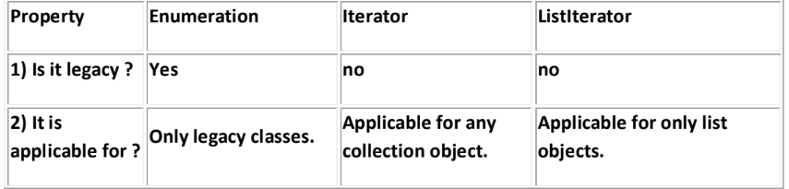
if(s.equals("nag"))
{
itr.add("chitu");
}
Output:
[balakrishna, venki, chiru, nag]
[balakrishna, venki, chiru, nag, chitu]
The most powerful cursor is listIterator but its limitation is it is applicable only for "List
objects".
Compression of Enumeration Iterator and ListIterator ?
21

Slide 70
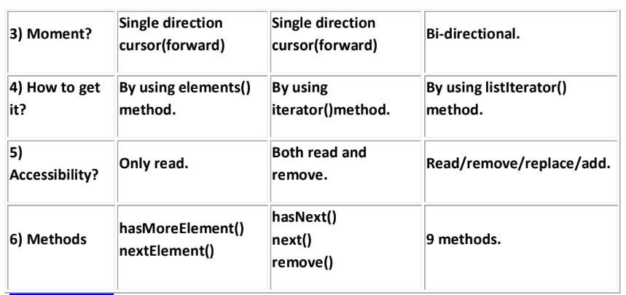
22

Slide 71
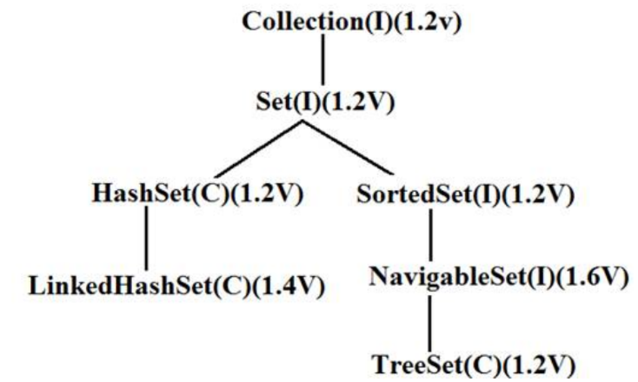
Set interface:
1. It is the child interface of Collection.
2. If we want to represent a group of individual objects as a single entity where
duplicates are not allow and insertion order is not preserved then we should go for Set interface.
Diagram:
22
Set interface does not contain any new method we have to use only Collection interface methods.

Slide 72
HashSet:
23

Slide 73
1. The underlying data structure is Hashtable.
2. Insertion order is not preserved and it is based on hash code of the objects.
3. Duplicate objects are not allowed.
4. If we are trying to insert duplicate objects we won't get compile time error and
runtime error add() method simply returns false.
5. Heterogeneous objects are allowed.
6. Null insertion is possible.(only once)
7. Implements Serializable and Cloneable interfaces but not RandomAccess.
8. HashSet is best suitable, if our frequent operation is "Search".
Constructors:
1. HashSet h=new HashSet();
Creates an empty HashSet object with default initial capacity 16 and default fill
ratio 0.75(fill ratio is also known as load factor).
2. HashSet h=new HashSet(int initialcapacity);
Creates an empty HashSet object with the specified initial capacity and default fill
ratio 0.75.
3. HashSet h=new HashSet(int initialcapacity,float fillratio);
4. HashSet h=new HashSet(Collection c);
23

Slide 74
Note : After filling how much ratio new HashSet object will be created , The ratio is called
"FillRatio" or "LoadFactor".
Example:
import java.util.*;
class HashSetDemo
{
public static void main(String[] args)
{
HashSet h=new HashSet();
h.add("B");
h.add("C");
h.add("D");
h.add("Z");
h.add(null);
h.add(10);
System.out.println(h.add("Z"));//false
System.out.println(h);//[null, D, B, C, 10, Z]
}
}
23

Slide 75
LinkedHashSet:
24

Slide 76
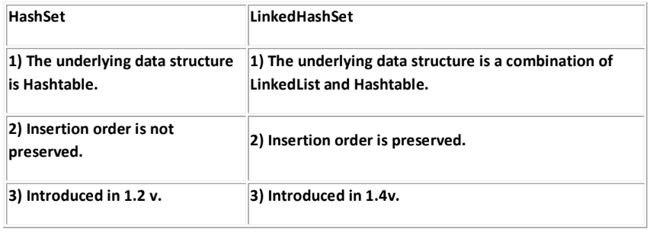
1. It is the child class of HashSet.
2. LinkedHashSet is exactly same as HashSet except the following differences. .
In the above program if we are replacing HashSet with LinkedHashSet the output is [B, C,
D, Z, null, 10].That is insertion order is preserved.
Example:
import java.util.*;
class LinkedHashSetDemo
24

Slide 77
{
public static void main(String[] args)
{
LinkedHashSet h=new LinkedHashSet();
h.add("B");
h.add("C");
h.add("D");
h.add("Z");
h.add(null);
h.add(10);
System.out.println(h.add("Z"));//false
System.out.println(h);//[B, C, D, Z, null, 10]
}
}
Note: LinkedHashSet and LinkedHashMap commonly used for implementing "cache applications” where insertion order must be preserved and duplicates are not allowed.
24

Slide 78
SortedSet:
24

Slide 79
1. It is child interface of Set.
2. If we want to represent a group of "unique objects" where duplicates are not
allowed and all objects must be inserting according to some sorting order then we
should go for SortedSet interface.
3. That sorting order can be either default natural sorting (or) customized sorting
order.
SortedSet interface define the following 6 specific methods.
1. Object first();
2. Object last();
3. SortedSet headSet(Object obj);
Returns the SortedSet whose elements are <obj.
4. SortedSet tailSet(Object obj);
It returns the SortedSet whose elements are >=obj.
5. SortedSet subset(Object o1,Object o2);
Returns the SortedSet whose elements are >=o1 but <o2.
6. Comparator comparator();
o Returns the Comparator object that describes underlying sorting technique.
o If we are following default natural sorting order then this method returns
null.
25

Slide 80
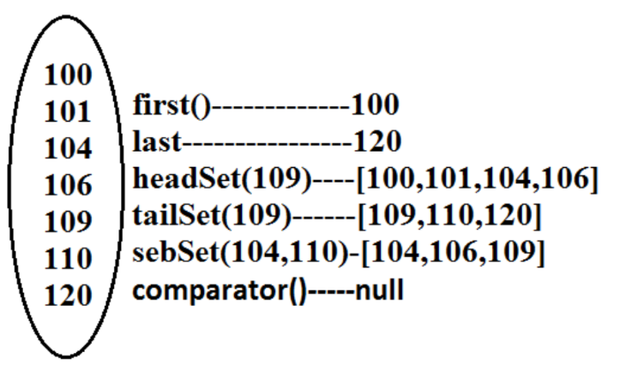
Diagram:
25

Slide 81
TreeSet:
25

Slide 82
1. The underlying data structure is balanced tree.
2. Duplicate objects are not allowed.
3. Insertion order is not preserved and it is based on some sorting order of objects.
4. Heterogeneous objects are not allowed if we are trying to insert heterogeneous objects then we will get ClassCastException.
5. Null insertion is possible(only once).
Constructors:
1. TreeSet t=new TreeSet();
Creates an empty TreeSet object where all elements will be inserted according to
default natural sorting order.
2. TreeSet t=new TreeSet(Comparator c);
Creates an empty TreeSet object where all objects will be inserted according to
customized sorting order specified by Comparator object.
3. TreeSet t=new TreeSet(SortedSet s);
4. TreeSet t=new TreeSet(Collection c);
26

Slide 83
Example 1:
import java.util.*;
class TreeSetDemo
{
public static void main(String[] args)
{
TreeSet t=new TreeSet();
t.add("A");
t.add("a");
t.add("B");
t.add("Z");
t.add("L");
//t.add(new Integer(10));//ClassCastException
//t.add(null);//NullPointerException
System.out.println(t);//[A, B, L, Z, a]
}
}
26

Slide 84
Null acceptance:
26

Slide 85
• For the empty TreeSet as the 1st element "null" insertion is possible but after
inserting that null if we are trying to insert any other we will get
NullPointerException.
• For the non empty TreeSet if we are trying to insert null then we will get
NullPointerException.
Example 2:
import java.util.*;
class TreeSetDemo
{
public static void main(String[] args)
{
TreeSet t=new TreeSet();
t.add(new StringBuffer("A"));
t.add(new StringBuffer("Z"));
t.add(new StringBuffer("L"));
t.add(new StringBuffer("B"));
System.out.println(t);
}
}
Output:
Runtime Exception.
26

Slide 86
Note :
• Exception in thread "main" java.lang.ClassCastException: java.lang.StringBuffer
cannot be cast to java.lang.Comparable
• If we are depending on default natural sorting order compulsory the objects should
be homogeneous and Comparable otherwise we will get ClassCastException.
• An object is said to be Comparable if and only if the corresponding class
implements Comparable interface.
• String class and all wrapper classes implements Comparable interface but
StringBuffer class doesn't implement Comparable interface hence in the above
program we are getting ClassCastException.
27

Slide 87
Comparable interface:
27

Slide 88
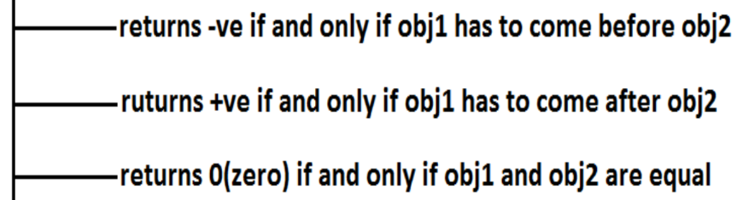
Comparable interface present in java.lang package and contains only one method
compareTo() method.
public int compareTo(Object obj);
Example:
obj1.compareTo(obj2);
Diagram:
Example 3:
class Test
{
public static void main(String[] args)
{
System.out.println("A".compareTo("Z"));//-25
27

Slide 89
System.out.println("Z".compareTo("K"));//15
System.out.println("A".compareTo("A"));//0
//System.out.println("A".compareTo(new
Integer(10)));
//Test.java:8: compareTo(java.lang.String)
in java.lang.String cannot
be applied to (java.lang.Integer)
//System.out.println("A".compareTo(null));//NullPointer
exception
}
}
If we are depending on default natural sorting order then internally JVM will use
compareTo() method to arrange objects in sorting order.
28

Slide 90
Example 4:
import java.util.*;
class Test
{
public static void main(String[] args)
{
TreeSet t=new TreeSet();
t.add(10);
t.add(0);
t.add(15);
t.add(10);
System.out.println(t);//[0, 10, 15]
}
}
28

Slide 91
compareTo() method analysis:
28

Slide 92
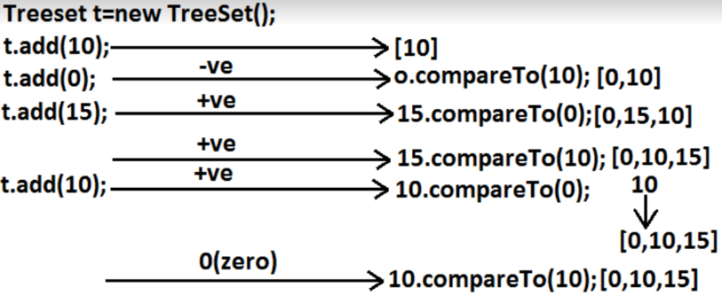
• If we are not satisfying with default natural sorting order (or) if default natural
sorting order is not available then we can define our own customized sorting by
Comparator object.
• Comparable meant for default natural sorting order.
• Comparator meant for customized sorting order.
29

Slide 93
Comparator interface:
29

Slide 94
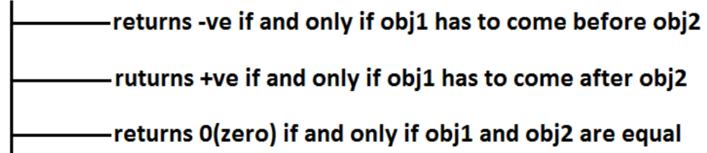
Comparator interface present in java.util package this interface defines the following 2 methods.
1) public int compare(Object obj1,Object Obj2);
Diagram:
2) public boolean equals(Object obj);
• Whenever we are implementing Comparator interface we have to provide
implementation only for compare() method.
• Implementing equals() method is optional because it is already available from
Object class through inheritance.
29

Slide 95
Requirement: Write a program to insert integer objects into the TreeSet where the
sorting order is descending order.
Program:
import java.util.*;
class Test
{
public static void main(String[] args)
{
TreeSet t=new TreeSet(new MyComparator()); //---
->(1)
t.add(10);
t.add(0);
t.add(15);
t.add(5);
t.add(20);
29

Slide 96
System.out.println(t);//[20, 15, 10, 5, 0]
}
}
class MyComparator implements Comparator
{
public int compare(Object obj1,Object obj2)
{
Integer i1=(Integer)obj1;
Integer i2=(Integer)obj2;
if(i1<i2)
return +1;
else if(i1 > i2)
return -100;
else return 0;
}
}
30

Slide 97
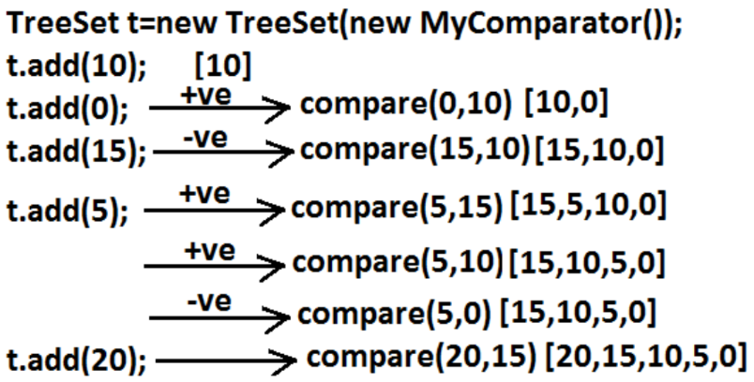
• At line "1" if we are not passing Comparator object then JVM will always calls
compareTo() method which is meant for default natural sorting order(ascending order)hence in this case the
output is [0, 5, 10, 15, 20].
• At line "1" if we are passing Comparator object then JVM calls compare() method of MyComparator class which is meant for customized
sorting order(descending order) hence in this case
the output is [20, 15, 10, 5, 0].
Diagram:
30

Slide 98
Various alternative implementations of compare() method:
public int compare(Object obj1,Object obj2)
{
Integer i1=(Integer)obj1;
Integer i2=(Integer)obj2;
//return i1.compareTo(i2);//[0, 5, 10, 15, 20]
//return -i1.compareTo(i2);//[20, 15, 10, 5, 0]
//return i2.compareTo(i1);//[20, 15, 10, 5, 0]
//return -i2.compareTo(i1);//[0, 5, 10, 15, 20]
//return -1;//[20, 5, 15, 0, 10]//reverse of insertion order
//return +1;//[10, 0, 15, 5, 20]//insertion order
//return 0;//[10]and all the remaining elements treated as
duplicate.
}
31

Slide 99
Requirement: Write a program to insert StringBuffer objects into the TreeSet where the sorting order is alphabetical order.
Program:
import java.util.*;
class TreeSetDemo
{
public static void main(String[] args)
{
TreeSet t=new TreeSet(new MyComparator());
t.add(new StringBuffer("A"));
t.add(new StringBuffer("Z"));
t.add(new StringBuffer("K"));
t.add(new StringBuffer("L"));
System.out.println(t);// [A, K, L, Z]
}
}
32
class MyComparator implements Comparator

Slide 100
{
public int compare(Object obj1,Object obj2)
{
String s1=obj1.toString();
String s2=obj2.toString();
return s1.compareTo(s2);
}
}
Note:
Whenever we are defining our own customized sorting by Comparator then the
objects need not be Comparable.
Example:StringBuffer
Requirement:
Write a program to insert String and StringBuffer objects into the TreeSet
where the sorting order is increasing length order. If 2 objects having the same length then consider they alphabetical order.
32

Slide 101
Program:
import java.util.*;
class TreeSetDemo
{
public static void main(String[] args)
{
TreeSet t=new TreeSet(new MyComparator());
t.add("A");
t.add(new StringBuffer("ABC"));
t.add(new StringBuffer("AA"));
t.add("xx");
t.add("ABCD");
t.add("A");
System.out.println(t);//[A, AA, xx, ABC, ABCD]
}
}
class MyComparator implements Comparator
32

Slide 102
{
public int compare(Object obj1,Object obj2)
{
String s1=obj1.toString();
String s2=obj2.toString();
int l1=s1.length();
int l2=s2.length();
if(l1 < l2)
return -1;
else if(l1 > l2)
return 1;
else
return s1.compareTo(s2);
}
}
Note:
If we are depending on default natural sorting order then the objects should be “homogeneous and comparable” otherwise we will get
ClassCastException. If we are defining our own sorting by Comparator then objects "need not be homogeneous and comparable".
33

Slide 103
Comparable vs Comparator:
• For predefined Comparable classes default natural sorting order is already available if we are not satisfied with default natural sorting order then we can define our own customized sorting order by Comparator.
• For predefined non Comparable classes [like StringBuffer] default natural sorting order is not available we can define our own sorting order by using Comparatorobject.
• For our own classes [like Customer, Student, and Employee] we can define default natural sorting order by using Comparable interface.
The person who is using our class, if he is not satisfied with default natural sorting order then he can define his own sorting order by using Comparator object.
33

Slide 104
Example:
import java.util.*;
class Employee implements Comparable
{
String name;
int eid;
Employee(String name,int eid)
{
this.name=name;
this.eid=eid;
}
public String toString()
{
return name+"----"+eid;
}
public int compareTo(Object o)
{
int eid1=this.eid;
int eid2=((Employee)o).eid;
if(eid1 < eid2)
{
return -1;
33

Slide 105
}
else if(eid1 > eid2)
{
return 1;
}
else return 0;
}
}
class CompComp
{
public static void main(String[] args)
{
Employee e1=new Employee("nag",100);
Employee e2=new Employee("balaiah",200);
Employee e3=new Employee("chiru",50);
Employee e4=new Employee("venki",150);
Employee e5=new Employee("nag",100);
TreeSet t1=new TreeSet();
t1.add(e1);
t1.add(e2);
t1.add(e3);
t1.add(e4);
t1.add(e5);
34

Slide 106
System.out.println(t1);//[chiru----50, nag----
100, venki----150, balaiah----200]
TreeSet t2=new TreeSet(new MyComparator());
t2.add(e1);
t2.add(e2);
t2.add(e3);
t2.add(e4);
t2.add(e5);
System.out.println(t2);//[balaiah----200, chiru--
--50, nag----100, venki----150]
}
}
class MyComparator implements Comparator
{
public int compare(Object obj1,Object obj2)
{
Employee e1=(Employee)obj1;
Employee e2=(Employee)obj2;
String s1=e1.name;
String s2=e2.name;
return s1.compareTo(s2);
}
}
34

Slide 107
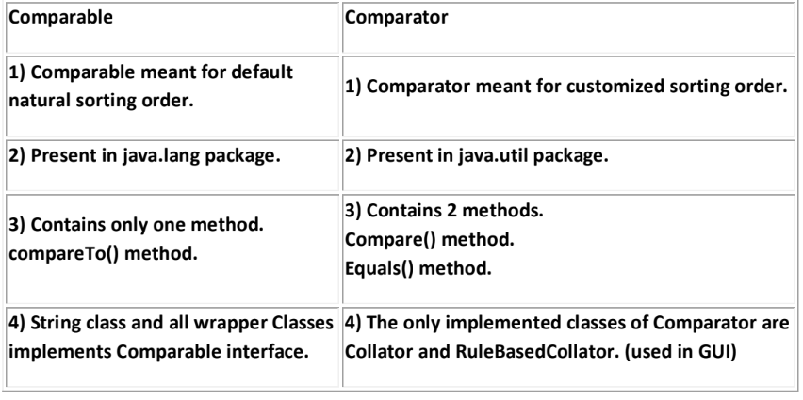
Compression of Comparable and Comparator ?
35

Slide 108
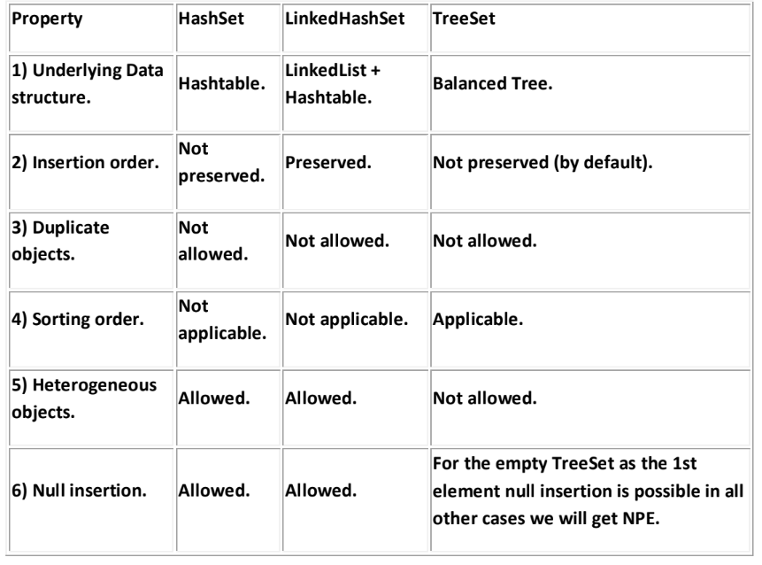
Compression of Set implemented class objects:
35

Slide 109
Map:

Slide 110
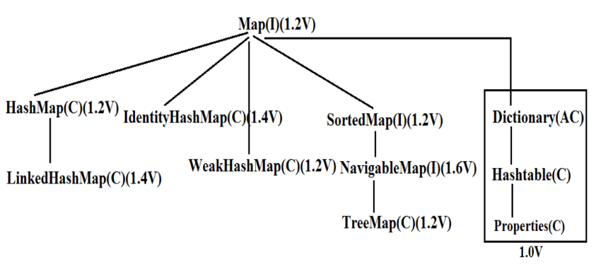
Diagram:
If we want to represent a group of objects as "key-value" pair then we
should go for Map interface
Both key and value are objects only.
3. Duplicate keys are not allowed but values can be duplicated
4. Each key-value pair is called "one entry".
36

Slide 111
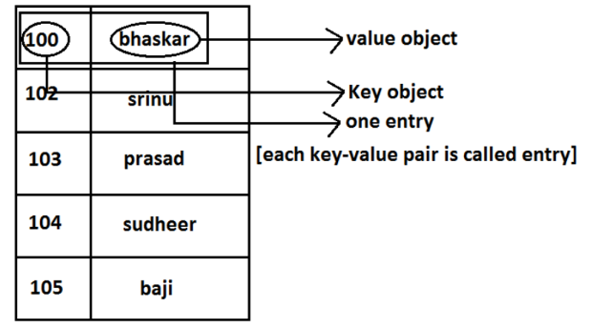
Diagram:
36

Slide 112
• Map interface is not child interface of Collection and hence we can't
apply Collection interface methods here.
• Map interface defines the following specific methods.
1. Object put(Object key,Object value);
To add an entry to the Map, if key is already available then the old value replaced with new value and old value will be returned.
Example:
2. import java.util.*;
3. class Map
4. {
5. public static void main(String[] args)
6. {
7. HashMap m=new HashMap();
8. m.put("100","vijay");
9. System.out.println(m);//{100=vijay}
10. m.put("100","ashok");
11. System.out.println(m);//{100=ashok}
12. }
13. }
37

Slide 113
14. void putAll(Map m);
15. Object get(Object key);
16. Object remove(Object key);
It removes the entry associated with specified key and returns the corresponding
value.
17. boolean containsKey(Object key);
18. boolean containsValue(Object value);
19. boolean isEmpty();
20. Int size();
21. void clear();
22. Set keySet();
The set of keys we are getting.
23. Collection values();
The set of values we are getting.
24. Set entrySet();
The set of entryset we are getting.
37

Slide 114
Entry interface:
37

Slide 115
Each key-value pair is called one entry. Hence Map is considered as a group of entry Objects, without existing Map object
there is no chance of existing entry object hence interface entry is define inside Map interface(inner interface).
Example:
interface Map
{
.................;
.................;
.................;
interface Entry
{
Object getKey();
Object getValue(); on Entry we can
apply these 3 methods.
Object setValue(Object new);
}
}
38

Slide 116
HashMap:
38

Slide 117
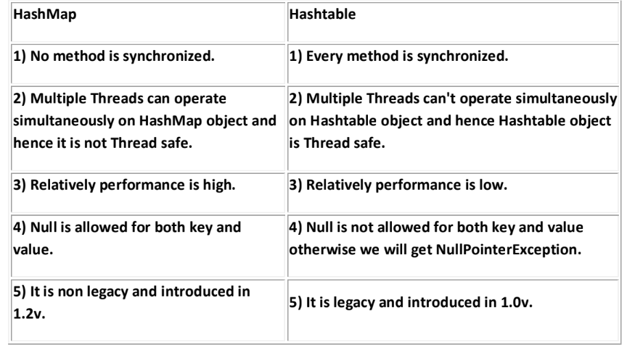
1. The underlying data structure is Hashtable.
2. Duplicate keys are not allowed but values can be duplicated.
3. Insertion order is not preserved and it is based on hash code of the keys.
4. Heterogeneous objects are allowed for both key and value.
5. Null is allowed for keys(only once) and for values(any number of times).
6. It is best suitable for Search operations.
Differences between HashMap and Hashtable ?
38

Slide 118
How to get synchronized version of HashMap:
By default HashMap object is not synchronized. But we can get synchronized version by using the following method of Collections class.
public static Map synchronizedMap(Map m1)
Constructors:
1. HashMap m=new HashMap();
Creates an empty HashMap object with default initial capacity 16 and default fill ratio "0.75".
2. HashMap m=new HashMap(int initialcapacity);
3. HashMap m =new HashMap(int initialcapacity, float fillratio);
4. HashMap m=new HashMap(Map m);
39

Slide 119
Example:
import java.util.*;
class HashMapDemo
{
public static void main(String[] args)
{
HashMap m=new HashMap();
m.put("chiranjeevi",700);
m.put("balaiah",800);
m.put("venkatesh",200);
m.put("nagarjuna",500);
System.out.println(m);//{nagarjuna=500,venkatesh=200,bal
aiah=800,chiranjeevi=700}
System.out.println(m.put("chiranjeevi",100));//700
Set s=m.keySet();
System.out.println(s);//[nagarjuna,venkatesh,balaiah,chi
ranjeevi]
Collection c=m.values();
System.out.println(c);//[500, 200, 800, 100]
Set s1=m.entrySet();
39

Slide 120
System.out.println(s1);//[nagarjuna=500,venkatesh=200,ba
laiah=800,chiranjeevi=100]
Iterator itr=s1.iterator();
while(itr.hasNext())
{
Map.Entry m1=(Map.Entry)itr.next();
System.out.println(m1.getKey()+"......"+m1.getValue());
//nagarjuna......500
//venkatesh......200 //
//balaiah......800
//chiranjeevi......100
if(m1.getKey().equals("nagarjuna"))
{
m1.setValue(1000);
}
}
System.out.println(m); //{nagarjuna=1000,venkatesh=200,balaiah=800,chiranjeevi=100}
}
}
39

Slide 121
LinkedHashMap:

Slide 122
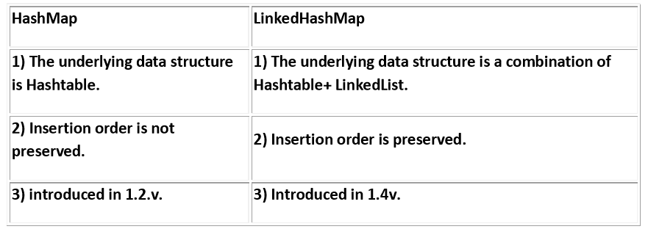
It is exactly same as HashMap except the following differences :
Note: in the above program if we are replacing HashMap with LinkedHashMap then the output is {chiranjeevi=100, balaiah......800, venkatesh......200, nagarjuna......1000} that is insertion order is preserved.
Note: in general we can use LinkedHashSet and LinkedHashMap for implementing cache applications.
40

Slide 123
IdentityHashMap:
40

Slide 124
It is exactly same as HashMap except the following differences:
1. In the case of HashMap JVM will always use ".equals()"method to identify duplicate keys, which is meant for content comparision.
But in the case of IdentityHashMap JVM will use== (double equal operator) to identify duplicate keys, which is meant for reference comparision.
Example:
import java.util.*;
class HashMapDemo
{
public static void main(String[] args)
{
HashMap m=new HashMap();
Integer i1=new Integer(10);
40

Slide 125
Integer i2=new Integer(10);
m.put(i1,"pavan");
m.put(i2,"kalyan");
System.out.println(m);
}
}
• In the above program i1 and i2 are duplicate keys because i1.equals(i2) returns true.
• In the above program if we replace HashMap with IdentityHashMap then i1 and i2 are not duplicate keys because i1==i2 is false hence in this case the output is {10=pavan, 10=kalyan}.
System.out.println(m.get(10));//null
10==i1------false
10==i2------false
41

Slide 126
WeakHashMap:
41

Slide 127
It is exactly same as HashMap except the following differences:
• In the case of normal HashMap, an object is not eligible for GC even though it doesn't have any references if it is associated with HashMap. That is HashMap dominates garbage collector.
• But in the case of WeakHashMap if an object does not have any references then it's always eligible for GC even though it is associated with WeakHashMap that is garbage collector dominates WeakHashMap.
Example:
import java.util.*;
class WeakHashMapDemo
{
public static void main(String[] args)throws Exception
{
WeakHashMap m=new WeakHashMap();
Temp t=new Temp();
m.put(t,"ashok");
System.out.println(m);//{Temp=ashok}
t=null;
System.gc();
41

Slide 128
Thread.sleep(5000);
System.out.println(m);//{}
}
}
class Temp
{
public String toString()
{
return "Temp";
}
public void finalize()
{
System.out.println("finalize() method called");
}
}
Output:
{Temp=ashok}
finalize() method called
{}
42

Slide 129
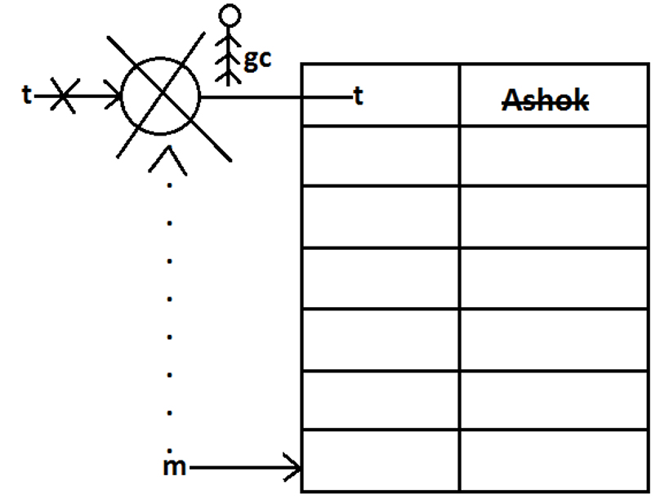
Diagram:
In the above program if we replace WeakHashMap with normal HashMap then object won't be destroyed by the garbage collector in this the output is
{Temp=ashok}
{Temp=ashok}
42

Slide 130
SortedMap:
• It is the child interface of Map.
• If we want to represent a group of key-value pairs according to some sorting order of keys then we should go for SortedMap.
• Sorting is possible only based on the keys but not based on values.
• SortedMap interface defines the following 6 specific methods.
1. Object firsyKey();
2. Object lastKey();
3. SortedMap headMap(Object key);
4. SortedMap tailMap(Object key);
5. SortedMap subMap(Object key1,Object key2);
6. Comparator comparator();
43

Slide 131
TreeMap:
43

Slide 132
The underlying data structure is RED-BLACK Tree.
2. Duplicate keys are not allowed but values can be duplicated.
3. Insertion order is not preserved and all entries will be inserted according to some sorting order of keys.
4. If we are depending on default natural sorting order keys should be homogeneous and Comparable otherwise we will get ClassCastException.
5. If we are defining our own sorting order by Comparator then keys can be heterogeneous and non Comparable.
6. There are no restrictions on values they can be heterogeneous and non Comparable.
7. For the empty TreeMap as first entry null key is allowed but after inserting that entry if we are trying to insert any other entry we will get NullPointerException.
8. For the non empty TreeMap if we are trying to insert an entry with null key we will get NullPointerException.
9. There are no restrictions for null values.
43

Slide 133
Constructors:
TreeMap t=new TreeMap();
For default natural sorting order.
TreeMap t=new TreeMap(Comparator c); For customized sorting order.
TreeMap t=new TreeMap(SortedMap m);
4. TreeMap t=new TreeMap(Map m);
43

Slide 134
Example 1:
import java.util.*;
class TreeMapDemo
{
public static void main(String[] args)
{
TreeMap t=new TreeMap();
t.put(100,"ZZZ");
t.put(103,"YYY");
t.put(101,"XXX");
t.put(104,106);
t.put(107,null);
//t.put("FFF","XXX");//ClassCastException //t.put(null,"xxx");//NullPointerException System.out.println(t);//{100=ZZZ, 101=XXX, 103=YYY, 104=106, 107=null}
}
}
44

Slide 135
Example 2:
import java.util.*;
class TreeMapDemo
{
public static void main(String[] args)
{
TreeMap t=new TreeMap(new MyComparator());
t.put("XXX",10);
t.put("AAA",20);
t.put("ZZZ",30);
t.put("LLL",40);
System.out.println(t);//{ZZZ=30, XXX=10, LLL=40, AAA=20}
}
}
class MyComparator implements Comparator
{
public int compare(Object obj1,Object obj2)
{
String s1=obj1.toString();
String s2=obj2.toString();
return s2.compareTo(s1);
}
}
44

Slide 136
Hashtable:
44

Slide 137
The underlying data structure is Hashtable.
2. Insertion order is not preserved and it is based on hash code of the keys.
3. Heterogeneous objects are allowed for both keys and values.
4. Null key (or) null value is not allowed otherwise we will get NullPointerException.
5. Duplicate keys are allowed but values can be duplicated.
6. Every method present inside Hashtable is syncronized and hence Hashtable objet is Thread-safe.
44

Slide 138
Constructors:
Hashtable h=new Hashtable();
Creates an empty Hashtable object with default initialcapacity 11 and default fill ratio 0.75.
2. Hashtable h=new Hashtable(int initialcapacity);
3. Hashtable h=new Hashtable(int initialcapacity,float fillratio);
4. Hashtable h=new Hashtable (Map m);
Example:
import java.util.*;
class HashtableDemo
{
public static void main(String[] args)
{
Hashtable h=new Hashtable();
h.put(new Temp(5),"A");
h.put(new Temp(2),"B");
45

Slide 139
h.put(new Temp(6),"C");
h.put(new Temp(15),"D");
h.put(new Temp(23),"E");
h.put(new Temp(16),"F");
System.out.println(h);//{6=C, 16=F, 5=A, 15=D, 2=B, 23=E}
}
}
class Temp
{
int i;
Temp(int i)
{
this.i=i;
}
public int hashCode()
{
return i;
}
public String toString()
{
return i+"";
}
}
45

Slide 140
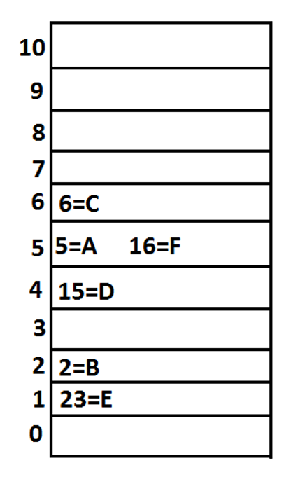
Diagram:
Note: if we change hasCode() method of Temp class as follows.
public int hashCode()
{
return i%9;
}
Then the output is {16=F, 15=D, 6=C, 23=E, 5=A, 2=B}.
46

Slide 141
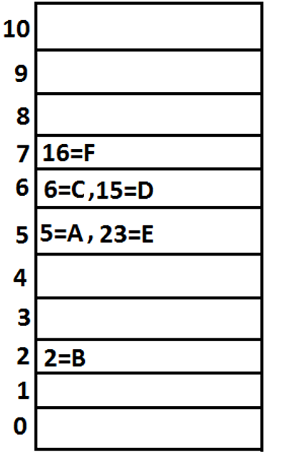
Diagram:
Note: if we change initial capacity as 25.
Hashtable h=new Hashtable(25);
output is : { 23=E, 16=F, 15=D, 6=C, 5=A, 2=B }
47

Slide 142
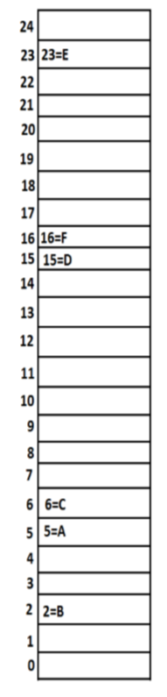
Diagram:
48

Slide 143
Properties:
49

Slide 144
Properties class is the child class of Hashtable.
2. In our program if anything which changes frequently like DBUserName, Password etc., such type of values not recommended to hardcode in java application because for every change we have to recompile, rebuild and redeployed the application and even server restart also required sometimes it creates a big business impact to the client.
3. Such type of variable things we have to hardcode in property files and we have to read the values from the property files into java application.
4. The main advantage in this approach is if there is any change in property files automatically those changes will be available to java application just redeployment is enough.
5. By using Properties object we can read and hold properties from property files into java application.
49

Slide 145
Constructor:
Properties p=new Properties();
In properties both key and value "should be String type only".
Methods:
String getPrperty(String propertyname) ; Returns the value associated with specified property.
2. String setproperty(String propertyname,String propertyvalue); To set a new property.
3. Enumeration propertyNames();
4. void load(InputStream is);//Any InputStream we can pass. To load Properties from property files into java Properties object.
5. void store(OutputStream os,String comment);//Any OutputStream we can pass. To store the properties from Properties object into properties file.
49

Slide 146
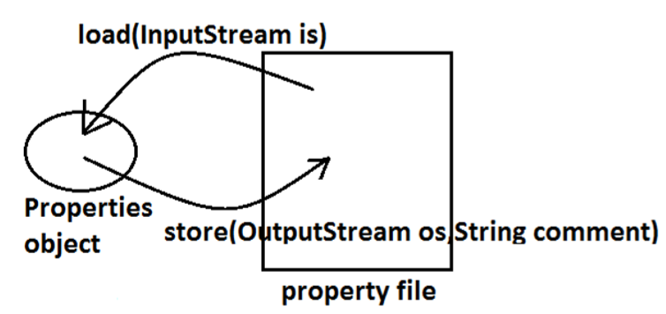
Diagram:
50

Slide 147
Example:
import java.util.*;
import java.io.*;
class PropertiesDemo
{
public static void main(String[] args)throws Exception
{
Properties p=new Properties();
FileInputStream fis=new
FileInputStream("abc.properties");
p.load(fis);
System.out.println(p);//{user=scott, password=tiger, venki=8888}
String s=p.getProperty("venki");
System.out.println(s);//8888
p.setProperty("nag","9999999");
Enumeration e=p.propertyNames();
while(e.hasMoreElements())
50

Slide 148
{
String s1=(String)e.nextElement(); System.out.println(s1);//nag //user //password //venki
}
FileOutputStream fos=new FileOutputStream("abc.properties");
p.store(fos,"updated by ashok for scjp demo class");
}
}
50

Slide 149
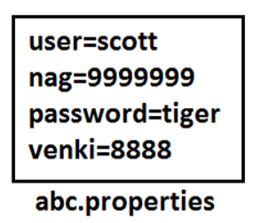
Property file:
51

Slide 150
Example:
import java.util.*;
import java.io.*;
class PropertiesDemo
{
public static void main(String[] args)throws Exception
{
Properties p=new Properties();
FileInputStream fis=new
FileInputStream("db.properties");
p.load(fis);
String url=p.getProperty("url");
String user=p.getProperty("user");
String pwd=p.getProperty("pwd");
Connection con=DriverManager.getConnection(url, user, pwd);
-------------------------------------------------------- -------------------------------------------------------
FileOutputStream fos=new
FileOutputStream("db.properties");
p.store(fos,"updated by ashok for scjp demo class");
}
}
51

Slide 151
1.5 enhancements
Queue interface
52

Slide 152
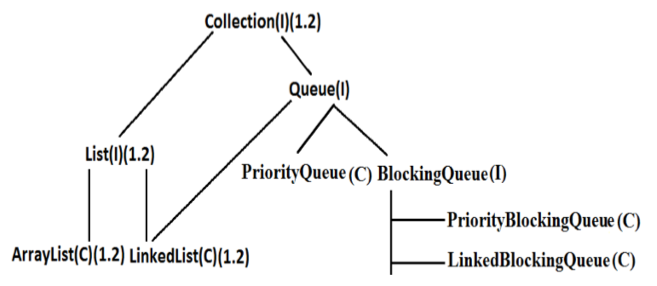
Diagram:
Queue is child interface of Collections.
2. If we want to represent a group of individual objects prior (happening before something else) to processing then we should go for Queue interface.
3. Usually Queue follows first in first out(FIFO) order but based on our requirement we can implement our own order also.
4. From 1.5v onwards LinkedList also implements Queue interface.
5. LinkedList based implementation of Queue always follows first in first out order.
52

Slide 153
Assume we have to send sms for one lakh mobile numbers , before sending messages we have to store all mobile numbers into Queue so that for the first inserted number first message will be triggered(FIFO)
Queue interface methods:
boolean affer(Object o); To add an object to the Queue.
2. Object poll() ; To remove and return head element of the Queue, if Queue is empty then we will get null.
3. Object remove(); To remove and return head element of the Queue. If Queue is empty then this method raises Runtime Exception saying NoSuchElementException.
4. Object peek(); To return head element of the Queue without removal, if Queue is empty this method returns null.
5. Object element(); It returns head element of the Queue and if Queue is empty then it will raise Runtime Exception saying NoSuchElementException.
53

Slide 154
PriorityQueue:
PriorityQueue is a data structure to represent a group of individual objects prior to processing according to some priority.
2. The priority order can be either default natural sorting order (or) customized sorting order specified by Comparator object.
3. If we are depending on default natural sorting order then the objects must be homogeneous and Comparable otherwise we will get ClassCastException.
4. If we are defining our own customized sorting order by Comparator then the objects need not be homogeneous and Comparable.
5. Duplicate objects are not allowed.
6. Insertion order is not preserved but all objects will be inserted according to some priority.
7. Null is not allowed even as the 1st element for empty PriorityQueue.Otherwise we will get the "NullPointerException".
53

Slide 155
Constructors:
PriorityQueue q=new PriorityQueue(); Creates an empty PriorityQueue with default initial capacity 11 and default natural sorting order.
2. PriorityQueue q=new PriorityQueue(int initialcapacity,Comparator c);
3. PriorityQueue q=new PriorityQueue(int initialcapacity);
4. PriorityQueue q=new PriorityQueue(Collection c);
5. PriorityQueue q=new PriorityQueue(SortedSet s);
Example 1:
import java.util.*;
class PriorityQueueDemo
{
public static void main(String[] args)
{
PriorityQueue q=new PriorityQueue(); //System.out.println(q.peek());//null
//System.out.println(q.element());//NoSuchElementExcepti on for(int i=0;i<=10;i++)
{
q.offer(i);
}
53

Slide 156
System.out.println(q);//[0, 1, 2, 3, 4, 5, 6, 7, 8, 9, 10] System.out.println(q.poll());//0
System.out.println(q);//[1, 3, 2, 7, 4, 5, 6, 10, 8, 9]
}
}
Note: Some platforms may not provide proper supports for PriorityQueue [windowsXP].
54

Slide 157
Example 2:
import java.util.*;
class PriorityQueueDemo
{
public static void main(String[] args)
{
PriorityQueue q=new PriorityQueue(15,new MyComparator());
q.offer("A");
q.offer("Z");
q.offer("L");
q.offer("B");
System.out.println(q);//[Z, B, L, A]
}
}
class MyComparator implements Comparator
{
public int compare(Object obj1,Object obj2)
{
String s1=(String)obj1;
String s2=obj2.toString();
return s2.compareTo(s1);
}
}
54
1.6v Enhancements :

Slide 158
NavigableSet:
54

Slide 159
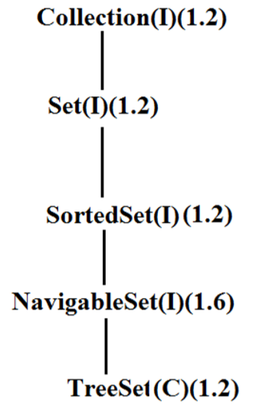
It is the child interface of SortedSet.
2. It provides several methods for navigation purposes.
Diagram:
55

Slide 160
NavigableSet interface defines the following methods.
1. ceiling(e);
It returns the lowest element which is >=e.
2. higher(e);
It returns the lowest element which is >e.
3. floor(e);
It returns highest element which is <=e.
4. lower(e);
It returns height element which is <e.
5. pollFirst ();
Remove and return 1st element.
6. pollLast ();
Remove and return last element.
7. descendingSet ();
Returns SortedSet in reverse order.
55

Slide 161
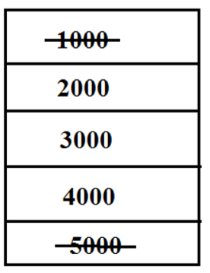
Diagram:
Example:
import java.util.*;
class NavigableSetDemo
{
public static void main(String[] args)
56

Slide 162
{
TreeSet<Integer> t=new TreeSet<Integer>(); t.add(1000);
t.add(2000);
t.add(3000);
t.add(4000);
t.add(5000);
System.out.println(t);//[1000, 2000, 3000, 4000, 5000]
System.out.println(t.ceiling(2000));//2000 System.out.println(t.higher(2000));//3000 System.out.println(t.floor(3000));//3000 System.out.println(t.lower(3000));//2000 System.out.println(t.pollFirst());//1000 System.out.println(t.pollLast());//5000 System.out.println(t.descendingSet());//[4000, 3000, 2000] System.out.println(t);//[2000, 3000, 4000]
}
}
56

Slide 163
NavigableMap:
57

Slide 164
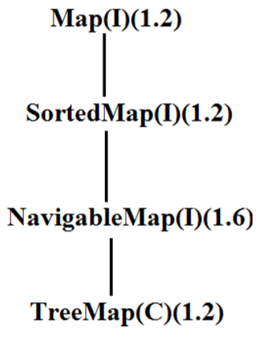
It is the child interface of SortedMap and it defines several methods for navigation purpose
Diagram:
NavigableMap interface defines the following methods.
1. ceilingKey(e);
2. higherKey(e);
3. floorKey(e);
4. lowerKey(e);
5. pollFirstEntry();
6. pollLastEntry();
7. descendingMap();
57

Slide 165
Example:
import java.util.*;
class NavigableMapDemo
{
public static void main(String[] args)
{
TreeMap<String,String> t=new
TreeMap<String,String>();
t.put("b","banana");
t.put("c","cat");
t.put("a","apple");
t.put("d","dog");
t.put("g","gun");
System.out.println(t);//{a=apple, b=banana, c=cat, d=dog, g=gun}
57

Slide 166
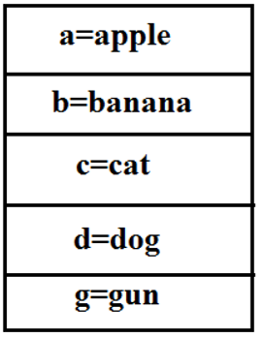
System.out.println(t.ceilingKey("c"));//c System.out.println(t.higherKey("e"));//g System.out.println(t.floorKey("e"));//d System.out.println(t.lowerKey("e"));//d System.out.println(t.pollFirstEntry());//a=apple System.out.println(t.pollLastEntry());//g=gun System.out.println(t.descendingMap());//{d=dog, c=cat, b=banana}
System.out.println(t);//{b=banana, c=cat, d=dog}
}
}
Diagram:
58

Slide 167
Collections class:
58

Slide 168
Collections class defines several utility methods for collection objects.
Sorting the elements of a List:
Collections class defines the following methods to perform sorting the elements of a List.
public static void sort(List l);
• To sort the elements of List according to default natural sorting order in this case the elements should be homogeneous and comparable otherwise we will get ClassCastException.
• The List should not contain null otherwise we will get NullPointerException.
public static void sort(List l,Comparator c);
• To sort the elements of List according to customized sorting order.
58

Slide 169
Program 1:
To sort elements of List according to natural sorting order.
import java.util.*;
class CollectionsDemo
{
public static void main(String[] args)
{
ArrayList l=new ArrayList();
l.add("Z");
l.add("A");
l.add("K");
l.add("N");
//l.add(new Integer(10));//ClassCastException //l.add(null);//NullPointerException
System.out.println("Before sorting :"+l);//[Z, A, K, N]
Collections.sort(l);
System.out.println("After sorting :"+l);//[A, K, N, Z]
}
}
59

Slide 170
Program 2:
To sort elements of List according to customized sorting order.
import java.util.*;
class CollectionsDemo
{
public static void main(String[] args)
{
ArrayList l=new ArrayList();
l.add("Z");
l.add("A");
l.add("K");
l.add("L");
l.add(new Integer(10));
//l.add(null);//NullPointerException
System.out.println("Before sorting :"+l);//[Z, A, K, L, 10] Collections.sort(l,new MyComparator());
System.out.println("After sorting :"+l);//[Z, L, K, A, 10]
}
}
59

Slide 171
class MyComparator implements Comparator
{
public int compare(Object obj1,Object obj2)
{
String s1=(String)obj1;
String s2=obj2.toString();
return s2.compareTo(s1);
}
}
Searching the elements of a List:
Collections class defines the following methods to search the elements of a List. public static int binarySearch(List l,Object obj);
• If the List is sorted according to default natural sorting order then we have to use this method.
public static int binarySearch(List l,Object obj,Comparator c);
• If the List is sorted according to Comparator then we have to use this method.
60

Slide 172
Program 1:
To search elements of List.
import java.util.*;
class CollectionsSearchDemo
{
public static void main(String[] args)
{
ArrayList l=new ArrayList();
l.add("Z");
l.add("A");
l.add("M");
l.add("K");
l.add("a");
System.out.println(l);//[Z, A, M, K, a] Collections.sort(l);
System.out.println(l);//[A, K, M, Z, a]
System.out.println(Collections.binarySearch(l,"Z"));//3
System.out.println(Collections.binarySearch(l,"J"));//-2
}
60
}

Slide 173
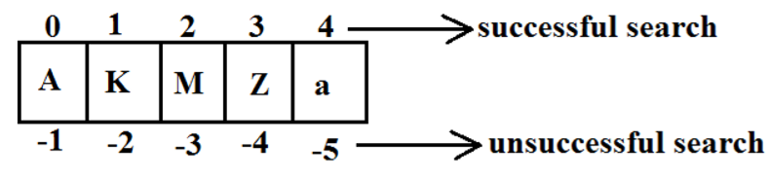
Diagram:
Program 2:
import java.util.*;
class CollectionsSearchDemo
{
public static void main(String[] args)
{
ArrayList l=new ArrayList();
l.add(15);
l.add(0);
l.add(20);
l.add(10);
l.add(5);
System.out.println(l);//[15, 0, 20, 10, 5] Collections.sort(l,new MyComparator());
System.out.println(l);//[20, 15, 10, 5, 0]
61

Slide 174
System.out.println(Collections.binarySearch(l,10,new MyComparator()));//2
System.out.println(Collections.binarySearch(l,13,new MyComparator()));//-3
System.out.println(Collections.binarySearch(l,17));//-6
}
}
class MyComparator implements Comparator
{
public int compare(Object obj1,Object obj2)
{
Integer i1=(Integer)obj1;
Integer i2=(Integer)obj2;
return i2.compareTo(i1);
}
}
61

Slide 175
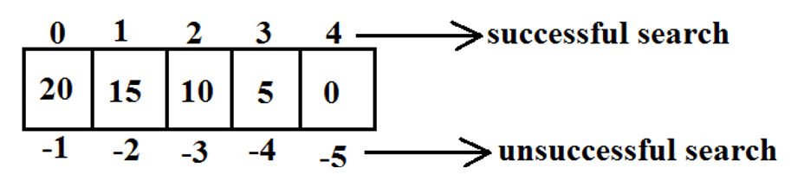
Diagram:
61

Slide 176
Conclusions:
Internally these search methods will use binary search algorithm.
2. Successful search returns index unsuccessful search returns insertion point.
3. Insertion point is the location where we can place the element in the sorted list.
4. Before calling binarySearch() method compulsory the list should be sorted otherwise we will get unpredictable results.
5. If the list is sorted according to Comparator then at the time of search operation also we should pass the same Comparator object otherwise we will get unpredictable results.
Note:
For the list of n elements with respect to binary Search() method.
• Successful search range is: 0 to n-1.
• Unsuccessful search results range is: -(n+1)to -1.
• Total result range is: -(n+1)to n-1.
62

Slide 177
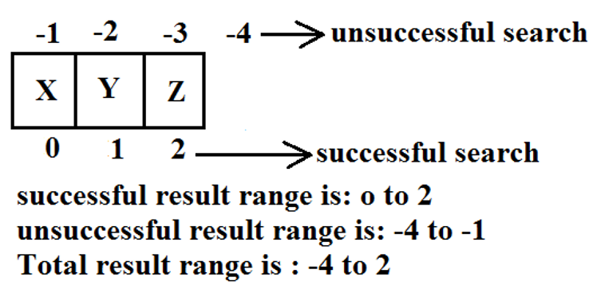
Example:
Reversing the elements of List:
public static void reverse(List l);
reverse() vs reverseOrder() method
• We can use reverse() method to reverse the elements of List.
• Where as we can use reverseOrder() method to get reversed Comparator.
62

Slide 178
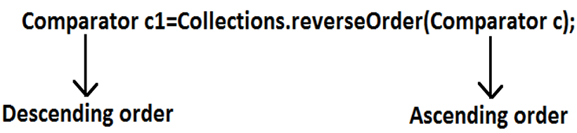
Program:
To reverse elements of list.
import java.util.*;
class CollectionsReverseDemo
{
public static void main(String[] args)
{
ArrayList l=new ArrayList();
l.add(15);
l.add(0);
l.add(20);
l.add(10);
l.add(5);
System.out.println(l);//[15, 0, 20, 10, 5]
Collections.reverse(l);
System.out.println(l);//[5, 10, 20, 0, 15]
}
}
63

Slide 179
Arrays class:
63

Slide 180
Arrays class defines several utility methods for arrays.
Sorting the elements of array:
• public static void sort(primitive[] p);//any primitive data type we can give To sort the elements of primitive array according to default natural sorting order.
• public static void sort(object[] o); To sort the elements of object[] array according to default natural sorting order. In this case objects should be homogeneous and Comparable.
• public static void sort(object[] o,Comparator c); To sort the elements of object[] array according to customized sorting order.
Note:
We can sort object[] array either by default natural sorting order (or) customized sorting order but we can sort primitive arrays only by default natural sorting order.
63

Slide 181
Program:
To sort elements of array.
import java.util.*;
class ArraySortDemo
{
public static void main(String[] args)
{
int[] a={10,5,20,11,6};
System.out.println("primitive array before sorting");
for(int a1:a)
{
System.out.println(a1);
}
Arrays.sort(a);
System.out.println("primitive array after sorting");
for(int a1: a)
{
System.out.println(a1);
}
String[] s={"A","Z","B"};
System.out.println("Object array before sorting");
for(String s1: s)
64

Slide 182
{
System.out.println(s1);
}
Arrays.sort(s);
System.out.println("Object array after sorting");
for(String s1:s)
{
System.out.println(s1);
}
Arrays.sort(s,new MyComparator());
System.out.println("Object array after sorting by Comparator:");
for(String s1: s)
{
System.out.println(s1);
}
}
}
class MyComparator implements Comparator
{
public int compare(Object obj1,Object obj2)
{
String s1=obj1.toString();
String s2=obj2.toString();
return s2.compareTo(s1); } }
64

Slide 183
Searching the elements of array:
Arrays class defines the following methods to search elements of array.
public static int binarySearch(primitive[] p,primitive key);
2. public static int binarySearch(Object[] p, object key);
3. public static int binarySearch(Object[] p,Object key,Comparator c);
All rules of Arrays class binarySearch() method are exactly same as Collections class binarySearch() method.
Program:
To search elements of array.
import java.util.*;
class ArraysSearchDemo
{
public static void main(String[] args)
{
int[] a={10,5,20,11,6};
Arrays.sort(a); System.out.println(Arrays.binarySearch(a,6));//1 System.out.println(Arrays.binarySearch(a,14));//5 String[] s={"A","Z","B"};
Arrays.sort(s);
65

Slide 184
System.out.println(Arrays.binarySearch(s,"Z"));//2
System.out.println(Arrays.binarySearch(s,"S"));//-3
Arrays.sort(s,new MyComparator()); System.out.println(Arrays.binarySearch(s,"Z",new MyComparator()));//0 System.out.println(Arrays.binarySearch(s,"S",new MyComparator()));//-2
System.out.println(Arrays.binarySearch(s,"N"));//4(unpredictable result)
}
}
65

Slide 185
Converting array to List:
65

Slide 186
Arrays class defines the following method to view array as List. public static List asList (Object[] o);
• Strictly speaking we are not creating an independent List object just we are viewing array in List form.
• By using List reference if we are performing any change automatically these changes will be reflected to array reference similarly by using array reference if we are performing any change automatically these changes will be reflected to the List reference.
• By using List reference if we are trying to perform any operation which varies the size then we will get runtime exception saying UnsupportedOperationException.
• By using List reference if we are trying to insert heterogeneous objects we will get runtime exception saying ArrayStoreException.
66

Slide 187
Program:
To view array in List form.
import java.util.*;
class ArraysAsListDemo
{
public static void main(String[] args)
{
String[] s={"A","Z","B"};
List l=Arrays.asList(s);
System.out.println(l);//[A, Z, B]
s[0]="K";
System.out.println(l);//[K, Z, B]
l.set(1,"L");
for(String s1: s)
System.out.println(s1);//K,L,B //l.add("ashok");//UnsupportedOperationException //l.remove(2);//UnsupportedOperationException
//l.set(1,new Integer(10));//ArrayStoreException
}
66
}

Slide 188
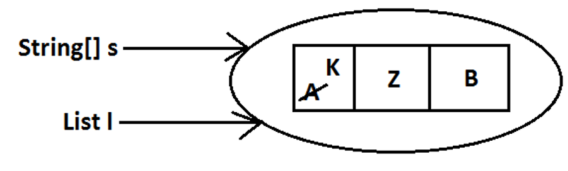
Diagram:
66

