Slide 1

Neural Semiconductor Limited Seamless Technology Service
Project Report of cv32e40p Block
Name : Khairul Alam Johny
Associate Physical Design Engineer (Trainee)

Slide 2
CONTENTS
DESIGN SUMMARY
SYNTHESIS
FLOORPLAN
ROUTING
PLACEMENT
CLOCK TREE SYNTHESIS
SETUP & HOLD TIMING FIXED
POSTROUTE
DESIGN RULE CHECK
02
Notes:
Today I will be looking over these topic from my project starting from design summary all the way to design rule

Slide 3
Design Summary
DESIGN FLOW & SPECIFICATION
FLOW | SYNTHESIS | FLOORPLAN | PLACEMENT | CTS | ROUTING | POSTROUTE
SPECIFICATION | Frequency - 450MHz Synthesis VT cell – HVT & RVT Physical synthesis - Required | Area ratio – 0.7 Shape After floorplan utilization – 95% Power stripe 15% to 20% | 2nd highest instance module fixed in a specified core boundary area | NDR rule 2x space 3x width -- Top rule 2x space 2x width -- Trunk-- Shield Apply rule 2x space 1x width – leaf Check if the uncertainty if set properly if not find the root cause and fix it. (10% of clock period) Check if the clock is propagated or ideal if ideal find root cause make the clock tree propagated | Detouring off Routing congestion high used partial blockage | Setup time and hold time fixing DRC fixing DRV fixing
03
Notes:
Here we can see the design flow and specifications that are required for my design. Here the design flow are from synthesis to postroute and Given some specifications for synthesis

Slide 4
SYNTHESIS
The process of translating the RTL into a gate-level netlist is called Synthesis. There are two type of synthesis.
1. Logical synthesis
2. Physical synthesis.
Input Files
SDC Modification
Report of Results
Total cell | 17586
Cell area | 54069.174 um²
Total Area | 77019.492 um²
Setup Time | reg2reg (0.0)ps wns
RTL
Constraints file (.sdc)
Lib file
Period 2.22ns
Waveform 0 to 1.11ns
Uncertainty 0.222ns (10%)
syn_generic
Converting RTL into simple logic gates.
syn_map
Mapping gates to actual technology-dependent logic gates
syn_opt
Optimizing the mapped netlist.
Output Files
Netlist
SDC
Reports
04
Notes:
I was changing sdc modification for my design specification period was 2.22ns waveform was 0 to 1.11ns.uncertainty was 0.222ns which is 10% of period. The process of genus synthesis is done in 3 main steps. then I get some output files. here we can see the report of results after the synthesis is done.

Slide 5
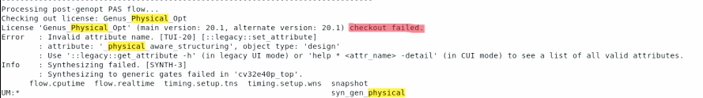
Physical Synthesis
Physical synthesis begins with a mapped netlist generated by logic synthesis. The netlist describes the logical connections among the physical components (logic gates, macro, I/O pins, etc.). Physical synthesis generates a new optimized netlist and a corresponding layout.
Input Files
Synthesis
RTL
SDC
Lib files
DEF and LEF files
syn_physical_opt
0
1
Logical Synthesis
Physical Synthesis
syn_generic -physical
Fig : syn_generic log file
05
Notes:
Logical synthesis is done after using data in physical synthesis and When is used physical information from design impelementation I set the syn_phy_opt to 1 which initial syn_gen –physical proceedes to take the read lef and read def but due to unavailibity of the license phy syn can not take place

Slide 6
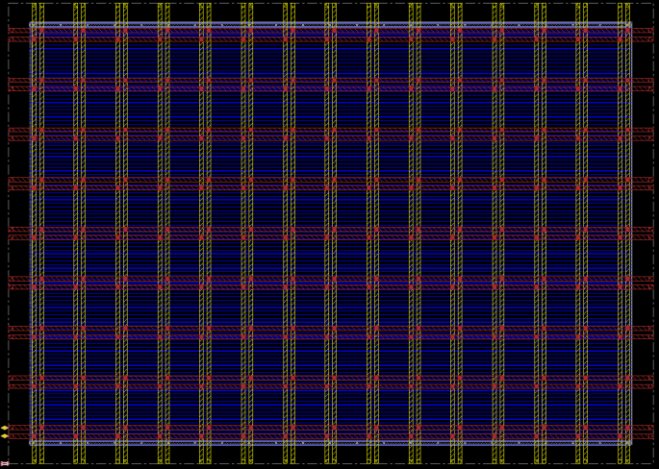
Floorplan & Powerplan
Floorplan creates die boundary and core boundary . It is also a process of positioning blocks or macros on the core boundary.
Floorplan
Core width |  | 285.57um
Core height |  | 200.64um
Core to die width |  | 10.26um
Core to die height |  | 9.12um
Powerplan
Layer name | Top power layer |  | Bottom power layer
Metal Number | Metal 5 |  | Metal4
VDD width | 2 |  | 1.8
VSS width | 2 |  | 1.8
Set to set distance | 23.58 |  | 19.86
Number of stripe | 9 |  | 15
Percentage of power stripe | 18% |  | 18.9%
sroute
Core boundary
Die boundary
Metal5
Metal4
command
Fig : Floorplan & Powerplan
create_floorplan -core_size
add_stripe
06
Notes:
Floorplanning die and core area has to be fixed before placing the std cell .this is the picture of the floorplan stage of my project. I used some parameters for floorplaning and powerplaning.i set core and die boundary. Top Power routing I used metal5 which is hor and bottom power routing metal4 which is vertical. Create_floorplan –core_size this cammand is used for floorplaning and add_strips

Slide 7
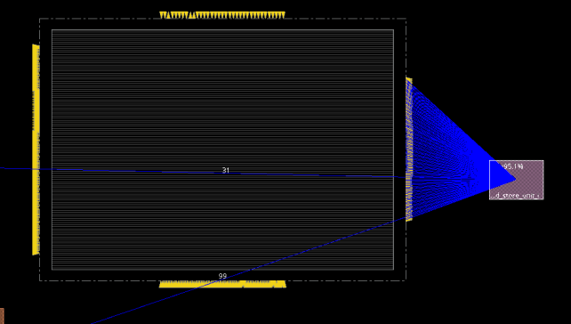
Floorplan & IO placement
IO file command
write_io_file cv32e40p_top.io
read_io_file cv32e40p_top.io
Pin connection
Module name | Position
id_stage_i | half of bottom side pin
load_store_unit_i | right side pin
if_stage_i | left side pin
cs_register_i | half of bottom side pin
After Floorplan check reports
Verify command | Comments
check_pin_assignment | Total 379 number of pin is legal
check_place | Place cell 282 Unplace cell 18318 Utilization density is 95.36%
check_pg_short | Zero violations
Setup time | -0.773ns (wns) reg to reg
Fig : Pin connection
07
Notes:
In order to make my pin management optimized I tried to keep all the pin associate to certaint module in one side that the picture have mentioned and dumped io script using write_io. then I verified some ascpect after floorplan stage .My recomendation is 95% density after floorplan I have done it

Slide 8
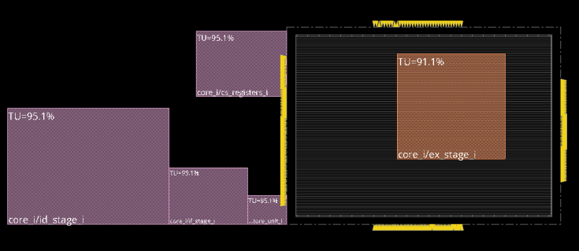
Placement
Placement is the step in the design process where standard cells are placed on the core boundary.
Boundary constraint command
set_db place_hard_fence true
set_db opt_honor_fences true
create_boundary_constraint -type fence -rects {129.00500 199.15800 255.34550 75.32550} -hinst core_i/ex_stage_i
Module instance count
Inst name | Inst Count
id_stage_i | 6627
ex_stage_i | 5321
cs_register_i | 2258
If_stage_i | 1503
Load_store_unit | 653
Sanity Checks
Verify command | Results
check_place | Placed = 21579 Unplaced = 0
report_timing -pre_cts | Wns -5.139ns (reg-reg)
Fig : ex_stage_i – fixed module
08
Notes:
I have placed this module in the specific area because this is optimal place for module to be placed because this will not coming the way other module and their respective pins while maintaining the connection with other module without barrier. I have used boundary constrain command is

Slide 9
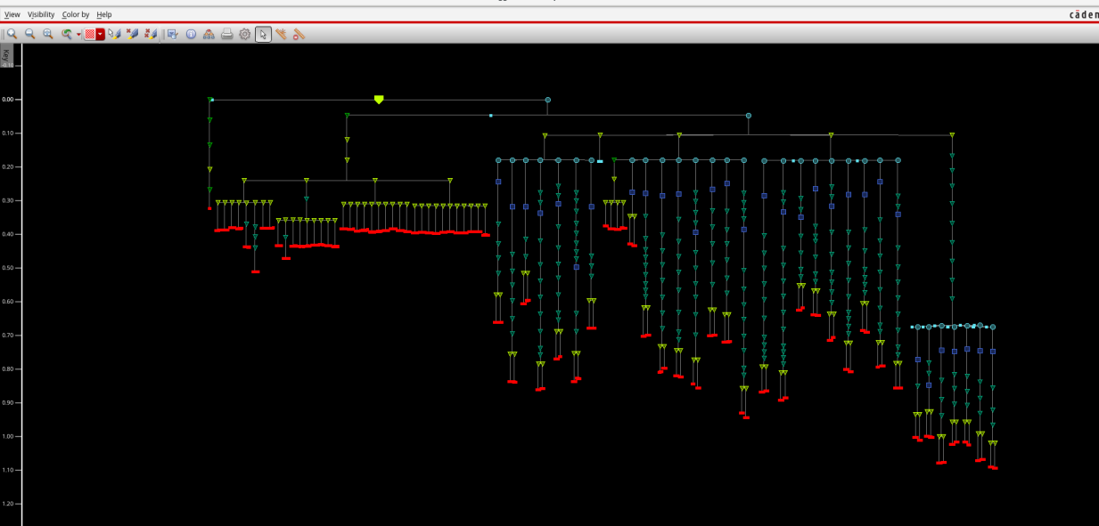
Clock Tree Synthesis
Clock tree synthesis is the process of creating this clock path from clock source to clock sinks. All clock pins of flip flop are considered as clock sinks (leaf) where the clock tree synthesis ends
trunk
Clock tree synthesis command
ccopt_design
opt_design –post_cts -hold
leaf
Fig : Clock tree window
09
Notes:
In this stage ideal clock converts to clock tree synthesis and creating this clock path from clock source to clock sinks. I have used in this command ccopt_design for build in a clock tree. And also uesd opt_design command purpose of hold timing optimization before cts. This picture is clock tree synthesis for my design and clock is propagated and we can see these are trunk and these are leaf.

Slide 10
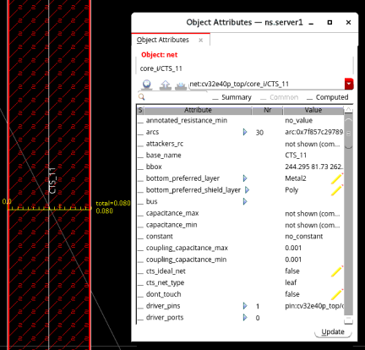
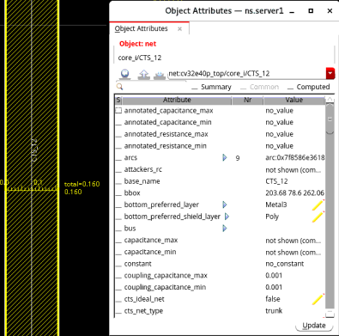
Clock Tree Synthesis
Non Default Rules (NDR)
NDRs make the clock routes less sensitive to crosstalk
Double/triple width for avoiding electromigration
Double/triple width for avoiding crosstalk
Create route rule command
create_route_rule -name cts_2x_space_2x_width
-spacing_multiplier “Metal3:Metal4 2”
-width_multiplier “Metal3:Metal4 2”
Fig : Metal2 is used for the Leaf
Fig : Metal4 is used for the Trunk
Execute command
create_route_type -name cts_trunk
route_rule cts_2x_space_2x_width
10
Notes:
I have applied NDR for avoiding crosstalk and electromigration. I have used in this command for route rule and this command used for route rule execute.i have created NDR rule 2x space and 2x width for metal4 which is trunk. And similar command used for meat2 which is leaf just changed NDR. Where space is 2x and width is 1x.

Slide 11
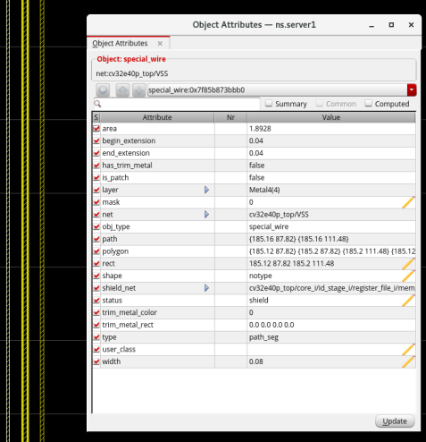
Clock Tree Synthesis
CTS Routing Rules
Shielding
Non Default Rules (NDR)
Shielding command
Metal4
create_route_type -name cts_trunk -shield_net VSS
Shield VSS
Timing Report
Setup | -0.928ns (reg-reg)wns
Hold | -0.182ns (reg-reg)wns
Fig : Metal4 shielding window
11

Slide 12
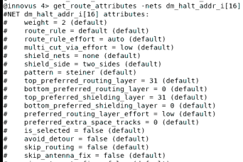
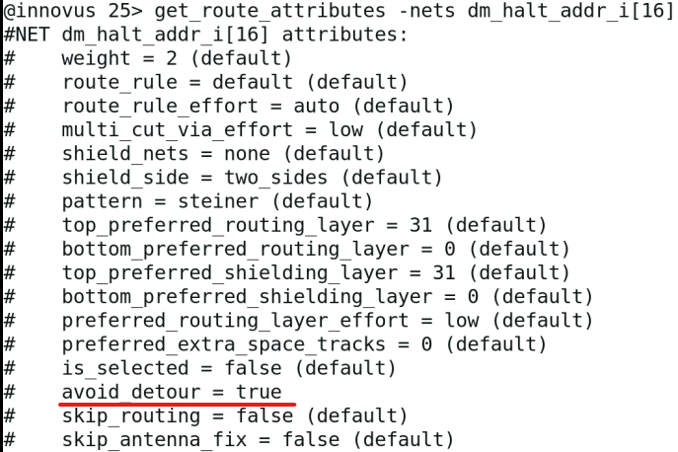
Routing
Making physical connection between signal pins using metal layer are called routing.
Detouring using GUI mode
Route
NanoRoute
Specify Attribute
Route Attribute window
Net Attribute
Avoid Detour
Detouring using command
True
set_route_attributes -nets * -avoid_detour true
Fig : Detouring on
Fig : Detouring off
12

Slide 13
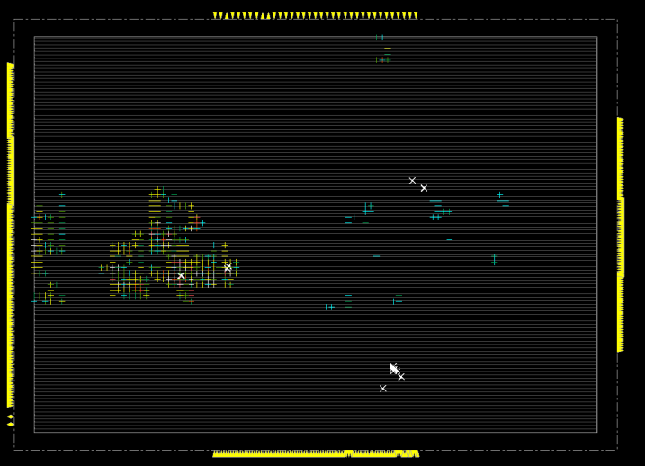
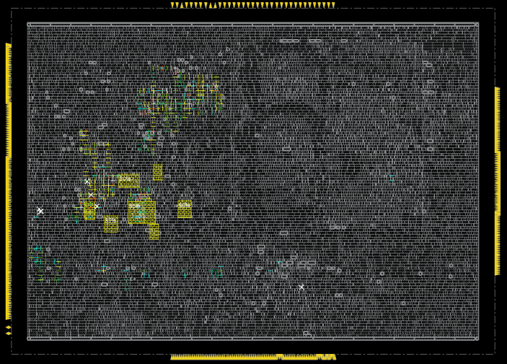
Routing Congestion
Routing partial blockage command
create_route_blockage -rects {27.36 13.68 205.19 157.31} -partial 70 -layers {Metal2 Metal4}
Routing Congestion Reports
 | Hotspot Score | Max Hotspot (worst) | Top Routing layer
Before partial blockage | 690 | 467 (Metal2) | Metal4
Before partial blockage | 548 | 419 (Metal4) | Metal5
After partial blockage | 468 | 514 (Metal4) | Metal5
Power stripe density 15% | 225 | 74 (Metal2) | Metal5
Fig : Before partial blockage
Timing Reports
Setup | - 4.684ns (reg-reg) wns
Hold | - 0.184ns (reg-cgate) wns
Fig : After partial blockage
13

Slide 14
Postroute
Timing optimization
Design Rule Constrains clean
Design Rule violation fixing
Timing report
Command : time_design –post_route
View: Setup WNS ALL -1.118
Group : in2out -0.135
Group : in2reg -0.330
Group : reg2cgate 0.000
Group : reg2out -1.118
Group : reg2reg -0.700
Group : Default 0.037
Timing optimization command
Opt_design –post_route
Opt_design –post_route -hold
Sanity Check
Verify commnad | Results
check_drc | Metspc -395 Short -1 Total -396
check_place | Placed -24387 Density without filler -92.73% Density with filler -100%
check_connectivity | Zero violation
Command : time_design –post_route -hold
View: Hold WNS
ALL -0.189
Group : in2out 0.690
Group : in2reg -0.042
Group : reg2cgate -0.189
Group : reg2out 0.400
Group : reg2reg -0.184
Group : Default -0.077
14

Slide 15
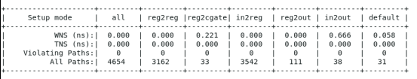

Setup & Hold Timing Fixed
Used Method
Reduced the frequency to 350MHz
Set new input delay is 0.2857ns which is 10% of the period
Set new output delay is 0.5714ns which is 20% of the period
Command used is opt_design –postroute –setup
Fig : Setup timing results
Fig : Hold timing results
15

Slide 16
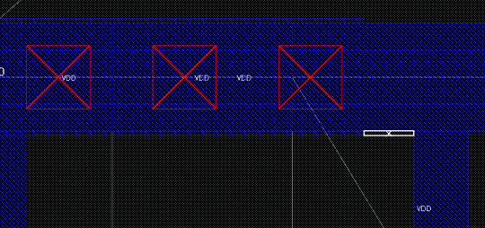
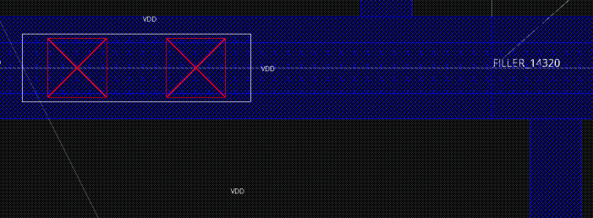
Design Rule Check
Verify DRC
Verify Command | Results
check_drc | MetSpec – 395 Short - 1
Violation_browser
Error position in the design
From Via selected
Replace via
MetSpec fixed command
edit_update_via -area {x1 x2 y1 y2} -from M2_M1_1 -to M2_M1_2x1_HH_C
To via selected
Metal Short fixed command
check_drc –view_window
delete_routes -regular_wire_with_drc
route_eco -fix_drc
result
DRC Result = zero violation
17

Slide 17
Challenges
Cells are bounded within the selected region
Routing congestion even after applying partial blockage
Meeting setup and hold timing violations
Multiple DRC Fixing
18

Slide 18

Thank You

