Slide 1
Webtime with John
John McAvoy
Profhacks Workshop
February 2020

Slide 2
Agenda
Learning Objectives:
At the end of this workshop, you should be able to:
  Understand the basics of
    HTML
    CSS
    JavaScript
  Modify a template to make your website
  Leave with your own free Github.io website

Slide 3
Agenda
Introduction
The Fundamental Theory with Examples
  HTML
  CSS
  JavaScript
How to setup your own Github.io webpage

Slide 4
Who am I?
Hi, my name is John McAvoy
Relative Experience
  Webmaster for Rowan IEEE and Engineers without Borders
  Lead ProfHacks website team for past 3 years
  Spent past 2 summers developing website in industry
  Have worked on about ∼20 web-development projects
  http://profhacks.com/

Slide 5
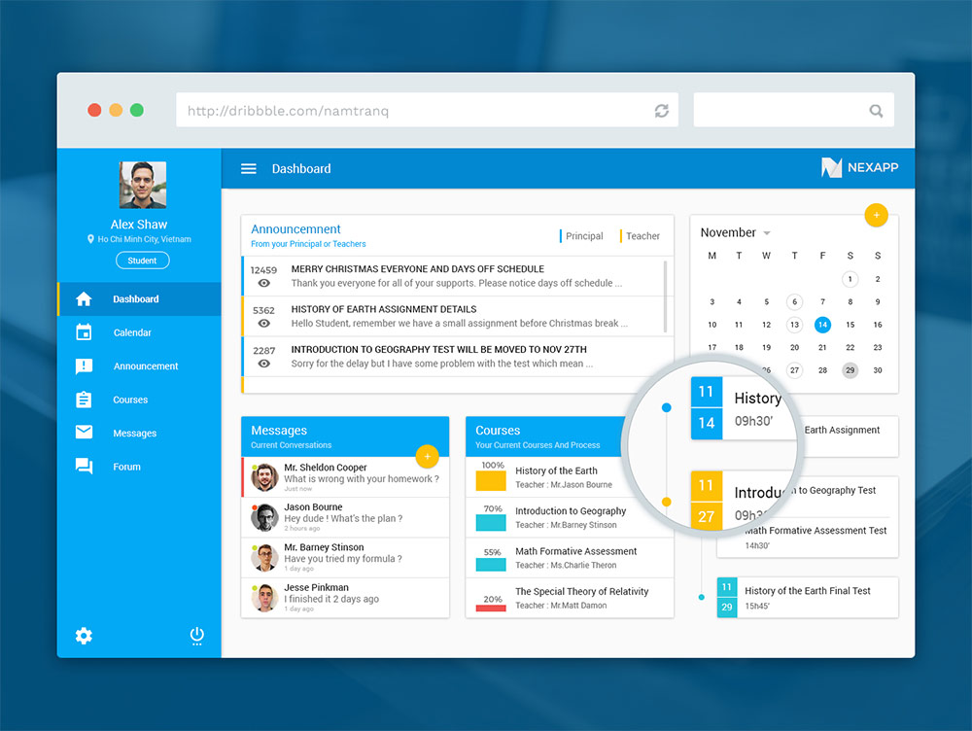
Introduction
What is Front-end Web Development?
  What you see when you visit a website
  The “Front-end” is the user sees
  The “Back-end” is the magic that happens behind the scenes
  “Full-stack” web developers are able to work with both the front-end and back-end

Slide 6
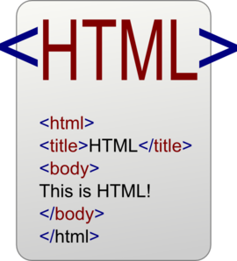
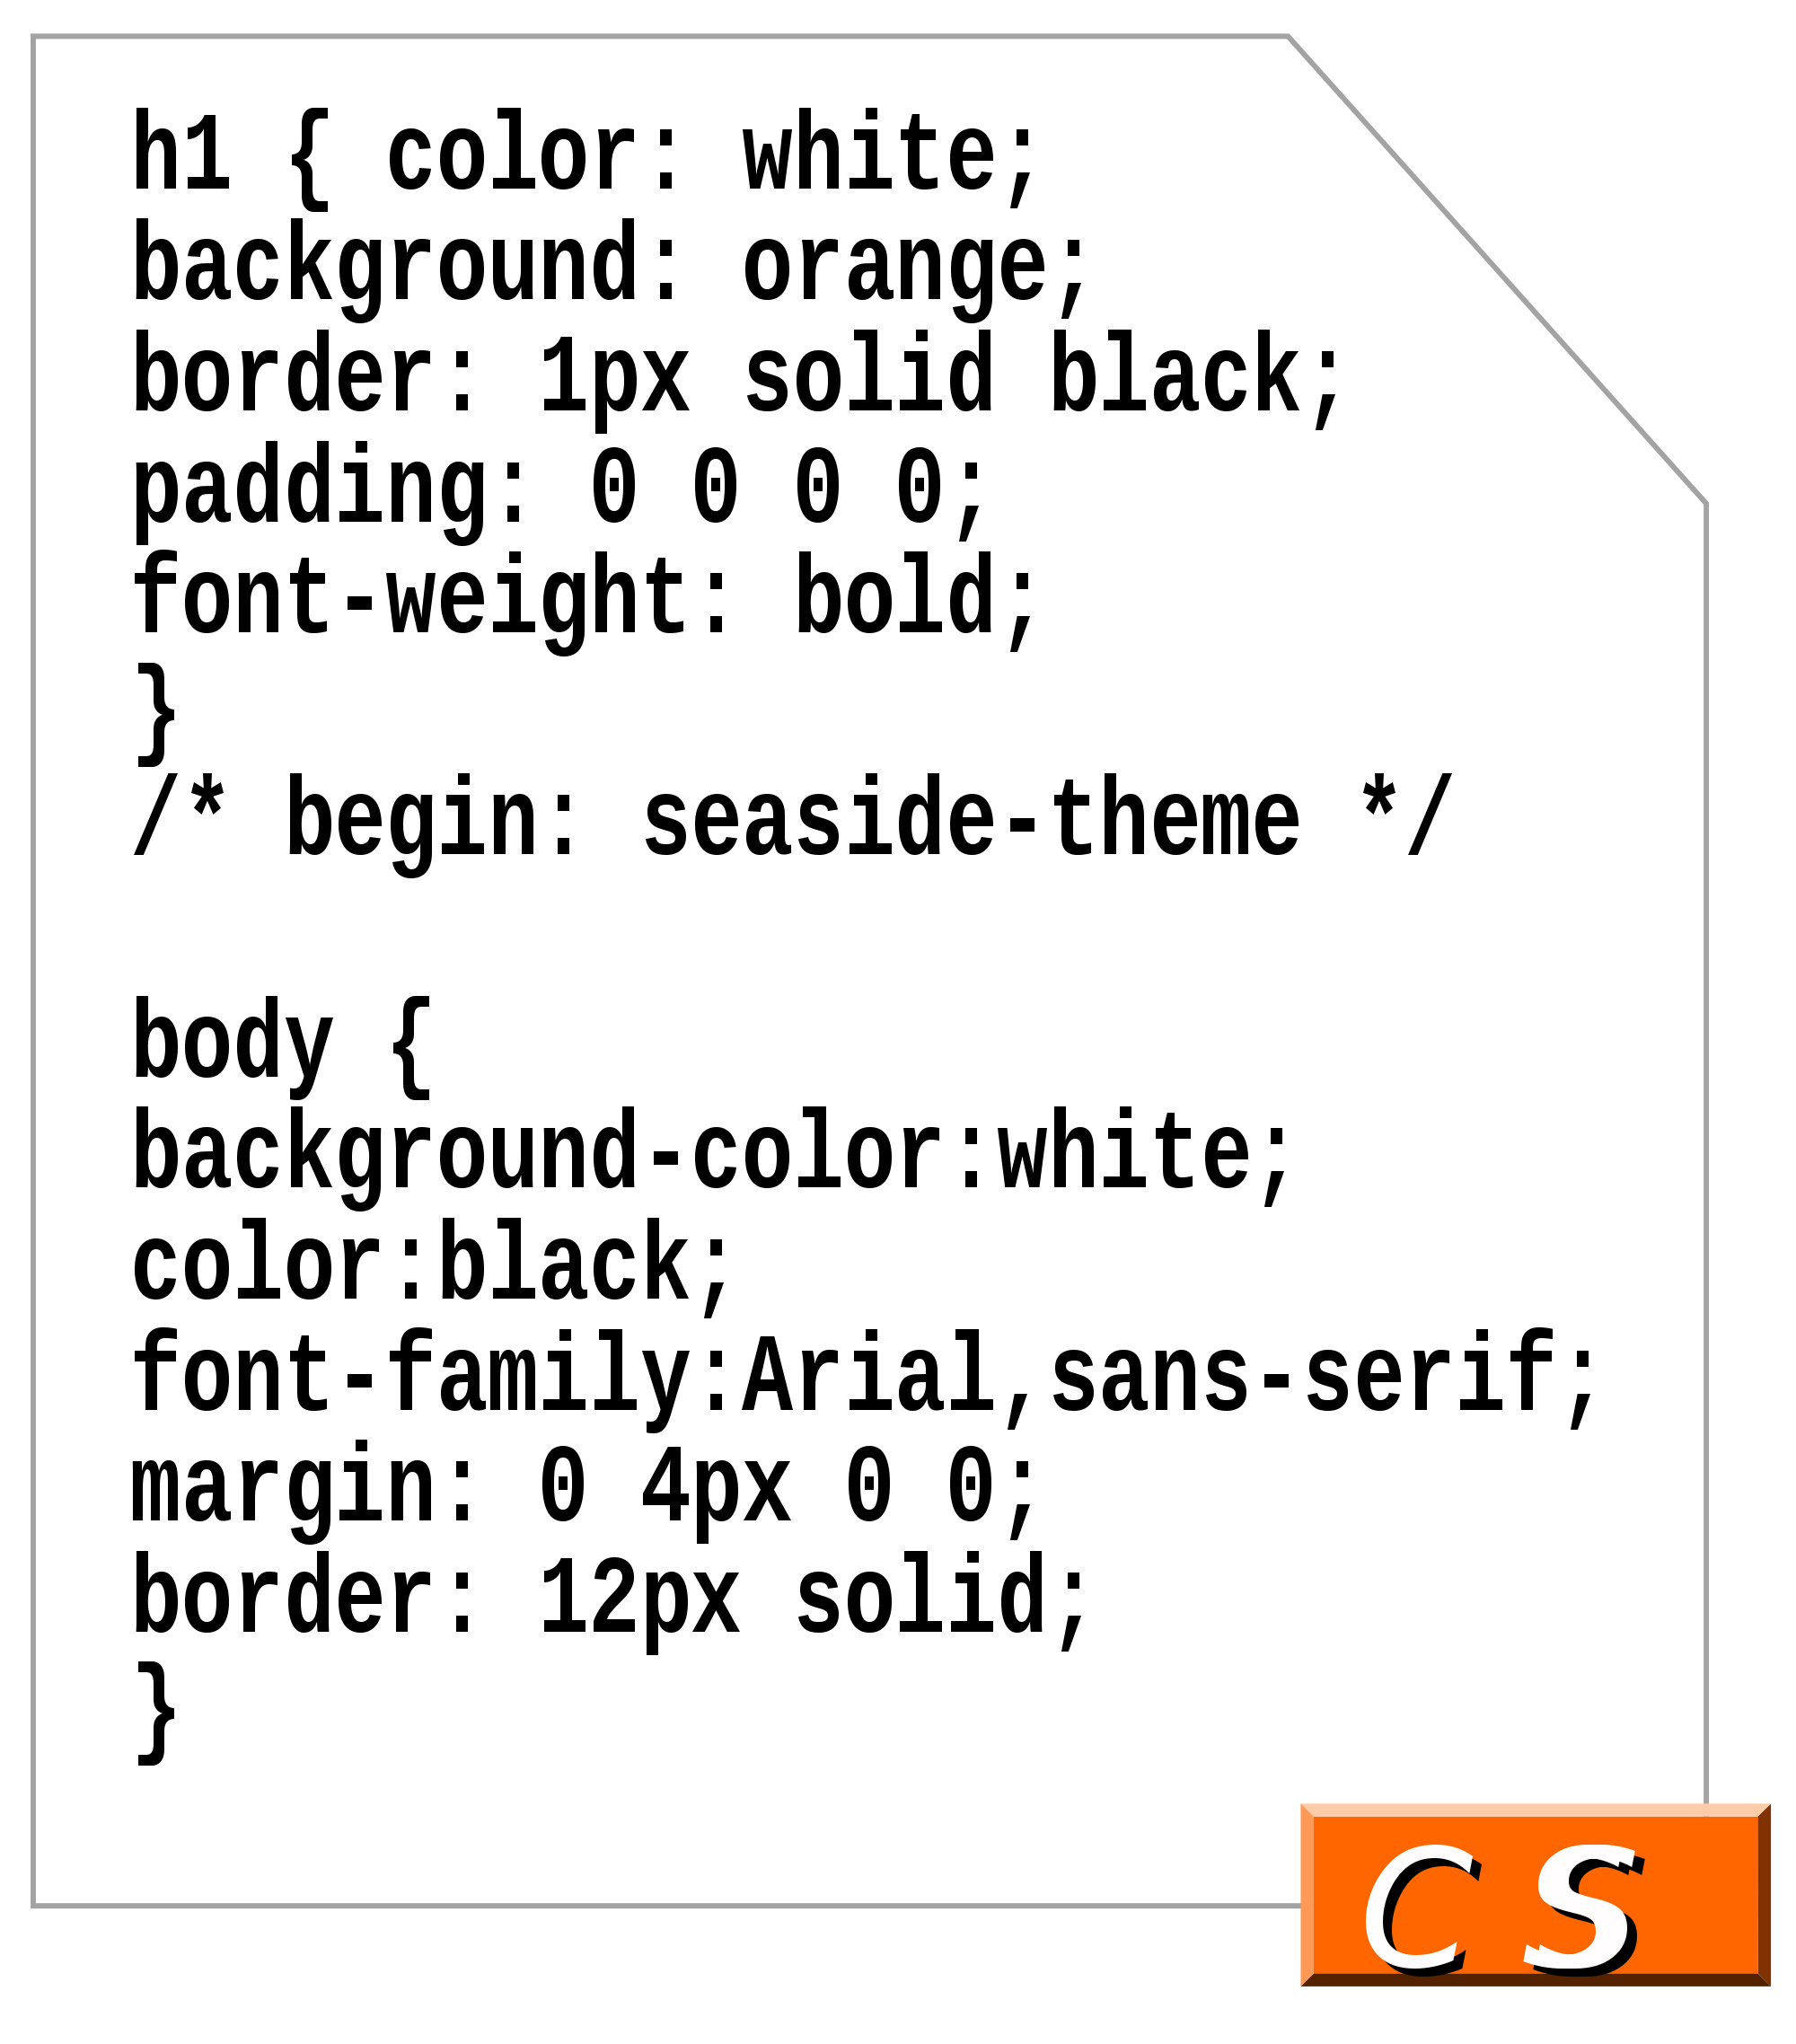
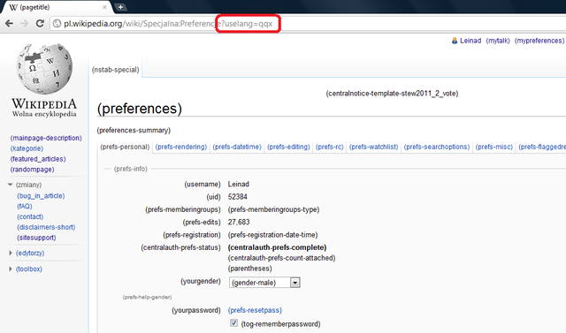

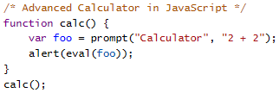
Introduction
Websites are designed using code
  Predominately HTML, CSS, and JavaScript
The code tells the web browser how to display content
The web browser interprets the code
The web browser displays the website
HTML/CSS/JS
and other files
Web Browser renders webpage
Web browser parses and interprets the plain-text HTML/CSS/JS

Slide 7
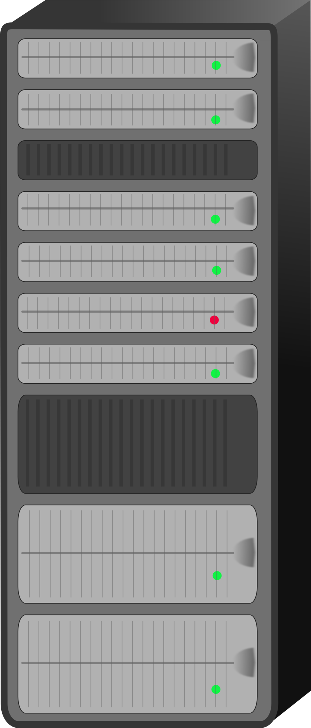
How Do Websites Work? (cont.)
Websites are hosted on servers connected to the internet which have unique public IP addresses
  Servers are computers designed for sharing centralized resources
When your web browser goes to a site’s IP address, its code is downloaded and your web browser can then display the website
Server’s Public IP Address
Enter Website Domain
Sends HTML/CSS/JS
and other files
Web Browser renders webpage

Slide 8
Let’s Build a Website!
All you need is a text editor and a web browser

Slide 9

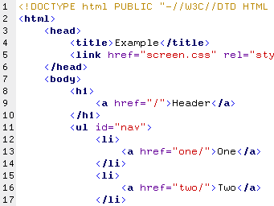
Crash Course: HTML
HTML – Hypertext Markup Language
What Does it Do?
  HTML is the backbone of your website
  It provides meaningful structure to your content

Slide 10
Crash Course: HTML
Syntax:
  HTML uses tags in angle brackets <> to structure your website
    Ex:
      <h1>This is a Heading 1</h1>
      <p>This is a paragraph</p>
  Attributes go inside tags and convey additional information
    Ex:
      <section id="example_section">
        <h1 class="custom_heading">Example</h1>
        <img src="img/example.jpg">
        <a href="http:www.example.com">example link</a>
      </section>

Slide 11

Crash Course: CSS
CSS – Cascading Style Sheets
What Does it Do?
  CSS is what makes your site look pretty
  It provides instructions to your web browser for how to render your content
  CSS references your HTML elements via tag, class, and id

Slide 12
Crash Course: CSS
Syntax:
  CSS references HTML elements by its tag, class, and id
  Classes are referenced by periods .class
  Id’s are referenced by number-sign #id
  There are over a hundred style attributes that can be referenced at https://www.w3schools.com/cssref/default.asp

Slide 13

Crash Course: JavaScript
What Does it Do?
  JavaScript adds functionallity to you website
  It is a versitle programming language that is run in-browser and is capable of modifying your HTML

Slide 14
Crash Course: JavaScript
Syntax:
  JavaScript is a loosely typed, C-style language.
  Variable declaration:
    var foo;
  Function declaration
    function bar (x, y, z) {
      // Do Something
    }
  Modifying HTML
    var exampleDiv = document.getElementById(“example_div”);
    exampleDiv.innerHTML = “modified text”;
    exampleDiv.style.color = “red”;

Slide 15

Example Website

Slide 16
Hosting Your Website on the Web
Now that you have your website designed the way you want, you’ll need to host your website online so anyone can access it
Luckily, getting free hosting is possible thanks to MLH!
  Go to http://hackp.ac/domaions - 1 year free Domain.com domain
  Enter code MARCH2345
Free hosting with Github Pages
  http://github.io/

Slide 17
Helpful Resources
Everything you’ll need to know about HTML, CSS, and Javascript - https://www.w3schools.com/

