Slide 1

Customer Shopping Behavior Analysis
Uncovering insights from 3,900 purchases to guide strategic business decisions

Slide 2

Dataset at a Glance
3,900
18
$59.76
Total Purchases
Data Points
Avg Purchase
Transactions analyzed across all categories
Features tracking demographics and behavior
Mean transaction value per customer
3.75
Avg Rating
Customer satisfaction score
Customer Demographics
Shopping Behavior
Age, Gender, Location
Purchase patterns & frequency
Subscription Status
Discount & promo usage

Slide 3
Data Preparation Journey
01
02
03
Data Loading & Exploration
Missing Data Handling
Feature Engineering
Imported dataset, checked structure and summary statistics
Imputed 37 missing Review Ratings using category medians
Created age groups and purchase frequency metrics
04
05
Data Consistency
Database Integration
Standardized columns, removed redundant promo code field
Loaded cleaned data into PostgreSQL for analysis

Slide 4
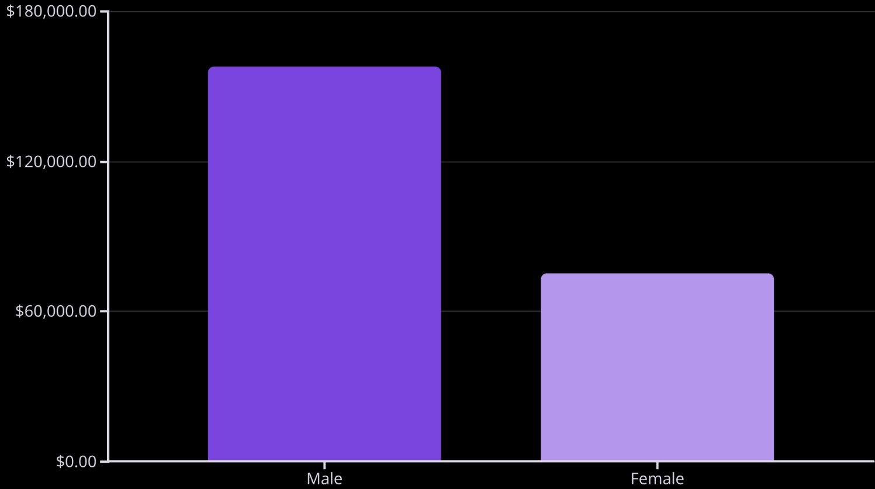
Revenue Insights
Gender Revenue Gap
Male customers generate 2.1x more revenue than female customers
Key Opportunity: Expand product lines and marketing to female demographics

Slide 5



Customer Segmentation
Loyal Customers
Returning Buyers
New Customers
3,116 customers
701 customers
83 customers
Highest value segment with consistent purchases
Growth opportunity for loyalty programs
Focus on conversion and retention
80%
18%
2%
Loyal Base
Returning
New
Customers with strong purchase history
Mid-tier engagement level
Recent acquisitions

Slide 6


Product Performance
Top Rated Products
Most Purchased by Category
Gloves (3.86)
Sandals (3.84)
Clothing: Blouse, Pants, Shirt
Boots (3.82)
Accessories: Jewelry, Sunglasses, Belt
Hat (3.80)
Footwear: Sandals, Shoes, Sneakers
Skirt (3.78)
Outerwear: Jacket, Coat
Insight: Top-rated products show consistent quality across categories—leverage in marketing campaigns

Slide 7

Discount Strategy Analysis
High-Value Discount Users
Discount-Dependent Products
839 customers used discounts but spent above average ($60+)
Hat (50%), Sneakers (49.7%), Coat (49.1%) have highest discount rates
Strategic Opportunity
Balance promotional pricing with margin control—discounts drive volume without sacrificing quality buyers

Slide 8
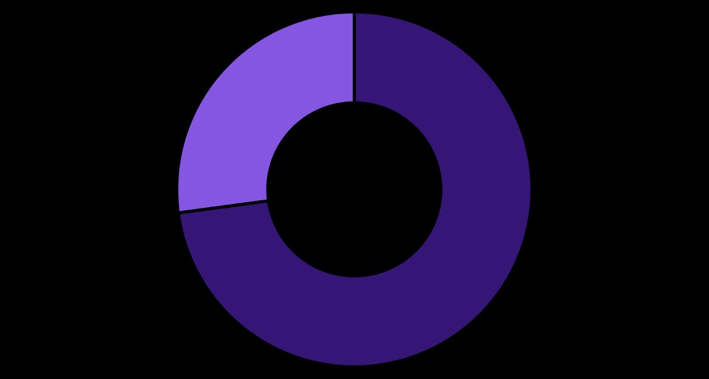

Subscription & Shipping Insights
Subscription Status
Shipping Preferences
Express: $60.48 avg purchase
Standard: $58.46 avg purchase
Express users spend 3.5% more—premium service attracts higher-value customers
Non-Subscribers
Subscribers
27% subscription rate with similar avg spend ($59.49 vs $59.87)

Slide 9
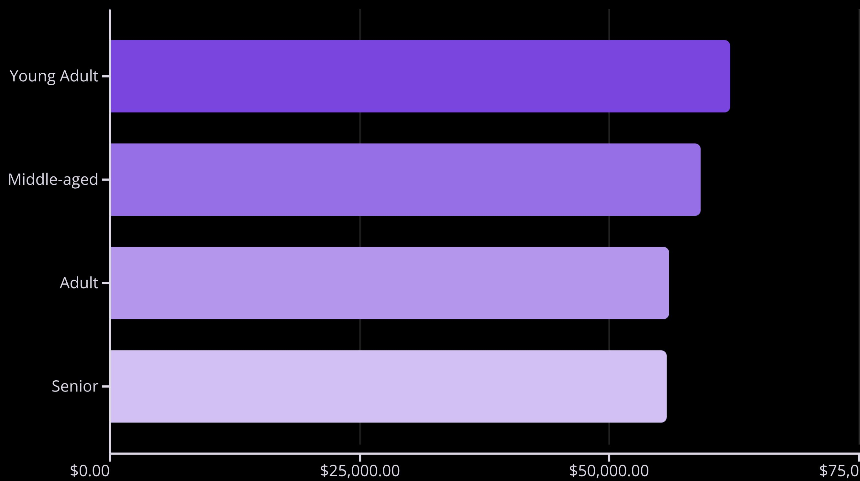
Age Group Revenue Distribution
Young Adults lead revenue generation—target this demographic with tailored campaigns and product positioning

Slide 10

Strategic Recommendations
Boost Subscriptions
Loyalty Programs
Optimize Discounts
Promote exclusive benefits to convert 73% non-subscribers—untapped revenue potential
Reward repeat buyers to move Returning segment into Loyal—strengthen 80% base
Balance promotional pricing with margin control—focus on high-value discount users
Targeted Marketing
Product Positioning
Focus on Young Adults and express-shipping users—highest revenue demographics
Highlight top-rated products (Gloves, Sandals, Boots) in campaigns—leverage quality reputation

