Slide 1
Comparing
Handwritten Number
Recognition Networks
Keras versus Nengo
Simon Tröster, Dominik Weidner 23.01.2024

Slide 2
Project Overview
NeuromorphicAI
Simon Tröster, Dominik Weidner
Create 2 versions of a handwritten number recognizer
Utilizing the MNIST dataset for training
Provide model input via webcam
Compare the 2 approaches regarding performance, programmability, usability and other metrics
23.01.2024

Slide 3
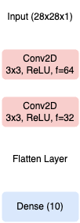
Traditional Approach: CNN with Keras
NeuromorphicAI
Simon Tröster, Dominik Weidner
Straight forward implementation
Well documented resources and examples
This approach was used to test and implement the webcam functionality
More sophisticated approach by finding contours in the full webcam image didn’t prove viable
→ Solution: Using the biggest square image frame possible
← Topology
Optimizer:
RMSProp(0.01)
Loss: categorical
cross entropy
captured area
23.01.2024

Slide 4
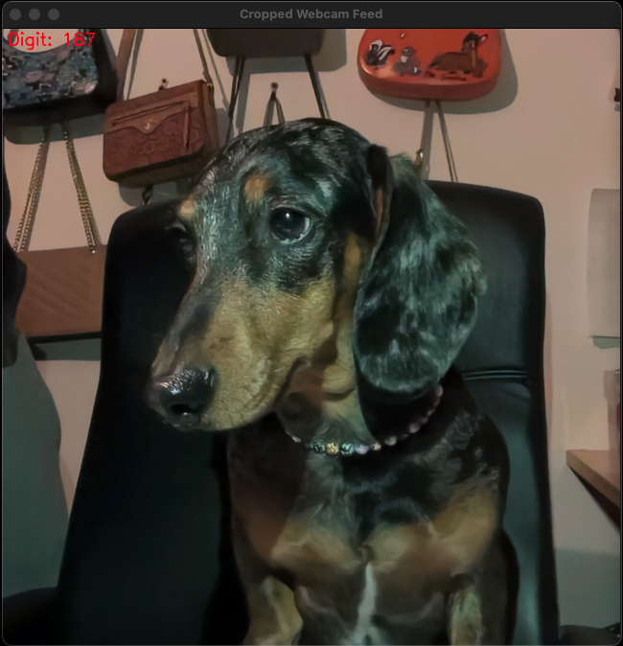
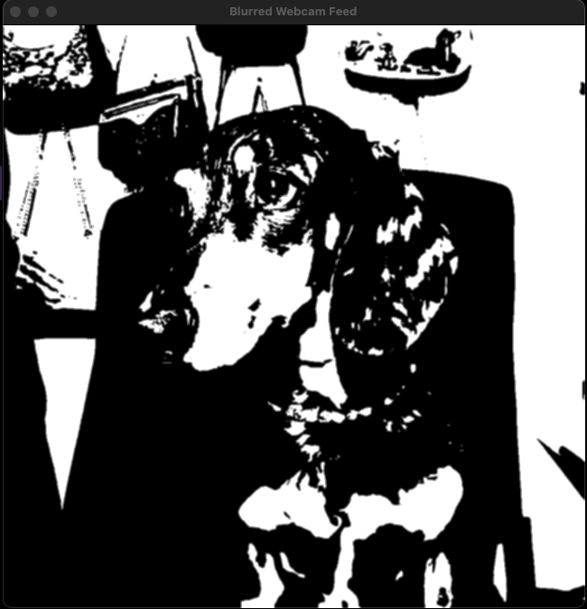
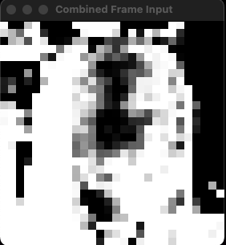
Model Input Preprocessing with Webcam
NeuromorphicAI
Simon Tröster, Dominik Weidner
1080p raw capture
Transformations:
greyscale
gaussian blur
Inverted model input
28x28p (280x280)
23.01.2024

Slide 5
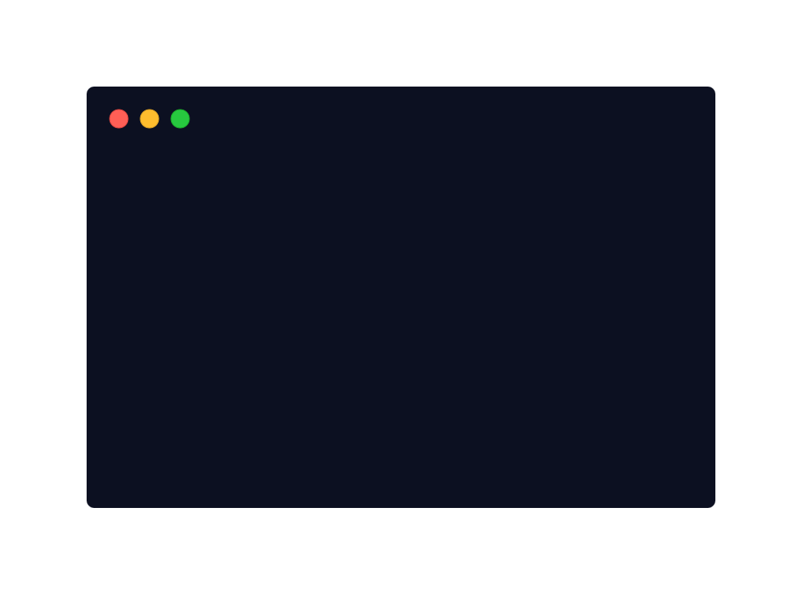
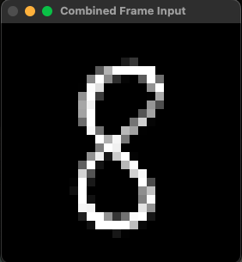
Model Input Image Buffering
NeuromorphicAI
Simon Tröster, Dominik Weidner
Running the model/sim every frame is expensive
Instead: A 30 frame buffer is implemented
. . .
This reduces camera shake and increases general image quality
In Nengo, this is needed as the simulation can not yield “real-time” results
avg.
23.01.2024

Slide 6
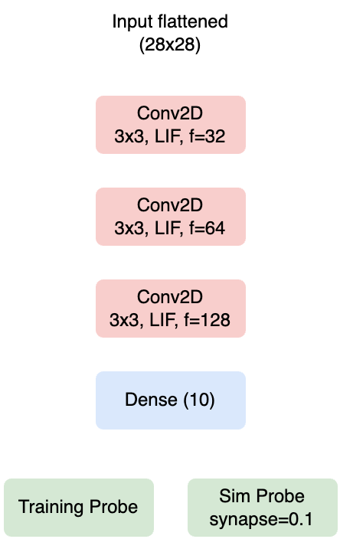
The Nengo Approach
NeuromorphicAI
Simon Tröster, Dominik Weidner
← Topology
Optimizer:
RMSProp(0.01)
Loss:
sparse categorical
accuracy
Goal: Mirroring the Keras CNN as closely as possible but utilizing spiking neurons (LIF)
Additional goal: Incorporating the “real-time” webcam functionality
Additional Conv2D layer added as it improves result quality
23.01.2024

Slide 7
The Nengo Approach - Requirement Conflicts
NeuromorphicAI
Simon Tröster, Dominik Weidner
nengo, nengo-dl and tensorflow library are needed
Conflicts: Version and system compatibility are problematic on mac & windows w/o nvidia gpu
Working on Windows (with NVIDIA):
tensorflow-gpu==2.11.0
nengo==3.2.0
nengo-dl==3.6.0
(CUDA-toolkit 11.2 & cudnn 8.1.0)
Working on Mac M2 Pro:
(Python 3.9) tensorflow-macos==2.8.0
tensorflow-metal==0.4.0
nengo==3.2.0
nengo-dl==3.6.0
23.01.2024

Slide 8
Results - Both Models in Numbers
Keras CNN
Nengo SNN
NeuromorphicAI
Simon Tröster, Dominik Weidner
Training time: ~4 min
(batch_size=32, epochs=10)
(batch_size=300 → <3min but OF)
Accuracy after training: 98.71%
Prediction time: <1s (~36ms step)
Training time: ~10 min
(batch_size=300, epochs=10) Training goal: Similar acc. as the CNN
Accuracy after training: 98.72%
Simulation time: ~10s (30 steps @ 0.001)
→ Maybe multithreading would help
23.01.2024

Slide 9

Visualized Results - CNN
NeuromorphicAI
Simon Tröster, Dominik Weidner
23.01.2024

Slide 10
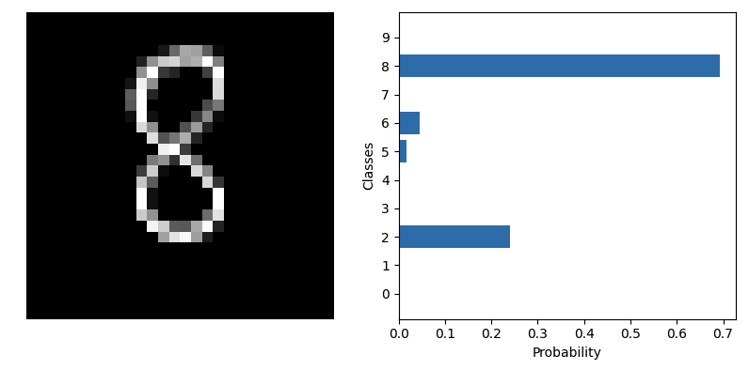
Visualized Results - CNN Plotted
NeuromorphicAI
Simon Tröster, Dominik Weidner
23.01.2024

Slide 11
Visualized Results - SNN
NeuromorphicAI
Simon Tröster, Dominik Weidner
23.01.2024

Slide 12
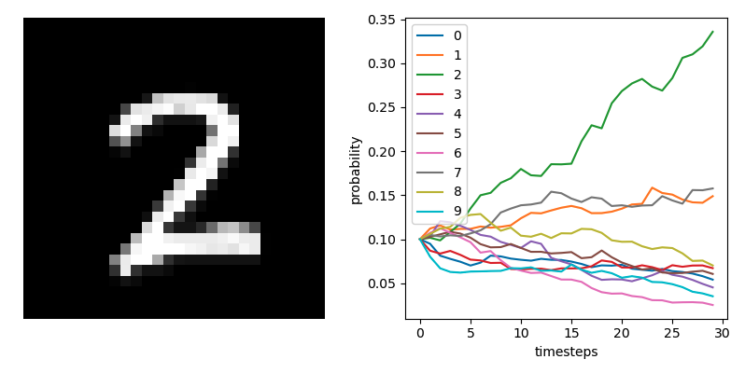
Visualized Results - SNN Plotted
NeuromorphicAI
Simon Tröster, Dominik Weidner
23.01.2024

Slide 13
Conclusion
Outlook
NeuromorphicAI
Simon Tröster, Dominik Weidner
It is possible to create a well-functioning handwritten digit recognizing SNN with webcam functionality
Obvious drawbacks include longer training times and the simulation time
In the right circumstances (low power environments) the SNN can provide a viable alternative to traditional models
It would be interesting to see the SNNs performance compared with an implementation on neuromorphic hardware (Intel Loihi)
23.01.2024

Slide 14
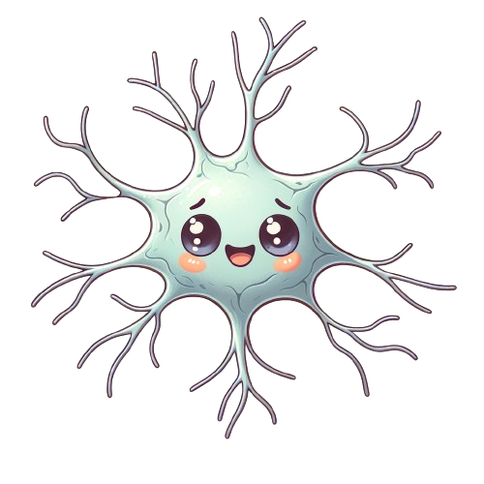
Thank you for your attention!
NeuromorphicAI
Simon Tröster, Dominik Weidner
23.01.2024

