Slide 1
Network Intrusion Detection
on CIC-IDS2017
Comparing classifiers, Kernel PCA, and the rare-attack problem
Advanced Computer Networks course project

Slide 2
The problem
• Intrusion detection. classify each network flow as benign or one of 14 attacks.
• Flow-based. uses summary statistics (sizes, timings, TCP flags), not packet contents, so it works on encrypted traffic. Same idea as NetFlow / IPFIX.
• The catch: imbalance. benign traffic outnumbers the rarest attack 195,291 to 1.
• Three aims. compare classifiers fairly, test Kernel PCA, and explain the results in networking terms.

Slide 3
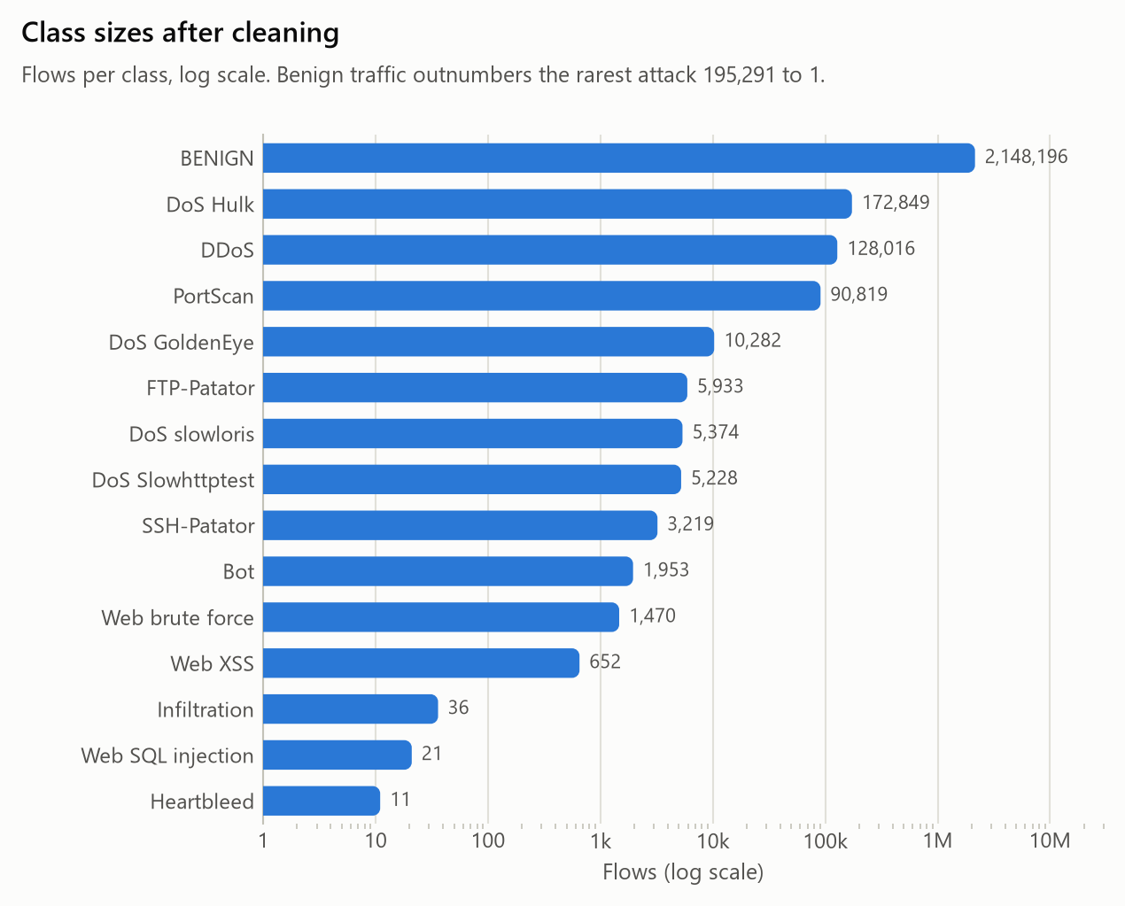
The dataset, after cleaning
• 2,574,059 flows, 69 features, 15 classes (CIC-IDS2017, five days of traffic).
• Removed 9% duplicate rows that skew the class balance (we measured the leakage: it barely affects accuracy).
• Dropped 8 dead columns and one duplicated column.
• Rarest attacks: Heartbleed 11 flows, SQL injection 21, Infiltration 36.

Slide 4
Why accuracy is not enough
• One shared pipeline. impute, scale (for scale-sensitive models), classify; fitted on the training split only.
• Accuracy hides rare attacks. a model can ignore every rare attack and still score above 0.9, because benign traffic is 83% of the data.
• We report macro F1. it weights every class equally, so a missed rare attack shows up. Read with the per-class scores.

Slide 5
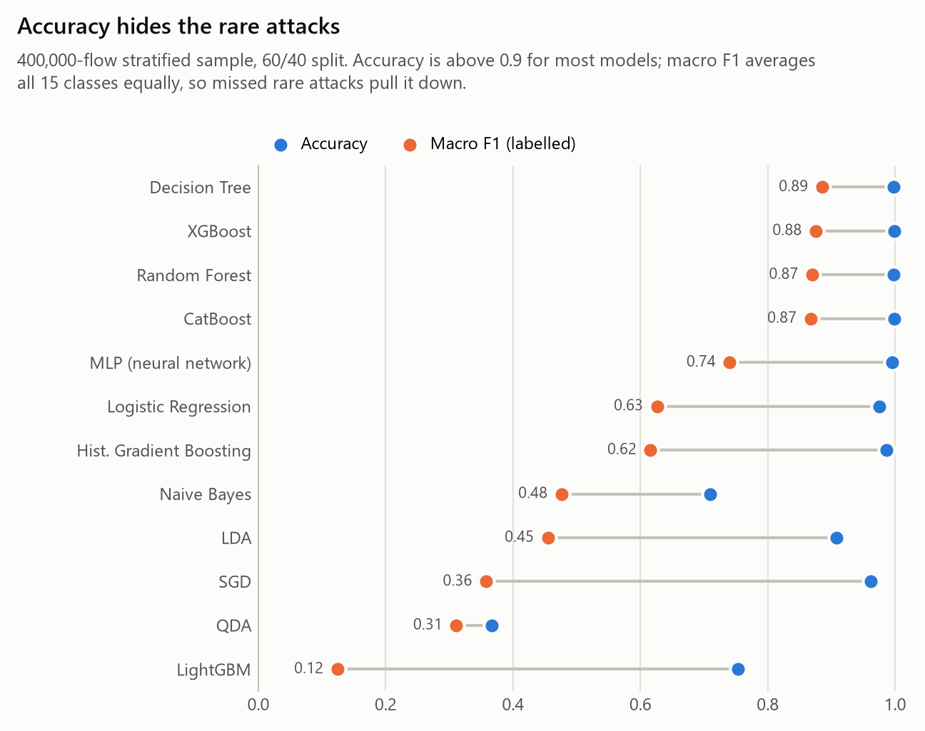
Classifier comparison
• Decision Tree wins. macro F1 0.885, accuracy 0.998.
• Tree ensembles lead; linear models trail.
• Accuracy above 0.9 for most, but macro F1 spreads far wider.

Slide 6
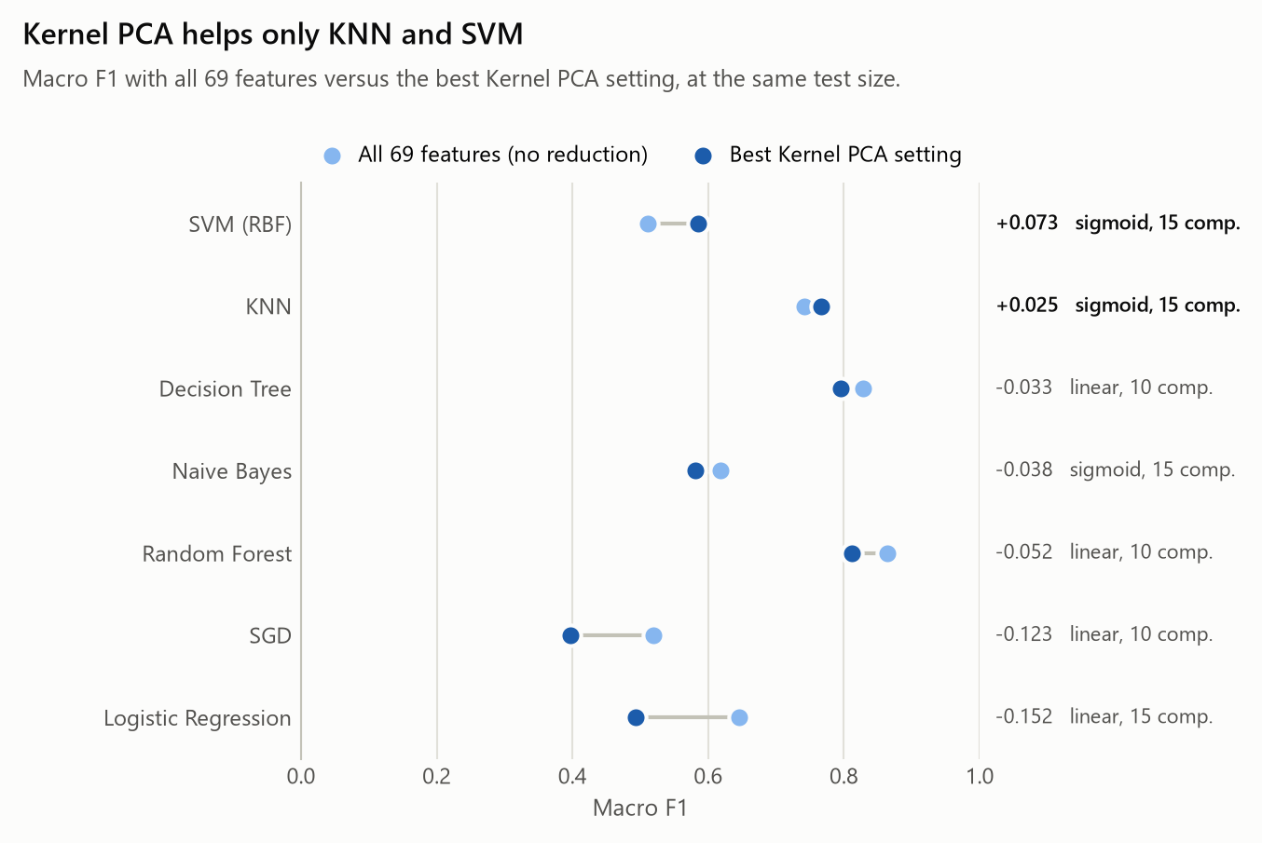
Kernel PCA: helps only KNN and SVM
• 5 kernels x 3 sizes x 3 counts, 7 classifiers = 336 runs on a 10k sample.
• Reduction helps only KNN (+0.025) and SVM (+0.073), both with the sigmoid kernel.
• Every other classifier does worse than with all 69 features.
• Poly is the worst kernel; more components always help.

Slide 7
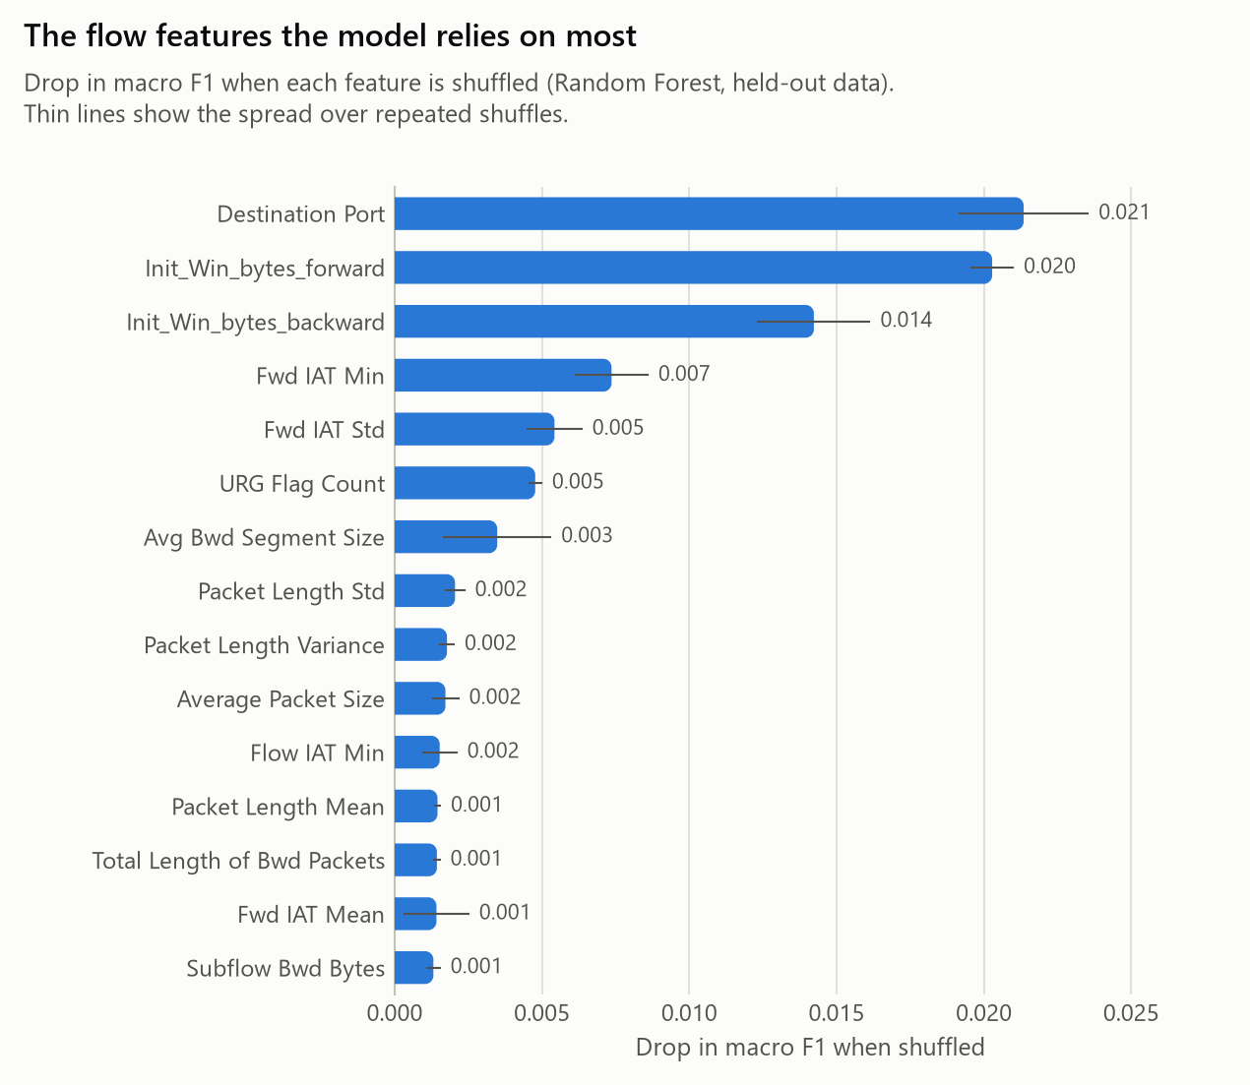
What the features say about each attack
• PortScan: tiny flows, zero payload, thousands of probes per second.
• Slow DoS: packets seconds apart, not milliseconds.
• Heartbleed: huge server reply packets separate all 11 flows perfectly.
• Web brute force vs XSS: identical flow signature, so they get confused.
• Caution: top features (port, TCP window) are partly dataset shortcuts.

Slide 8
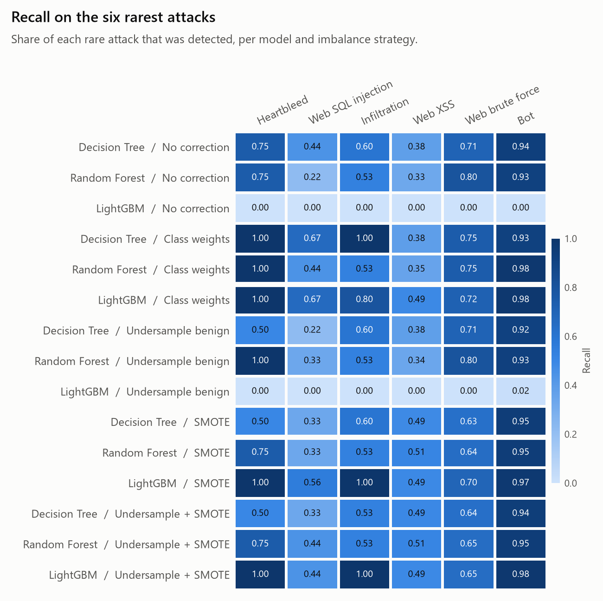
Fixing the class imbalance
• Applied to training only, so the test scores stay honest.
• Class weights, undersampling, SMOTE.
• Recovers rare-attack recall that the plain models miss entirely.

Slide 9
We tested two common assumptions. Both were wrong.
• "Duplicates inflate the scores." 13.2% of test rows are memorisable, yet accuracy on them is only +0.001 above unseen rows. Inflation: +0.0002.
• "Models lean on giveaway features." drop Destination Port and both TCP window features and macro F1 falls just 0.02 to 0.04. Not an artefact.
• Why: unseen-row accuracy is already 0.998, so memorisation has no headroom; and 28 correlated feature pairs mean the signal simply reroutes.
• The real lesson: importance rankings mislead when features are redundant. Dedup still matters, but for class balance, not inflation.

Slide 10
Deployment and takeaways
• Runs beside the traffic, not inline: a verdict comes only when the flow ends.
• Speed matters: the classifier must keep up with the link's flow rate.
• Encryption is fine; payload attacks (SQL injection, XSS) need application logs too.
• Takeaway: a plain decision tree is enough; report macro F1, not accuracy; Kernel PCA is not a free win; the rare and look-alike attacks stay hard.

Slide 11
Thank you
github.com/JONATHANJOHN95001/acn-network-intrusion-detection

