Slide 1

Ol Saathi
ओल साथी
A teacher speaks Hindi. A child hears her mother tongue. With no internet.
SIH26042 Government of Jharkhand, Dept of Higher & Technical Education
Team INNOV8 · JAIN Deemed-to-be University
Notes:
Ol Saathi. "Ol" is Santali for write, and opens the name of Ol Chiki, the script Raghunath Murmu created for Santali in 1925. "Saathi" is Hindi for companion. Half Santali, half Hindi, like the product.

Slide 2
THE PROBLEM
PALASH works. It cannot scale.
5,000+
3
~0
tribal-area primary schools where children are taught in a language they do not speak at home
languages the state needs: Ho, Mundari and Santali, all Austroasiatic, all low-resource
teachers posted there who speak them. Almost every one was trained in Hindi
Jharkhand’s PALASH programme has measurably improved foundational literacy by teaching in the mother tongue. The bottleneck is not method or funding. It is that there is no one in the room who speaks the language, and training a generation of teachers is a decade of work.
Ol Saathi puts the language in the room today, on a tablet the school already has.

Slide 3
THE NINETY-SECOND DEMO
What a teacher actually does
1
2
3
4
Teacher speaks Hindi
Santali appears
The class hears it
It goes home on paper
›
›
›
She presses to talk and says
“जोहार बच्चों”. No typing, no
language setting to choose.
The sentence shows in Ol Chiki
script, labelled Machine
translation, with the Hindi
kept above it.
Pre-rendered audio plays from
the device. No network, no
waiting, no model loading.
The same lines print as a
bilingual worksheet and
flashcards, NIPUN coded.
Measured, not budgeted. Median 98 ms from speech result to first sound, over seven phrases with the network off, against a 3,000 ms ceiling. Recognition time is not in that figure, and the app shows its own measurements on the Check and Proof screen.

Slide 4
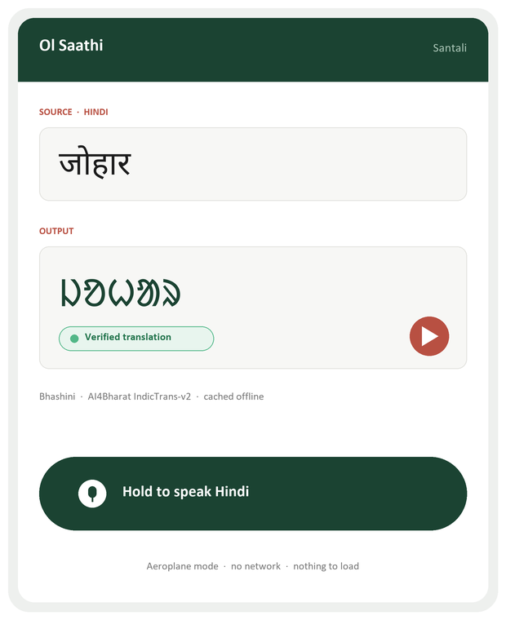
THE PRODUCT
One screen, and one promise on it
1
Hindi stays on screen
The teacher keeps her own words in view, so she always knows what was sent.
2
Ol Chiki, in the real script
Rendered with Noto Sans Ol Chiki, bundled in the APK. Android ships no Ol Chiki font, so without it every character would be an empty box.
3
The provenance chip
Says what produced the line and who, if anyone, has checked it. Machine output says machine output. It is the first thing we built and the last thing we would remove.
4
Press to talk, nothing to configure
No language field, no settings, no typing in a script she cannot read.
The word on the screen is johar, the greeting shared across Santali, Ho and Mundari. It is the first thing a teacher would say, and the only Santali in this deck, because no Santali speaker has checked our pack yet. The app says that on every line it shows.
Notes:
The chip is the whole argument. Anyone can put Ol Chiki on a screen. Saying where it came from, and refusing to show anything you cannot source, is the part nobody else will do.

Slide 5
WHERE EVERY LINE COMES FROM
Four models, each named on screen
Each piece of content records the model that produced it. These are the four in the shipped app:
TRANSLATION, IN THE PACK
TRANSLATION, LIVE
AI4Bharat IndicTrans2 1.1B
Bhashini IndicTrans v2
Santali and 16 more languages, from the human-written English for each Hindi line. Run locally at build time.
Only for a sentence not in the pack, and only when the tablet is online.
SPEECH, FIVE LANGUAGES
SPEECH, SANTALI
Bhashini AI4Bharat Indic-TTS
AI4Bharat Indic Parler-TTS
Tamil, Malayalam, Telugu, Bengali and Bodo. Generated once, shipped as audio.
Bhashini has no Santali voice; we checked with a working key. Run locally, labelled unchecked.
Why this matters for defensibility. Our team does not read Santali, so we cannot be the authority on it, and neither can a model. Every entry records the model and timestamp that produced it, and a two-route cross-check ranks the twelve lines a Santali speaker should read first.

Slide 6
ARCHITECTURE
Translate once online. Run forever offline.
BUILD TIME · once, with a network
RUN TIME · in the classroom, no network
1
Hindi FLN content: 53 lines, classroom phrases plus NCERT Sarangi lesson lines
1
Teacher speaks. Android speech recognition, Hindi, on device
2
Translated by IndicTrans2, then spoken by Bhashini Indic-TTS, or by Indic Parler-TTS for Santali
→
2
Hash lookup in the shipped pack. Microseconds, zero network
3
Target text and audio written into the APK, with the model named for each line
3
Ol Chiki on screen, Santali audio played from local storage
No machine learning runs on the tablet. The problem statement requires full offline operation “after initial content synchronisation”, and this is exactly that. It also means nothing can fail on stage: no network, no model load, no variance.

Slide 7
THE DESIGN RULE WE WILL NOT BREAK
The app never invents a translation
A teacher who does not speak Santali cannot tell a good translation from a bad one. The children can. So every piece of output carries its provenance, shown on screen next to the text.
MACHINE TRANSLATION
TRANSLITERATED
UNAVAILABLE
Produced by a named model
during the pack build and
shipped verbatim. Says so,
and says it is unchecked.
Hindi respelled in Ol Chiki.
Readable aloud, but it is not
the language. Always labelled
as such, never as translation.
Nothing verified for this input.
The app says so and shows
nothing, rather than offering
a plausible guess.
This is not caution for its own sake. Output that looks plausible and is wrong is the single failure mode that would discredit the whole project in a Jharkhand classroom, and it is invisible to everyone in the room except the children.

Slide 8
AGAINST THE PROBLEM STATEMENT
The four things it asks us to deliver
1
Hindi to tribal language,
minimum one language
Santali in Ol Chiki, 53 lines, with synthesised audio labelled unchecked. 16 more languages in the same format. Ho and Mundari have no model anywhere yet.
2
Real-time voice translation,
under three seconds
Measured median 98 ms from speech result to first sound, network off, over seven phrases. Recognition time not included.
3
Auto-generated bilingual
worksheet output
A4 worksheets and flashcards from the same pack: Hindi line, target line, NIPUN Bharat outcome code on every item.
4
Full offline operation on a
low-end Android tablet
minSdk 28. On a 2 GB Android 9 emulator: 43 to 45 MB peak memory, zero network calls, tested with the network off.
Also required at submission: a demo video and a public GitHub repository. Both are planned into the build schedule.

Slide 9
TECHNICAL STACK
Deliberately small
Models
Android application
Content and assurance
AI4Bharat IndicTrans2 1B, run locally
Bhashini Indic-TTS for five languages
Indic Parler-TTS for Santali, run locally
Bhashini live translation when online
Kotlin, minSdk 28, targets 2 GB tablets
Android SpeechRecognizer, hi-IN, offline
PdfDocument for the bilingual worksheet
Noto Sans Ol Chiki and Devanagari bundled
NCERT Sarangi Class 2 Hindi, hand-checked
NIPUN Bharat outcome codes on every item
Node pack generator, resumable, provenance
CI checks assets are real, not placeholders
What we are deliberately not building: on-device neural translation, vector search, OCR, mesh sync, a custom keyboard. Hindi and Santali are from different language families, so on-device character mapping cannot produce meaning, and the rest is scope that does not serve the four requirements.

Slide 10
What we are asking for
Bhashini access now runs live translation and speech for five languages. What is missing is people: a Santali speaker to review the pack, and a Santali voice to replace our synthesised one.
Santali first
Ho and Mundari next
Beyond Jharkhand
Text, synthesised audio and a printed worksheet today. A speaker review turns it from machine output into checked content.
No model exists for either yet. The app takes a new language the day one does.
17 languages already ship in the same pack format, same app.
Ol Saathi · ओल साथी
Team INNOV8 · JAIN Deemed-to-be University · SIH26042, Government of Jharkhand
Notes:
Close on the ask: Bhashini API access for Santali translation and TTS. Everything else we build ourselves.

