Slide 1

– I Love this!
Name: Ong Jin Sheng
Class: SP-IT8302 Applied Machine Learning

Slide 2

Part A: Classification – Manufacturing factory

Slide 3
Objectives and Outline:
Purpose:
- Build a machine learning model to predict whether a machine is working or faulty.
Approach :
- Examine features in existing data set and identify critical features used for modelling.
- Build classification models with machine learning algorithms; use regularization (Ridge), hyperparameters tuning (GridSearch) and SMOTE to improve performance.
- The output variable is Machine status is working (=0) or faulty (=1).
- The model is evaluated on Confusion Matrix.

Slide 4
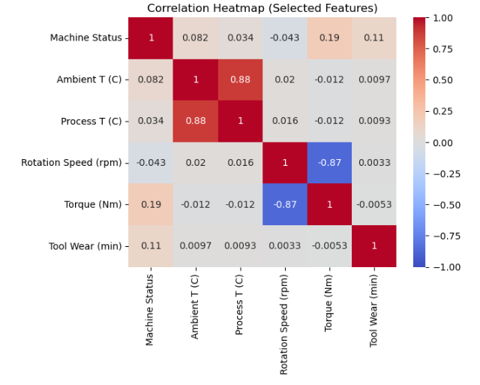
1. Data Preprocessing
#A. Data Cleaning
Checked for missing values; dropped null values from Columns: Quality, Rotation speed and Process T (C). They comprised of 2471 rows or 12% which is deemed small.
Unrequired columns (e.g. Unique/Product ID) are also dropped for model efficiency.
#B. Data Curation
Generate a quick data summary to view the range and magnitude of values.
To decide if removal of outliers or standardization is required (i.e. Rotation speed).
#C. Features Selection (Provisional)
Correlation heatmap (Fig 1) and pair plots are created on numerical features to check for correlation ratios and collinearity on features.
Observations:
Based on heatmap, the correlation of features with machine status appears to be weak (< 0.2), the highest is Torque (Nm) (0.19).
Ambient and Process T(C) suggests strong positive relationship (0.88) and collinearity.
Conversely, rotation speed and torque exhibits a strong negative relationship (-0.87) and collinearity.
Recommendations:
Use EDA to determine which features are critical to create baseline model.
Fig 1 Correlation heatmap (provisional)
Foot notes
#A. #B. #C. - refers to section labels which are found at the top of the accompanying Jupyter notebook.

Slide 5
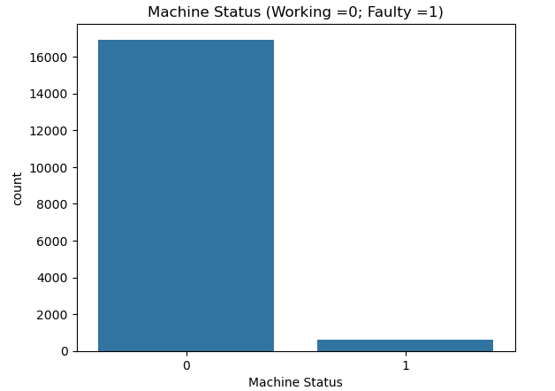
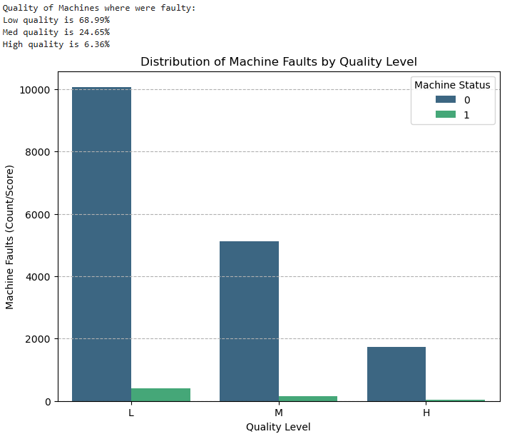
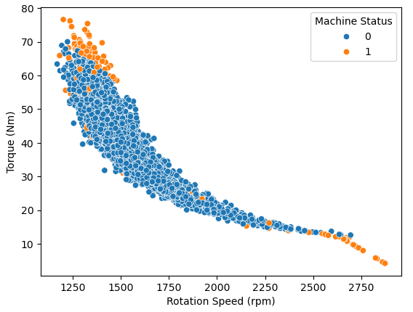
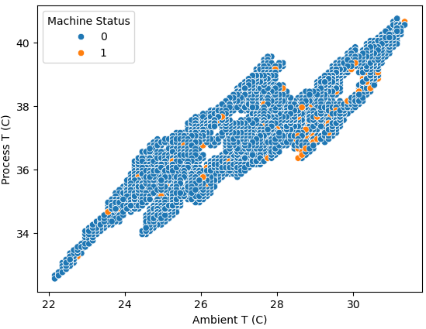
2. Exploratory Data Analysis
#D. Exploratory Data Analysis (EDA)
Observations:
Machine Status (Top left): Only 3.4% of dataset are faulty, this suggest significant class imbalance (minority class).
Quality (Top Right): Machines quality are categorized as low (60%), medium (30%) and high (10%); o/w ~69% of faulty machines are of low quality. This indicates majority of faulty machines are low - medium quality which is a critical feature.
Scatter plot (Bottom left): Machine faults seems likely to occurred at high rpm – low torque (e.g. idling state) or low rpm - high torque (e.g. heavy load at slow speed).
Scatter plot (Bottom right) # Despite high positive correlation, there is no clear trend (randomly distributed) to evaluate at which temperatures does machines fail.
Recommendations:
Strong indication that torque, rotation speed and quality affects machine faults.
Causality between machine faults, environmental and process temperature is unclear.
Further analysis on torque, rotation speed and temperature (Ambient T(C)) using box plot charts.
Foot notes
#D. - refers to section labels which are found at the top of the accompanying Jupyter notebook.

Slide 6
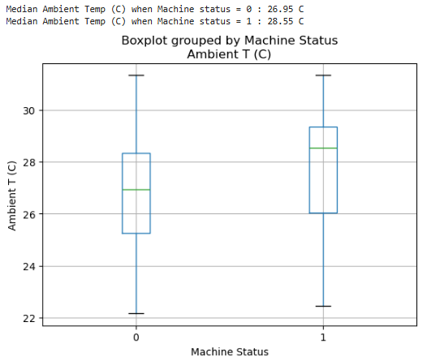
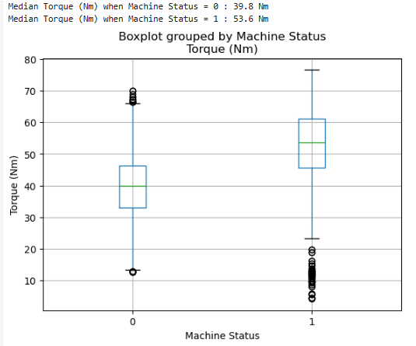
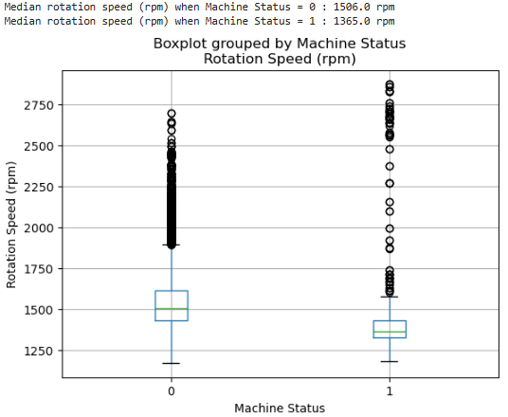
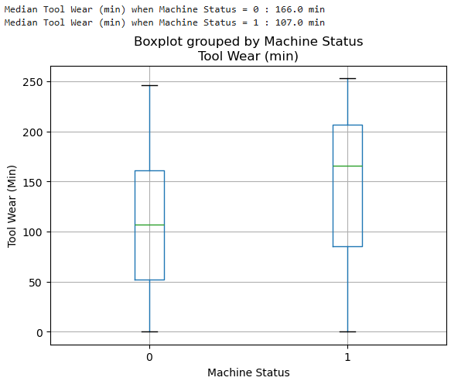
2. Exploratory Data Analysis
#D. Exploratory Data Analysis (EDA)
Observations:
Ambient T (C): Median temp for faulty machines are higher (~ 29 > ~27); this resonates with higher temperatures occurs at higher rpm or torque that results in high thermal stress on components.
Torque (Nm): The interquartile range (IQR) and median Nm is higher for the faulty machines; higher faults also occurred below minimum (i.e. outliers).
Rotation Speed (rpm): Contrast to torque, IQR and median rpm is lower for faulty machines; higher faults also occurred above max (i.e. outliers).
Tool Wear (min): Median tool wear min is higher on faulty machines (166min > 107 min). Intuitively, the longer duration a tool is used results in higher wear & tear and leading to fatigue and break down.
Recommendations:
Findings above coincides with scatter plot where machine faults are likely to occurred at high rpm – low torque or low rpm - high torque.
Tool wear is also a critical factor; longer duration of tool usage results in specific fatigue and failure of components.
Ambient T(C) does not clearly signal a clear relationship with machine faults; range of max and min temp for working machines are similar and little difference - to exclude temperatures.
Torque, rotation, tool wear and quality are selected as features for modelling.
Foot notes
#D. - refers to section labels which are found at the top of the accompanying Jupyter notebook.

Slide 7
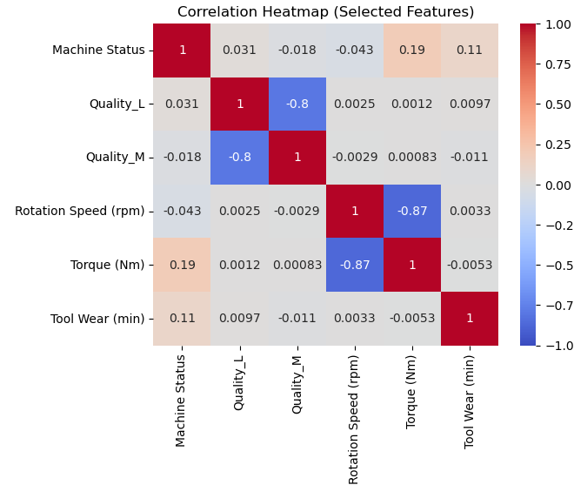
3. Data Transformation
#E. Dummy Encoding
Dummy encoding was applied on Quality to convert it from categorical to numerical values (i.e. Quality_L, Quality_M).
New columns were created as abbreviations (e.g. Torque (Nm) = TRQ ) for convenience and data converted to appropriate types (e.g. float) to ensure smooth data processing to upload onto models.
Generate final heatmap (Fig 2) with selected features to check for correlation ratios.
#F. Train - Test Split
Used train-test split for 70 % - 30 % onto dataset, dropped non-critical columns and applied standard scale on training data with numerical values (excluding Quality).
Applied standardization on training data; test data is transformed with same columns. Standardization prevents any features with large magnitude (e.g. Rotation speed) to dominate the machine learning process and improves model reliability/performance.
#G. SMOTE (Synthetic Minority Over-sampling Technique)
To address the data class imbalance, SMOTE will be adopted to create new artificial samples of the minority class.
This helps to balance the minority data and improve performance of models.
It is observed number of rows in training data grew from 12,270 to 23,702 after SMOTE was applied.
Fig 2 Correlation heatmap (final)
Foot notes
#E. #F. #G. - refers to section labels which are found at the top of the accompanying Jupyter notebook.

Slide 8
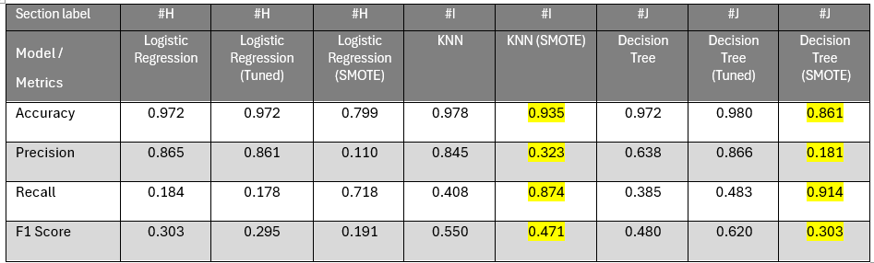
4. Model Evaluation (Confusion Matrix)
*
^
+
^
* Ridge regression; hyper parameter tuned was C ; best C was 0.5.
^ Hyper parameter tuned was criterion = entropy, max depth =7, min samples leaf=1.
+ Hyper parameter tuned was criterion = entropy, max depth =7, min samples split=2, min samples leaf=1.
Comments:
3 classification learning algorithms (Logistic Regression, KNN and Decision Tree) were used.
The approach is to first use a base learning algorithm, followed by improving the model by techniques regularization, tuned hyperparameters and SMOTE.
The desired output is to detect if a machine is faulty; the metrics above evaluates if a machine is faulty (i.e. machine status =1).
For example, under KNN, out of all machines predicted as faulty, 84.5% (Precision, high) were actually faulty. But, it only detected 40.8% (Recall, weak - moderate)
of total faulty machines in the testing.
Recommendations:
Recall is the primary priority; it enables us to correctly screen for faulty machines. Higher recall means fewer false negatives or missed faulty machines.
Precision will be second priority; higher false positives generated by Precision is acceptable, it can be sorted out with follow up checks by technicians.
[ Conclusion ]
Although Decision Tree (SMOTE) has the highest recall score at 91.4%, it has a low precision of 18.1%. This indicate the model would likely classify a larger number of working machines falsely as faulty (false positive). Comparatively, KNN (SMOTE) has second highest recall at 87.4% and a higher precision of 32.3%.
KNN (SMOTE) will be the more efficient model to use to detect machine faults.
Foot notes
#H. #I. #J. - refers to section labels which are found at the top of the accompanying Jupyter notebook.

Slide 9

Part B: Regression - House Sales Prices for King County

Slide 10
Objectives and Outline:
Purpose:
- Build a machine learning model to predict sale prices of houses in King County.
Approach :
- Examine features in existing data set and identify critical features used for modelling.
- Build regression models with machine learning algorithms; use regularization (Ridge) and tuning of hyper parameters to improve performance.
- The output variable is house prices.
- The model will be evaluated by RMSE.

Slide 11
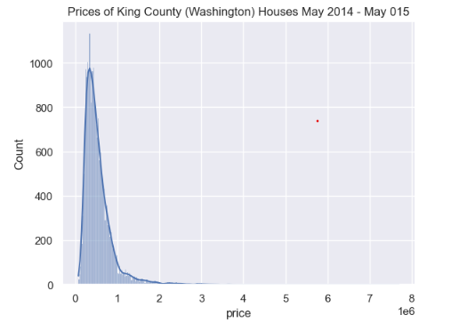
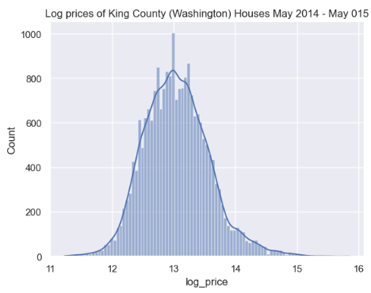
1. Data Preprocessing
Fig 1 Price distribution chart (Original)
Fig 2 Price distribution chart (Log prices)
#A. Data Cleaning
Verified there are no missing values; dropped unrequired columns (e.g. id, date) for preliminary cleaning.
Generate data summary: a wide range of values suggested outliers (e.g. bedrooms) and will investigate further in EDA.
#B. Data Curation
Identify and study characteristics of columns of interest e.g. view, grade.
Preliminary review found prices are rightly skewed (Fig 1); to log prices to achieve normal distribution on y-variable (Fig 2).
Foot notes
#A. #B. - refers to section labels which are found at the top of the accompanying Jupyter notebook.

Slide 12
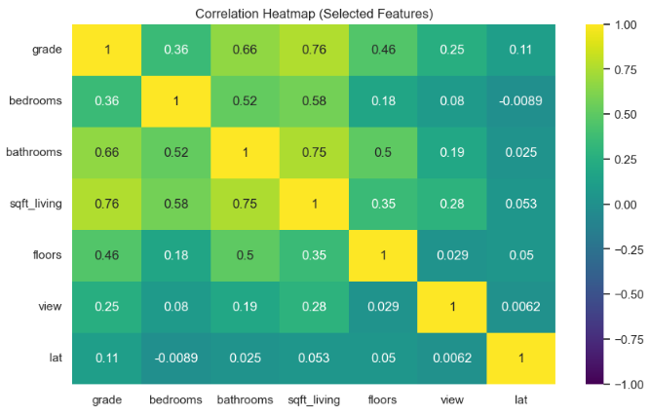
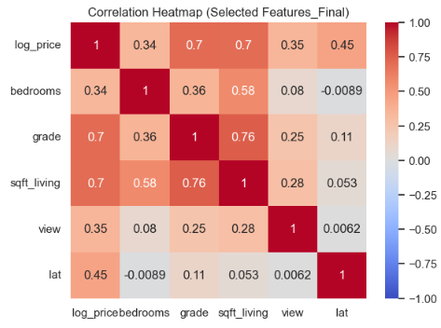
2. Features Selection
#C. Features Selection
Problem:
There are too many features in the dataset, we have to methodologically reduce and sieve for critical features.
Approach:
Create correlation heatmap for all features; next dropped metrics with weak correlation ratios (> 0.2) to log price.
Identify features which belongs in a similar category or appears to exhibit strong collinearity e.g. i) Location: zipcode, lat, view etc or ii) Size: sqft_living, sqft_above etc.
Retain 1 - 2 features of similar category to manage model complexity e.g sqft features exhibited strong collinearity, selected only “sqft_living” (0.7) as the most critical.
Create a second heatmap (Fig 3) without log price to examine collinearity.
Observations:
Bathrooms, bedrooms and floors belong the same category: house components.
Bathrooms and sqft_living have stronger collinearity compared to bedrooms (0.75 vs 0.58); Floors have a lower ratio 0.31 to log price.
Dropped bathrooms and floors; only select bedrooms.
Recommendations:
Bedrooms, grade, sqft_living, view and lat are selected as features for modelling.
Fig 3 Correlation heatmap (features w/o log price)
Fig 4 Correlation heatmap (final)

Slide 13
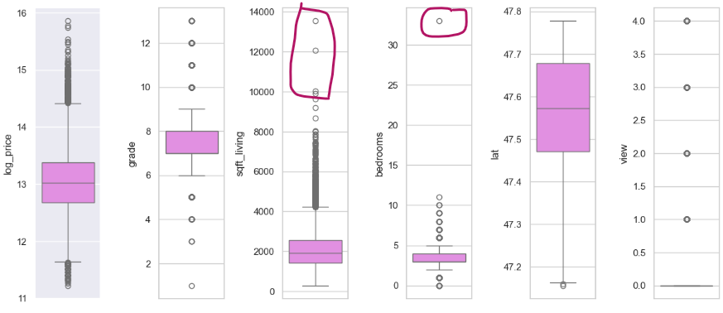
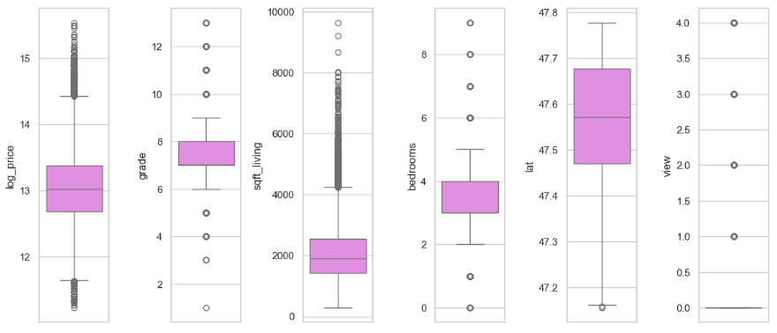
2. Exploratory Data Analysis – Data Transformation
Fig 5 Box Plot for selected Features (original)
Fig 6 Box Plot for selected Features (revised)
#D. Exploratory Data Analysis (EDA)
Sqft_living and bedrooms have significant outliers (Fig 5) which might impact regression algorithms. As the quantity appears to be small, they will be removed.
Using a quantile of 0.02 and 0.98 on said features to minimally remove a total of 9 rows ( Sqft_living: 4, Bed: 5).
In Fig 6, less outliers for selected features are observed. More analysis on features are found in Jupyter notebook under Section label #D.
#E. Train - Test Split
Used train-test split for 70 % - 30 % onto dataset.
Applied standardization on sqft-living in training data and test data. As observed in data summary, its large magnitude would dominate machine learning algorithm and needs to be standardize to improve model reliability/performance.
Foot notes
#D. , #E. - refers to section labels which are found at the top of the accompanying Jupyter notebook.

Slide 14
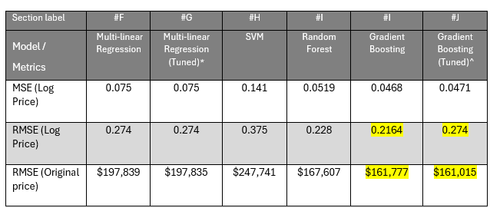
3. Model Evaluation (Confusion Matrix)
* Ridge regression; hyper parameter tuned was alpha; best alpha was 0.3.
^ Hyper parameter tuned was learning rate; best rate was 0.4
Observations:
4 regression learning algorithms (Multi Linear Regression, SVM, Random Forest and Gradient Boosting) for model building.
Regularization (Ridge) and tuning of hyper parameters were applied on to improve performance.
RMSE (log price) will be transformed by exponential function back to original scale to allow a meaningful comparison on prediction of housing prices.
Consequently, RMSE (Original price) is the primary metric to evaluate models; a lower score indicates lower prediction error on the original scale (price $).
[ Conclusion ]
Gradient Boosting produced the lowest metric scores for MSE (0.0468) and RMSE (0.2164); with the second lowest RMSE original price $161,777.
Gradient Boosting (tuned) has the lowest RMSE original score at $161,015; with an optimal learning rate of 0.4. This suggested it is likely to predict housing prices at the lowest prediction error compared to remaining models.
Gradient Boosting (tuned) will be the preferred model for predicting of house prices.
Foot notes
#F. #G. #H. #J. - refers to section labels which are found at the top of the accompanying Jupyter notebook.

Slide 15
End

