Slide 1

인간행동예측을 위한 Recurrent Neural Network 기반의 변형된 Sequence to Sequence 구조제안
2017.10.12
지도교수 : 박광현 교수님
발표자 : 김종곤

Slide 2
CONTENT
Robot Media Laboratory
1. Problem Suggestion
Prediction of Human motion
2. BackGround and Experiment
Recurrent Neural Networks(RNN)
RNN Encoder-Decoder Network
Sequence to Sequence(Seq2Seq) Network
Let’s apply it to motion
Problem Analysis
3. My suggestion and Result , Analysis
4. Learning Environment
5. Additional Usage
6. Future Research
7. Question and Answer
8. Appendix

Slide 3
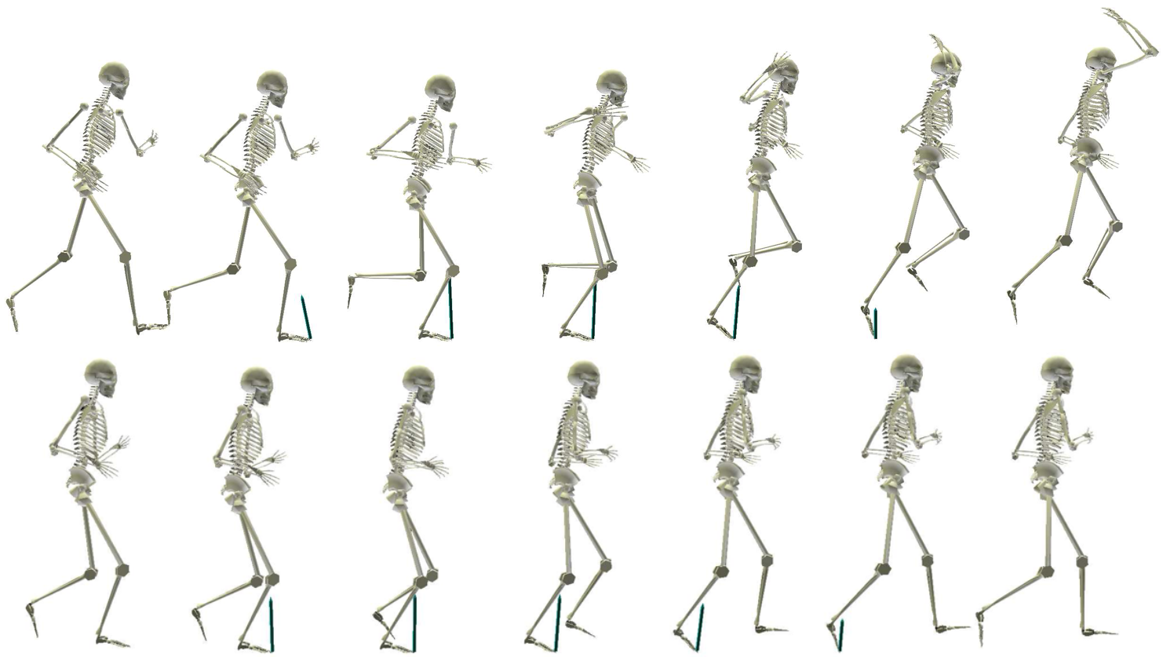
Problem Suggestion – Human Motion Analysis
Robot Media Laboratory
Generation of Human motion
Is it possible to generate the next motion with the previous motion information?

Slide 4
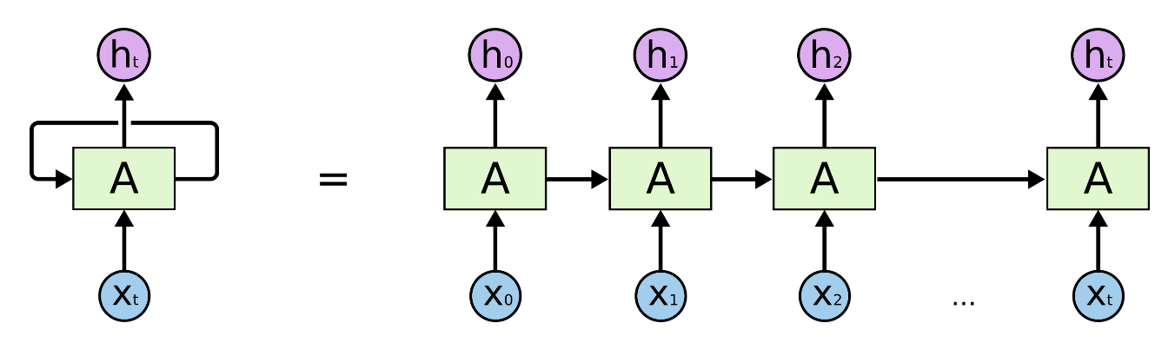
BackGround – Recurrent Neural Network
Robot Media Laboratory
<RNN Structure>
Notes:
RNN예 댸한 간딴 쏘꺠

Slide 5
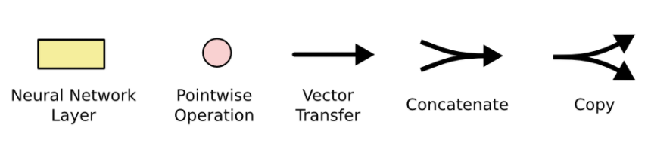
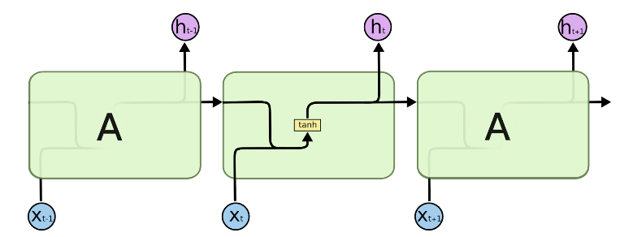
BackGround – Recurrent Neural Network
Robot Media Laboratory
<Inside of Basic RNN>
Notes:
RNN예 댸한 간딴 쏘꺠

Slide 6
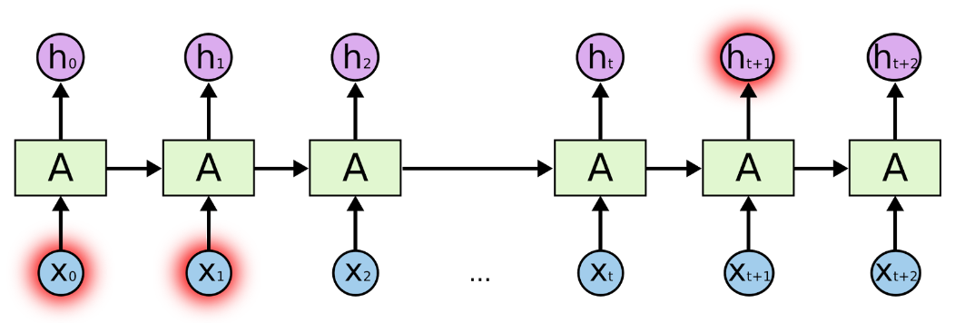
BackGround – Recurrent Neural Network
Robot Media Laboratory
<Short-Length RNN>
<The Problem of Long-Term Dependencies>
Notes:
RNN 에는

Slide 7
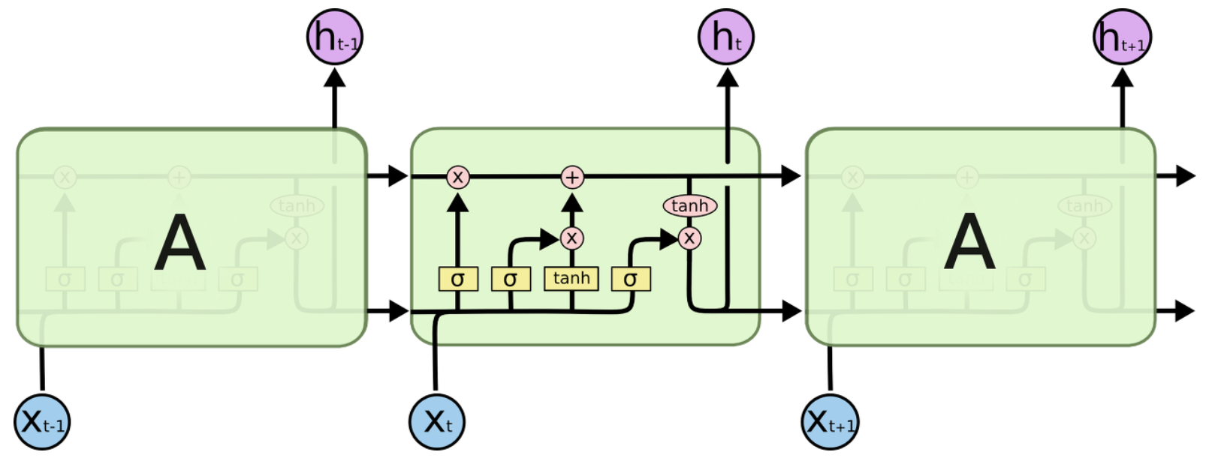
BackGround – Long Short Term Memory
Robot Media Laboratory
<Inside of Basic LSTM>
Notes:
RNN 에는

Slide 8
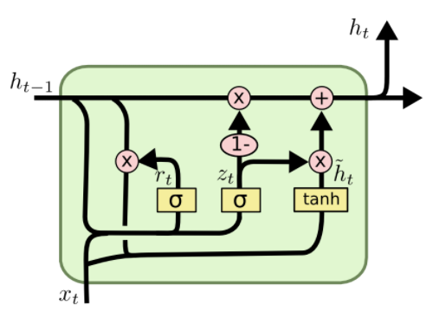
BackGround – Gated Recurrent Unit
Robot Media Laboratory
<Inside of Basic GRU>
Notes:
RNN 에는

Slide 9
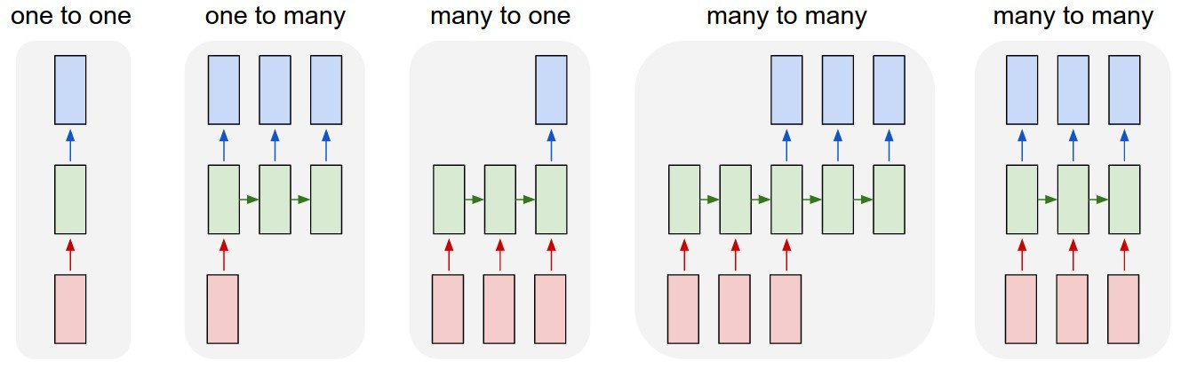
BackGround – Various Structures Using RNN
Robot Media Laboratory
Notes:
one to one : 가장 기본적인 RNN으로 Vanilla RNN 이라고도 함.
one to many : image captioning(이미지를 입력으로 주면 문장이 출력)처럼 출력이 연속적인 데이터.
many to one : sentimental analysis(영화 리뷰가 긍정적인지 부정적인지 출력)처럼 입력이 연속적인 데이터.
many to many(not synced) : 기계번역, 챗봇 등과 같이 입력과 출력이 모두 연속적인 데이터.
many to many(synced) : video classification(각 프레임을 입력으로 받아 설명을 동시에 출력)처럼 입력과 출력이 모두 연속적인 데이터.

Slide 10
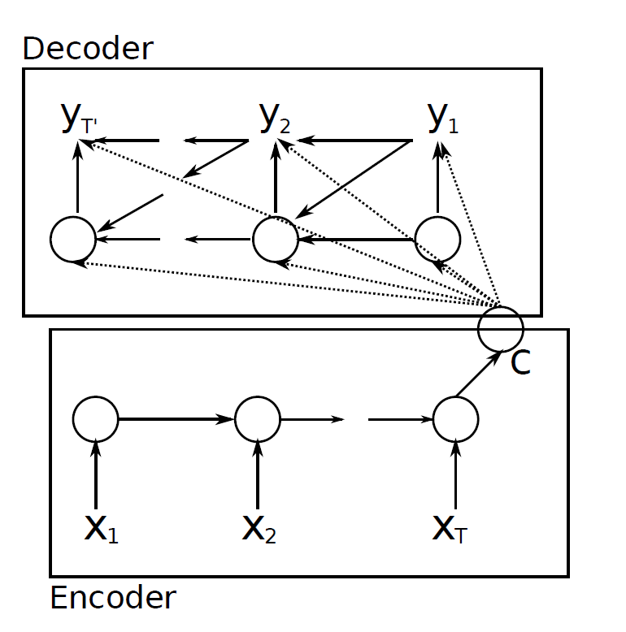


BackGround – RNN Encoder-Decoder Network
Robot Media Laboratory
$Y_{T^{′}}$ , $Y_{2}$ , $Y_{1}$
C : Context
Sequence Data
$X_{1}$ , $X_{2}$ , $X_{T}$
Usually Used for Language Translation

Slide 11
BackGround – Sequence to Sequence
Robot Media Laboratory
좋은
아침
C
O
N
T
E
X
T
LSTM/GRU
LSTM/GRU
LSTM/GRU
LSTM/GRU
Good
morning
<start>
좋은
encoder
decoder
<Seq2Seq Training Process>
Notes:
RNN을 활용한 여러가지것
One to one 기본구조
One to many 사진 - 단어
Many to one 분류
Many to Many 번역

Slide 12
BackGround – Sequence to Sequence
Robot Media Laboratory
좋은
아침
C
O
N
T
E
X
T
LSTM/GRU
LSTM/GRU
LSTM/GRU
LSTM/GRU
Good
morning
<start>
encoder
decoder
<Seq2Seq Test Process>

Slide 13
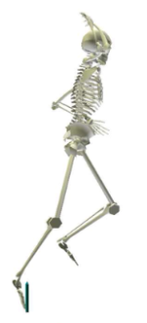
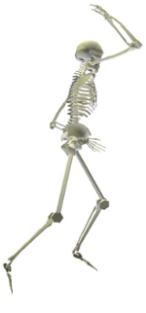
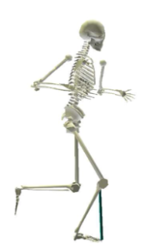
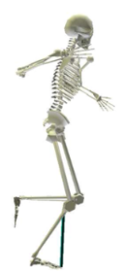
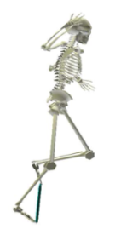
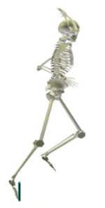
Let’s apply it to motion
Robot Media Laboratory
Training Process
LSTM/GRU = 1000
Linear = 72
30Frame
60Frame
C
O
N
T
E
X
T
Linear
Linear
Linear
Linear
LSTM/GRU
LSTM/GRU
LSTM/GRU
LSTM/GRU
+
+
+
+
Noise
Noise
Link : Dataset
Noise
Noise
Notes:
Dataset에 대한 설명 반드시 하기

Slide 14
Let’s apply it to motion
Robot Media Laboratory
Test Process
LSTM/GRU = 1000
Linear = 72
30Frame
60Frame
C
O
N
T
E
X
T
Linear
Linear
Linear
Linear
Linear
LSTM/GRU
LSTM/GRU
LSTM/GRU
LSTM/GRU
Notes:
RNN을 활용한 여러가지것
One to one 기본구조
One to many 사진 - 단어
Many to one 분류
Many to Many 번역

Slide 15
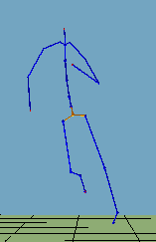
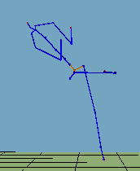
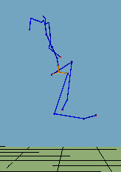
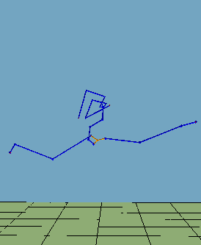
Let’s apply it to motion - Result
Robot Media Laboratory
100000 Epoch
Training Process
Joint angle Error :
Test Process
Joint angle Error :
30-Frame
40-Frame
60-Frame
90-Frame
Notes:
영상꼭넣기

Slide 16
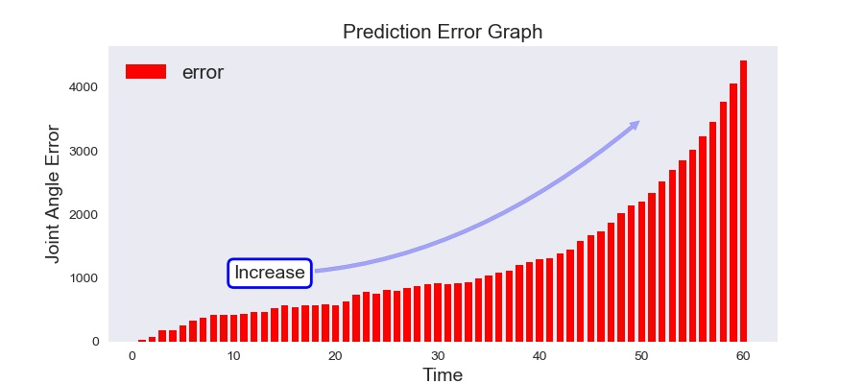
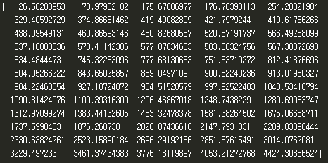
Problem Analysis
Robot Media Laboratory
Cause Analysis
It seems that the test method and the training method are different.
Error Analysis
Link : Suggestion
Notes:
RNN을 활용한 여러가지것
One to one 기본구조
One to many 사진 - 단어
Many to one 분류
Many to Many 번역

Slide 17
My Suggestion
Robot Media Laboratory
Training Process
LSTM/GRU = 1000
Linear = 72
30Frame
60Frame
C
O
N
T
E
X
T
Linear
Linear
Linear
Linear
LSTM/GRU
LSTM/GRU
LSTM/GRU
LSTM/GRU
+
+
+
Noise
Noise
Noise
Notes:
RNN을 활용한 여러가지것
One to one 기본구조
One to many 사진 - 단어
Many to one 분류
Many to Many 번역

Slide 18
My Suggestion
Robot Media Laboratory
Test Process
LSTM/GRU = 1000
Linear = 72
30Frame
60Frame
C
O
N
T
E
X
T
Linear
Linear
Linear
Linear
Linear
LSTM/GRU
LSTM/GRU
LSTM/GRU
LSTM/GRU
Notes:
RNN을 활용한 여러가지것
One to one 기본구조
One to many 사진 - 단어
Many to one 분류
Many to Many 번역

Slide 19
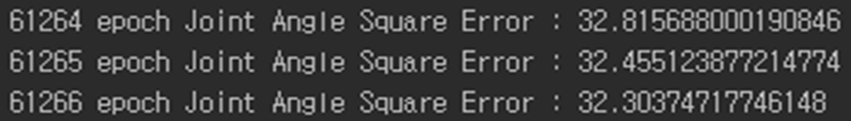
My Suggestion
Robot Media Laboratory
Training Process
Joint angle Error
It does not converge = Learning does not work.
cause analysis
It seems that it does not contain all the information.
solution
Let's change the structure of the network
Notes:
Training dataset에서 조차 수렴이 되지 않았다.

Slide 20

My Suggestion
Robot Media Laboratory
Training Process
LSTM/GRU = 1000
Linear1, 2,..,N = Not sharing
Linear = 72
Linear(N) = 72X2
30Frame
60Frame
C
O
N
T
E
X
T
Linear
Linear
Linear
Linear
LSTM/GRU
LSTM/GRU
Linear1
Linear2
LSTM/GRU
LSTM/GRU
Parameter
Sharing
+
+
+
Noise
Noise
Noise

Slide 21
My Suggestion
Robot Media Laboratory
Test Process
LSTM/GRU = 1000
Linear1,..,N = Not sharing
Linear = 72
Linear(N) = 72X2
30Frame
60Frame
C
O
N
T
E
X
T
Linear
Linear
Linear
Linear
LSTM/GRU
LSTM/GRU
Linear1
Linear2
LSTM/GRU
LSTM/GRU
Parameter
Sharing

Slide 22
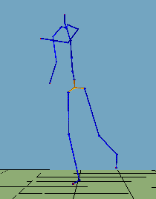
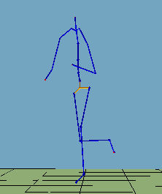
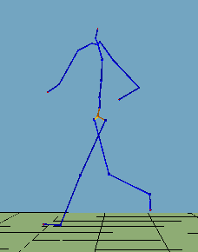
Result
Robot Media Laboratory
100000 Epoch
Training Process
Joint angle Error :
Test Process
Joint angle Error :
30-Frame
40-Frame
60-Frame
90-Frame

Slide 23
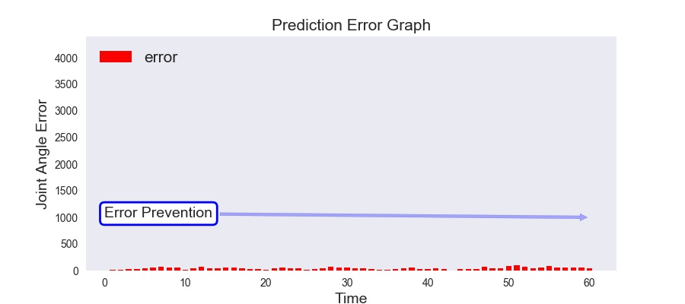
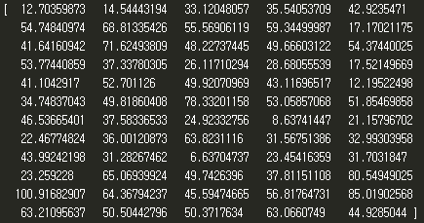
Analysis
Robot Media Laboratory
Error Analysis
Link : Compare
Linear
Linear2
LSTM/GRU
Linear1
: Role to prevent error accumulation

Slide 24
Learning Environment
Robot Media Laboratory
Dataset
Training Data : The training motion data (816) for 8 men and 4 women,
68 motion data per person.
Test Data : The Test motion data (204) for 2 men and 1 women,
68 motion data per person.
Learning Hyperparamter
Using GTX1070 : about 20 hours
Adam optimizer : Learning rate = 0.0001
Batch size = 68
Initialization : Normal Distribution(mean=0 , standard Deviation=0.01)
LSTM Layer = 1
LSTM Cell = 1000
Encoder : 30 Time Step , Decoder : 60 Time Step

Slide 25
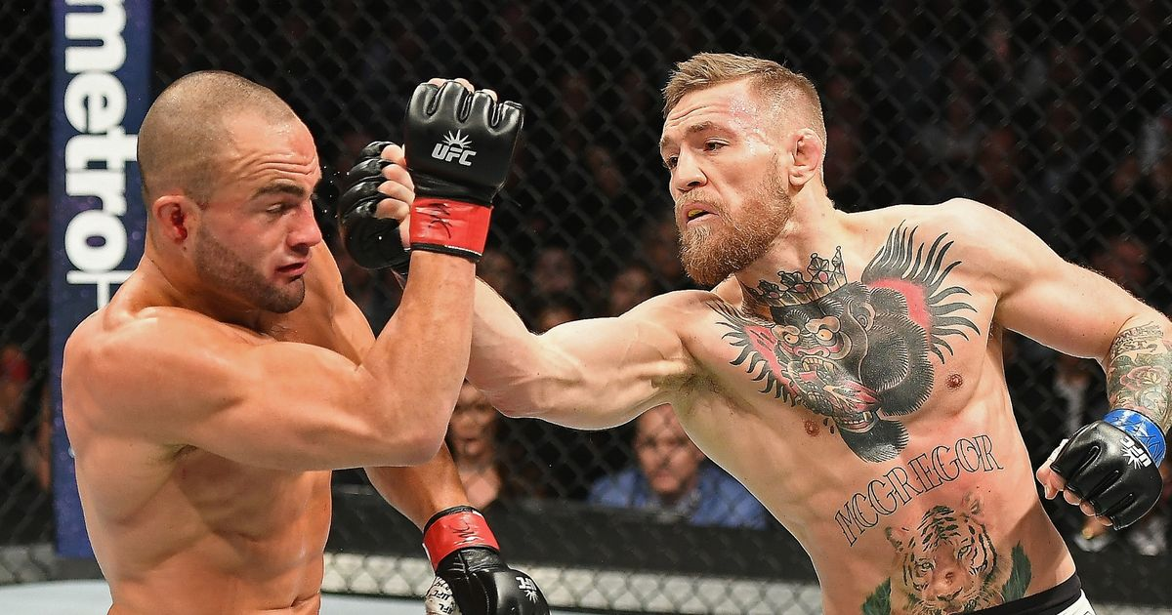
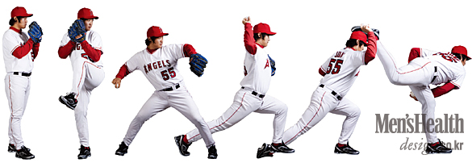
Additional Usage
Robot Media Laboratory
Notes:
물체변형 성능 향상을 위한 u-net and reu 기반의 c 생성신경망 구조 개선
인강행동예측을 위한 Recurrent Neural Network 기반의 변형된 Sequence to Sequence구조제안

Slide 26
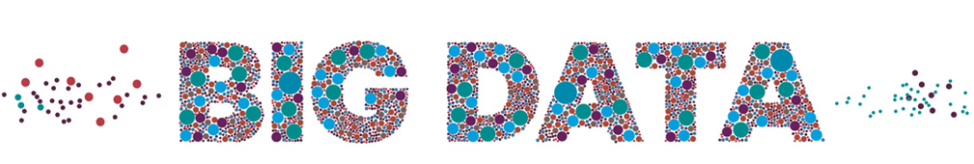
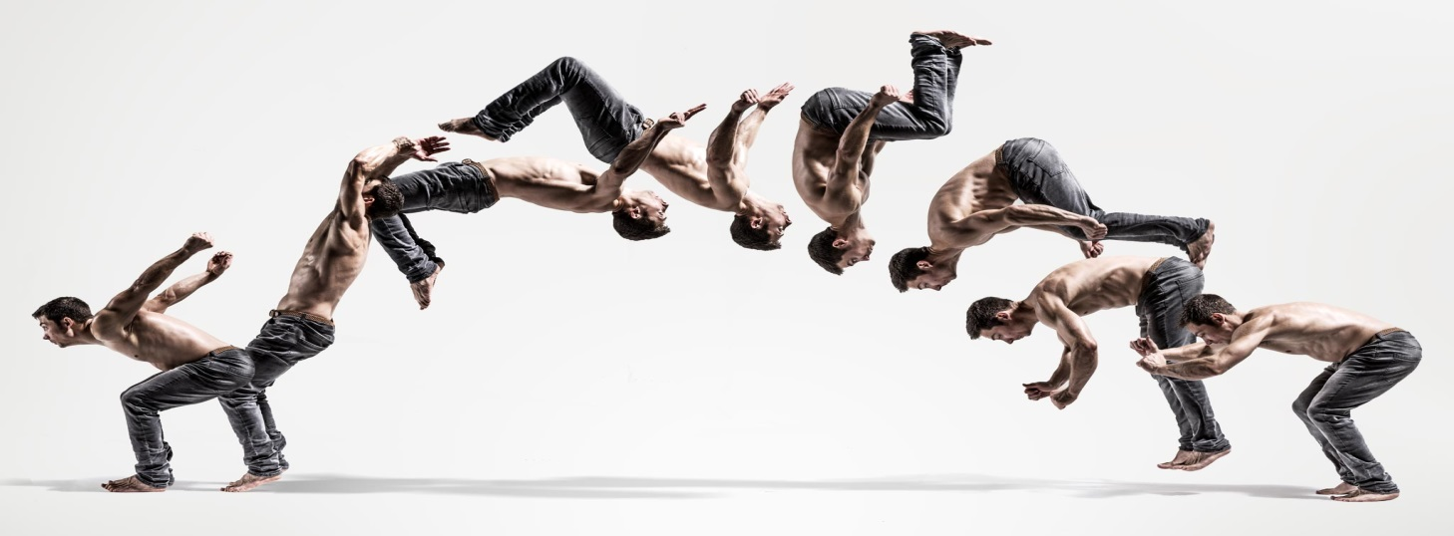
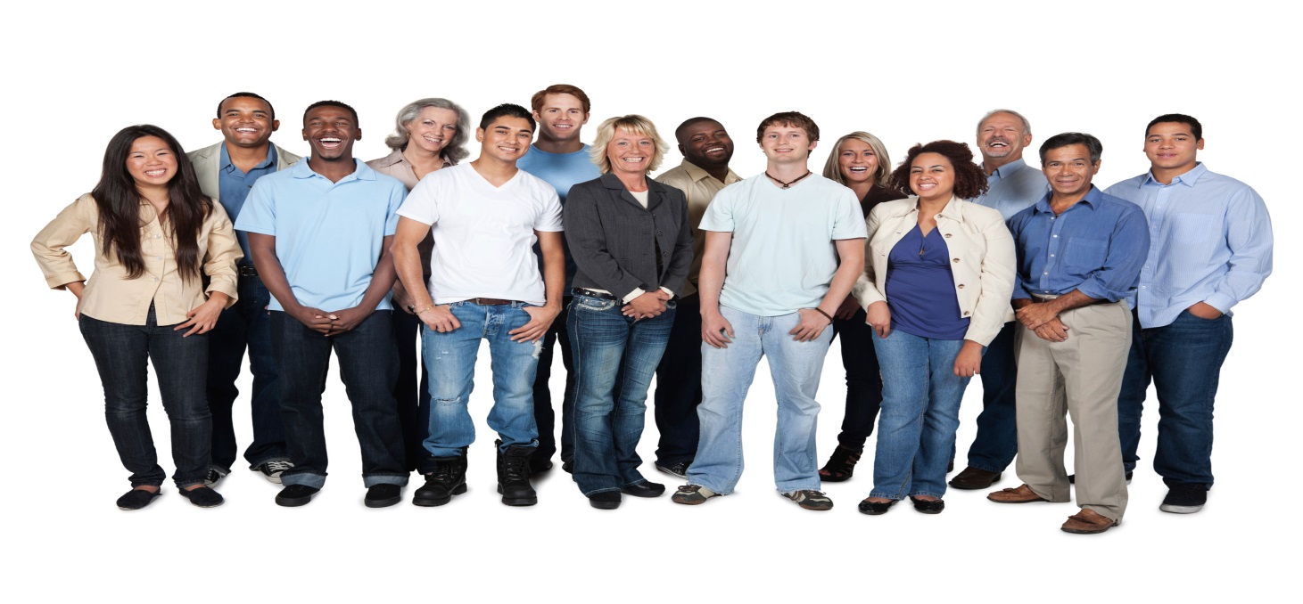
Future Research
Robot Media Laboratory
Notes:
더 다양한 동작 , 더 많은 사람의 데이터를 만들기

Slide 27
Q / A

Slide 28
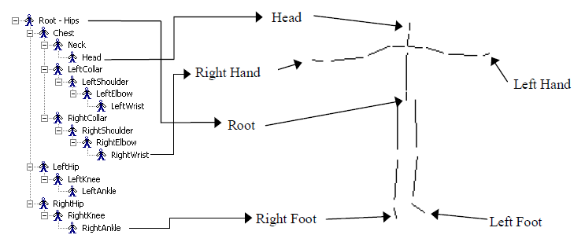
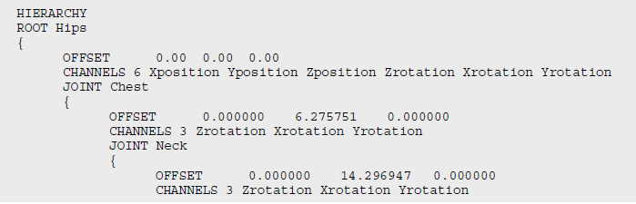
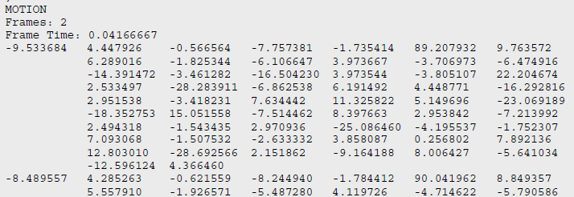
Appendix1-1
Robot Media Laboratory
Skeletal motion files created by attaching the C3D data to a BVH format skeleton in MotionBuilder. The BVH file defines both the skeleton and the motion data all in one file.
Link : Back

Slide 29
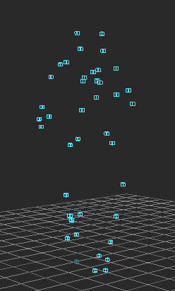
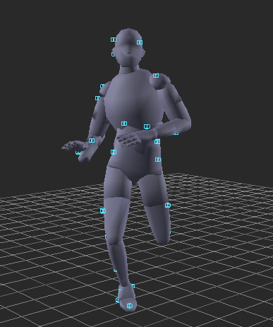
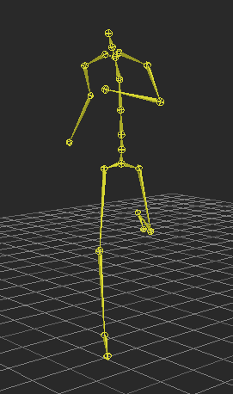
Appendix1-2
Robot Media Laboratory
Reconstructed 3D data from the Vicon Workstation or iQ. Can be used in MotionBuilder, Maya or any 3D program to drive skeletal or other data.
Link : Back

Slide 30
감사합니다.

