Slide 1


progress

Slide 2
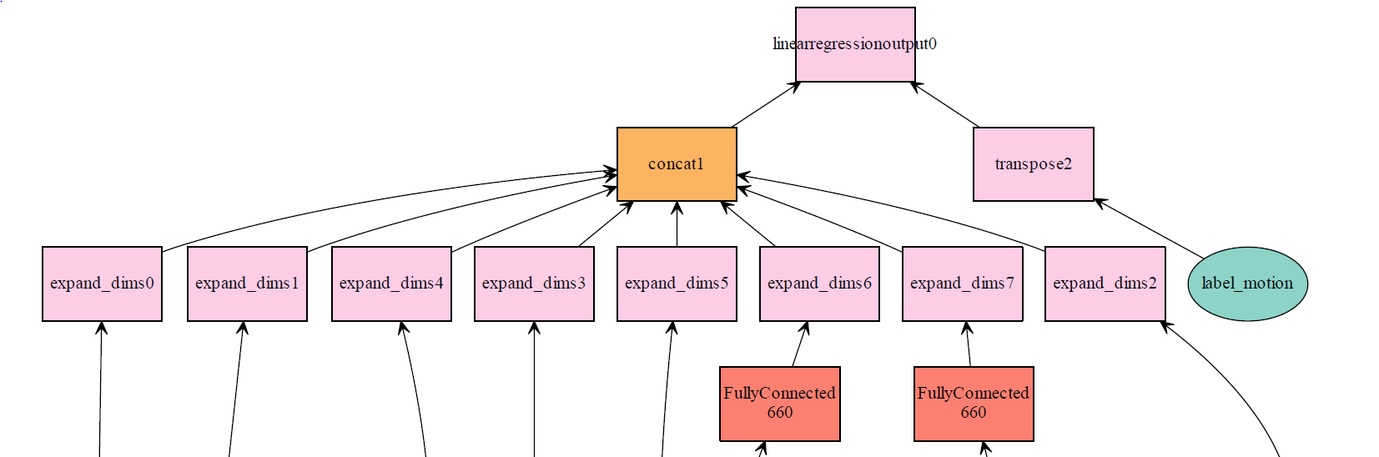
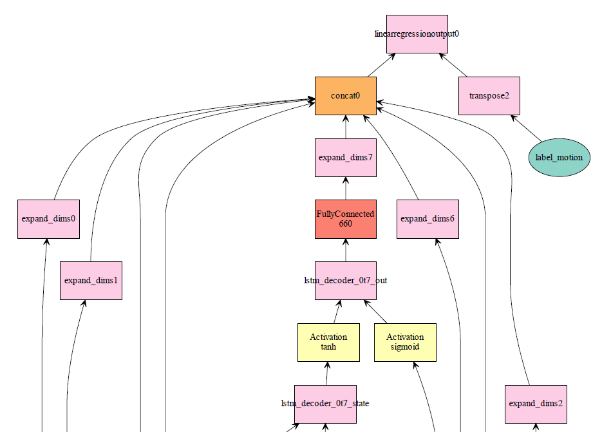
Structure
Robot Media Laboratory
Training
TEST

Slide 3


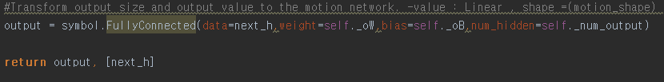
Structure
Robot Media Laboratory
Structure
Label
Label
Label
Label
Label
Label
Label
Encoder(seed time step)
Decoder(prediction time step)
context
T=1
T=2
T=3
T=4
T=5
T=6
T=M
〮〮〮
〮〮〮
T=1
T=2
T=3
T=4
T=N
전 프레임의 정보
〮〮〮
Decoder input
Value : Y=X , Ouput Size : ( joint angle( x , y , z ) )
Modifier LSTM
Test Seq2Seq
Modifier GRU

Slide 4
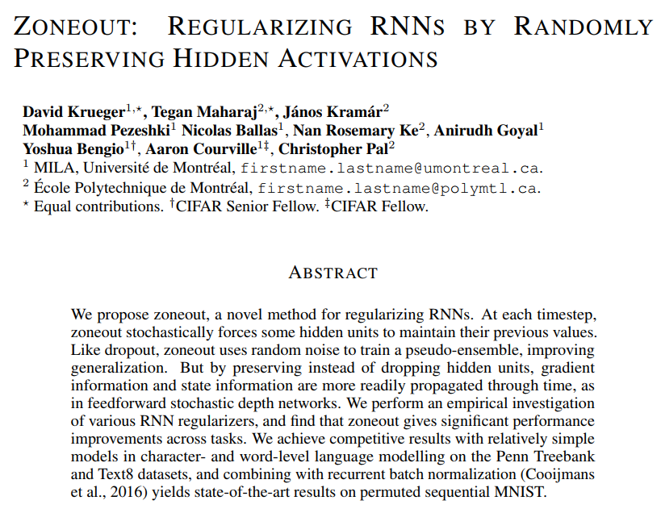
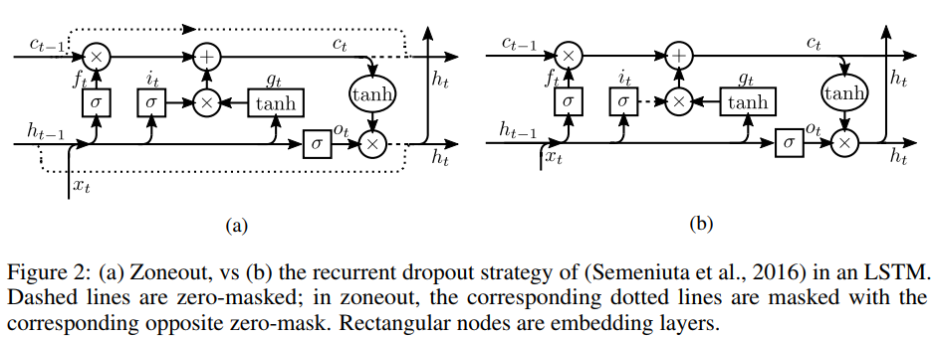
Structure
Robot Media Laboratory
Structure+
Label
Label
Label
Label
Label
Label
Label
Encoder(seed time step)
Decoder(prediction time step)
context
T=1
T=2
T=3
T=4
T=5
T=6
T=M
〮〮〮
〮〮〮
T=1
T=2
T=3
T=4
T=N
전 프레임의 정보
〮〮〮
Decoder input

Slide 5
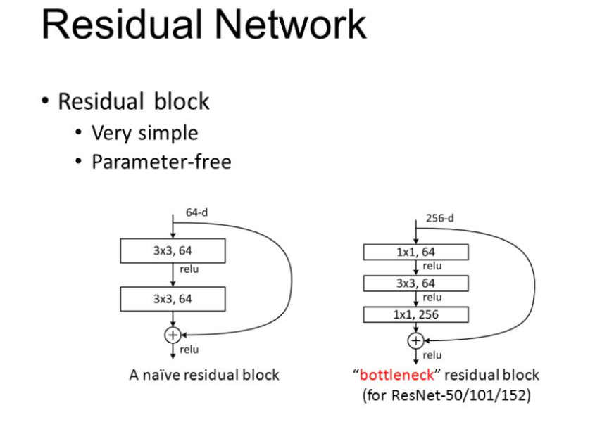
Structure
Robot Media Laboratory
Structure+
Label
Label
Label
Label
Label
Label
Label
Encoder(seed time step)
Decoder(prediction time step)
context
T=1
T=2
T=3
T=4
T=5
T=6
T=M
〮〮〮
〮〮〮
T=1
T=2
T=3
T=4
T=N
전 프레임의 정보
〮〮〮
Decoder input

Slide 6

Structure
Robot Media Laboratory
http://lo-th.github.io/olympe/BVH_player.html
Structure
Label
Label
Label
Label
Label
Label
Label
Encoder(seed time step)
Decoder(prediction time step)
context
T=1
T=2
T=3
T=4
T=5
T=6
T=M
〮〮〮
〮〮〮
T=1
T=2
T=3
T=4
T=N
전 프레임의 정보
〮〮〮
Decoder input

Slide 7
감사합니다.

