Slide 1


progress

Slide 2
Structure
Robot Media Laboratory
약 : 0.6초
LSTM CELL = 1000
약 : 2 초
20 Frame
60 Frame
Not Shared parameter
Each sequence Length : 66
2 Linear Layer FNN
sequence
sequence
sequence
sequence
sequence
sequence
sequence
66~132 unit
66 unit
Decoder(prediction time step)
Shared parameter
T=1
T=2
T=3
T=4
T=5
T=6
T=M
Encoder(seed time step)
context
FNN
(LINEAR)
FNN
(LINEAR)
FNN
(LINEAR)
FNN
(LINEAR)
FNN
(LINEAR)
FNN
(LINEAR)
FNN
(LINEAR)
FNN
(LINEAR)
FNN
(LINEAR)
FNN
(LINEAR)
FNN
(LINEAR)
FNN
(LINEAR)
〮〮〮
〮〮〮
T=1
T=2
T=3
T=4
T=N
첫 프레임의 정보
〮〮〮
최적화
Shared parameter
1. LINEAR LAYER 2계층 – (반드시, 66개 ~ 132개) – No Activation
2. Initialization : normal distribution(평균 = 0 and 표준편차 = 0.01
3. Adam optimizer , Learning rate = 0.0001
약 60분

Slide 3
Structure
Robot Media Laboratory
약 : 0.6초
LSTM CELL = 1000
약 : 2 초
20 Frame
60 Frame
Not Shared parameter
Each sequence Length : 66
2 Linear Layer FNN
sequence
sequence
sequence
sequence
sequence
sequence
sequence
66~132 unit
66 unit
Decoder(prediction time step)
Shared parameter
T=1
T=2
T=3
T=4
T=5
T=6
T=M
Encoder(seed time step)
context
FNN
(LINEAR)
FNN
(LINEAR)
FNN
(LINEAR)
FNN
(LINEAR)
FNN
(LINEAR)
FNN
(LINEAR)
FNN
(LINEAR)
FNN
(LINEAR)
FNN
(LINEAR)
FNN
(LINEAR)
FNN
(LINEAR)
FNN
(LINEAR)
〮〮〮
〮〮〮
T=1
T=2
T=3
T=4
T=N
첫 프레임의 정보
〮〮〮
Residual Connection
(Only one layer)
Shared parameter
TIED
Noise
Gaussian Distribution= -3~3

Slide 4
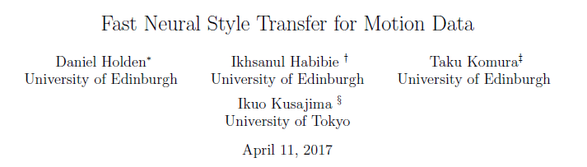
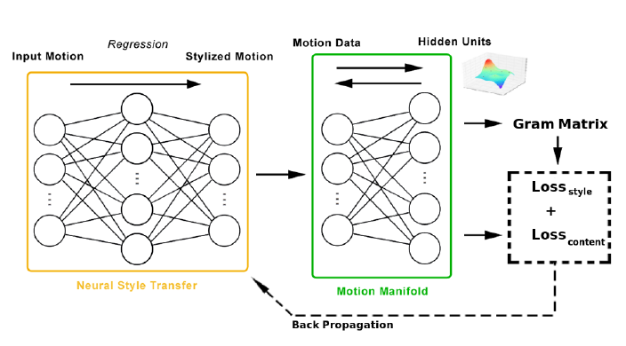
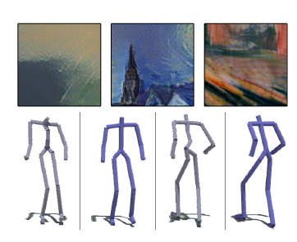
Structure
Robot Media Laboratory

Slide 5
감사합니다.

