Slide 1

Human Motion Analysis Using varidfa
2017.10.12
지도교수 : 박광현 교수님
발표자 : 김종곤

Slide 2
CONTENT
Robot Media Laboratory
1. Problem Suggestion
Prediction of Human motion
2. BackGround and Experiment
Recurrent Neural Networks(RNN)
RNN Encoder-Decoder Network
Sequence to Sequence(Seq2Seq) Network
Let’s apply it to motion
Problem Analysis
3. My suggestion and Result , Analysis
4. Learning Environment
5. Additional Usage
6. Future Research
7. Question and Answer
8. Appendix

Slide 3
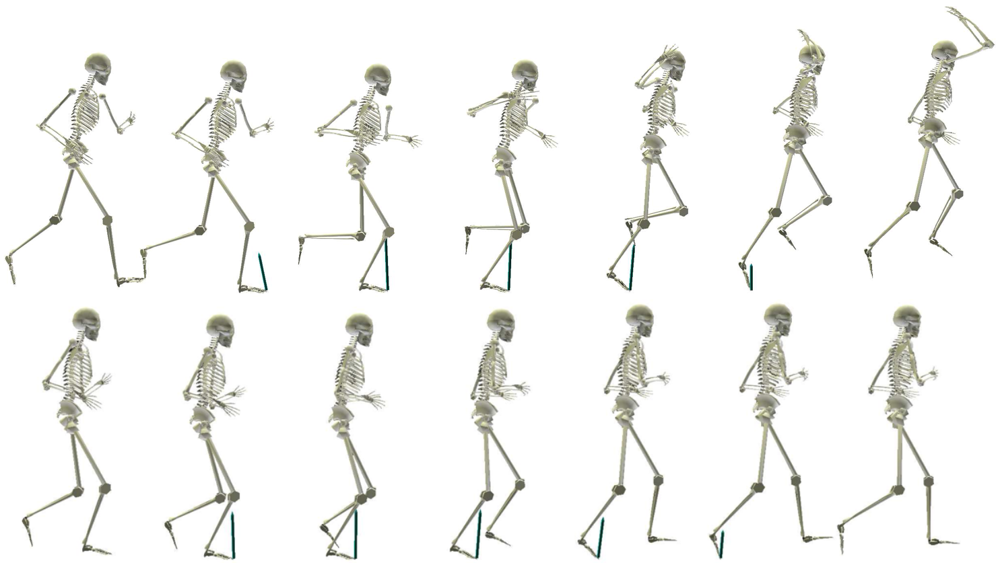
Problem Suggestion – Human Motion Analysis
Robot Media Laboratory
Generation of Human motion
Is it possible to generate the next motion with the previous motion information?

Slide 4
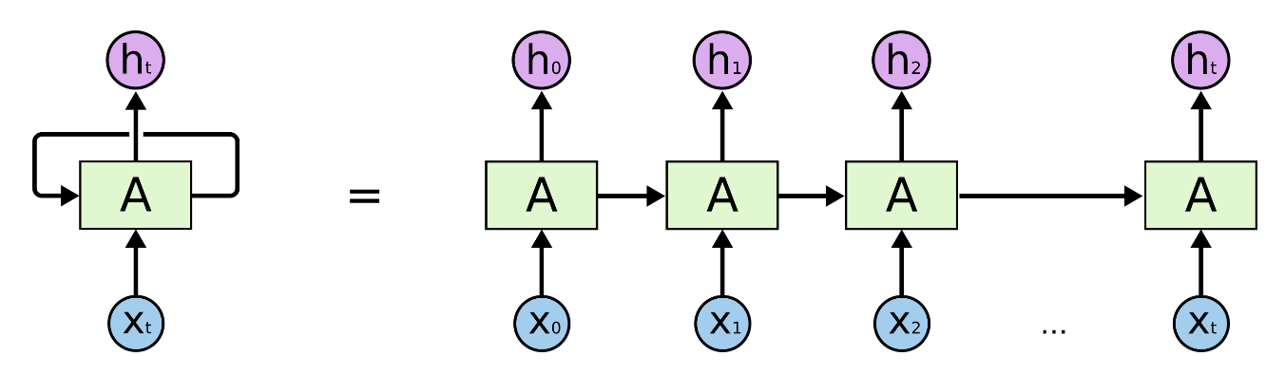
BackGround – Recurrent Neural Network
Robot Media Laboratory
<RNN Structure>
Notes:
RNN예 댸한 간딴 쏘꺠

Slide 5
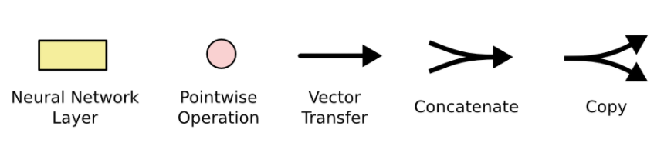
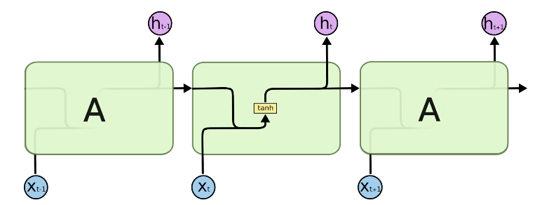
BackGround – Recurrent Neural Network
Robot Media Laboratory
<Inside of Basic RNN>
Notes:
RNN예 댸한 간딴 쏘꺠

Slide 6
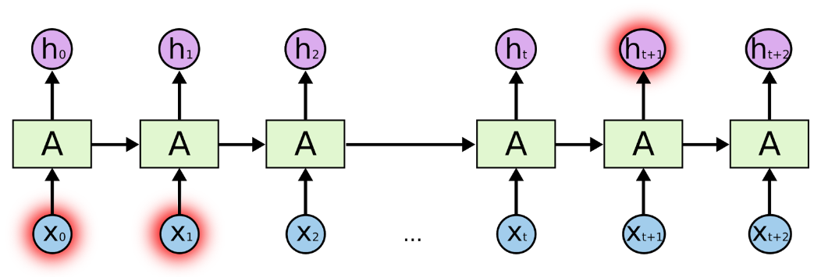
BackGround – Recurrent Neural Network
Robot Media Laboratory
<Short-Length RNN>
<The Problem of Long-Term Dependencies>
Notes:
RNN 에는

Slide 7
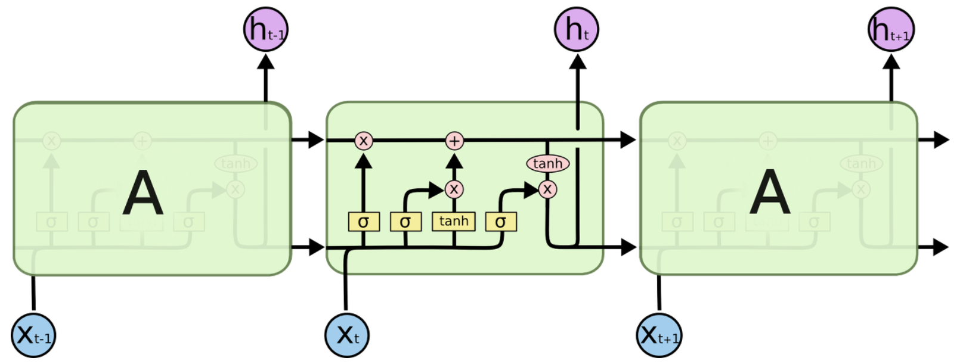
BackGround – Long Short Term Memory
Robot Media Laboratory
<Inside of Basic LSTM>
Notes:
RNN 에는

Slide 8
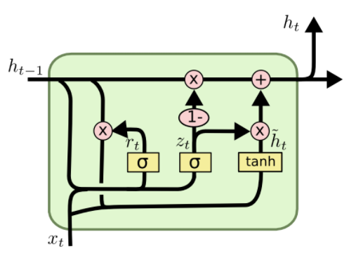
BackGround – Gated Recurrent Unit
Robot Media Laboratory
<Inside of Basic GRU>
Notes:
RNN 에는

Slide 9
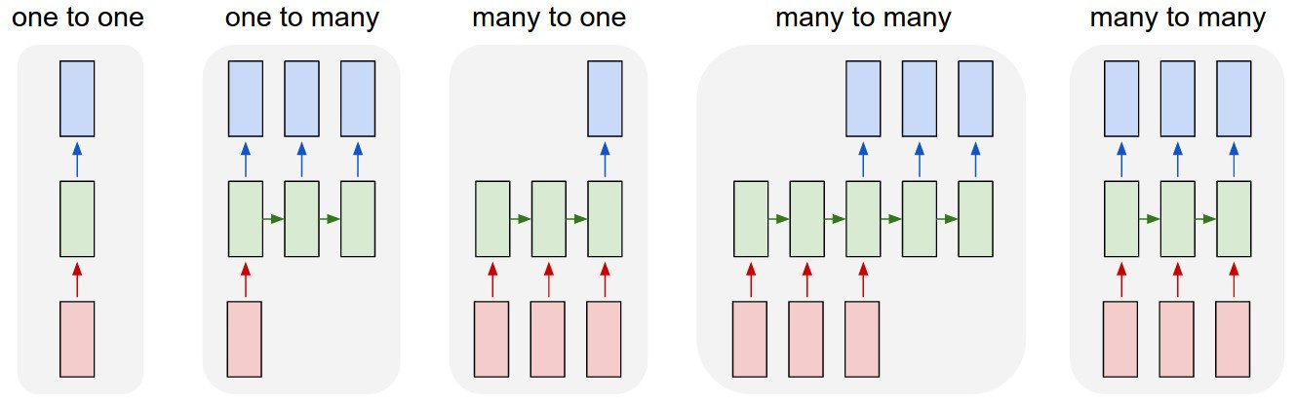
BackGround – Various Structures Using RNN
Robot Media Laboratory
Notes:
one to one : 가장 기본적인 RNN으로 Vanilla RNN 이라고도 함.
one to many : image captioning(이미지를 입력으로 주면 문장이 출력)처럼 출력이 연속적인 데이터.
many to one : sentimental analysis(영화 리뷰가 긍정적인지 부정적인지 출력)처럼 입력이 연속적인 데이터.
many to many(not synced) : 기계번역, 챗봇 등과 같이 입력과 출력이 모두 연속적인 데이터.
many to many(synced) : video classification(각 프레임을 입력으로 받아 설명을 동시에 출력)처럼 입력과 출력이 모두 연속적인 데이터.

Slide 10
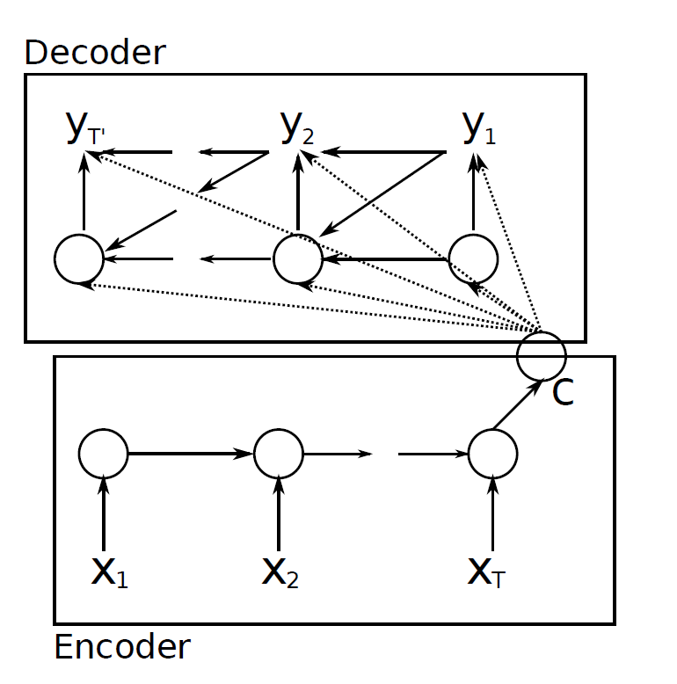


BackGround – RNN Encoder-Decoder Network
Robot Media Laboratory
$Y_{T^{′}}$ , $Y_{2}$ , $Y_{1}$
C : Context
Sequence Data
$X_{1}$ , $X_{2}$ , $X_{T}$
Usually Used for Language Translation

Slide 11
BackGround – Sequence to Sequence
Robot Media Laboratory
좋은
아침
C
O
N
T
E
X
T
LSTM/GRU
LSTM/GRU
LSTM/GRU
LSTM/GRU
Good
morning
<start>
좋은
encoder
decoder
<Seq2Seq Training Process>
Notes:
RNN을 활용한 여러가지것
One to one 기본구조
One to many 사진 - 단어
Many to one 분류
Many to Many 번역

Slide 12
BackGround – Sequence to Sequence
Robot Media Laboratory
좋은
아침
C
O
N
T
E
X
T
LSTM/GRU
LSTM/GRU
LSTM/GRU
LSTM/GRU
Good
morning
<start>
encoder
decoder
<Seq2Seq Test Process>

Slide 13
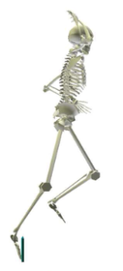
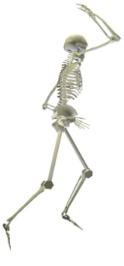
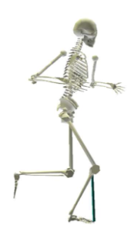
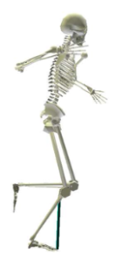
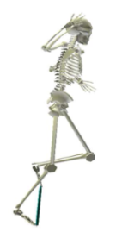
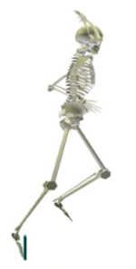
Let’s apply it to motion
Robot Media Laboratory
Training Process
LSTM/GRU = 1000
Linear = 72
30Frame
60Frame
C
O
N
T
E
X
T
Linear
Linear
Linear
Linear
LSTM/GRU
LSTM/GRU
LSTM/GRU
LSTM/GRU
+
+
+
+
Noise
Noise
Link : Dataset
Noise
Noise
Notes:
Dataset에 대한 설명 반드시 하기

Slide 14
Let’s apply it to motion
Robot Media Laboratory
Test Process
LSTM/GRU = 1000
Linear = 72
30Frame
60Frame
C
O
N
T
E
X
T
Linear
Linear
Linear
Linear
Linear
LSTM/GRU
LSTM/GRU
LSTM/GRU
LSTM/GRU
Notes:
RNN을 활용한 여러가지것
One to one 기본구조
One to many 사진 - 단어
Many to one 분류
Many to Many 번역

Slide 15
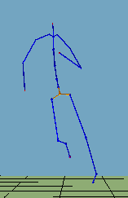
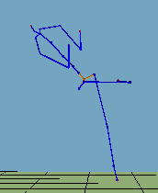
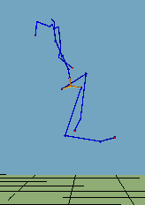
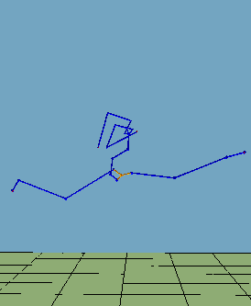
Let’s apply it to motion - Result
Robot Media Laboratory
100000 Epoch
Training Process
Joint angle Error :
Test Process
Joint angle Error :
30-Frame
40-Frame
60-Frame
90-Frame
Notes:
영상꼭넣기

Slide 16
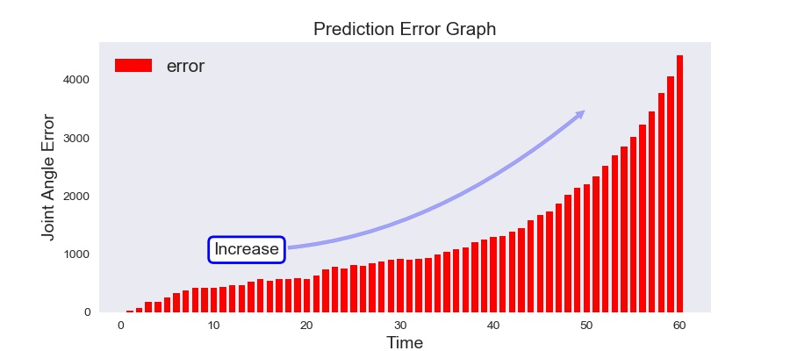
Problem Analysis
Robot Media Laboratory
Cause Analysis
It seems that the test method and the training method are different.
Error Analysis
Notes:
RNN을 활용한 여러가지것
One to one 기본구조
One to many 사진 - 단어
Many to one 분류
Many to Many 번역

Slide 17
My Suggestion
Robot Media Laboratory
Training Process
LSTM/GRU = 1000
Linear = 72
30Frame
60Frame
C
O
N
T
E
X
T
Linear
Linear
Linear
Linear
LSTM/GRU
LSTM/GRU
LSTM/GRU
LSTM/GRU
+
+
+
Noise
Noise
Noise
Notes:
RNN을 활용한 여러가지것
One to one 기본구조
One to many 사진 - 단어
Many to one 분류
Many to Many 번역

Slide 18
My Suggestion
Robot Media Laboratory
Test Process
LSTM/GRU = 1000
Linear = 72
30Frame
60Frame
C
O
N
T
E
X
T
Linear
Linear
Linear
Linear
Linear
LSTM/GRU
LSTM/GRU
LSTM/GRU
LSTM/GRU
Notes:
RNN을 활용한 여러가지것
One to one 기본구조
One to many 사진 - 단어
Many to one 분류
Many to Many 번역

Slide 19
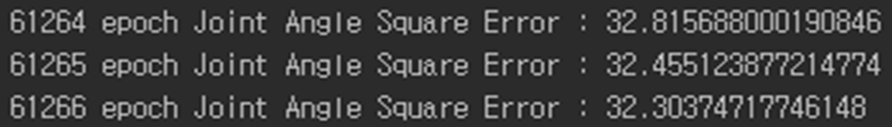
My Suggestion
Robot Media Laboratory
Training Process
Joint angle Error
It does not converge = Learning does not work.
cause analysis
It seems that it does not contain all the information.
solution
Let's change the structure of the network
Notes:
Training dataset에서 조차 수렴이 되지 않았다.

Slide 20

My Suggestion
Robot Media Laboratory
Training Process
LSTM/GRU = 1000
Linear1, 2,..,N = Not sharing
Linear = 72
Linear(N) = 72X2
30Frame
60Frame
C
O
N
T
E
X
T
Linear
Linear
Linear
Linear
LSTM/GRU
LSTM/GRU
Linear1
Linear2
LSTM/GRU
LSTM/GRU
Parameter
Sharing
+
+
+
Noise
Noise
Noise

Slide 21
My Suggestion
Robot Media Laboratory
Test Process
LSTM/GRU = 1000
Linear1, 2,..,N = Not sharing
Linear = 72
Linear(N) = 72X2
30Frame
60Frame
C
O
N
T
E
X
T
Linear
Linear
Linear
Linear
LSTM/GRU
LSTM/GRU
Linear1
Linear2
LSTM/GRU
LSTM/GRU
Parameter
Sharing

Slide 22
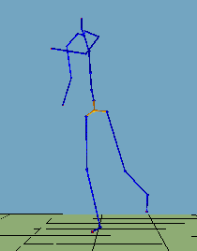
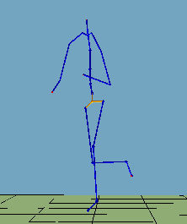
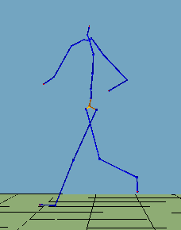
Result
Robot Media Laboratory
100000 Epoch
Training Process
Joint angle Error :
Test Process
Joint angle Error :
30-Frame
40-Frame
60-Frame
90-Frame

Slide 23
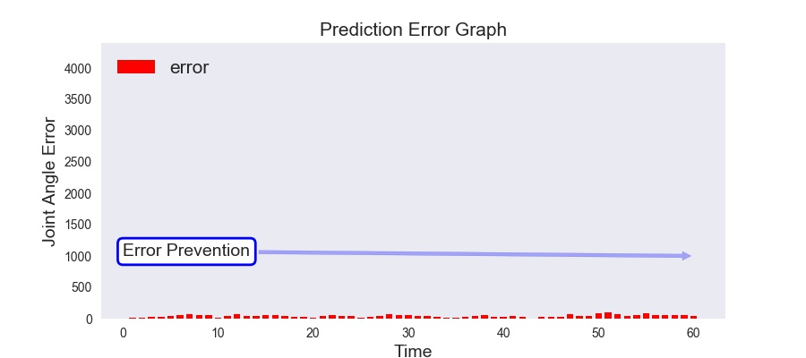
Analysis
Robot Media Laboratory
Error Analysis
Linear
Linear2
LSTM/GRU
Linear1
: Role to prevent error accumulation

Slide 24
Analysis
Robot Media Laboratory
How to predict longer time?

Slide 25
Learning Environment
Robot Media Laboratory
Dataset
Training Data
Test Data
Learning Hyperparamter
Using GTX1070 : about 20 hours
Adam optimizer : Learning rate = 0.0001
Batch size = 68
Initialization : Normal Distribution(mean=0 , standard Deviation=0.01)
LSTM Layer = 1
LSTM Cell = 1000
Encoder : 30 Time Step , Decoder : 60 Time Step

Slide 26
Additional Usage
Robot Media Laboratory

Slide 27
Future Research
Robot Media Laboratory

Slide 28
Q / A

Slide 29
Appendix1-1
Robot Media Laboratory
Link : Dataset

Slide 30
Appendix1-2
Robot Media Laboratory
Link : Dataset

Slide 31
감사합니다.

