Slide 1


progress

Slide 2


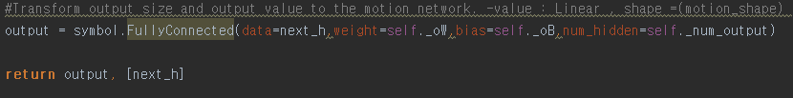
Structure
Robot Media Laboratory
Structure
Label
Label
Label
Label
Label
Label
Label
Encoder(seed time step)
Decoder(prediction time step)
context
T=1
T=2
T=3
T=4
T=5
T=6
T=M
〮〮〮
〮〮〮
T=1
T=2
T=3
T=4
T=N
전 프레임의 정보
〮〮〮
Decoder input
Value : Y=X , Ouput Size : ( joint angle( x , y , z ) )
Modifier LSTM
Test Seq2Seq
Modifier GRU

Slide 3
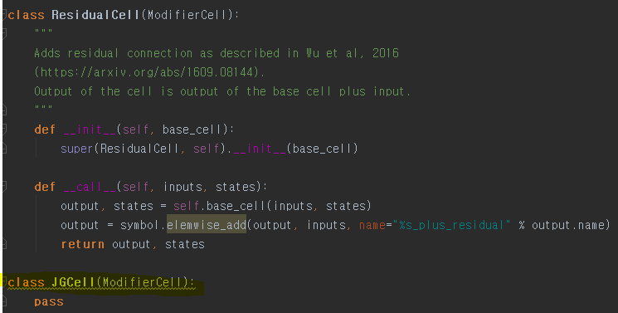
Structure
Robot Media Laboratory
Structure+

Slide 4
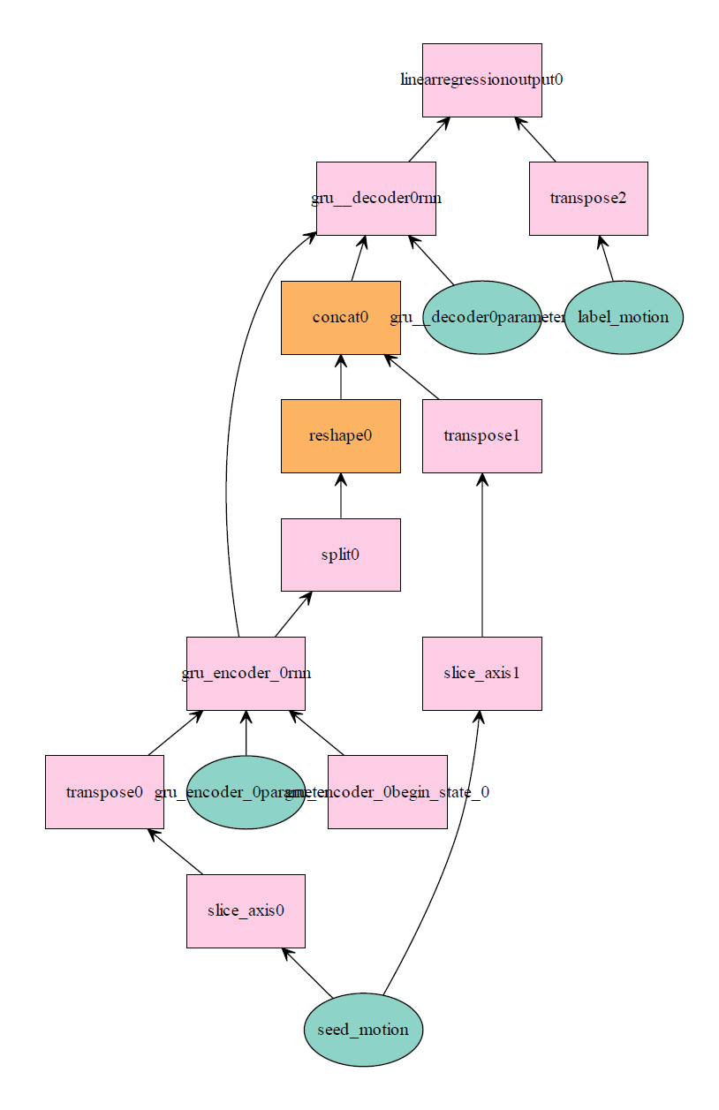
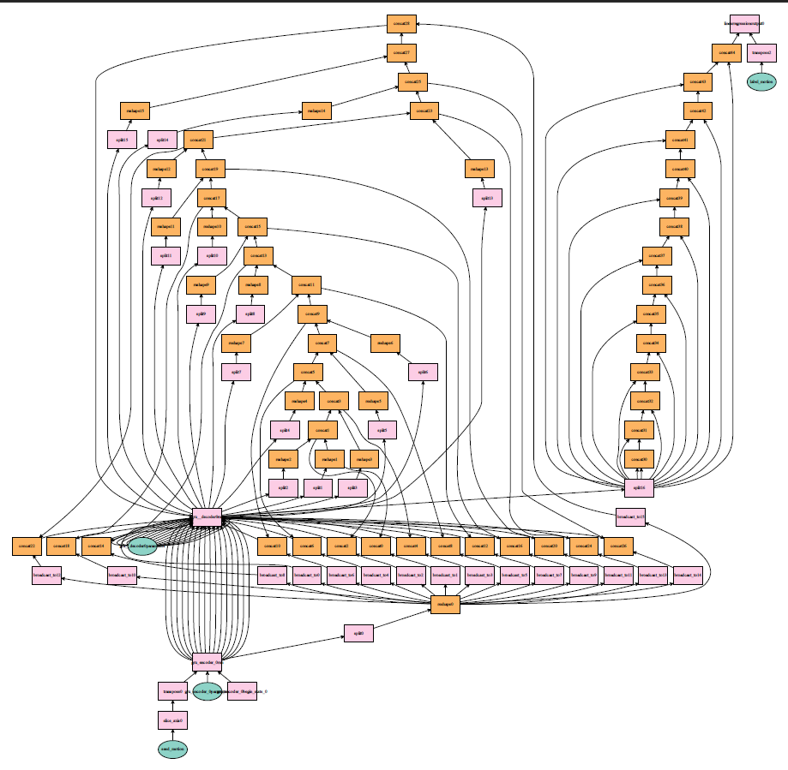
Structure
Robot Media Laboratory
Training
TEST

Slide 5
감사합니다.

