Slide 1
Random Forests
2020-03-13
이지원

Slide 2


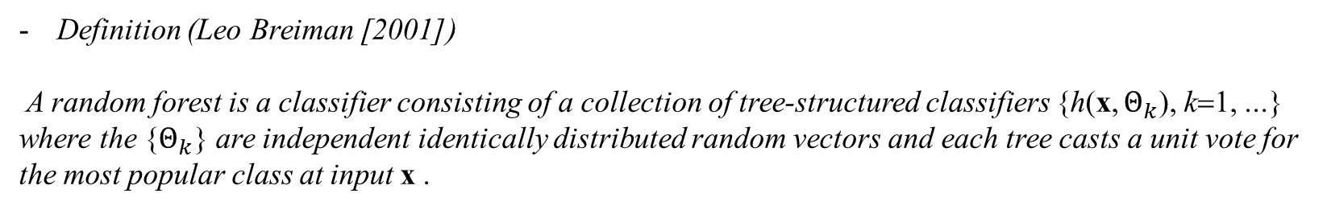
랜덤 포레스트
Definition (Leo Breiman [2001])
A random forest is a classifier consisting of a collection of tree-structured classifiers {h(x, $Θ_{k}$), k=1, ...} where the {$Θ_{k}$} are independent identically distributed random vectors and each tree casts a unit vote for the most popular class at input x .
수많은 트리 기반 분류기들의 집합 $\{h\left(x, Θ_{k}\right), k=1, …\}$으로 구성된 분류기.
$Θ_{k}$들은 i.i.d 랜덤 벡터들이며, 각 트리는 인풋 $x$에 다수결 투표를 던진다.
회귀에도 적용 가능함.

Slide 3
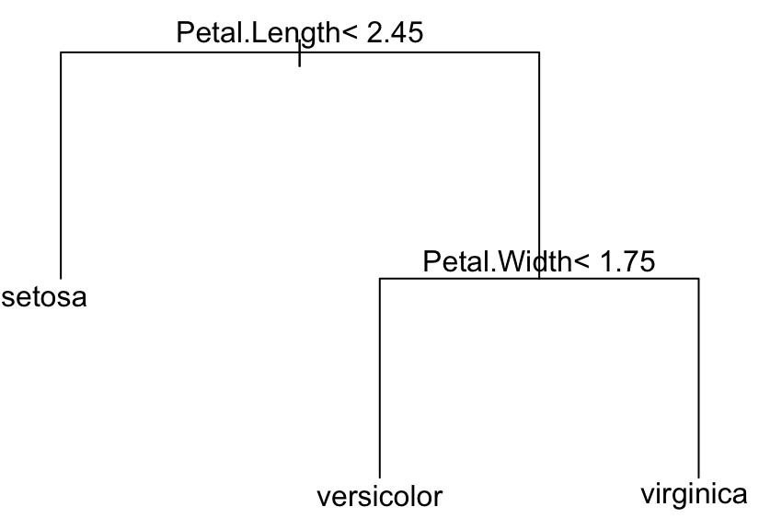
의사결정나무 (decision tree)
Petal.Length < 2.45
Petal.Width < 1.75
setosa
versicolor
virginica

Slide 4
배깅 (bagging: bootstrap aggregating)
Bootstrap Sample
Modeling
Random Sampling
Ensemble
Bootstrap Sample
Modeling
Population
Sample
Bootstrap Sample
Modeling
Final Model
ㆍ
ㆍ
ㆍ
ㆍ
ㆍ
ㆍ
Bootstrap Sample
Modeling

Slide 5
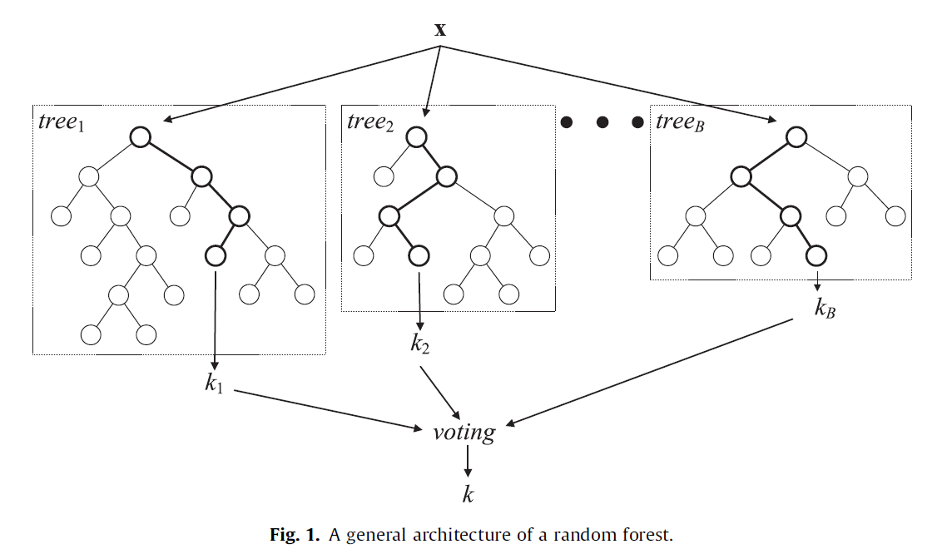
랜덤 포레스트

Slide 6
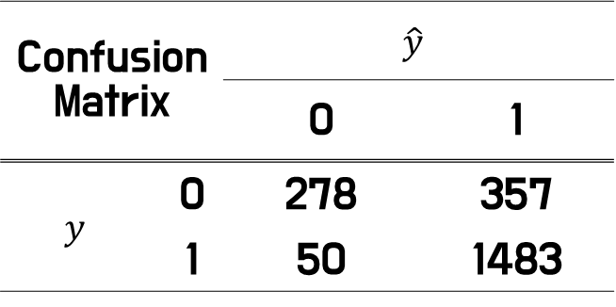
Confusion Matrix |  | $$\hat{y}$$
 |  | 0 | 1
$$y$$ | 0 | 278 | 357
 | 1 | 50 | 1483
정분류율(Accuracy) = 81.23%
민감도(Sensitivity) = 96.74%
특이도(Specificity) = 43.78%

Slide 7
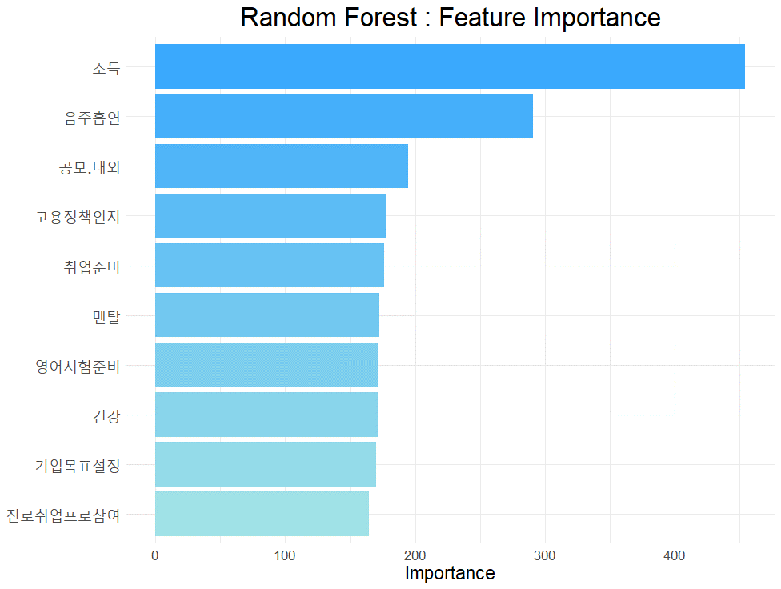
“Black Box”

