Slide 1
A Few Closing Thoughts Draw pictures Build Models Embrace Uncertainty

Slide 2
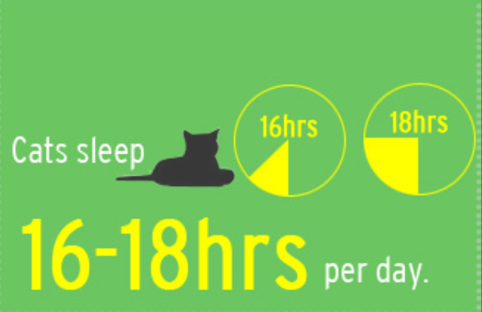
Well, draw good pictures…

Slide 3
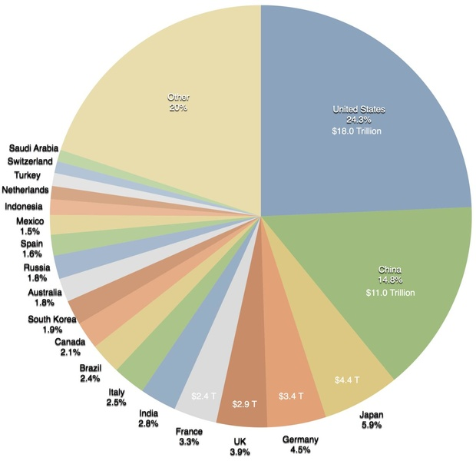

Slide 4
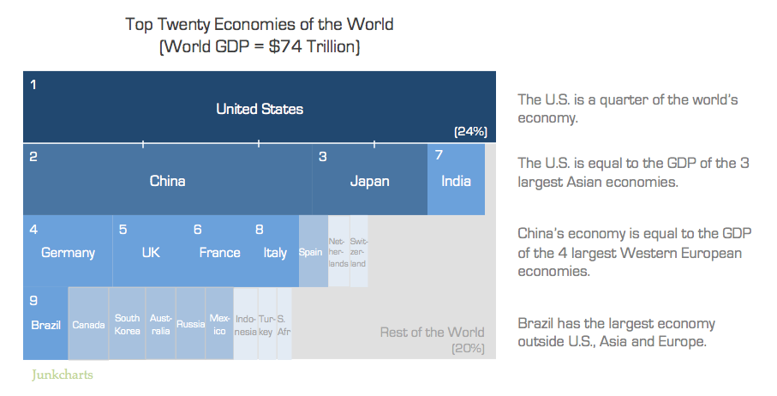

Slide 5
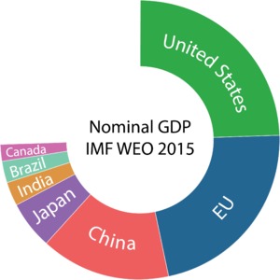

Slide 6
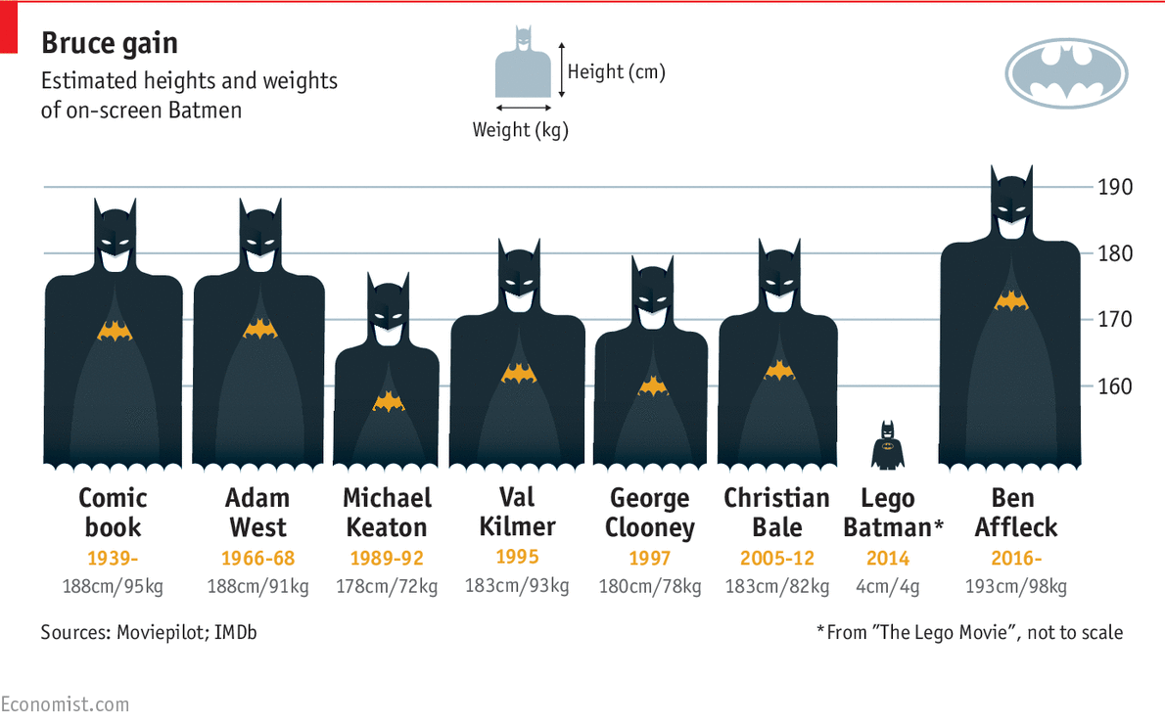
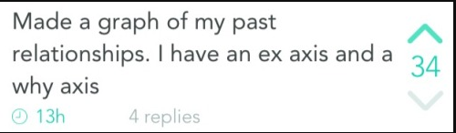

Slide 7
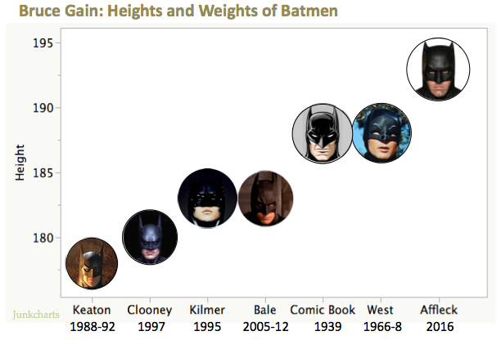

Slide 8
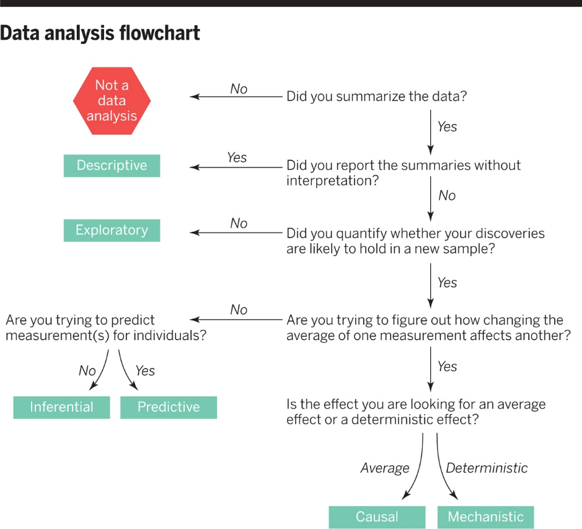
Leek JT Peng RD What is the question? Science 2015-03-20

Slide 9
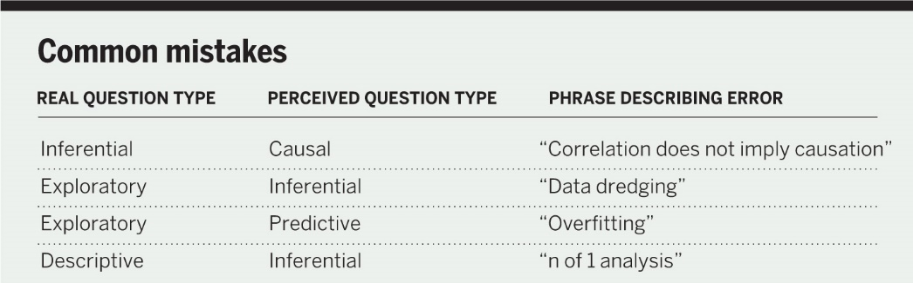
Leek JT Peng RD What is the question? Science 2015-03-20

Slide 10
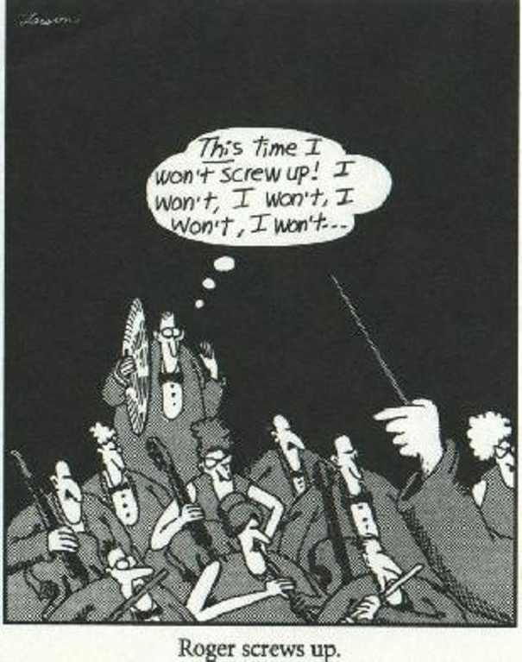
http://www.rossmanchance.com/artist/proceedings/cobb.pdf

Slide 11
I’m trying to systematically pay attention to you.
http://www.rossmanchance.com/artist/proceedings/cobb.pdf

Slide 12
I’m trying to emphasize things you’ve done well and things you can fix.
http://www.rossmanchance.com/artist/proceedings/cobb.pdf

Slide 13
I’m trying to emphasize things done well and things you can fix. I’m trying to make it safe to screw up. And I’m abandoning fairness in favor of assessing your work in your context.
http://www.rossmanchance.com/artist/proceedings/cobb.pdf

Slide 14
Some Recommendations
Five Thirty Eight
Simply Statistics
Statistical Model, Causal Inference and Social Science
American Statistical Association
STATS at Sense about Science
NY Times Upshot
Visualizations
Gapminder
Junkcharts
Podcasts: Not So Standard Deviations Stats + Stories Freakonomics More or Less: Behind the Stats The Effort Report
Twitter: @thomaselove @EdwardTufte @NateSilver538 @askdrstats @jtleek @rdpeng @RLangTip @rstudiotips @JennyBryan @hadleywickham

Slide 15
Statistics / Data Science is
… a science, not a branch of mathematics, but uses mathematical models as essential tools.
(John Tukey)

Slide 16
Statistics / Data Science is
Statistics is an important tool in the data analysis/science toolbox. Statistics provides a coherent framework for thinking about random variation, and tools to partition data into signal and noise.
(Hadley Wickham)

Slide 17
Statistics / Data Science is
… more than just p values and how you get to them.
In fact, forget about null hypothesis significance testing entirely and concentrate instead on
embracing variation, exploring data and building models and studying the size of effects more meaningfully,
even in the rare and unfortunate case where an important and binary decision “must” be made.

Slide 18
Statistics / Data Science is
… too important to be left to statisticians

