Slide 1
CAP680
PROGRAMMING IN JAVA-LAB

Slide 2

Using Sandbox

Slide 3
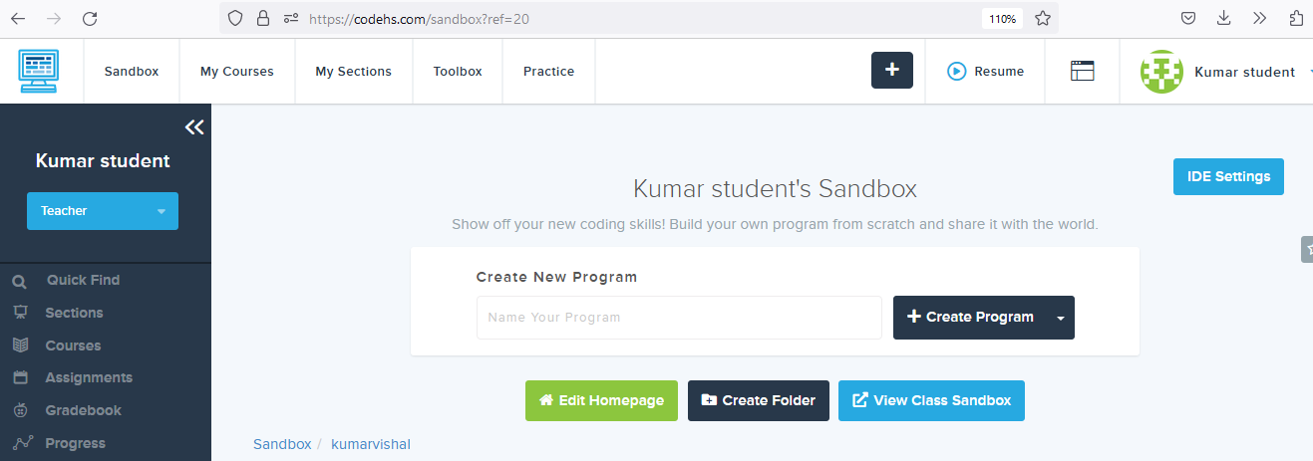
Using Sandbox

Slide 4
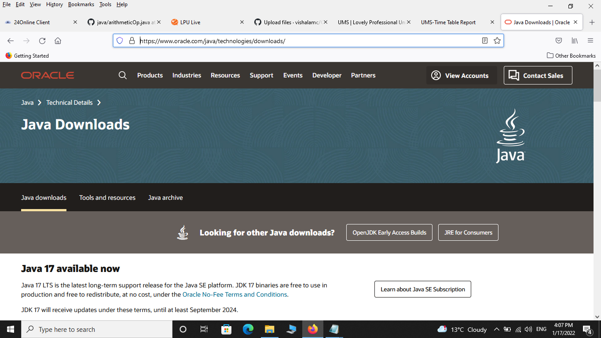
Using JDK

Slide 5
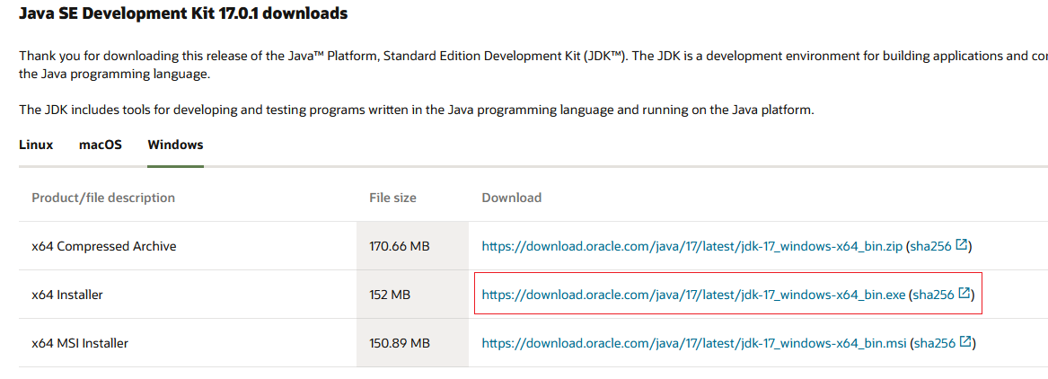
Select window tab:x64 Installer

Slide 6
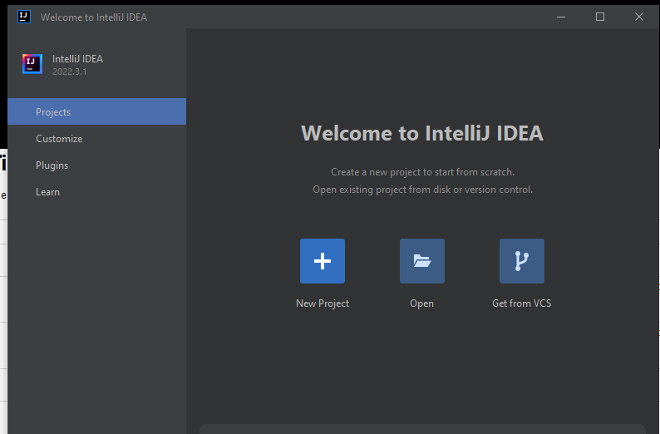
Using IntelliJ https://www.jetbrains.com/idea/

Slide 7
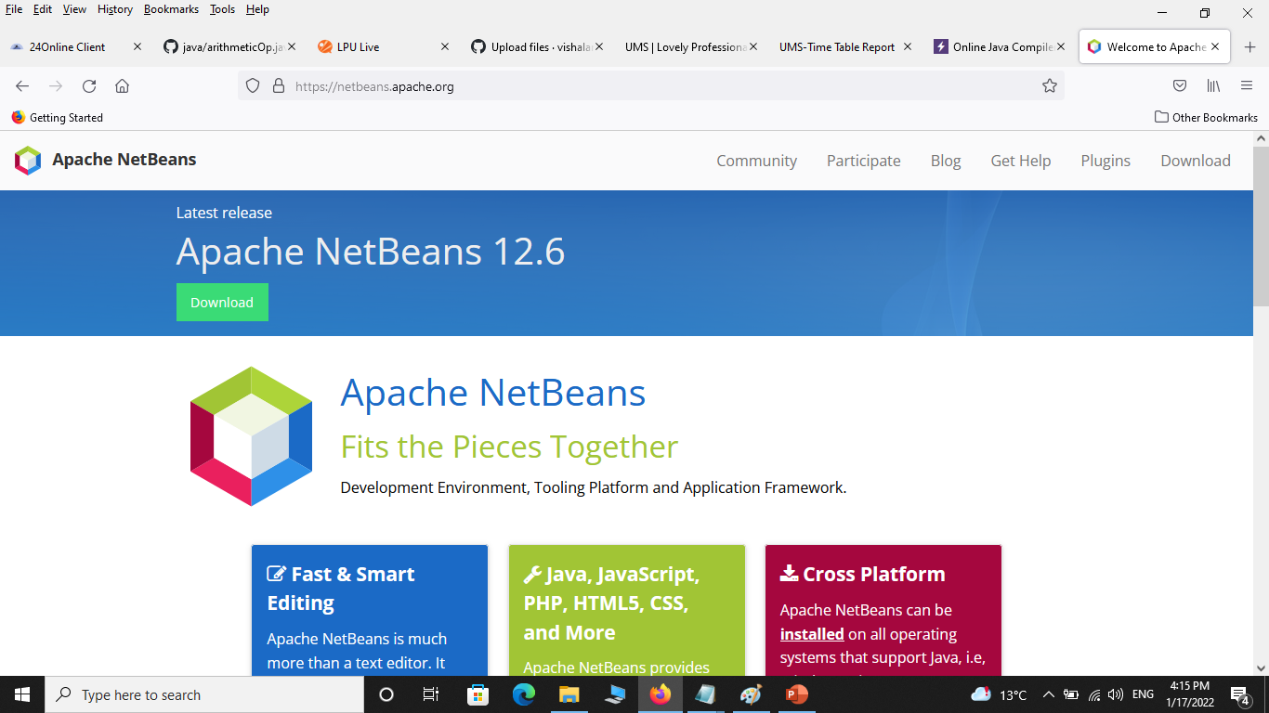
Using NetBeans IDE:

Slide 8
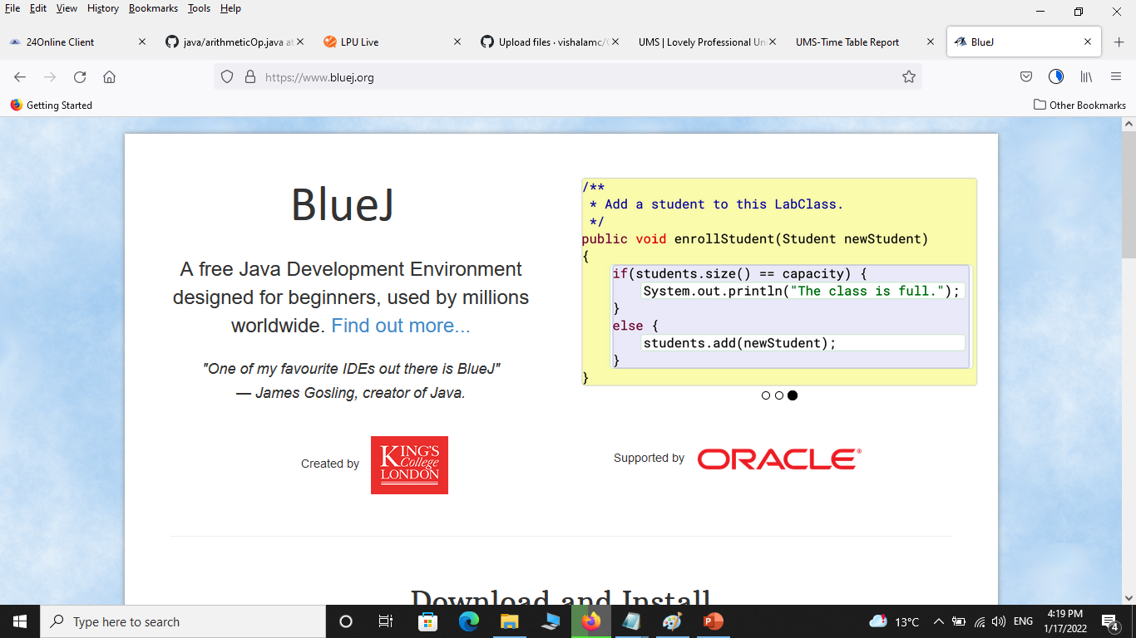
https://www.bluej.org/

Slide 9
running/ testing a java program
class test
{
public static void main(String []args)
{
System.out.println("hello");
}
}
Steps:->
Now save this file with extension .java inside bin folder in JDK.
Note: The file name should be same as class name
Now Compile this program on command prompt, suppose jdk folder is location at c: drive, open the command prompt and go inside the jdk folder.
c:/> cd jdk
now go inside the bin folder
c:/> jdk\>cd bin
c:/>jdk\bin>
Now compile the programme with javac command
c:/>jdk\bin>javac test.java
Where test.java is our filename
After compilation now run the programme by using java filename
c:/>jdk\bin>java test
Note:here during run the program no need to give the filename with extension java.
Now, you can get the output on the command line

Slide 10

Thanks

