Slide 2
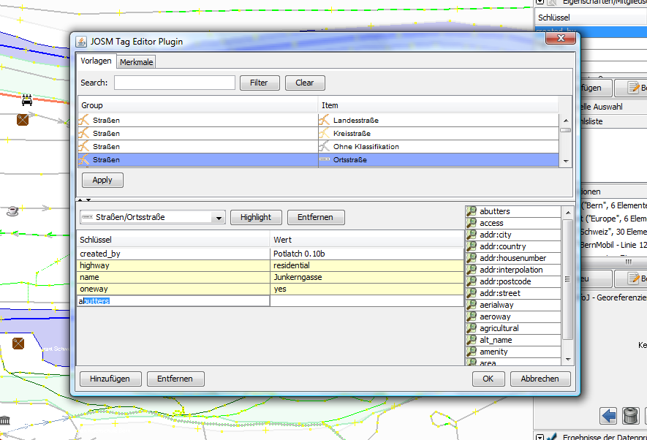
Table of "offical" map features, searchable
JOSM presets, searchable
Auto-completion in grid
cells
Tabular grid for editing tag keys and tag values
Preview of auto-completion values. Distinguishes between "official" values and user-defined values in the current dataset

