Slide 1
INDUSTRIAL KNOWLEDGE INTELLIGENCE
A Hybrid GraphRAG platform that turns scattered industrial documents into one queryable intelligence layer
ET AI Hackathon 2.0 · Round 2 — Revised Submission · Problem Statement #8

Slide 2
The problem: data present, but unacted upon
35%
7–12
18–22%
of working hours in asset-heavy industry lost to searching for or recreating information (McKinsey, 2024)
disconnected document systems in the average large Indian plant (NASSCOM-EY)
of unplanned downtime traced to decisions made without full equipment history
The knowledge cliff
An estimated 25% of India's experienced industrial engineers retire within the decade, taking decades of undocumented operational knowledge with them. The signals to prevent failures usually exist across separate records; no layer connects them into a decision in time.
ET AI Hackathon 2.0 · Problem #8 · Industrial Knowledge Intelligence (Revised)
2

Slide 3
Why hybrid GraphRAG, not the alternatives
Pure vector RAG
Pure graph RAG
Hybrid (this build)
Strong on semantic lookup, blind to relationship reasoning. Multi-hop questions are exactly where it fails.
Elegant, but brittle. If entity extraction misses something, that information is gone with no fallback.
Graph for relationship reasoning, vector store as safety net, fused by Reciprocal Rank Fusion.
WHAT MOST TEAMS SHIP
SINGLE POINT OF FAILURE
BEST OF BOTH
ET AI Hackathon 2.0 · Problem #8 · Industrial Knowledge Intelligence (Revised)
3

Slide 4
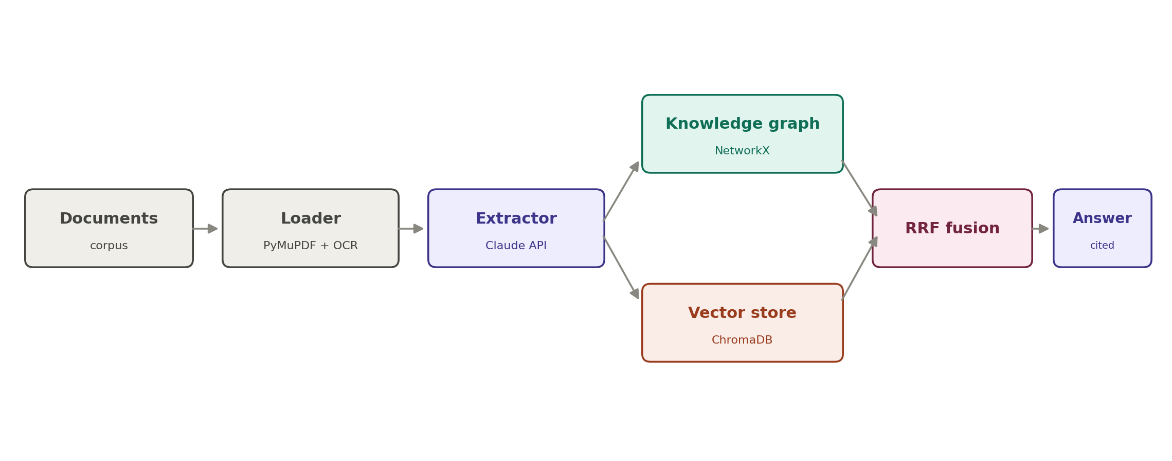
Architecture: a seven-stage pipeline
A document enters at the left; a cited answer leaves at the right. Graph and vector store are built and queried independently, then fused.
ET AI Hackathon 2.0 · Problem #8 · Industrial Knowledge Intelligence (Revised)
4

Slide 5
The proof: a five-hop chain vector-only search misses
Day −21
Inspection report Elevated bearing vibration flagged, 'monitor'
RESULT
Q01 recall: 0.80 → 1.00
Day −14
Maintenance log Bearing replacement deferred — against procedure
(vector-only → hybrid)
Day −5
Vibration trend Alarm threshold crossed, no work order raised
The full five-document chain is now retrieved. Hybrid recovers exactly what vector-only search misses: VS-204 and M-118, the two documents whose text never mentions "P-204" directly.
Day 0
Incident report Catastrophic bearing seizure, downtime
Five documents, no shared keywords. Relationship reasoning connects them into the answer.
ET AI Hackathon 2.0 · Problem #8 · Industrial Knowledge Intelligence (Revised)
5

Slide 6
Not learned for the hackathon — re-pointed from production
The same three-layer agentic pattern that runs a live production system maps directly onto this build.
Production agentic pattern | Role there | Equivalent in this build
Persistent memory layer | Holds and connects the knowledge corpus | Knowledge graph (NetworkX) + extraction cache
Prediction & scoring layer | Ranks and scores candidate outputs | RRF fusion + answer confidence scoring
Agentic orchestration | Coordinates reasoning steps into a result | Synthesis agent (LLM answer-and-cite chain)
Choosing a problem that matched an already-operating architecture meant the design decisions were pre-validated in production, applied to a new corpus.
ET AI Hackathon 2.0 · Problem #8 · Industrial Knowledge Intelligence (Revised)
6

Slide 7
An engineered evaluation corpus
Built, not just collected — so every judging metric has a source that exercises it.
Synthetic corpus
Real OEM manuals
11 PDFs around a planted five-document near-miss chain + realistic distractors
3 genuine centrifugal-pump manuals — real tags, real messiness
Scanned documents
FailureSensorIQ
3 degraded image versions to exercise the OCR path end-to-end
IBM Research, NeurIPS 2025, CC-BY-4.0 — 8,296 QA pairs as reference benchmark
Hand-labelled ground truth
Tagged benchmark set
Entity set across 3 doc types — enables a real Macro-F1, not an estimate
8 questions labelled by retrieval type (keyword / graph-only / hybrid)
ET AI Hackathon 2.0 · Problem #8 · Industrial Knowledge Intelligence (Revised)
7

Slide 8
Results — real, reproducible, honestly reported
0.8411
1.00
0.83 / 0.81
Entity extraction Macro-F1
Star question (Q01) recall
Overall recall, hybrid / vector
9 entity types, hand-labelled ground truth
Full 5-doc chain retrieved (was 0.60)
Top-12 across 8 questions
Honest reading, stated directly
A stronger embedding model lifted the vector-only baseline too, so the aggregate hybrid margin is now small — and at a stricter top-5 cutoff, hybrid trails vector-only (0.70 vs 0.76). The graph earns its place on the multi-hop question this system was built for (Q01: 0.80 → 1.00), not on aggregate averages.
ET AI Hackathon 2.0 · Problem #8 · Industrial Knowledge Intelligence (Revised)
8

Slide 9
Second hardening pass — found, fixed, honestly verified
Embedding truncation bug — found and fixed
VS-204 cutoff — resolved
The original model silently cut off long pages at ~256 tokens. Switched to a 512-token model with overlapping windows — the direct cause of the retrieval gains.
Scanned/clean duplicate documents were each consuming separate ranking slots. Deduplicating them freed the slot needed for the full chain.
Q02 hop-tier tie-flooding — still open
26 automated tests + CI
A structurally different ranking ceiling. Two fixes attempted and precisely diagnosed; neither crosses the tie-flooded tier.
Chunking, citations, determinism, graph invariants, eval-data consistency — running automatically on every push.
ET AI Hackathon 2.0 · Problem #8 · Industrial Knowledge Intelligence (Revised)
9

Slide 10
Known limitations — documented, not hidden
Understanding failure modes precisely is more valuable than pretending they don't exist.
Hop-tier tie-flooding (Q02)
Many documents share an identical graph score for merely mentioning the query entity, crowding out a more specific but structurally-further answer. Two fixes attempted, precisely diagnosed, neither solved it — a genuine ranking ceiling, not an unbuilt fix.
Aggregate margin at strict cutoffs
At top-5, hybrid trails vector-only (0.70 vs 0.76) due to hop-0 graph noise on single-document questions. The system's advantage concentrates on multi-hop questions, not every question type — stated directly.
Both are understood and reproducible. The full pipeline, including the honest cases, can be cloned and re-verified by anyone.
ET AI Hackathon 2.0 · Problem #8 · Industrial Knowledge Intelligence (Revised)
10

Slide 11
Built deep, with a path to scale
PRODUCTION UPGRADE PATH
PHASE 2 COMPONENTS
In-memory graph → managed graph database
Maintenance & root-cause agent
Local vector store → managed vector service
Regulatory compliance mapper
Extraction cached per document — zero-cost re-runs
Lessons-learned engine
CI + 26-test suite runs on every push
Docker packaging included (build unverified)
A working, benchmarked, honestly-documented Hybrid GraphRAG system that turns scattered industrial documents into one queryable intelligence layer — proving the difference on the multi-hop question this system was built for.
ET AI Hackathon 2.0 · Problem #8 · Industrial Knowledge Intelligence (Revised)
11

