Slide 1

E-Learning Platform
Contributors:
INDHU R
JOTHSHANA S M
PRIYADARSHAN B
SOUNDHARYAA SHRI S

Slide 2

Objectives
Develop an E-learning platform using React and Node.js, featuring interactive courses, secure authentication, instructional videos, and an integrated code compiler. The platform aims to provide a comprehensive learning experience, enabling users to access educational resources, practice coding, and discussion forum.

Slide 3
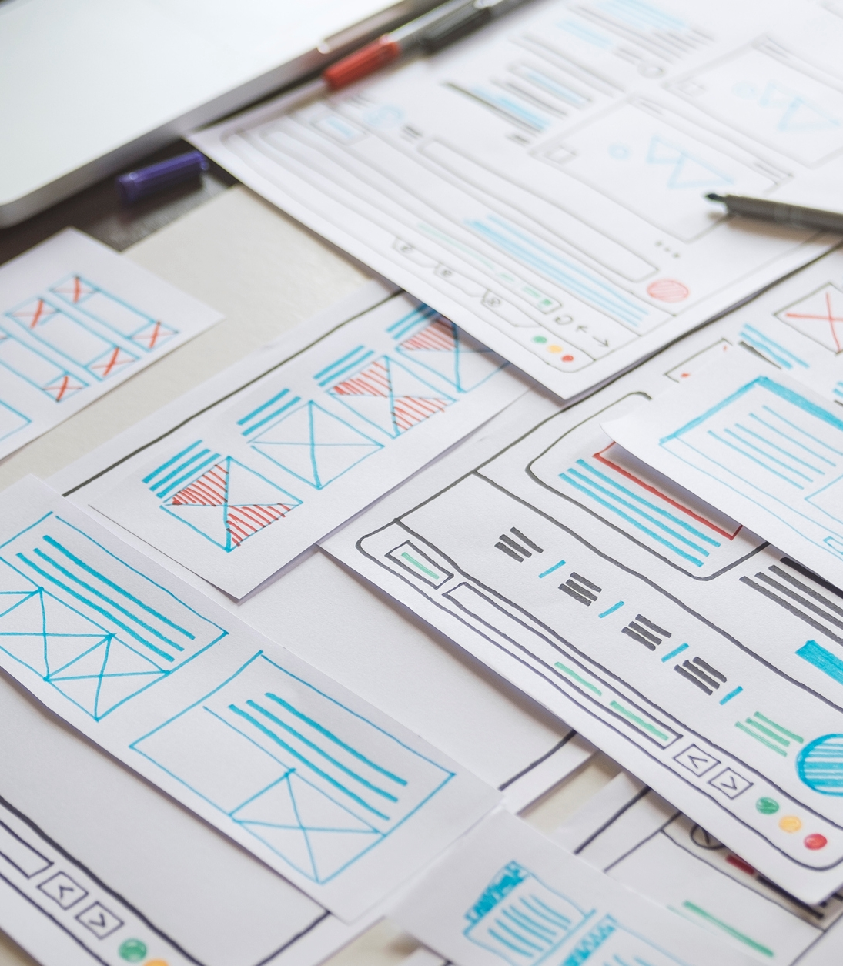
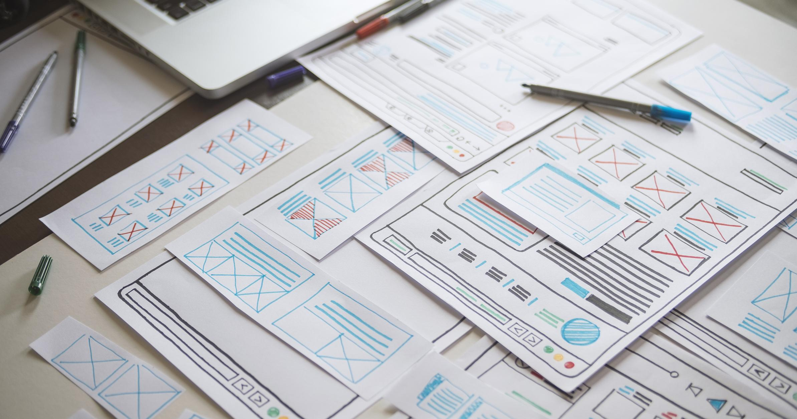
Existing Methodology
Limited Functionalities: They offer courses, basic login, and videos but lack built-in coding tools, requiring users to use other software for practice.
Basic Security: Security is often basic, relying only on usernames and passwords.
Poor User Interface: Interfaces are often confusing and not mobile-friendly, making it hard to use on different devices.
Static Content: Course content is static and not interactive, missing out on modern web technology benefits.
Need for Improvement: These issues highlight the need for a more integrated, secure, and user-friendly e-learning platform for learners and educators.
ANNUAL REVENUE GROWTH

Slide 4

Methodology of Proposed Work
Front-End Development: React will be used to build a dynamic, responsive user interface, allowing for interactive and engaging course content with real-time updates and feedback. The platform will support seamless access across various devices, including desktops, tablets, and smartphones.
Back-End Development: Node.js will handle server-side operations, managing user data, authentication, and course content efficiently. RESTful APIs will facilitate smooth data transfer and real-time updates between the front-end and back-end.
Integrated Compiler: A key feature will be an integrated code compiler, enabling users to practice coding within the learning environment. It will support multiple programming languages and provide instant feedback on code submissions, promoting hands-on learning.
Video Integration: Instructional videos will be embedded within the course content, offering visual and auditory learning aids. These videos will be hosted on a scalable video hosting service to ensure smooth playback and minimal latency.

Slide 5




Plan for product launch
Planning
Design
Development
Testing
Launch
Deciding the features and discussing about requirements and cost optimization
Designing the frontend using UI/UX design and backend using ER diagrams.
Implementing the design as a code to develop a UI with backend integration.
Testing the project with a team of tech people and implementing user testing
Deploying the project using deployment platforms

Slide 6




Thank you

