Slide 1
MACHINE LEARNING PROJECT
PROJECT OUTCOME
Bank Customer Churn Prediction
0.862
Final ROC-AUC Tuned Random Forest 10,000 customers End-to-end ML app
Predicting customer attrition and identifying high-risk customers before they leave.
FINAL PRESENTATION
EDA • Model Comparison • Random Forest • Streamlit
Banking Analytics | Customer Retention

Slide 2
BUSINESS CONTEXT
02
The Business Problem
Customer churn is a business problem—not just a classification problem.
WHY IT MATTERS
PROJECT OBJECTIVE
SUCCESS CRITERIA
When customers leave, the bank loses future revenue and the opportunity to build a long-term relationship. The goal is to identify customers with a higher probability of churn early enough to take action.
Build a machine learning solution that predicts whether a customer is likely to leave the bank. The output can support retention campaigns, customer prioritization, and early-warning workflows.
Evaluate multiple classification models using Accuracy, ROC-AUC, Recall, and F1-Score. Select a strong final model and deploy it through a simple Streamlit interface.

Slide 3
DATA OVERVIEW
03
Dataset at a Glance
10,000 bank customers with demographic, financial, and engagement information.
CUSTOMERS
TARGET
COUNTRIES
FEATURES
10,000
Churn
3
10
Core numerical features
Categorical features
• Credit score, age, tenure and balance
• Number of products and estimated salary
• Binary indicators: credit card and active member
• Country: France, Germany, Spain
• Gender: Male, Female
• Customer ID removed before modeling

Slide 4
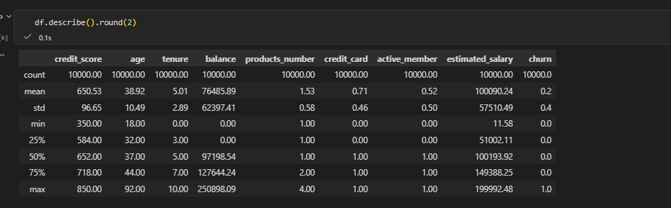
EXPLORATORY DATA ANALYSIS
04
Understanding the Customer Base
Descriptive statistics were used to understand distributions, ranges, and potential data issues.
KEY OBSERVATIONS
• Average age ≈ 38.9 years • Churn rate ≈ 20% • Average balance ≈ 76.5K • Products: mostly 1–2 per customer • Salary shows a wide range, while credit score is centered around the mid-600s

Slide 5
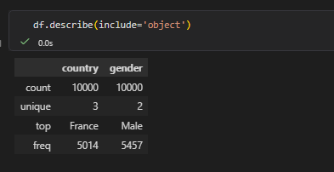
EXPLORATORY DATA ANALYSIS
05
Categorical Features
Country and gender distributions provide an initial view of the customer population.
DATASET DISTRIBUTION
Country: France is the largest group with 5,014 customers. Gender: Male customers are the larger group with 5,457 customers. These variables were retained because categorical differences can contribute to churn patterns.
EDA goal: understand the data first, then let the models learn patterns across multiple features.

Slide 6
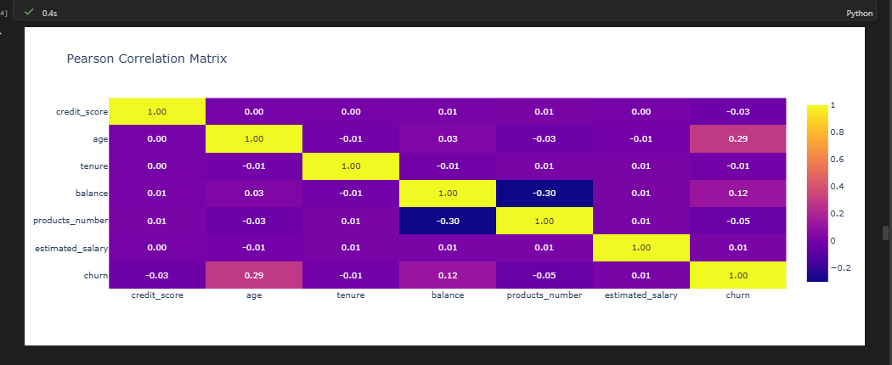
EXPLORATORY DATA ANALYSIS
06
Correlation Analysis
Pearson correlation highlights linear relationships between numerical variables and churn.
WHAT STANDS OUT
Age has the strongest linear relationship with churn at about 0.29. Balance follows at about 0.12. Most other numerical variables have weak linear correlation with churn. This supports using a model capable of capturing non-linear and interaction effects.

Slide 7
MODEL SELECTION
07
From Baseline to Model Selection
Six classification models were evaluated on the same train/test setup and preprocessing pipeline.
Random Forest
Extra Trees
SVM
0.849
0.840
0.828
ROC-AUC • 0.849 Recall • 0.455 F1 • 0.576
ROC-AUC • 0.840 Recall • 0.415 F1 • 0.537
ROC-AUC • 0.828 Recall • 0.386 F1 • 0.528
Logistic Regression
KNN
Decision Tree
0.775
0.763
0.679
ROC-AUC • 0.775 Recall • 0.187 F1 • 0.284
ROC-AUC • 0.763 Recall • 0.369 F1 • 0.480
ROC-AUC • 0.679 Recall • 0.506 F1 • 0.486
Decision: Random Forest showed the strongest overall discrimination and was selected for tuning.

Slide 8
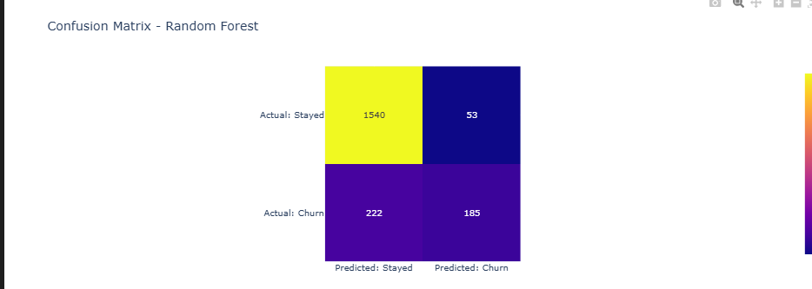
MODEL EVALUATION
08
Random Forest — Baseline Performance
The baseline Random Forest substantially improved churn detection compared with Logistic Regression.
ACCURACY
ROC-AUC
86%
0.849
CHURN RECALL
CHURN F1
45%
0.57
CONFUSION MATRIX INSIGHT
185 churners were correctly identified, while 222 actual churners were missed.

Slide 9
MODEL OPTIMIZATION
09
Hyperparameter Tuning
GridSearchCV was used to search for a stronger Random Forest configuration.
SEARCH STRATEGY
WHAT IMPROVED
IMPORTANT TRADE-OFF
Random Forest hyperparameters were tested across multiple combinations. 5-fold cross-validation was used with ROC-AUC as the optimization metric. The best configuration was then evaluated on the untouched test set.
Baseline ROC-AUC 0.849 Tuned ROC-AUC 0.862 Churn precision 0.78 → 0.81 The improvement is modest but meaningful.
Churn recall moved from 45% to 43%. This shows why model selection should consider several metrics—not ROC-AUC or accuracy alone. For a bank, missed churners are particularly important.

Slide 10
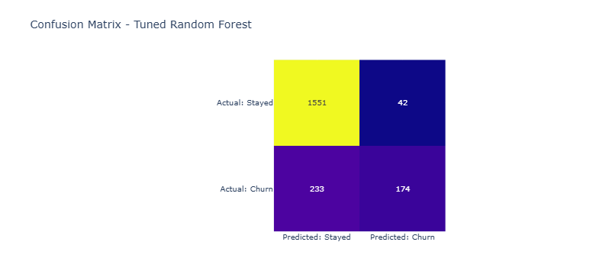
FINAL MODEL
10
Tuned Random Forest — Final Evaluation
The tuned pipeline became the final model used for deployment.
ROC-AUC
ACCURACY
0.862
86%
PRECISION
RECALL
81%
43%
FINAL TAKEAWAY
Good overall discrimination with a clear opportunity for future recall/threshold optimization.

Slide 11
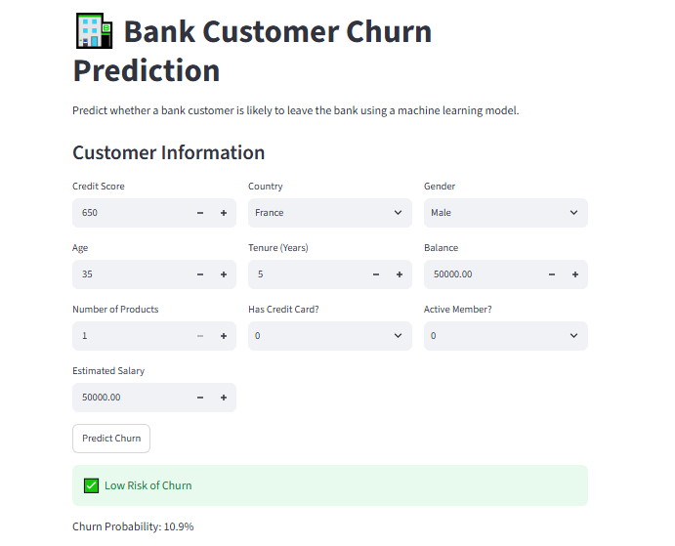
DEPLOYMENT
11
From Model to Usable Application
The trained pipeline was deployed as an interactive Streamlit app.
INPUT
Customer profile: credit score, country, gender, age, tenure, balance, products, card, activity, salary.
PREDICTION
The saved machine learning pipeline generates a churn class and churn probability.
OUTPUT
Low Risk / High Risk of Churn + probability percentage for quick interpretation.

Slide 12
CONCLUSION
12
What the Project Delivers
An end-to-end customer churn workflow—from raw data to a deployable prediction tool.
01 INSIGHT
02 MODEL
03 DELIVERY
EDA showed that churn is influenced by multiple customer characteristics, with age standing out in the linear correlation analysis.
Multiple classifiers were compared. Random Forest achieved the strongest baseline performance and was optimized using GridSearchCV.
The final tuned pipeline was saved and integrated into a Streamlit application for real-time customer-level predictions.
Next step: improve churn recall through threshold tuning, class balancing, and targeted retention strategies.
Thank you

