Slide 1
Timeline-Based Planning
SMT-based continuous-time scheduling for a Mars rover scenario
Ho Chit Joure | Candidate Number: 282953
BSc Computer Science and Artificial Intelligence
Supervisor: Dr Hsi-Ming Ho | University of Sussex | 2026
Notes:
Introduce yourself and state the project title. Emphasise that the project combines timeline-based planning with SMT solving to create a prototype planner for continuous-time scheduling.

Slide 2
Project Motivation
Why this problem matters
Traditional planning
Often represents actions as fixed discrete steps.
Real autonomous systems
Activities have durations, dependencies, resources and windows.
Mars rover planning
Remote operation requires careful scheduling under energy and daylight constraints.
The project focuses on continuous-time planning rather than simple step-by-step planning.
Rover tasks such as movement, imaging, analysis and recharge must be coordinated.
A formal planning approach helps check whether a schedule is feasible before execution.
Timeline-Based Planning | Final Year Project | 2
Notes:
Explain the real-world motivation. Do not spend too long on the literature. Make clear that Mars rover scheduling is used because it naturally has temporal, environmental and resource constraints.

Slide 3
Project Aim and Objectives
What the project set out to achieve
Aim: design and implement a prototype timeline-based planning system using SMT and Z3.
Objective 1
Represent tasks as temporal intervals
Objective 2
Encode duration, ordering, daylight and energy constraints
Objective 3
Use Z3 to check SAT / UNSAT / UNKNOWN
Objective 4
Extract and visualise generated schedules
Objective 5
Evaluate runtime and scalability
Timeline-Based Planning | Final Year Project | 3
Notes:
Present the objectives as a clear checklist. The main point is that this was a working prototype, not only a theoretical report.

Slide 4
Background: Timeline-Based Planning
Representing actions as intervals on timelines
Task i: duration dᵢ = eᵢ − sᵢ
sᵢ
task token
eᵢ
time
Activities are not instantaneous events.
Each activity has a start time, end time and duration.
This supports ordering, synchronisation and continuous-time reasoning.
Why it fits this project
Rover actions such as moving, imaging, analysing and recharging all take time and must satisfy operational constraints.
Key source: Cesta, Fratini and Pecora (2009)
Timeline-Based Planning | Final Year Project | 4
Notes:
Explain that timeline-based planning is the main planning representation. Activities are tokens with start and end times, rather than instant actions.

Slide 5
Background: SMT and Z3
Solving the planning problem as formal constraints
SAT
A feasible schedule exists
UNSAT
No schedule satisfies all constraints
UNKNOWN
The solver cannot confirm in that run
SMT combines logical reasoning with mathematical theories.
The project uses linear real arithmetic for continuous-time variables.
Z3 checks whether all encoded constraints can be satisfied.
Example constraints:
start_image ≥ end_move
0 ≤ start_image ≤ sunset
Key sources: Barrett et al. (2009); De Moura and Bjørner (2008)
Timeline-Based Planning | Final Year Project | 5
Notes:
Define SMT in simple terms. Say that the planner does not search manually; it encodes requirements and asks Z3 whether a satisfying assignment exists.

Slide 6
Formal Planning Model
How the report defines the planning problem
Meaning
T = tasks, V = temporal variables, C = constraints over those variables.
P = (T, V, C)
Task variables
Each task i has sᵢ and eᵢ as real-valued start and end times.
Duration
dᵢ = eᵢ − sᵢ, with minimum and maximum duration bounds.
Ordering
Example: s_image ≥ e_move means imaging starts after movement ends.
The formal model is then translated into an SMT instance over real-valued variables.
Timeline-Based Planning | Final Year Project | 6
Notes:
Use this slide to show technical understanding. Explain the tuple and one concrete constraint. Avoid overcomplicating the mathematics.

Slide 7
System Architecture
From structured input to a verified schedule
JSON Input
tasks, durations, constraints
Constraint Encoder
linear arithmetic formulas
Z3 Solver
SAT / UNSAT / UNKNOWN
Output Module
extract model values
Visualisation
timeline schedule
The architecture is modular: each stage can be tested or improved separately.
The user does not need to write low-level SMT formulas manually; the system performs the translation.
Timeline-Based Planning | Final Year Project | 7
Notes:
This is one of the most important slides. Clearly explain the pipeline. Emphasise that the architecture connects a readable input format to formal SMT solving and visual output.

Slide 8
Implementation
Python prototype using Z3 and JSON input
Tools used
Python, Z3 SMT solver, JSON input, timing functions and timeline visualisation.
Main modules
Input parser, constraint generator, solver interface, result extractor and visualiser.
Core idea
Translate planning rules into solver constraints and inspect the model returned by Z3.
solver.add(start["image"] >= end["move"])
solver.add(start["analyze"] >= end["image"])
solver.add(start["image"] >= sunrise)
solver.add(start["image"] <= sunset)
if solver.check() == sat:
model = solver.model()
Timeline-Based Planning | Final Year Project | 8
Notes:
Show that you wrote software. Explain the code briefly: movement before imaging, imaging before analysis, daylight constraints, then solver check.

Slide 9
Mars Rover Planning Scenario
Main case study used for evaluation
Task | Duration Range | Purpose
Move | 5–10 min | travel to target
Image | 2–4 min | capture terrain/science image
Analyze | 3–6 min | process collected data
Recharge | 10–20 min | recover battery power
Temporal constraints
Move before image; image before analysis.
Environmental constraints
Imaging and recharge must occur in daylight.
Resource constraints
Battery feasibility and recharge placement.
This simplified scenario is small enough to test, but still includes meaningful interactions between time, resources and environment.
Timeline-Based Planning | Final Year Project | 9
Notes:
Explain the scenario. The important part is not Mars science detail but showing that the model combines multiple types of constraints.

Slide 10
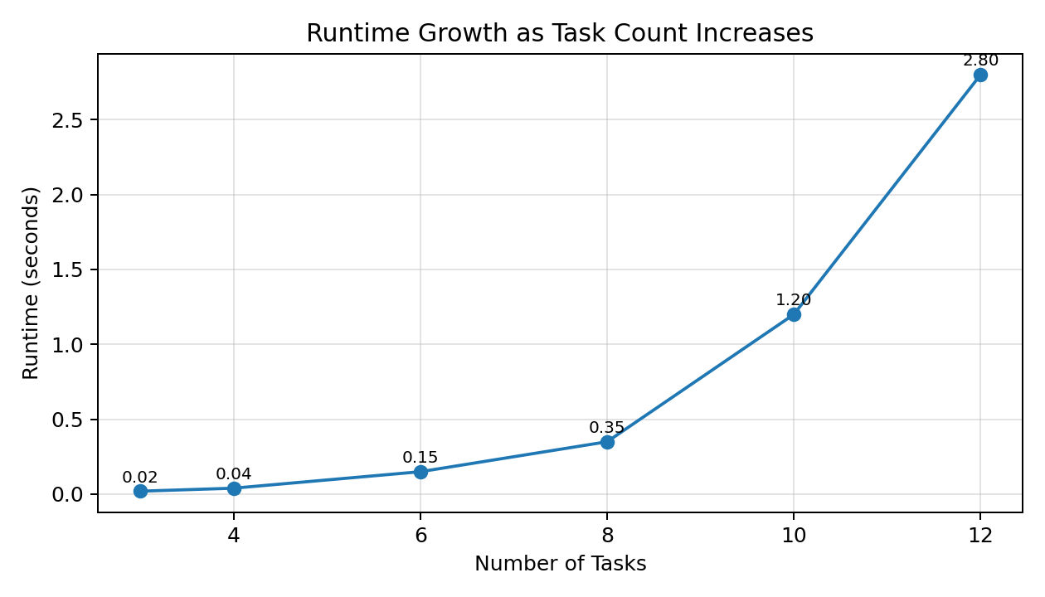
Experimental Results
Runtime and feasibility outcomes
Tasks | Density | Result | Runtime
3 | Low | SAT | 0.02s
4 | Low | SAT | 0.04s
6 | Medium | SAT | 0.15s
8 | Medium | SAT | 0.35s
10 | High | UNSAT | 1.20s
12 | High | UNKNOWN | 2.80s
Small and medium cases were solved quickly; up to 8 tasks solved in under 0.40 seconds.
High-density cases became more difficult: 10 tasks was UNSAT, while 12 tasks was UNKNOWN / NOT RESOLVED after 2.80 seconds.
Timeline-Based Planning | Final Year Project | 11
Notes:
Use this slide to show evidence of evaluation. Make clear that 2.80 seconds is the measured runtime for that run, not a fixed timeout threshold.

Slide 11
Conclusion and Future Work
What was achieved and what comes next
What was achieved
A working SMT-based timeline planning prototype was built, using Python and Z3 to model continuous-time rover scheduling.
Main finding
The approach is expressive and reliable for small and medium cases, but scalability is the main limitation.
Limitations
Simplified rover scenario, simplified battery model, no uncertainty handling, limited scale.
Future work
Optimisation, richer resource models, uncertainty handling, incremental or parallel solving.
Final message
Formal methods can support dependable autonomous planning, but practical deployment needs stronger scalability and realism.
Thank you — Questions?
Timeline-Based Planning | Final Year Project | 12
Notes:
End confidently. Summarise what you built, what the results show, and the most important future work. Then invite questions.

