Slide 1


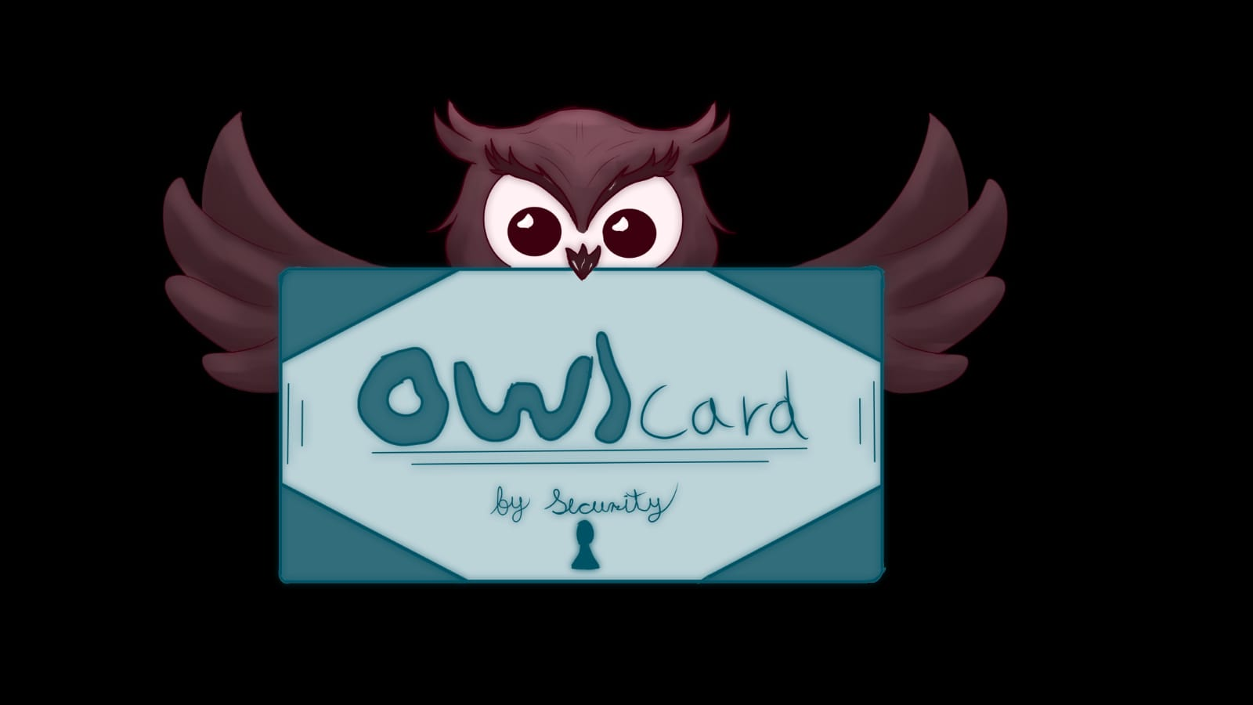



One Liner
OwlCard by security
The Solana-based ticketing platform that safeguards authenticity and simplifies resale.
Solana Based ticketing platform that helps event organizers to have low fees and resell tickets
Notes:
Superteam Deck Notes: Put your startup name and logo with a 1-line subtitle.
This subtitle should be a game changer - it focuses on outcomes and the secret sauce.
(eg. “Decentraland - a virtual world owned by its users”)

Slide 2






PROBLEM
A partner, recently, lost his physical wallet,, all his documents are lost and our friend can be in danger.
1000 millions of people lost any kind of documents a month
Its really frustrating and complicated recover all of your lost documents.
You can’t have your documents everywhere and anytime
[Your Startup Name]
01
Notes:
Use slide 2, 3, or 4 for the problem statement.
State your problem version 1: In this slide, there can be more than one problem statement. Data offers an objective foundation to the statement and intergration of stories can enhance the claim by providing relatiability.(eg: 73% of developers express reservations about diving into blockchain
Current platforms fail to provide X, causing frustration and inefficiencies in Y)
Incorporate any data / personal anecdotes that support your claim.

Slide 3
Solution
owlcard allows to the user have him documents and identities to all places
We create an app that allows you to have a digital copy of all your documents.
Safe, low cost and available on any device.
You can upgrade your docs to NFT to make it even more safe.
[Your Startup Name]
01
Notes:
Use slide 2, 3, or 4 for the problem statement.
State your problem version 1: In this slide, there can be more than one problem statement. Data offers an objective foundation to the statement and intergration of stories can enhance the claim by providing relatiability.(eg: 73% of developers express reservations about diving into blockchain
Current platforms fail to provide X, causing frustration and inefficiencies in Y)
Incorporate any data / personal anecdotes that support your claim.

Slide 4

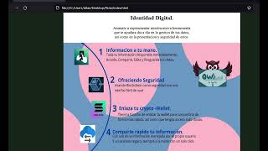

Introducing
OwlCard by security
OWLCARD
03
Notes:
Add a working demo of the product you've built. If your demo doesn't fit in a single slide, you can add another. (Add Product Demo Screenshot/Video Here)

Slide 5



Business Model Here is how we make/will make money...
0.01%
200%
50%
per subscription
income increase/quarter
chances of income
Transaction Fees: Charge a minimal amount to keep safe your docs.s
Staking Rewards: You can earn free subs and other thing renewing your subscription with us every month
[Your Startup Name]
01
Notes:
This is an optional Slide While understanding potential revenue streams is crucial for long-term sustainability and attracting investors, it's worth noting that many successful startups in the early stages, especially in the web3 space, are pre-revenue.
This slide serves as a blueprint for monetization strategy, highlighting your forward-thinking approach.
However, emphasizing revenue models may not be imperative for all hackathon pitches, especially if the primary focus is on innovation, tech feasibility, and market fit.

Slide 6












Where will we be next year if we win the hackathon/raise funds?
Tech Optimization 🔎
Global release 🚀
Improve our webpage and make a better promotion. 💼
Improve the interface 💼
Pre-release Marketing 📺
Q1 (2024)
Q2 (2024)
Q3 (2024)
Q4 (2024)
[Your Startup Name]
08
Notes:
What objectives will you conquer immediately after you get the resources? Can list down a short plan of action.

Slide 7
You can try it here!
https://twitter.com/BuhosTecno86412
08
Notes:
What objectives will you conquer immediately after you get the resources? Can list down a short plan of action.

