Slide 1

YT BRAND DESIGN
YT BRAND DESIGN
YT BRAND DESIGN
YT BRAND DESIGN
YT BRAND DESIGN
YT BRAND DESIGN
YT BRAND DESIGN
YT BRAND DESIGN
YT BRAND DESIGN
YT BRAND DESIGN
YT BRAND DESIGN
YT BRAND DESIGN
YT BRAND DESIGN
YT BRAND DESIGN
DESIGN DOC
YT BRAND DESIGN
YT BRAND DESIGN
YT BRAND DESIGN
YT BRAND DESIGN

Slide 2

CONTENTS PLANNED:
Pages:
Hero page -
About page -
Services page -
Case Studies -
Process -
Testimonials -
CTA -
Strong, Bold, Attractive
Precise, Unique
Clear, Affirmative
Simple Breakdown, Stats
Values, Impacts
Positive, Upselling
Funky, Instant Clicks
Leads:
Extras:
Links to Socials
Mailing Lists
Newsletters
Response Forms
Partner Logos
Project Deep dives
Location Map Design
Footer

Slide 3



FONT VARIATIONS:
SYNE
SPACE GROTESQUE
COLOR VARIATIONS:
#E6FA05
#FFFFFF
#8B31FF
#000000

Slide 4
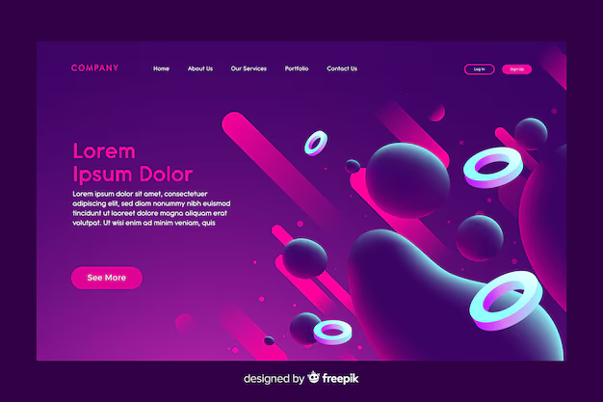
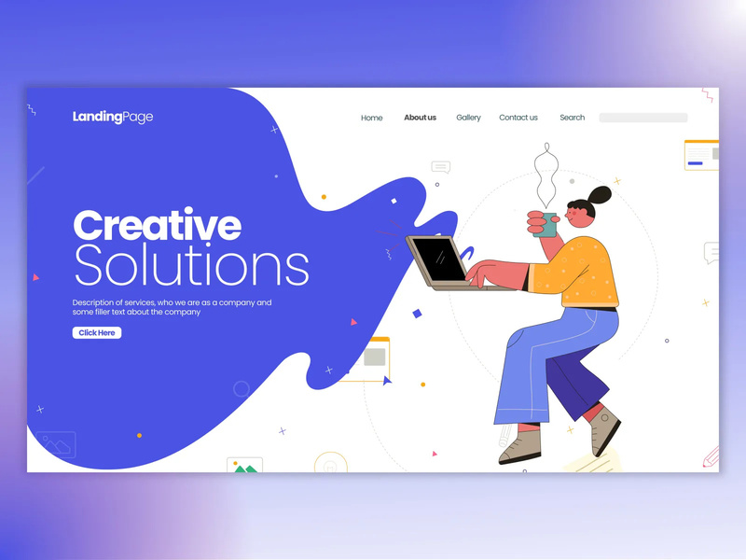
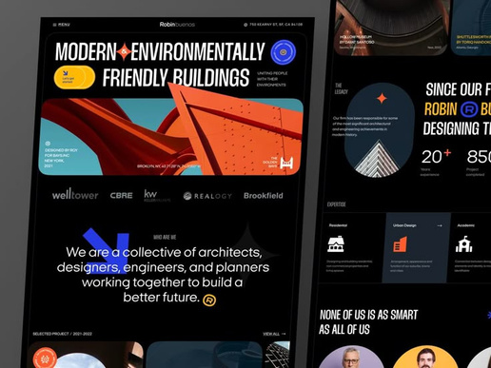
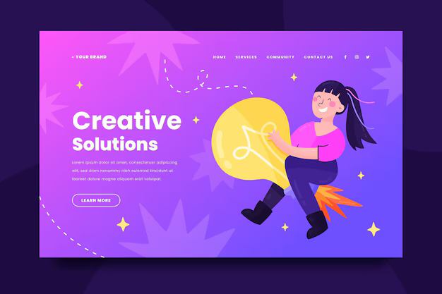
REFERENCES:

