Slide 1
Portfolio
Web contents Portfolio

Slide 2
Portfolio wireframe (desk)
intro
about
skill
Web portfolio
contact
design portfolio

Slide 3
Portfolio wireframe (mobile)
intro
about
skill
Web portfolio
design portfolio
contact

Slide 4
Design
Web contents Portfolio

Slide 5

Intro

Slide 6
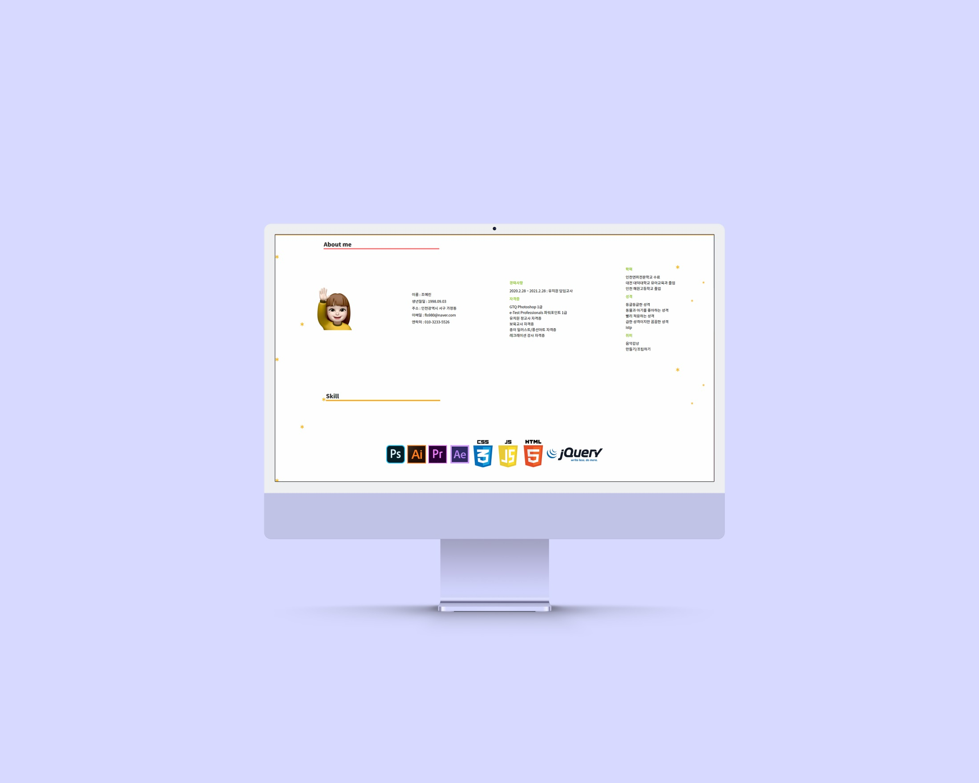
About

Slide 7

Web Portfolio

Slide 8

Design

Slide 9

Contact

