Slide 1
Installing JDE and Eclipse

Slide 2
Setting up JDE

Slide 3
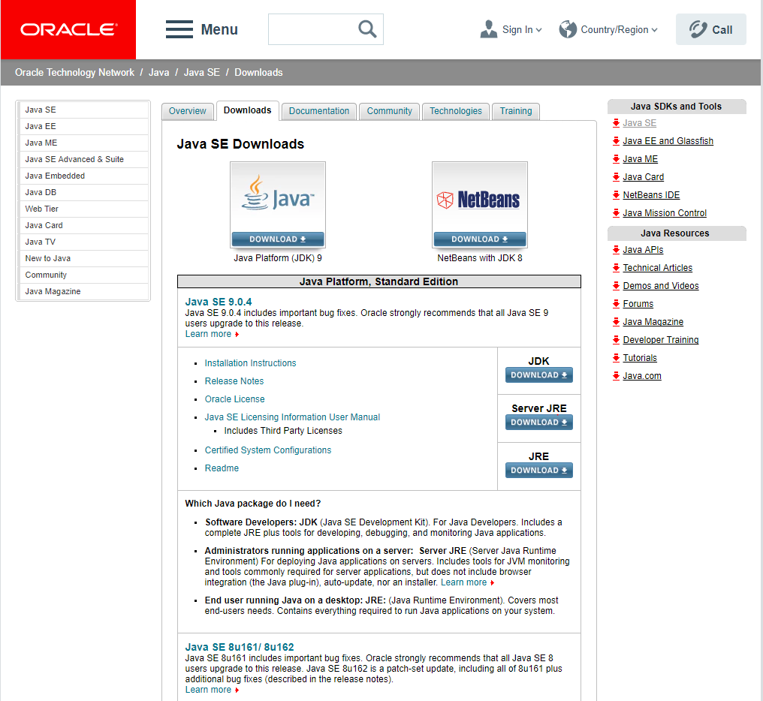
1) Set up the JDE
JDE (Java Development Environment)
Click the link below and you will see the following site:
http://www.oracle.com/technetwork/java/javase/downloads/index.html
Click the “Download” button below the JDK section.
*Mac users can follow the link below to see how to set up the JDE in a Mac system.
http://ishappy.tistory.com/entry/MAC-OS-X-%EC%97%90-JDK-%EC%84%A4%EC%B9%98%ED%95%98%EB%8A%94-%EB%B0%A9%EB%B2%95

Slide 4
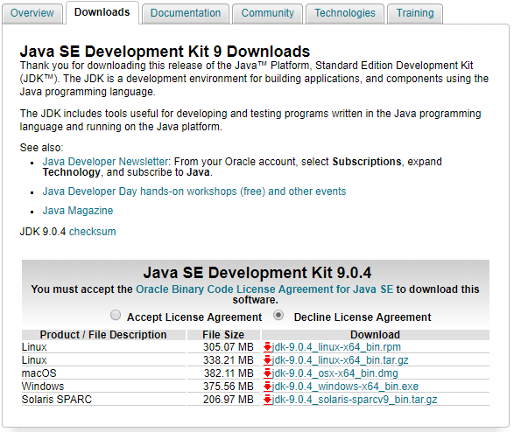
1) Setting up JDE
Check your computer’s OS version and download the corresponding package.
For Windows, click on “windows-x64_bin”
MacOS can click on “osx-x64_bin”
Downloading the package will take roughly about 3 to 4 minutes. (depending on the internet connection)

Slide 5
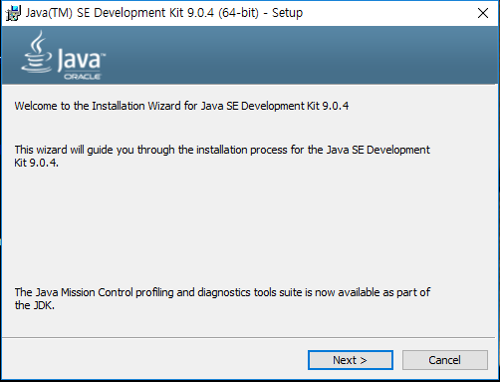
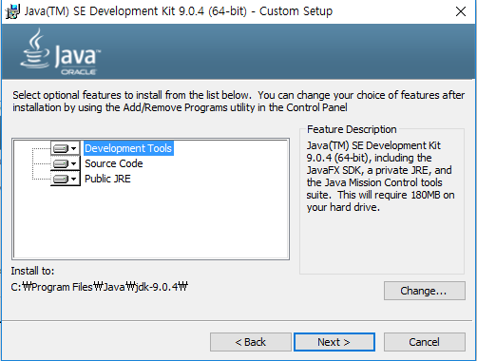
1) Setting up JDE
Click “Next”
And you can just keep on clicking “Next”. Easy.

Slide 6
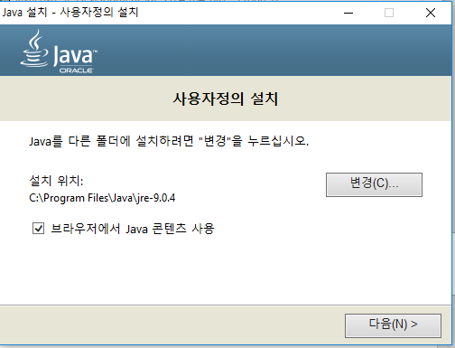
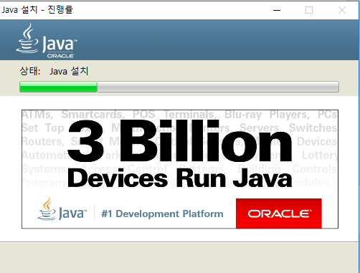
1) Setting up JDE
Let’s uncheck the “Use Java contents on your browser”
Click “Next” to complete the installation.

Slide 7
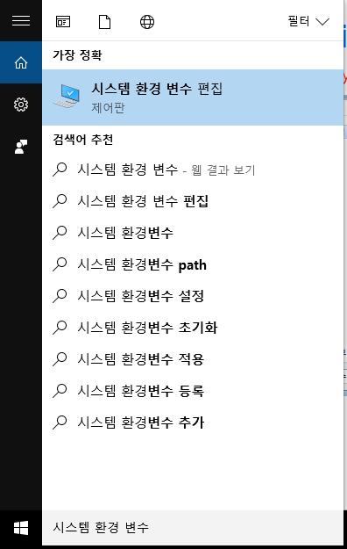
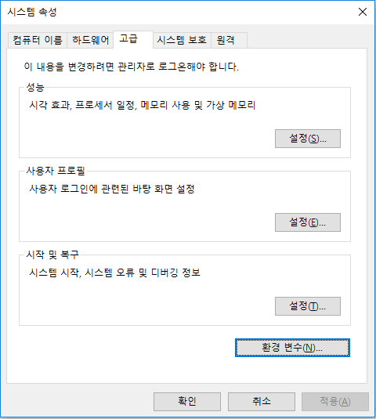
1) Setting up JDE
Type “System Environment Variables” (시스템 환경 변수 편집) in the search bar of your Windows system
Then you’ll see “Properties”
Click “Environment Variables” under the “Advanced System Settings” column

Slide 8
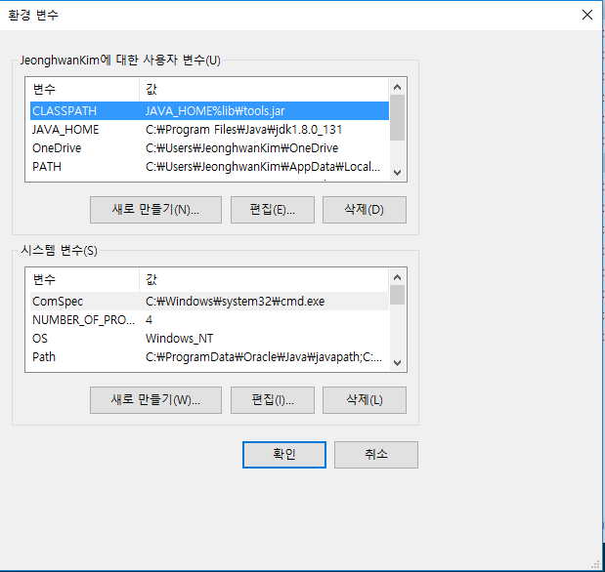
1) Setting up JDE
“Environment Variables” will give you the following screen
Now we add a new environment variable
CLASSPATH:
JAVA_HOME%lib\tools.jar
JAVA_HOME:
C:Program Files\Java\jdk-9.0.4
*The newest version of JDK is jdk-9.0.4. The versions may vary depending on what you have installed on your computer.

Slide 9
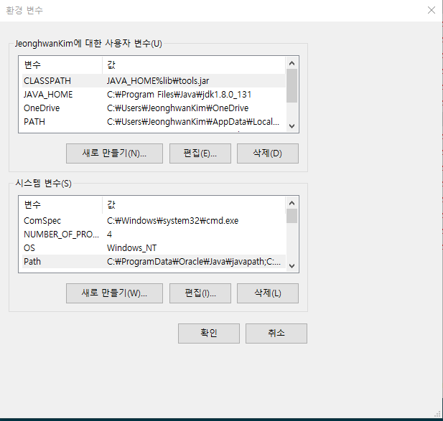
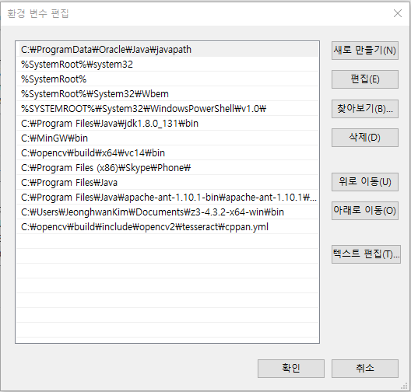
1) Setting up JDE
For “Path” in the “System Variables”, we give the following value:
C:Program Files\Java\jdk-9.0.4\bin

Slide 10
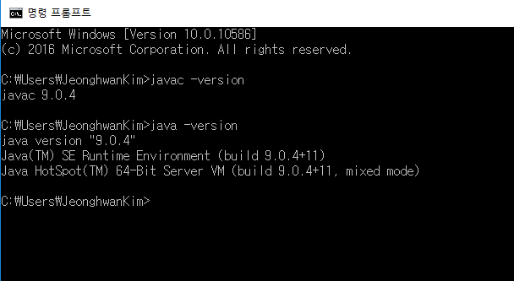
2) Check if it works
Type “java –version” and “javac –version” in the “Command Prompt (cmd)”.
If you see the following screen you are good to go with your JDE.

Slide 11
Setting up Eclipse

Slide 12
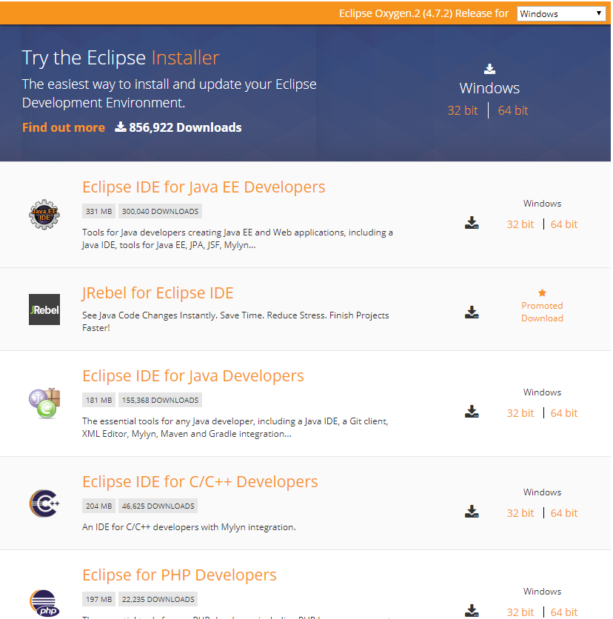
1) Setting up Eclipse
Eclipse IDE(Integrated Development Env.)
Follow the link below and you’ll see the following screen:
https://eclipse.org/downloads/eclipse-packages/
Download a 64-bit or 32-bit Eclipse IDE depending on the version of your Windows OS
*Mac users can follow the link below to see how to install Eclipse on Mac:
http://mirwebma.tistory.com/3

Slide 13
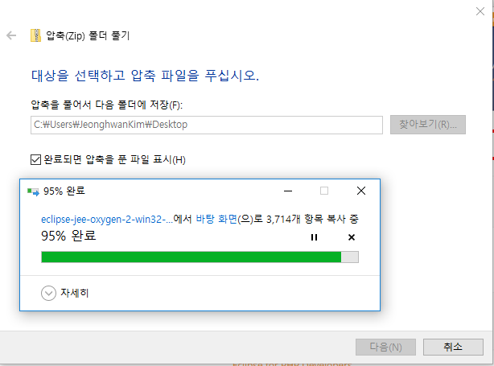
1) Setting up Eclipse
Unzip the downloaded Eclipse file in a desired directory.
I recommend you unzip the directory to the Background or an easily accessible directory.

Slide 14
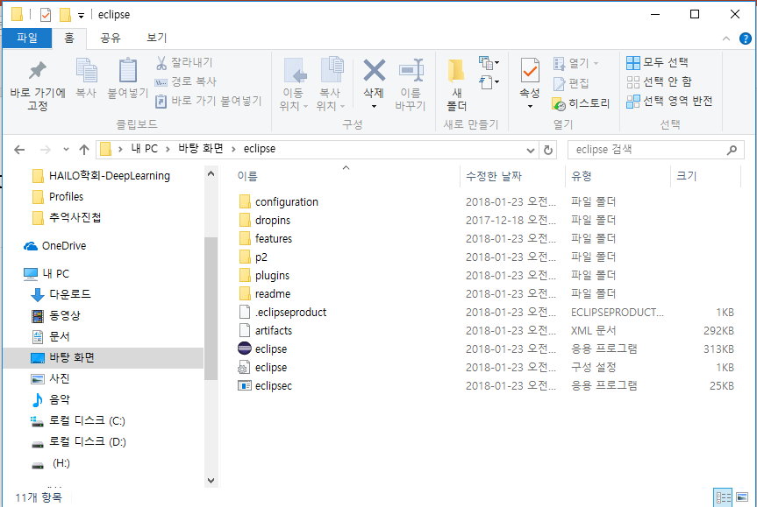

1) Setting up Eclipse
Click on the “Eclipse” folder and the purple “eclipse” icon to execute the program.
If you see the following screen below, “Eclipse” is good to go on your system.

Slide 15
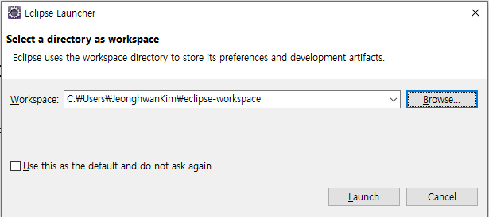
1) Setting up Eclipse
“Workspace” is where your source codes and related files are stored.
You can either put it in a folder in the Background or an easily accessible folder of your own.

Slide 16
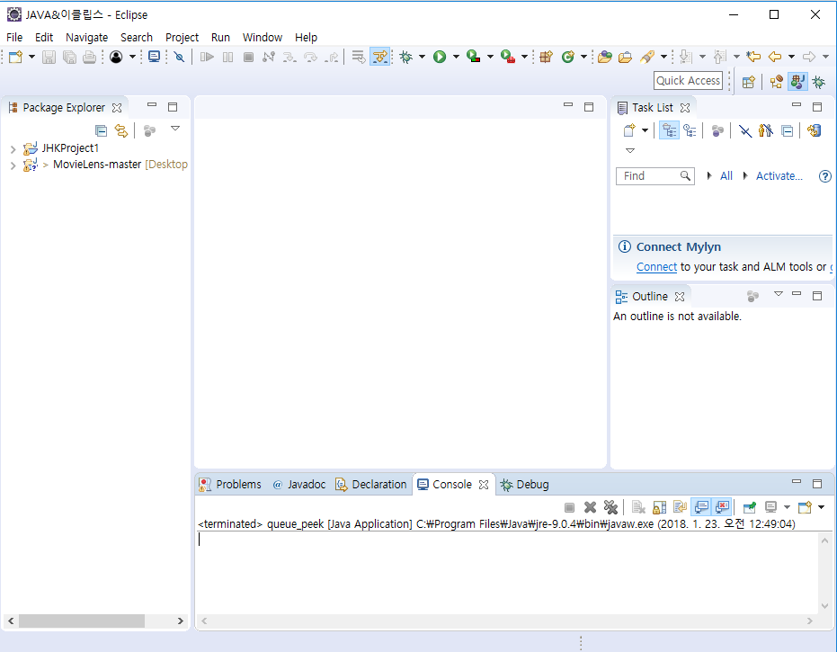
1) Setting up Eclipse
If you see the following screen, then you can now start coding in Java.

Slide 17
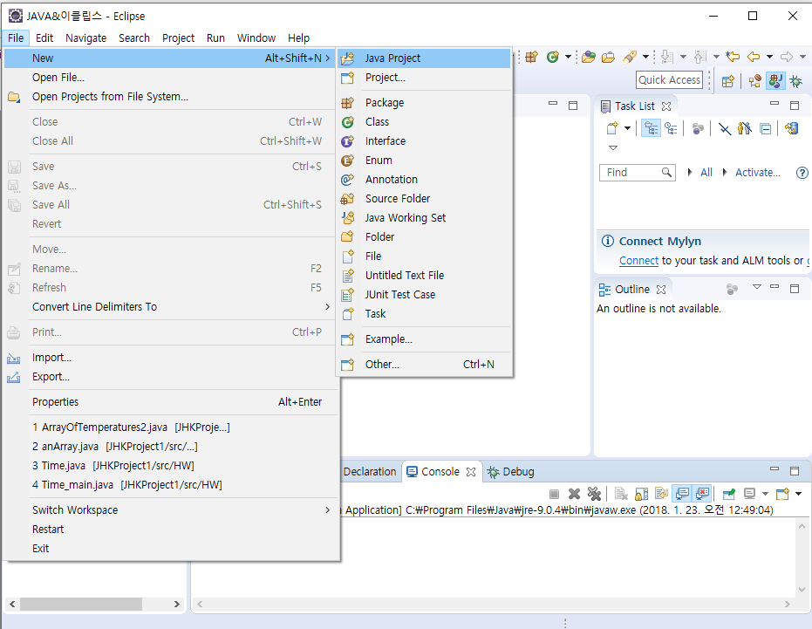
2) “Hello, eclipse!”
This is a very simple example
Putting “Hello, eclipse!” on your console
First, create a new project as you see on the following screen.

Slide 18
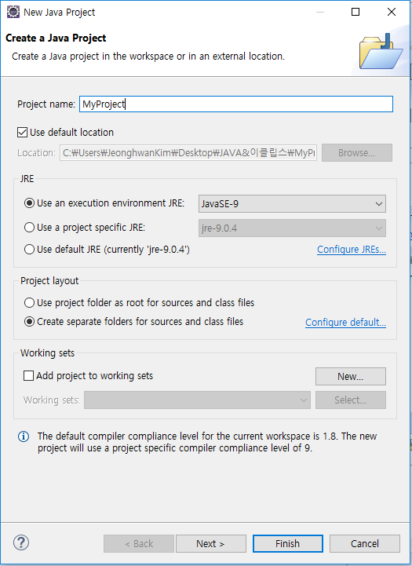
2) “Hello, eclipse!”
Enter your own project name to “Project name” (i.e. MyProject)
Click “Finish” to create your own project.

Slide 19
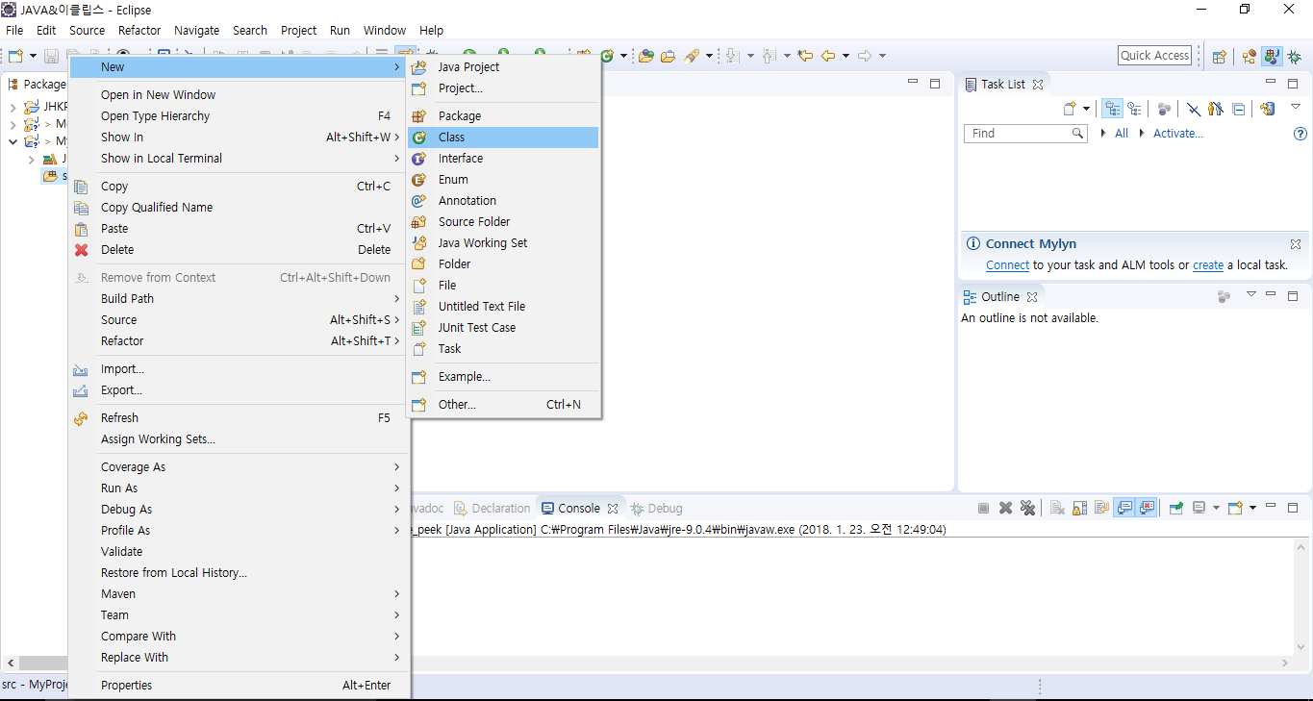
2) “Hello, eclipse!”
Below “MyProject”, click the “src” folder with a right mouse click.
Create a new class by selecting the “Class” section.

Slide 20
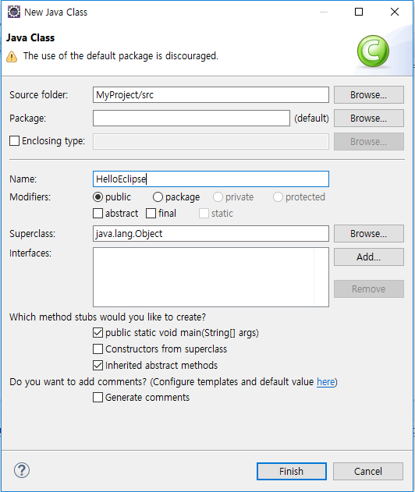
2) “Hello, eclipse!”
Type in “HelloEclipse” in “Name”, and this will be the class name.
Check the “Public static void main(String[] args)” box.
Then you’ll see an automatically created “main function”.

Slide 21
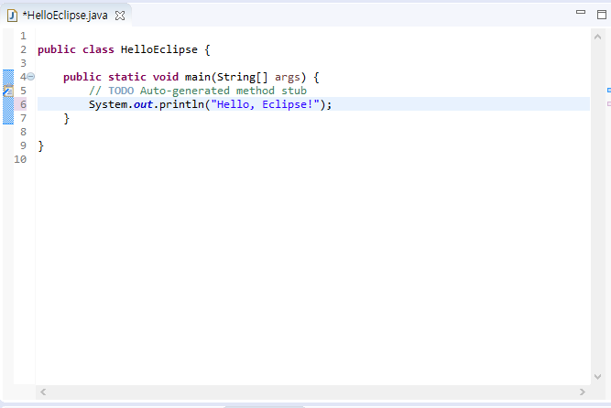
2) “Hello, eclipse!”
Enter the following line within the main function:
System.out.println(“Hello, Eclipse!”);
*This is the same as “printf()” function in C.

Slide 22
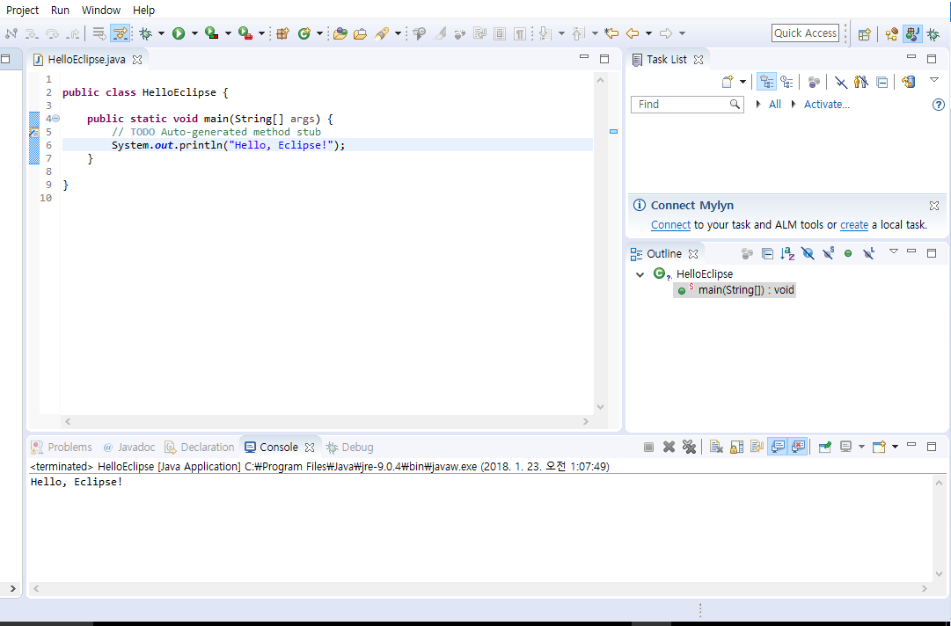
2) “Hello, eclipse!”
If you click the green “Execute” button below, it will automatically compile and execute the code.
In the below console, you will see the result saying, “Hello, Eclipse!”; if you did everything right.

