Slide 1
Sequence Models
Day 4
Ali Ramadan
NLP Team Leader, RDI

Slide 2
Content
Sequential Data
Sequential Tasks
Why RNN?
Sequence Models
Text Examples
Speech Example

Slide 3
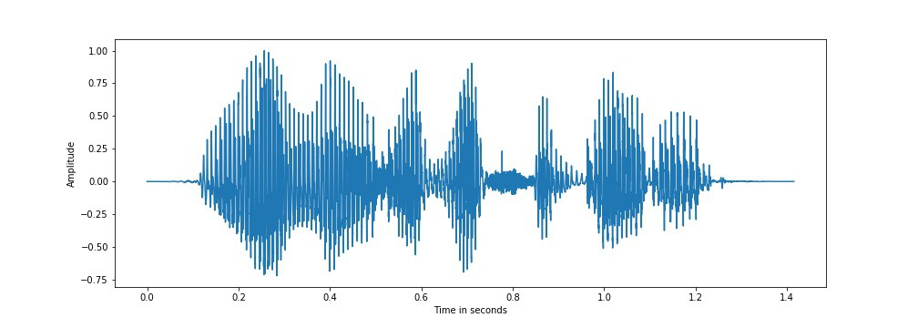
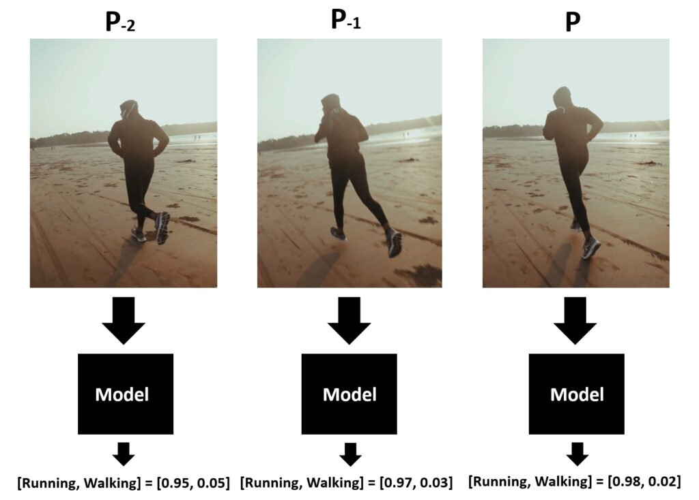
Sequential Data
Audio/Speech
Text
“I wasn't expecting that, very entertaining”
Video

Slide 4
Sequential Tasks Audio/Speech
Input
Task
Output
I wasn't expecting that, very entertaining
Speech Recognition
I wasn't expecting that, very entertaining
Text To Speech
Noise Reduction

Slide 5
Sequential Tasks Text
Input
Task
Output
I wasn't expecting that, very entertaining
Text Classification
Positive
I wasn't expecting that, very entertaining
“لم أكن أتوقع ذلك ، إنه ممتع للغاية”
Machine Translation
Ø
Text Generation
I wasn't expecting that, very good movie

Slide 6
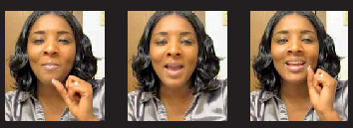
Sequential Tasks Video
Input
Task
Output
Activity Classification
Running
Sentiment Analysis
Positive

Slide 7

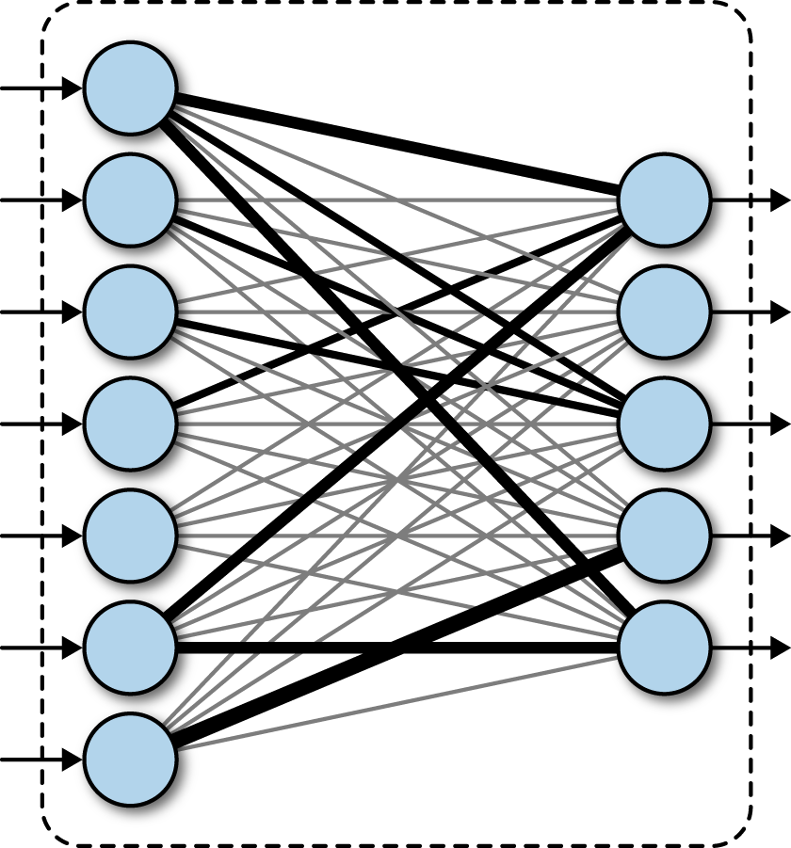
How About Fully Connected?
Speech Classification
Happy
100K Samples
100K

Slide 8

How About Fully Connected?
Speech Classification
I wasn't expecting that, very entertaining
100K Samples
100K

Slide 9













Sequence Models Notation
I wasn’t expecting that very entertaining ……
Input Vectors X
Sequence Length t
$$X^{<1>}$$
$$X^{<2>}$$
$$X^{<3>}$$
$$X^{<4>}$$
$$X^{<5>}$$
$$X^{<6>}$$
$$X^{<t>}$$
$$y^{<t>}$$
$$y^{<5>}$$
$$y^{<4>}$$
$$y^{<4>}$$
$$y^{<3>}$$
$$y^{<2>}$$
$$y^{<1>}$$
Output Target Y
Sequence Length t
لم أكن أتوقع ذلك إنه ممتع للغاية

Slide 10
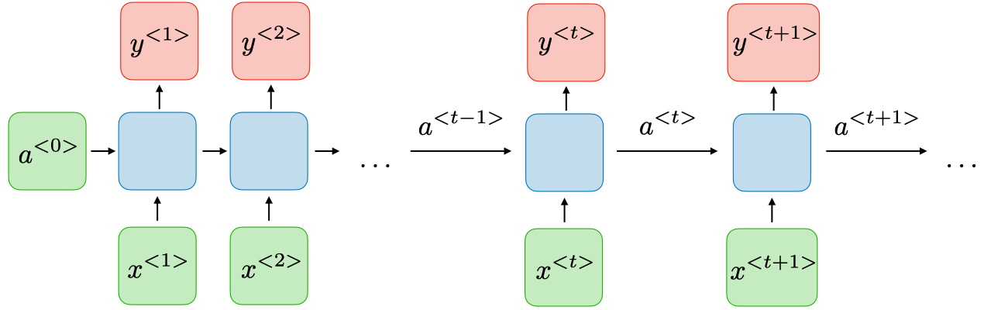
Sequence Models RNN
ɑ >>>> Hidden State

Slide 11
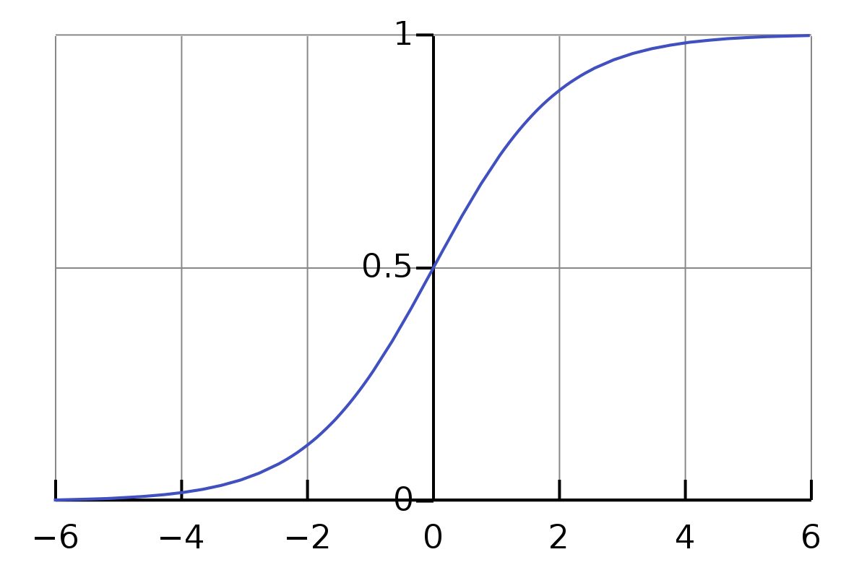
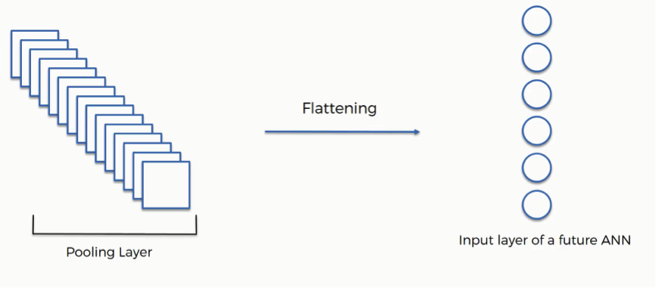
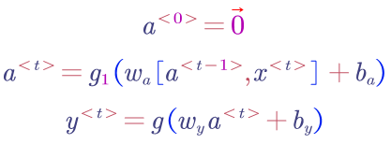
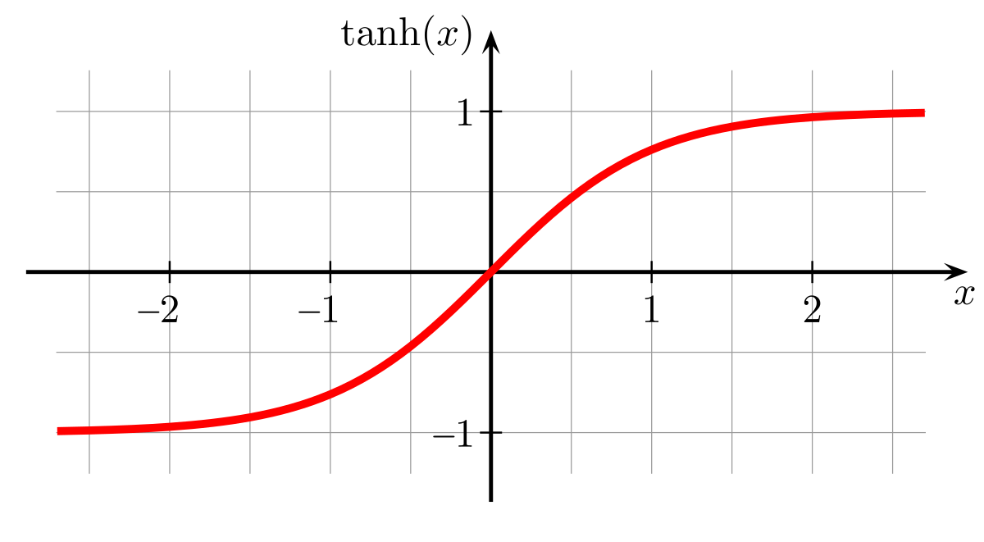








Sequence Models RNN
$$g$$
$$y^{<t>}$$
$$w_{y}$$
$$ɑ^{<t>}$$
$$g_{1}$$
$$w_{a}$$
$$X^{<t>}$$
$$ɑ^{<t−1>}$$

Slide 12
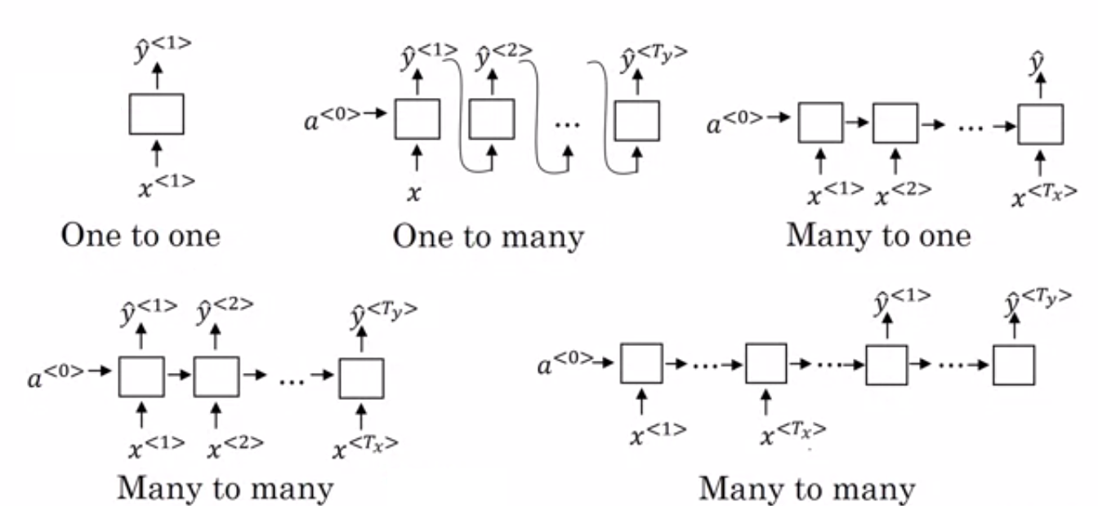
Sequence Models RNN Types
Text Generation
Text Classification

Slide 13
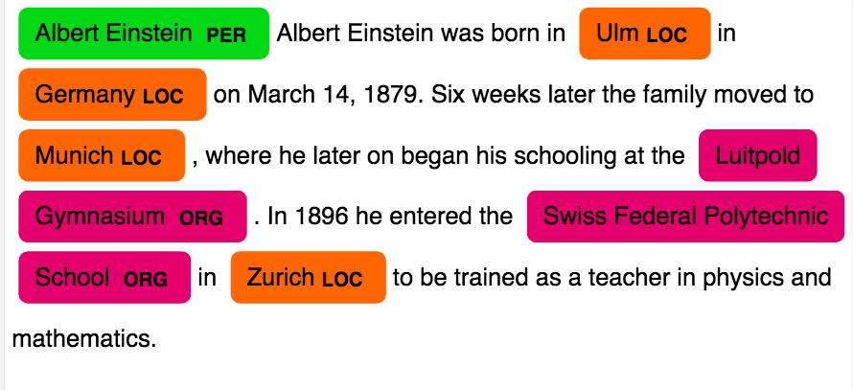

Sequence Models RNN Types
Named Entities Recognition
$$y^{<t>}≫Class$$

Slide 14
Sequence Models RNN Types
Speech Recognition
Machine Translation
Text To Speech

Slide 15

Sequence Models Long Sequence
Forgetting earlier steps
If t = 100 >>> The $ɑ^{<t>}$ will forget $x^{<1>}$

Slide 16
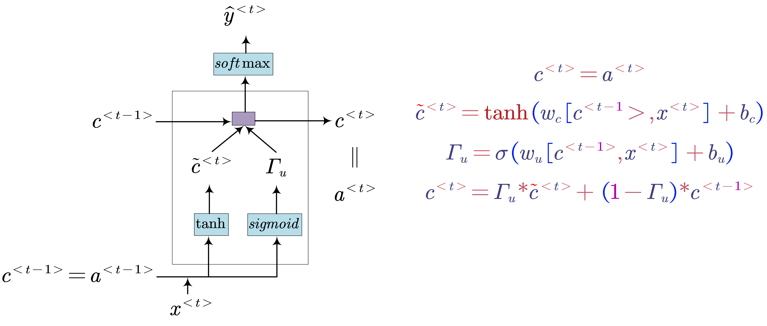

Sequence Models Gated Recurrent Unit (GRU)
C >> Memory Cell
$ℾ_{u}$>> Update Gate

Slide 17
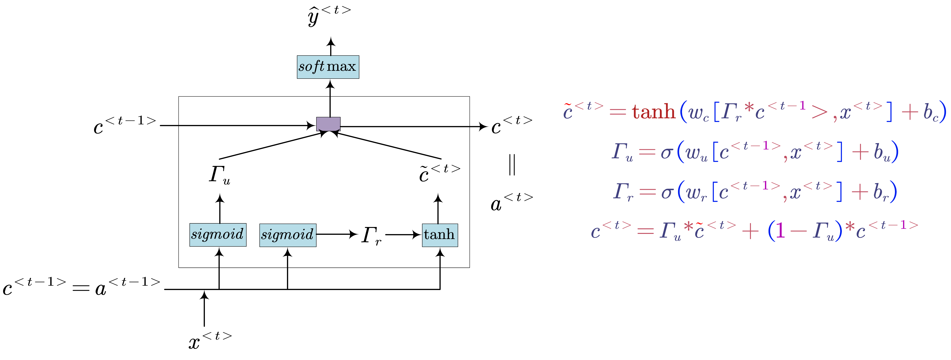


Sequence Models Full(GRU)
$ℾ_{r}$>> Relevance Gate
$ℾ_{u}$>> Update Gate

Slide 18
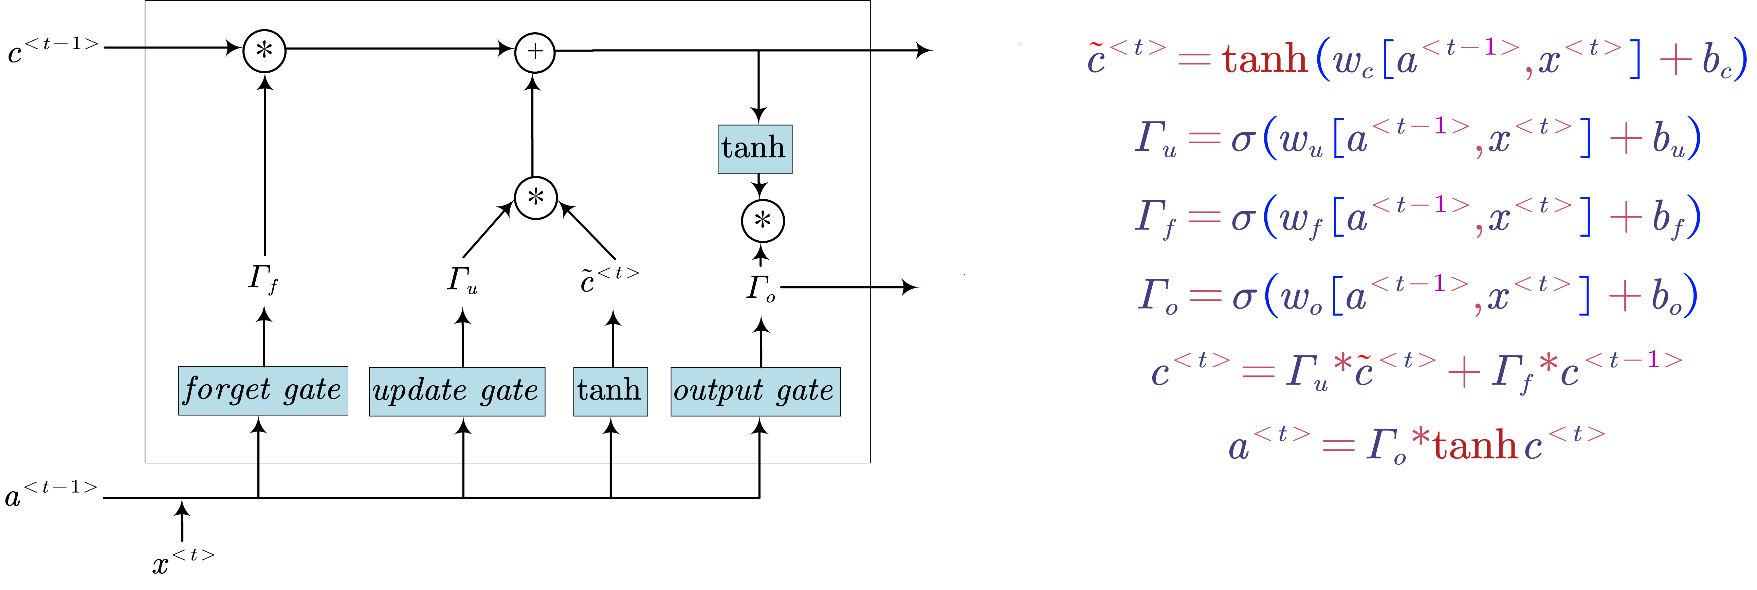





Sequence Models Long Short-Term Memory (LSTM)
$$c^{<t>}$$
$$a^{<t>}$$
$ℾ_{o}$>> Output Gate
$ℾ_{f}$>> Forget Gate
$ℾ_{u}$>> Update Gate

Slide 19
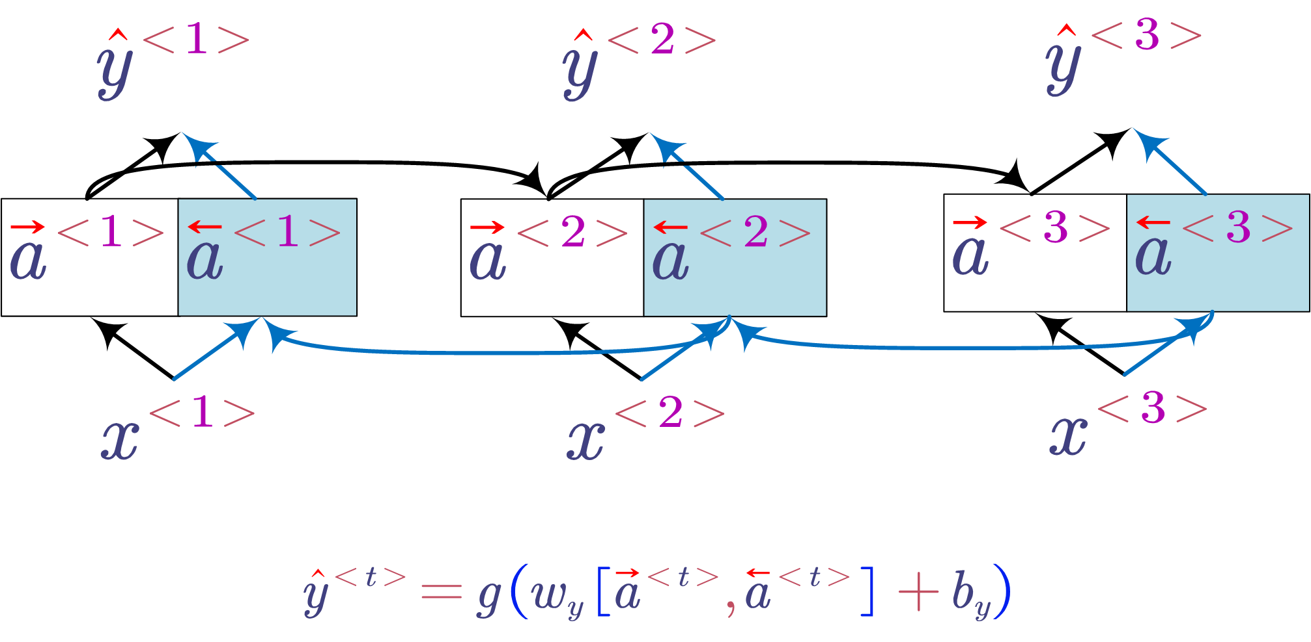
Sequence Models Bidirectional RNN (BRNN)
Two inputs
Two Layers
I wasn't expecting that very entertaining
entertaining very that expecting wasn’t I

Slide 20
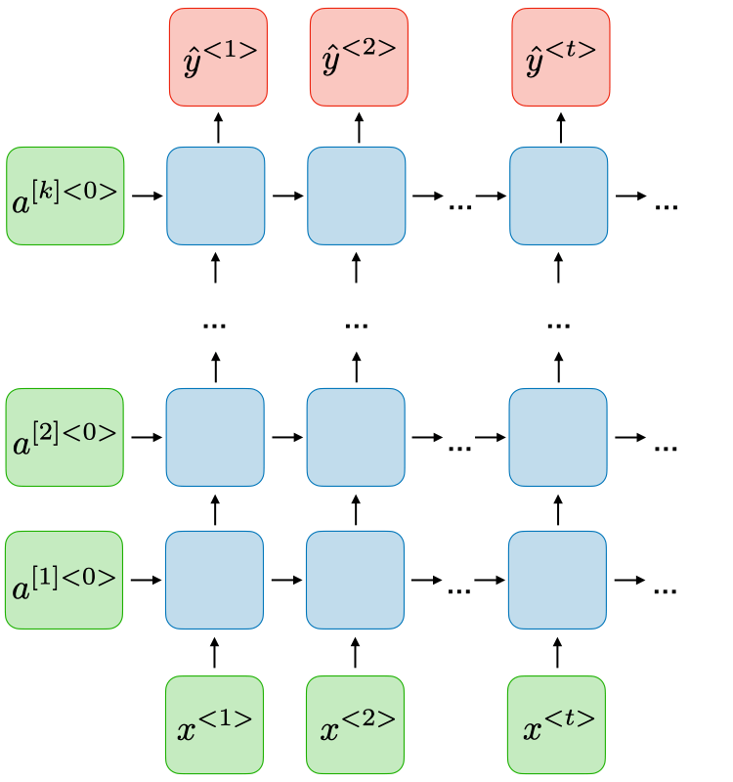




Sequence Models Deep RNN
$a^{[k]<t>}$ >>> Hidden state at layer k and time t
$a^{[k]<t>}$ >>> Is the new input to layers k+1 at time t
$a^{[1]<1>}$
$a^{[1]<2>}$
$a^{[1]<t>}$

Slide 21
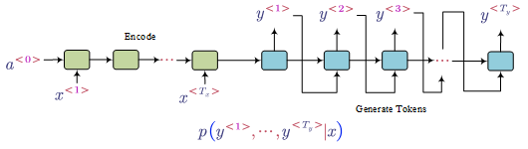









Sequence Models Sequence to Sequence Model
Used In:
Translation
Generation
Recognition
$$=EOS$$
$${ s}^{<1>}$$
$${ s}^{<2>}$$
$${ s}^{<t>}$$
$y^{<1>}$
$y^{<2>}$
Stop when y == EOS token
$$Encoder$$
$$Decoder$$
$${ s}^{<t> }≫Decode Hidden state$$

Slide 22
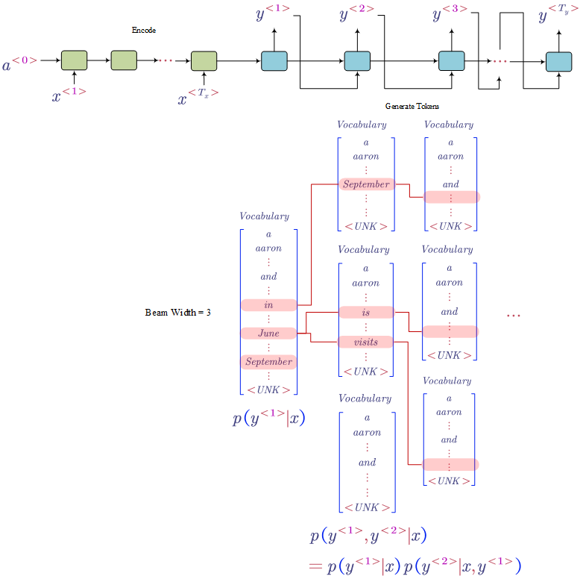

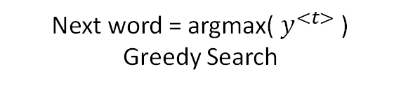
Sequence Models Sequence to Sequence Model
How to pick next word from${ y}^{<t>}$ ?
Next word = argmax(${ y}^{<t>}$ )
Greedy Search
Next word = search in top N words
Beam Search

Slide 23
Sequence Models Attention
C >> Context Vector >> Last Hidden State
To generate words, we just see C (last state)
$y^{<1>}$
$y^{<2>}$
I
wasn't
expecting
that
very
entertaining
للغاية
ممتع
إنه
ذلك
أتوقع
أكن
لم

Slide 24

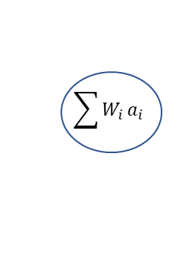


Sequence Models Attention
New context vector $c_{i}$
$$\sum{W_{i}}a_{i}$$
Hidden states weights $W^{<t>}$
0.5
0.2
0.7

Slide 25
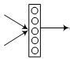


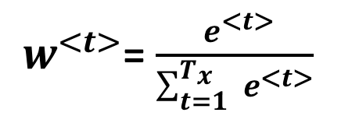



Sequence Models Attention
$$\sum{W_{i}}a_{i}$$
Hidden states weights $W^{<t>}$
${ w}^{<t>}$= $\frac{{ e}^{<t>}}{\sum_{t=1}^{T_{x}}{{ e}^{<t>}}}$
0.5
0.2
0.7
$${ s}^{<t−1>}$$
$${ e}^{<t>}$$
$${ a}^{<t>}$$

Slide 26
Sequence Models Text Examples
Positive
Negative
Neutral
Text Classification
I wasn't expecting that, very entertaining

Slide 27
Sequence Models Text Examples
Loc
Per
Org
Named Entities Recognition
Albert Einstein was born in Germany

Slide 28






Sequence Models Text Examples
Word1
Word2
Word3
“لم أكن أتوقع ذلك ، إنه ممتع للغاية”
$$=EOS$$
Machine Translation
$${ s}^{<1>}$$
$${ s}^{<2>}$$
$${ s}^{<t>}$$
$y^{<1>}$
$y^{<2>}$
$$Encoder$$
$$Decoder$$
I wasn't expecting that, very entertaining

Slide 29
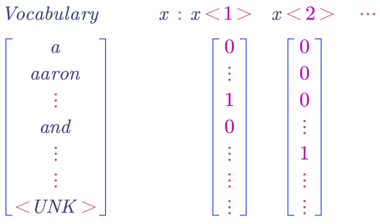
Sequence Models Word Representation
I
Wasn't
One Hot
N = Vocab Size

Slide 30

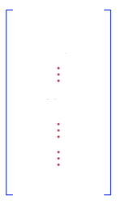
Sequence Models Word Representation
Words Frequency
10000
50
What if N = 1M words?
Corpus
One Hot
50000
2000
Select Top frequencies
N = 10000

Slide 31
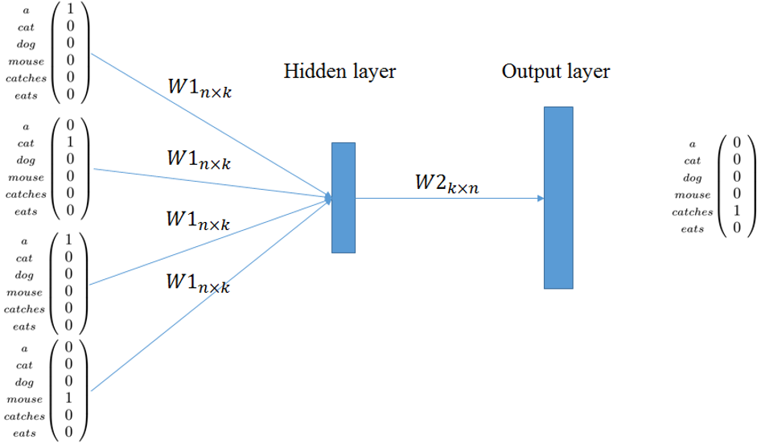
Sequence Models Word Representation
Word Embedding
Continuous bag of words (CBOW)
Output missing word
catches
N >> vocab size
K >> embedding dimension
Input Context
a cat --- a mouse

Slide 32
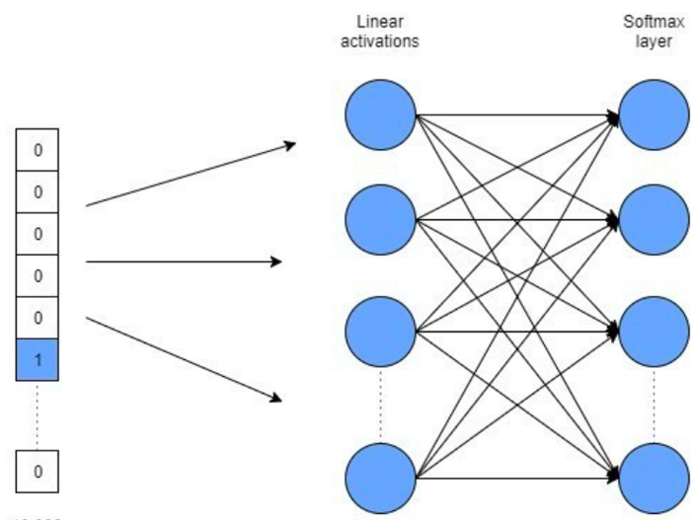
Sequence Models Word Representation
Word Embedding
a
cat
Skip-gram model
a
Mouse
Input Mid word
catches

Slide 33
Sequence Models Word Representation
a
Word Embedding
OOV words have same vector
cat
Out Of Vocab Words OOV
a
Fasttext Model
Mou se
Input Mid sub words
cat ch es
N >> Sub words vocab size
K >> embedding dimension

Slide 34
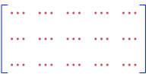
Sequence Models Word Representation
OOV Embedding
Word Embedding
OOV Word:
catches
Average
Fasttext Model
Sub words embeddings
OOV sub words:
Cat ch es
Catch es
C a t ch es
Fasttext Model

Slide 35
Sequence Models Word Representation
Words with same context has similar vectors
Train your own embedding
Word Embedding
Just change the target
It was so good
It was so bad
Sentiment Classification

Slide 36
Sequence Models Word Representation
Words with same context has similar vectors
Supervised Word Embedding
It was so good
It was so bad
Sentiment
Classes

Slide 37
Sequence Models Text Examples
Positive
Negative
Neutral
Text Classification
Word embeddings
I wasn't expecting that, very entertaining

Slide 38


Sequence Models Text Examples
Positive
Negative
Neutral
Average
$$a^{<1>}$$
$$a^{<2>}$$
Text Classification
Concatenation
Word embeddings
I wasn't expecting that, very entertaining

Slide 39
Sequence Models Text Examples
Word1
Word2
Word3
Machine Translation
“لم أكن أتوقع ذلك ، إنه ممتع للغاية”
$$=EOS$$
$${ s}^{<1>}$$
$${ s}^{<2>}$$
$${ s}^{<t>}$$
How many words?
$y^{<1>}$
$y^{<2>}$
Words could be 1M
SoftMax with 1M unit
$$Encoder$$
$$Decoder$$
I wasn't expecting that, very entertaining

Slide 40
Sequence Models Text Examples
Sub-Word1
Sub-Word2
Sub-Word3
Machine Translation
“لم أكن أتوقع ذلك ، إنه ممتع للغاية”
$$=EOS$$
$${ s}^{<1>}$$
$${ s}^{<2>}$$
$${ s}^{<t>}$$
How many words?
$y^{<1>}$
$y^{<2>}$
Words could be 1M
$$Encoder$$
SoftMax with 1M unit
Sub-Words Embeddings
$$Decoder$$
Sub-Word1
Sub-Word2
Sub-Word3
I wasn't expecting that, very entertaining

Slide 41
Sequence Models Text Examples
“لم أكن أتوقع ذلك ، إنه ممتع للغاية”
Attention
Bidirectional
Deep
Machine Translation
RNN
LSTM
GRU
CBOW
Skip-Gram
Fasttext
Your Own Embedding
Word Embedding
Sub-Word Embedding
I wasn't expecting that, very entertaining

Slide 42
Sequence Models Speech Example
Positive
Negative
Neutral
Audio Classification

Slide 43
Sequence Models Speech Example
Input Speech
N samples = 3200
0.2 Sec
N samples = 160
0.01 Sec = 10ms
“A”
Frame
Sampling Rate = 16K
N Seconds = 5 Secs
1 second = 16k
1second = 100 frame
5 seconds = 500 frame
N samples = 5 X 16k = 80K Samples

Slide 44
Sequence Models Speech Example
Input Speech
N samples = 160
0.01 Sec = 10ms
MFCC
Frame
13 OR 40
Sampling Rate = 16K
N Seconds = 5 Secs
N samples = 5 X 16k = 80K Samples
1 second = 16k
1second = 100 frame
5 seconds = 500 frame
5 Seconds = 500 X 40

Slide 45
Sequence Models Speech Example
Positive
Negative
Neutral
Audio Classification
MFCC
40 X 500

Slide 46
Sequence Models Speech Example
Letters
Sub-Words
Words
“لم أكن أتوقع ذلك ، إنه ممتع للغاية”
$$=EOS$$
$${ s}^{<1>}$$
$${ s}^{<2>}$$
$${ s}^{<t>}$$
Speech Recognition
$y^{<1>}$
$y^{<2>}$
$$Encoder$$
$$Decoder$$
MFCC
40 X 500

Slide 47
Sequence Models Speech Recognition (ASR)
Letters
Sub-Words
Words
“لم أكن أتوقع ذلك ، إنه ممتع للغاية”
$$=EOS$$
$${ s}^{<1>}$$
$${ s}^{<2>}$$
$${ s}^{<t>}$$
$y^{<1>}$
$y^{<2>}$
Input time steps 500
$$Encoder$$
Output time steps ~ 30
$$Decoder$$
MFCC
40 X 500

Slide 48
Sequence Models Speech Recognition (ASR)
Letters
A
B
C
Input time steps 500
Output time steps 500
MFCC
40 X 500

Slide 49
Sequence Models Speech Recognition (ASR)
Letters
A
B
C
N samples = 3200
0.2 Sec
“A” >> 20 Frame
MFCC
40 X 500
In Training we do not have frame level annotation

Slide 50


Sequence Models Speech Recognition (ASR)
Letters
A
B
C
N samples = 3200
0.2 Sec
HMM
“A” >> 20 Frame
MFCC
40 X 500
In Training we do not have frame level annotation
AAAAA BBBB CCCC ….

Slide 51




Sequence Models Speech Recognition (ASR)
Letter
FC
SoftMax
MFCC
40 X 500
We can use other layers?
Dense Layer
$${ F}^{<t−1>}$$
$${ F}^{<t>}$$
$${ F}^{<t+1>}$$
Context = 2

Slide 52


Sequence Models Speech Recognition (ASR)
Letter
SoftMax
CNN
CNN
MFCC
40 X 500
We can use other layers?
$${ F}^{<t−1>}$$
3 X 40
$${ F}^{<t>}$$
$${ F}^{<t+1>}$$
Context = 2

Slide 53

Sequence Models Speech Recognition (ASR)
ASR Framework
CNN
RNN
FC
MFCC
HMM

Slide 54


