Slide 1

Python Programming
Inheritance Homework 1

Slide 2
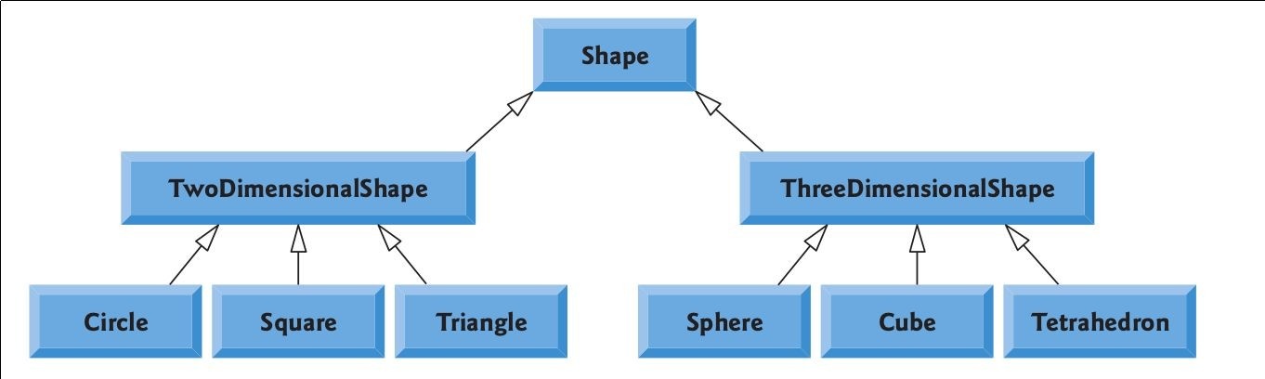
Problem #1: Build Hierarchy
Design set of classes (no data/functions) to express this classes hierarchy
Img Src

Slide 3
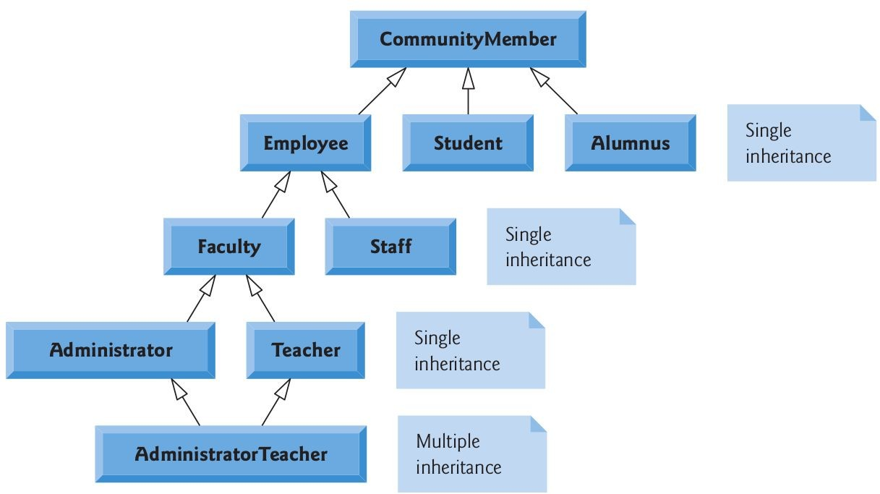
Problem #2: Build Hierarchy
Design set of classes (no data/functions) to express this classes hierarchy
Img Src

Slide 4
Problem #3: Customer Requirement
While taking to a customer asking to build a web application for their app he said: “In our system, customers may pay money with cash, cheque, credit or debit card”
Each order in the system should indicate how money was paid
Design set of classes that can potentially represents such requirement
Mainly classes, no attributes

