Slide 1

Introduction and User Guide
JOverseer was created and programmed by
Marios Skounakis
User Guide was authored by
Brad Brunet
The web site for JOverseer where you can download
the program and find various other information is
http://code.google.com/p/joverseer
June 10, 2008

Slide 2
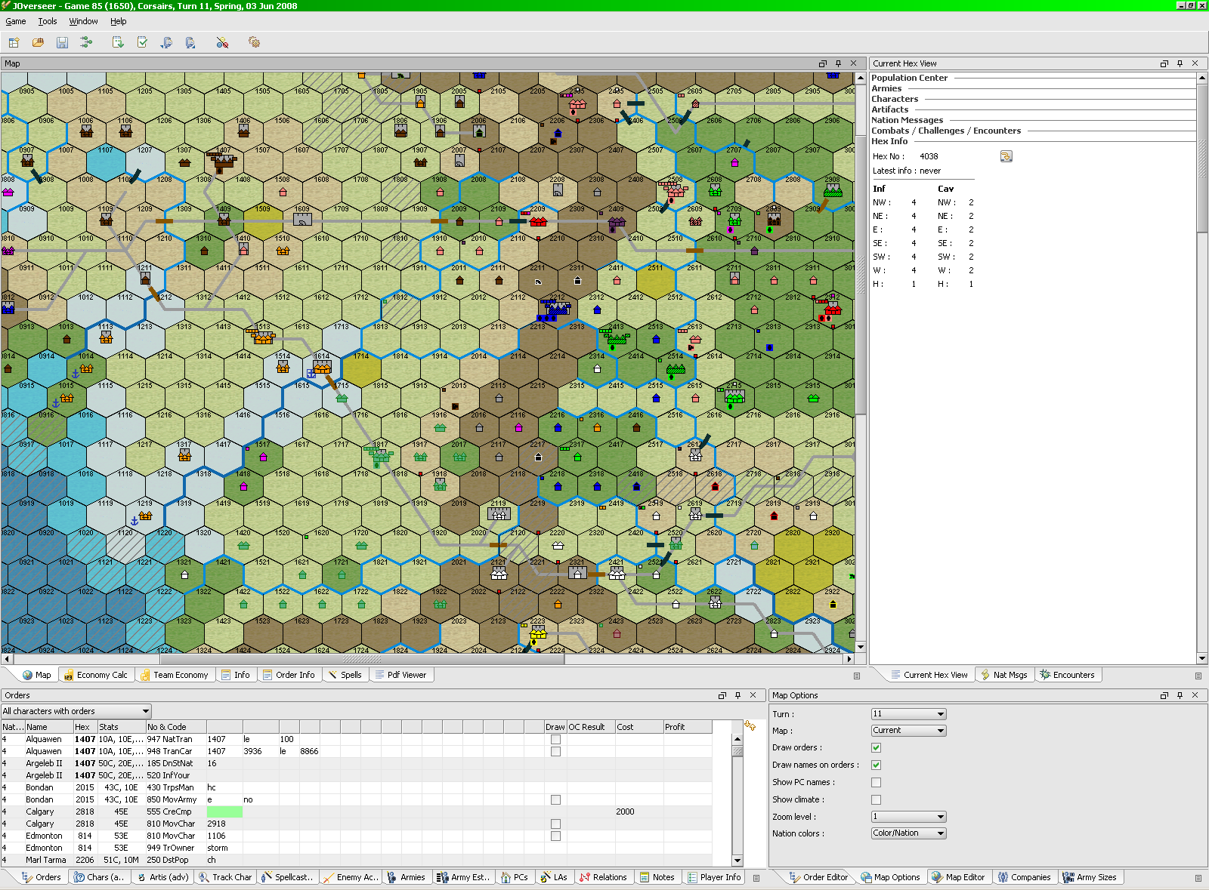

Some Important Terminology
As I go through, I’ll be using some words that may not be intuitive. If I use the word
Quadrant, it refers to one of the 4 sections of the program, the Map areas being the
largest. Within each quadrant, I’ll frequently use the word Pane or Tab. This refers to the
different information sheets available within each Quadrant.
Quadrants:
Tabs

Slide 3
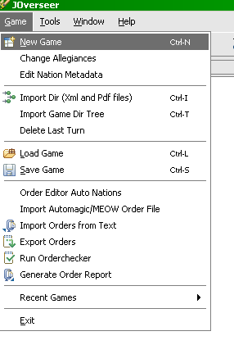
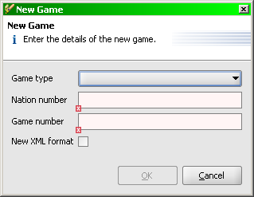
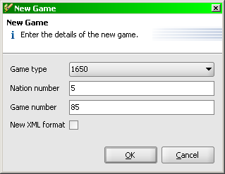
Setting Up a New Game
From the Game menu, select New Game. The New Game dialogue will pop up, enter your relevant information. Check the New XML box if applicable, then click Okay.
Nation Number allows JOverseer to know where to centre the map when you open the game.

Slide 4
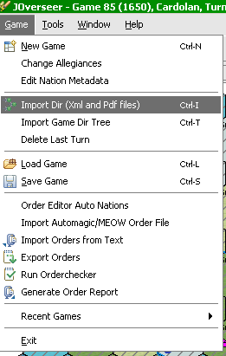

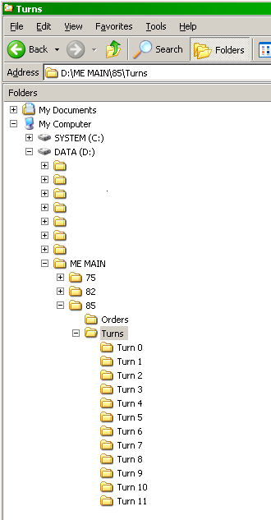
You’ll notice the Import Dir feature has it’s own icon on the main toolbar.
Keep your files together, both pdf and xml’s.
DO NOT IMPORT PDF’s ALONE!
You will get errors. You can import XML’s
alone, but you’ll lose many information
features available from the parsed text, etc.
See the Import Game Dir Tree option. This
will allow you to import as many turns as you
have for a game already in progress. As long as your folders are named in a similar manner as mine are to the right. Select this
option and you would highlight the Turns folder in my example to import the entire game up to Turn 11~! Otherwise, the Import Dir option requires you that point directly to the folder that contains your turn.
Happily, JOverseer remembers your last turn folder for each game, so you won’t have to start at My Documents and search every turn!

Slide 5
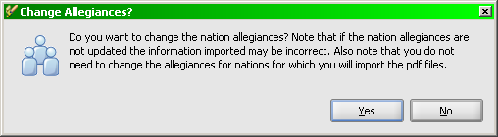
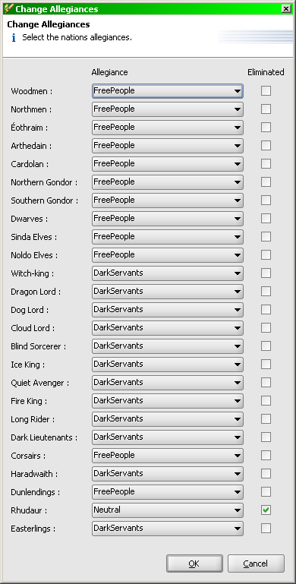
Every Time you Import a Directory, you’ll be asked if you want to adjust Allegiances. The program will stop asking when all neutrals have been aligned.
Here I’m setting Turn 0 up for a Grudge Game. Not a Standard WC, and it didn’t work out very well for the DS, so I don’t recommend this set up.. ☺

Slide 6
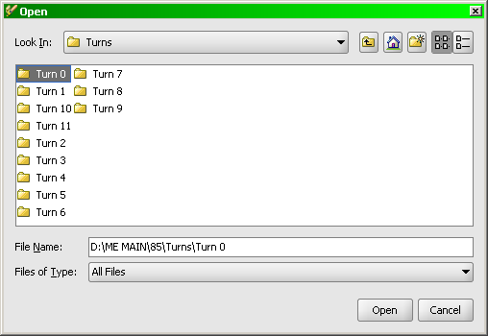
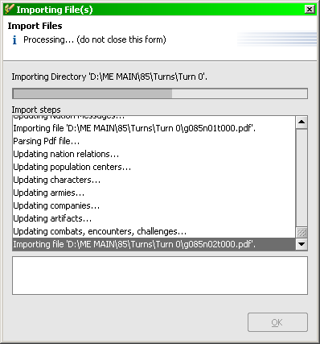
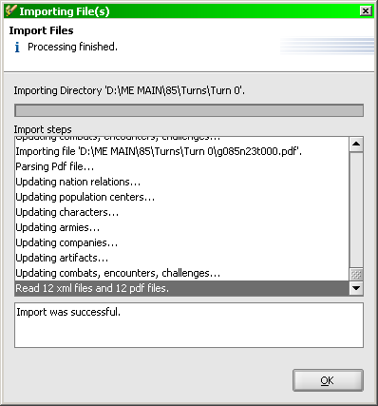
Direct JOverseer standard dialogue to your Turn 0 folder and select Open.
Once you Open, the Import Files dialogue will open. Let it run, it’s quite quick, then you can select OK when it’s finished. If there are any error messages, they’ll be displayed at this point.

Slide 7
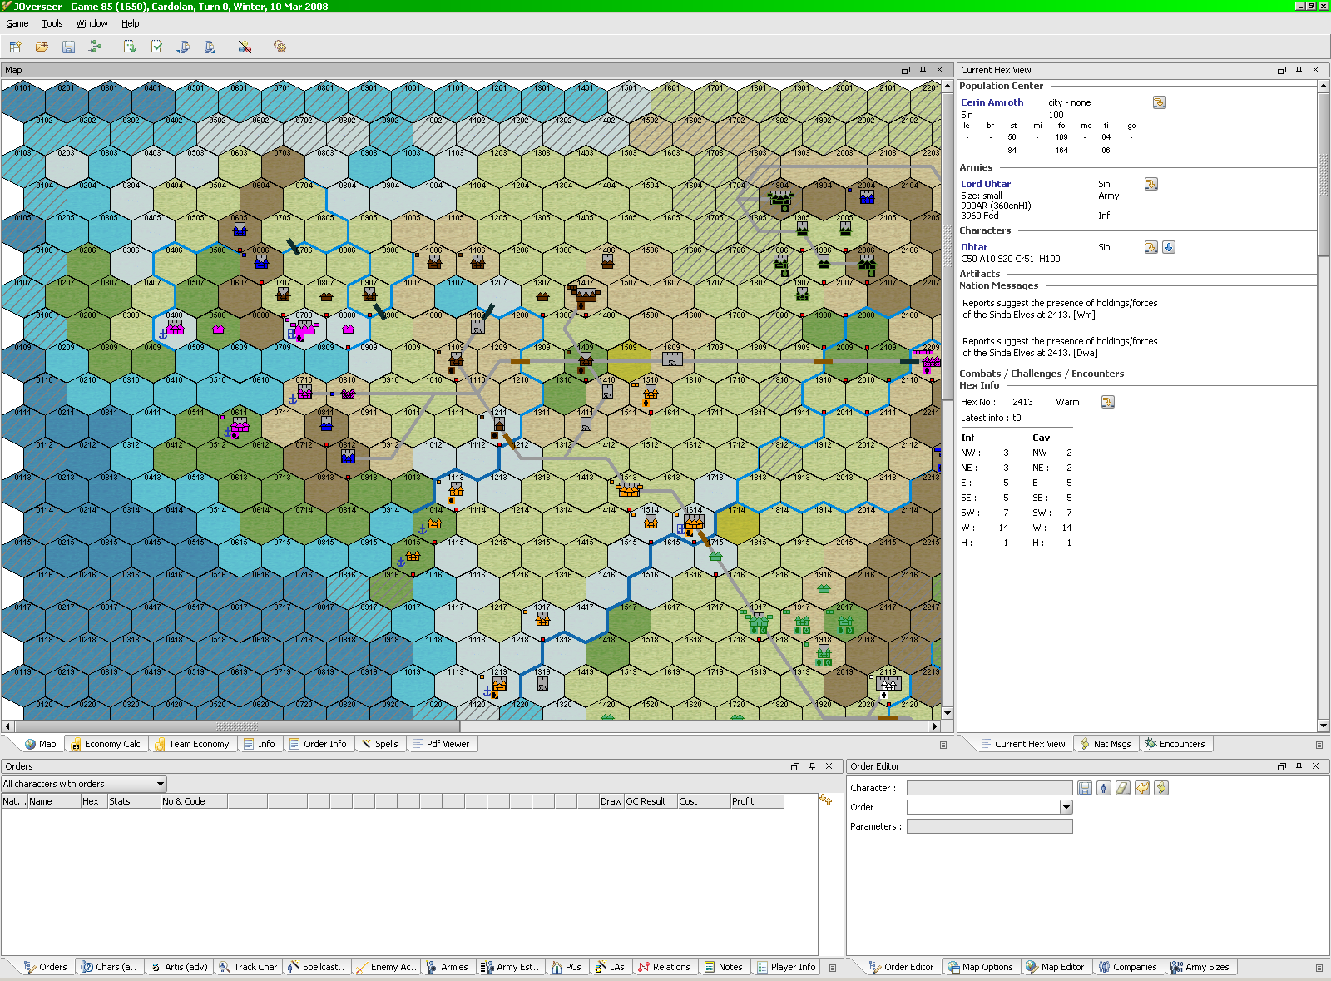
Congratulations! You are ready to manage your MEPBM experience like never before!
From this point on, I’ll review some of the basic features showing some of the information available, order creation/checking/export, map drawing and exporting the map file.

Slide 8
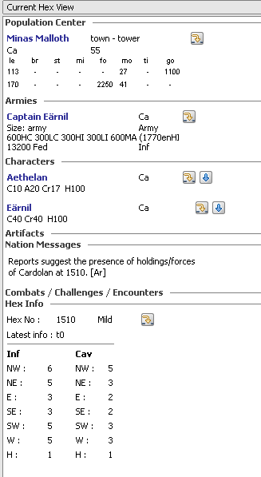

Current Hex View
Is where you’ll be looking easily 50% or more of the time. Population Centre information, Armies, Characters, Encounters, Nation Messages, Movement tables, etc. It’s worth exploring all the features of this area under the drop downs and arrows available. Take some time to get acquainted with what is provided for you here.

Slide 9

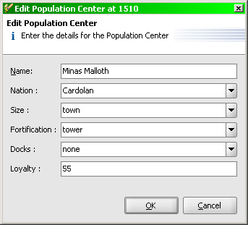
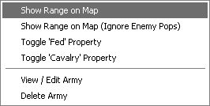
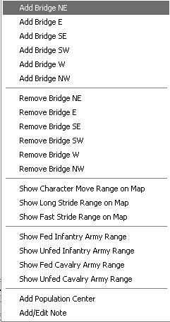
These “Show” features are amongst the coolest
you’ll come across! I’ll choose to show the range
of Earnil’s army and also the Character Move
Range on Map on the next page.

Slide 10
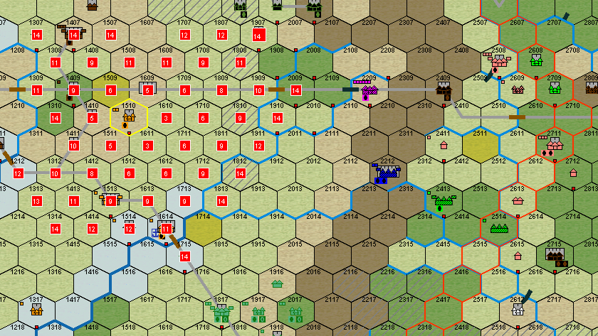
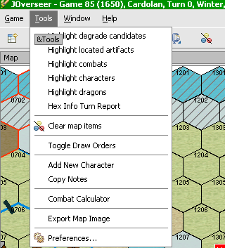
Earnil’s army range is represented by the red numbers on each hex – the Fed movement point at which the army will get you there. Note, there is also the Toggle Fed Property feature that allows you to show the movement after picking up food (340 order), or vice versa.
The Character Range is shown by the hexes outlined in red 12 from the hex selected. Long Stride, Far Stride, etc, also available.
Okay, we’re actually getting ahead of ourselves here, not surprising, most people want to just dive right in and hack around. Let’s find what one might imagine is an extremely important toolbar button for when we’re filling the map up with overlaying chaotic movements, ranges, etc.....
Also found in the Tools Menu, the Clear Map Items
button will rid our tired eyes of all these drawn ranges
and Highlighted items we haven’t covered, but as
per the menu on the left, are other options you can
guess we can draw on the map! Again, we’re getting
too far ahead of ourselves.

Slide 11
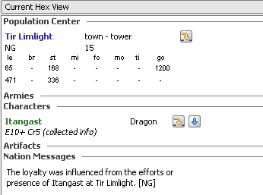

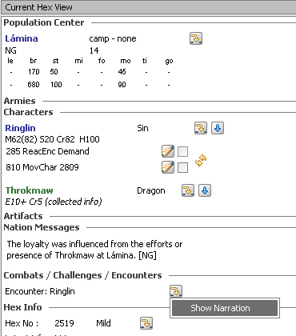

Map Features
There are lots of little dots and items on the map that direct you to Current Hex View.
Characters and Icons are pretty self explanatory. But there are lots of other items and dots you
see around. See below. In the top left, you see what looks like a Character icon, it is – but it’s
a Dragon! At the bottom, the red dot will always represent a Nation Message regarding that
hex.
For All Combats, Challenges, and Encounters,
You’ll get the option to Show Narration. This is
the actual text parsed from the pdf.
For the record, this is a 1 week turnaround Grudge Game, so by the time any of our opposition reads this, Thranduil with Throkmaw will
have already cleared out Morannon for a Woodmen army with War Machines to burn the place... ;)

Slide 12
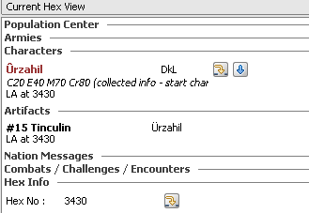

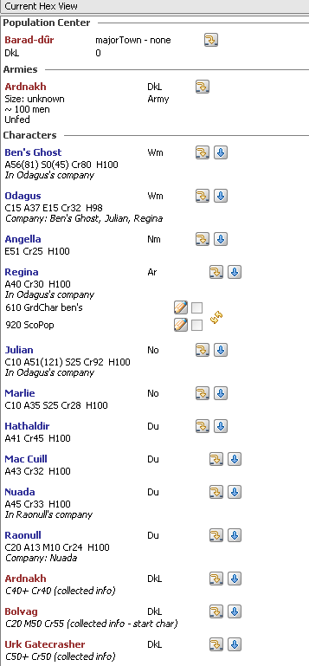

The Grey character icons are those that the program knows about but will not assume
to know the nation – because it hasn’t been reported. In this case, the Blue dot is an
LA/LAT spell showing an artefact. This is how we know Urzahil is here.
Here, you can see our ScoChar
Order has identified the nation of
the characters, so their character
icons on the map are showing
the appropriate colours. Unlike
Palantir, all characters and up to
5 Armies per allegiance actually
appear here – more complete info.

Slide 13
Here also, you’ll notice that a
Recon or Palantir has discovered
the Army Commander and the
approximate number of troops.
In Current Hex View, any orders
saved with the game file will
show here. You’ll also see how
company members are noted, so
you won’t forget to move or Join
Company if necessary!

Slide 14
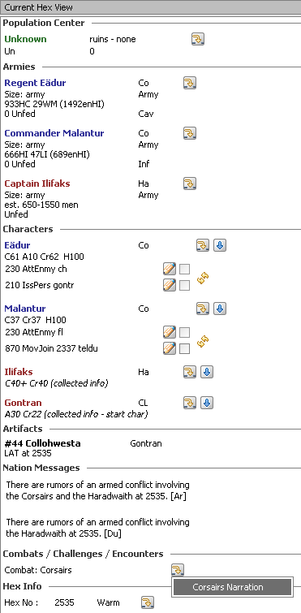

The Pink icon as illustrated below reflects a
Combat occurring in this hex, with the related
Narration parsed from the pdf for your reading
pleasure.
See how the Harad characters Ilifaks is listed
as a C40 from “collected info”. That reflects
his Title as shown due to him leading an Army,
or similarly from a ScoChar order. Challenge
Rank is also included (“Cr”) as best assumed
from the information available.
Note: this information is inferred from the Character
Title as per the tables in the rule book, also included
in the Info Pane of JOverseer
If you can imagine this icon is a horse’s head, then you would understand why it
represents an All Cavalry army.

Slide 15
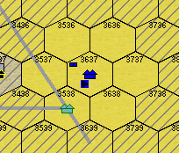
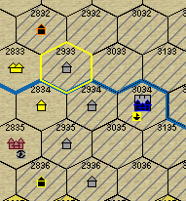
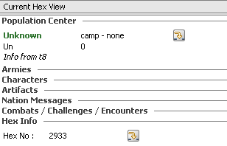
The Crossed Out areas represent hexes that are neither
on your map nor have an uploaded population centre on
them. This very clearly will identify the “off map” hexes
once all your files are loaded.
Everything that is known is colour coded (these colours can be adjusted in your
preferences). So the Grey icons, dots, pops, etc, are therefore Unknown. From the
map below, you see we have Unknown camps on crossed out areas that are not on
our turn files. Current Hex View for the selected hex (outlined in Yellow) tells the
tale – we did a Recon or Palantir that displayed this unknown camp on turn 8.
I’ve been working with this program exclusively for months, and have rigorously tested much,
but only in the writing of this document did I know, for example, that ‘Pink’ dots were Combats.
There is so much information displayed that one mustn’t feel bad for not knowing everything,
but providing Current Hex View is one of your default Panes displaying, a quick scan of your
map and curious Clicks on hexes where you do see Dots and Icons will allow you to get to
know the information capabilities of the program.
Now we’ll move into actually using the program to write, draw, check, and export our orders.

Slide 16
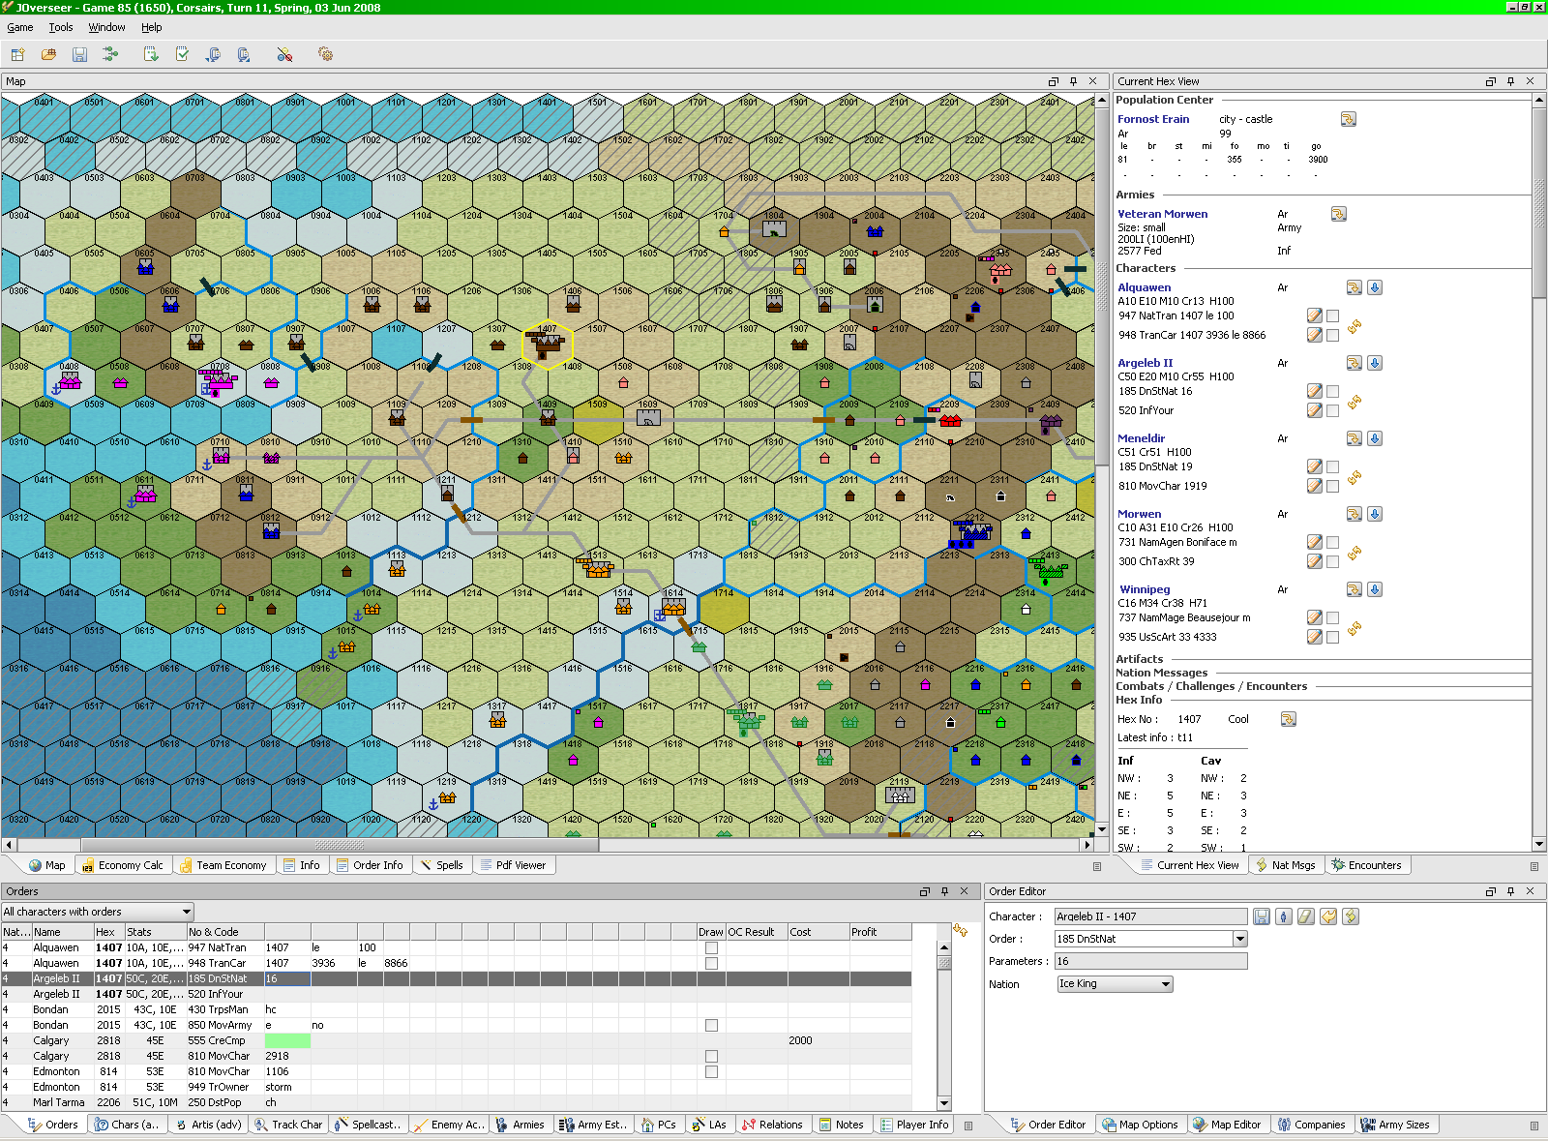
Orders
Current Hex View
Orders Pane
Order Editor
Here I’m doing orders for Arthedain. I’ve selected hex 1407 and am checking the orders for
the characters there. You’ll see Current Hex View has the orders highlighted, I’m
showing the Orders pane at the bottom and have selected one of Argeleb’s orders in the
Order Editor pane (bottom right). These are more detailed on the next page.

Slide 17
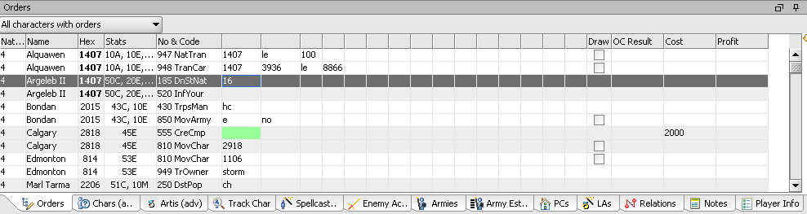
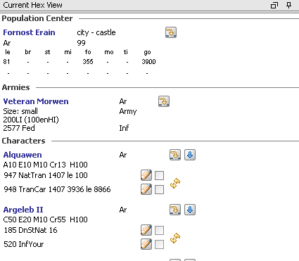
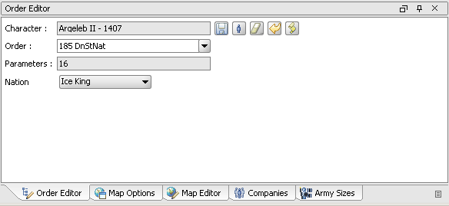
It’s possible to enter orders in the Orders pane as
illustrated above, excepting you will have to tab from
field to field and ensure you get the parameters in the
correct order. Or, you can use the Order Editor as
below. Simply click on the pencil icon beside the
order and the Order Editor opens up.
You can type the Order Number until it appears, or
choose from a drop down. Orders that the character
does not have the skill to perform will not be allowed.
Once the order is selected, the Parameters will present themselves. Here, a 185 order will provide a drop down of nations to select from.
In the Order Editor, there is Tab capability, it really takes getting used to, but is quite easy and intuitive.

Slide 18
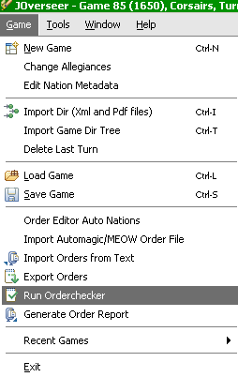
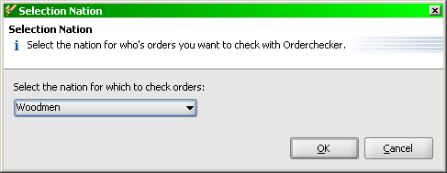
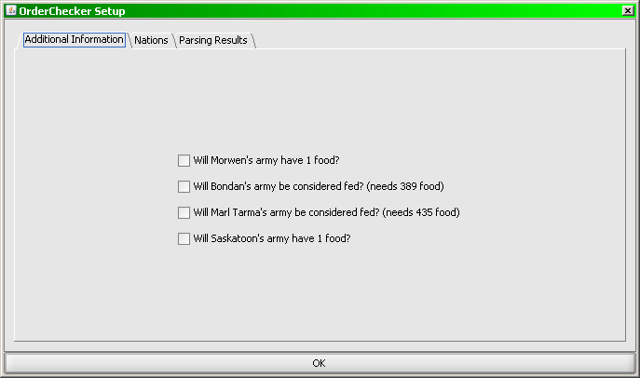
Order Checker
Choose Run Order checker from the Game menu,
Select your nation and away you go.
This is the program you might already know simply
embedded into JOverseer. The creator of JOverseer
cannot support this software add-on. It’s included here
as it’s an extremely popular program and therefore fits
into an “everything” type of program.

Slide 19
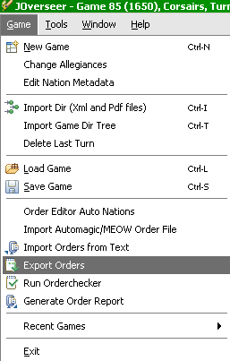
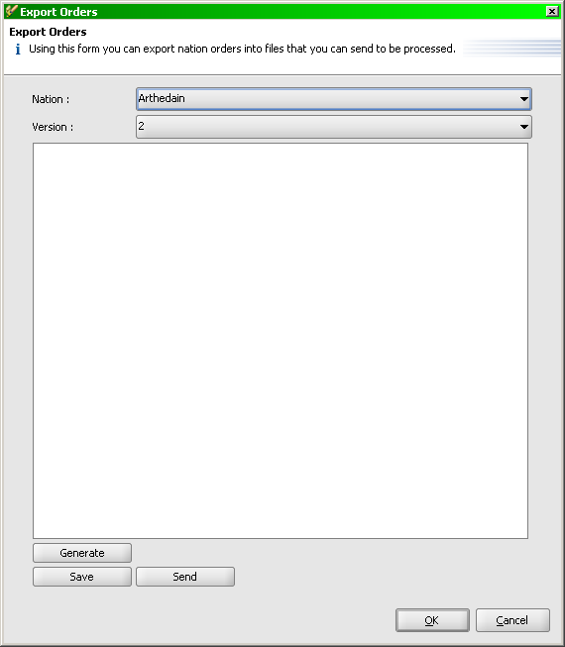
Exporting Orders
Providing you have the ability to connect to the
Internet, you can send your orders directly via the
meturn.com protocol. Or, you can simply create the
auto-order file and save it to email/upload later.
Choose your nation, the Version might require updating,
but if you’ve been saving your file properly, it will be
correct. Click Generate, then either Send or Save.

Slide 20
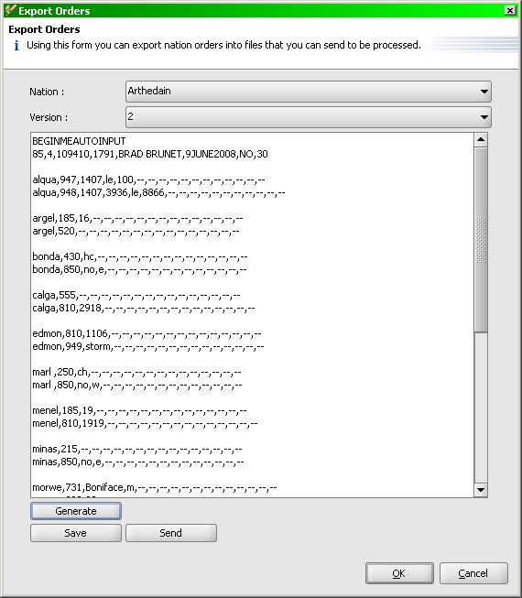
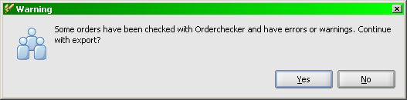
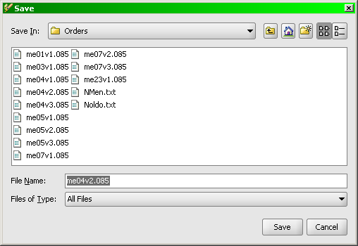
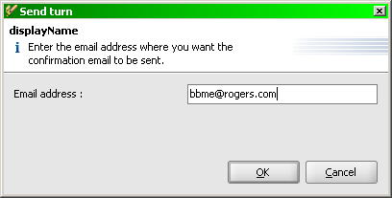
I’ll illustrate the 7 step process
to Export (Save then Send)
your orders.
After you’ve Saved them, you’ll
Send them, then the program
wants you to Save your game.
it’s the prudent thing to do
it allows JOverseer to know
which order file Version you are
on so the next update you have
to send, it will ensure your file
is named properly.
1
2
3
4

Slide 21
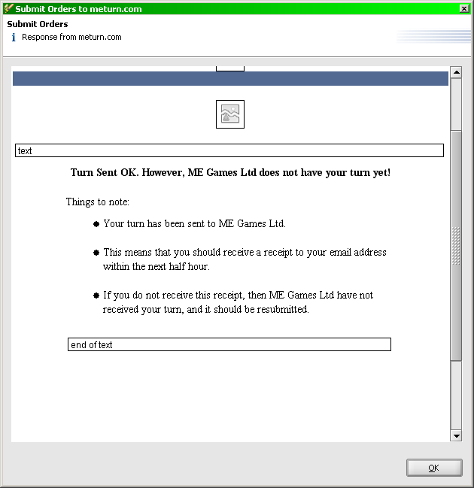
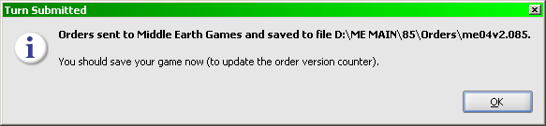
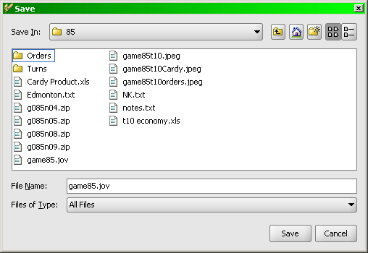
5
6
7

Slide 22
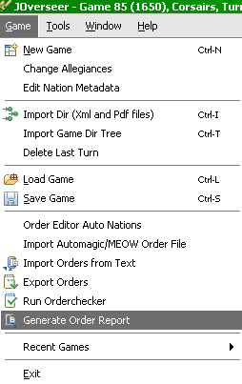
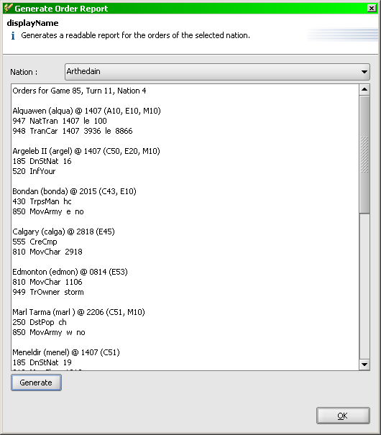
Generating an Order Report
Providing you want to share your orders with your allies,
select Generate Order Report from the Game Menu.
Select your nation and click Generate, and your orders
will display in text format.
Unfortunately, you have to use your mouse to Highlight the
orders then use Ctrl-C to Copy them to the Clipboard in
order to Paste them into a text file or email. I’ve been
nagging the developer about this one..!
You can continue by choosing another nation (multi
nation games) and click Generate again....repeat.

Slide 23
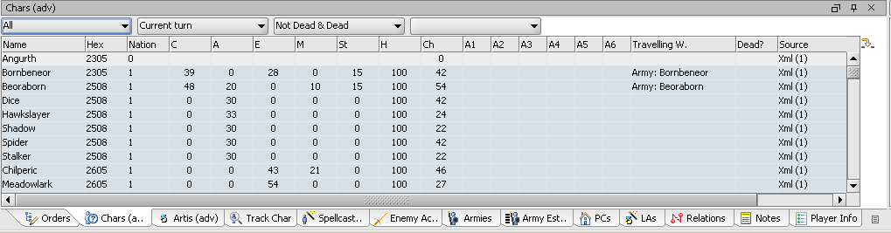
End of the Introduction!
You’ve now Created a New Game, Loaded a turn’s worth of information, checked out the map,
created orders for your characters, checked them with Order Checker, Exported them directly
to meturn.com, and then copy-pasted a text version of them to distribute to your nosy allies.
Congratulations!
But you’ve been able to do that before you found JOverseer...so why did you bother? Sure,
it might be handy to have all that in a single application, and since it’s free you can’t really
complain...but why all the fuss?
I’ll get into a lot of the fuss in the next pages. There is a lot of fuss for good reason, frankly,
and there really isn’t any easy way to get into it all without dragging you through hundreds of
pages of this... I’ll take you through a few items to illustrate, and leave you to explore the rest
of the program on your own.
The Way the Tabs Work
Every tab shows information. All column headers can be sorted on by double clicking. Any
buttons provide further filtering options. Most of the time, you’ll notice how the Defaults are
for Current Turn. I’ll use the Characters tab to illustrate:
Here I’ve selected the Chars(adv) tab (Advanced). Notice the Defaults of All, Current Turn,
Not Dead & Dead (yes, Dead characters appear – on Current Hex View too). Use the buttons
to Filter and then double click on any column header to Sort. I’ll choose to sort my Arthedain
characters by Emissary skill on the next page to figure out where these guys are...

Slide 24
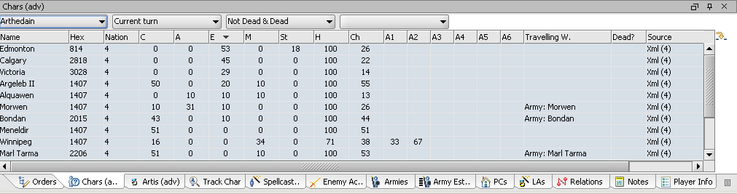
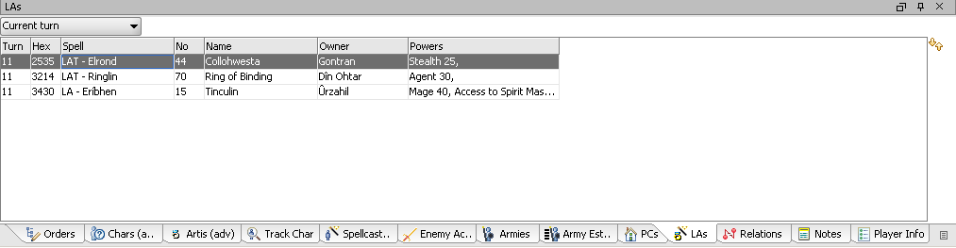
Here that is. Another most excellent feature that is consistent throughout the product, is that
I can now Double Click on any of those records and the map will bring me to that hex. If I
double click on Edmonton, my best emissary currently, the map would centre on his hex,
highlight it in Yellow, and Current Hex View would show that hex’s information.
Here I’ve selected the LA’s tab. Similarly, Double Clicking on the LAT by Elrond brings me
right to that hex, and shows it in Current Hex View. From which I can do all sorts of analysis
see who else is there, etc.

Slide 25
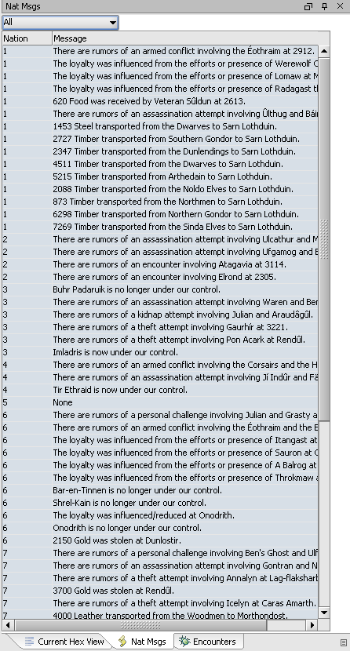
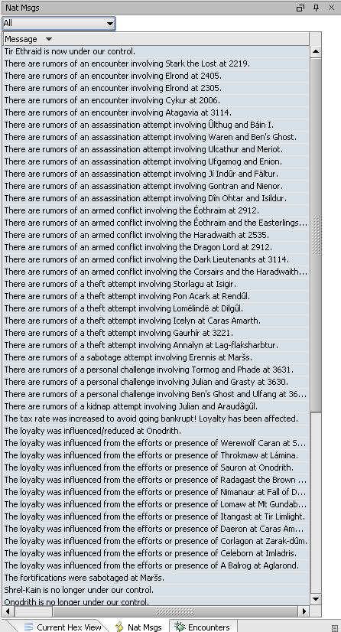
Here I’m showing the Nat Msgs pane. I can sort on Messages and very quickly find the kinds
of Rumours I’m looking for without having to read through them in the order they were loaded
into the program.
Again, this is how all the information panes work. Filtering, Sorting, and double-clicking, where
applicable, to show the relevant hex on the map, is consistent throughout. Once you get used
to the sheer volume of information that’s out there, you’ll realize the power you have to better
understand what’s going on across the whole map and how information can enable you to make
better decisions, improve coordination and planning, etc.

Slide 26
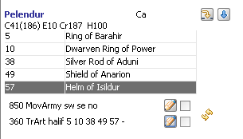


Drag and Drop
This is one of many of “the best” items in JOverseer in regards to issuing better orders~!
You can Drag and Drop Characters, Artefacts, and Hexes from the map into your order
parameter fields. Here I have Pelendur wanting to get rid of all those Command arties
before he get’s whacked and loses them all.
Instead of relying on typing, I can issue the
360 and then simply click on the artefact, hold
the mouse button, and drag it to the parameter
field, then release. Poof, no more typos! This
is most helpful when your ally names company
commanders with apostrophes and other
whacky names – no more missed ID’s! It works
the same with the map – issue the 810, then
after you Show Character Move Range on Map
form the Hex Info drop down, you can simply
Click on any hex, hold the mouse
button, and drag/drop it in your 810
parameter field in Order Editor. No
more transposed movements~!
Current Hex View Feature:
The Blue arrow beside the character will
reveal all Spells and Artefacts for that
character. They’re hidden by default, but
a simply click will reveal all the information
showing in the pdf.
Check out all the drop down arrows
throughout the program to see what’s
available. One I use a lot to review is
the Show Order Results option that
shows the text for that character’s last
turn straight from the pdf.

Slide 27


Draw Orders
Here is my absolute favourite item on this program~! You can draw your orders~! Character
movement appears as a black line, Army movement is hex by hex (with the movement points
required per) red line. Transport orders show in Green. Recons/Palantirs and ScoArea orders
show a blue outline around the hexes you expect to view. Take a look~!
No more duplicated emissary movements! No more navies sailing over mountains! And also,
if you make a mistake, the program will tell you! Here I’ve added a hex to an army move, see
the colour change? And the character movement
from 3627 I’ve extended to more than 12 hexes.

Slide 28

Draw Names on Orders
It get’s better! From the Map Options pane, click Draw Names on Orders and presto, you get
the above! This function requires some qualifications – for example, if a character is not
moving that turn, the program will ask where his end location for a Recon order will be. But
a Palantir order requires the Hex# as a parameter, so JOverseer doesn’t bug you. Also, newly
created armies will ask you if they’re Fed or Cavalry.
Now, this can be pretty tough to handle. Here, I’ve drawn orders for ALL nations. This is not
necessary – you can draw orders 1 at a time, nation by nation, or all at once. Next page, I’ll
show you how...

Slide 29




Click the check boxes to draw a single order.
In the Orders Pane, highlight an
order and you get this menu.
Note, if you Filter the Orders Pane
by Nation, you can Set Draw On
for All Orders for only that nation!
And finally, from the Tools menu, you can select
Toggle Draw Orders and the program will draw all
orders it has saved.
Note the other functions here in tools! Please
explore, I won’t go through them all in this guide,
although I may note a couple. One I’ll mention right
now is the Export Map Image option – this will export
the map exactly as it’s displaying for you at the time
you select this option, so if you’ve drawn all your
orders, you’ll create a jpg with them all showing.
You’ll recall I had drawn order for 12 nations – mine and
all of my allies also. How did I get all those orders
saved in the program.....?

Slide 30

Importing Orders
You can import Automagic/MEOW order files directly into JOverseer. You can also import text orders, like the order report you can generate from this program. Automagic and MEOW, for example, create the same kinds of order reports – Copy them to the clipboard from your ally’s email and paste them directly into JOverseer. Then, you can draw them too!
This is exceptionally handy in Team games where different players are responsible for different areas of the game – i.e., drawing all the orders can quickly show you where more than one Character Move Order lands in the same Misty mountain hex during the early camp
game!
Simply follow the instructions from the Game menu.
Again, we’ve come to the end of a section. Now, you can create a game, import all the information, look at it in many different ways, create/check/export/distribute your orders. You can draw them on the map (!), export a map jpg for your less technical allies, and even import their orders to cross-check and reconcile the coming turn. But as you might expect, that is far from the limit of this program. Next section, I’ll work through the various Economic tabs – the Economy is considered amongst the most important aspects of the game, no..?

Slide 31


Economy Calc
There is simply too much here to go over without killing too many trees in order to do a
“complete” job. Take a look at everything here.
While your order Costs are calculated automatically, you do have to manually enter your
Buys and Sells in this section. When you do, and click on the Update button to ensure your
order Costs are calculated, you’ll see the results of your turn. Toggle your Pops that you
expect to Lose in combat to ensure accuracy.
Personally, I rely exclusively on this tool to ensure I don’t die the unexpected death.... After
I’ve done all my extraneous orders, I usually click on my Capital to show all those characters
in Current Hex View, and then switch to the Economy Calc pane in order to ensure I’m
issuing the buys/sells necessary to maintain my nation.
As you might expect, in Current Hex View, Population Centre section, you can also Toggle
Expected to be Lost. This information will then carry forward to the Economy Calc pane.
As you might expect, in the Orders pane, you can see the cost of the orders you’ve entered.

Slide 32





Team Economy
Again, it’s virtually impossible
to go over everything in here,
but at least this is simply data
and I’m not glossing over
important functionality...
Notice how my Economy Calc
information was brought over.
Again, for fun with statistics, every table displayed here except the first one
can be sorted by each column!

Slide 33




Miscellaneous Tabs
Now I’m going to go over a few things until my laptop battery dies... I don’t use everything in here,
and with the variation in players styles, I’m sure many will use what I don’t, and vice versa...
I’m sure you can see the value in this particular tab~! Note, Drag and Drop functionality works
here also, excepting where the Character Names have funky accents and things. From the
Tools menu, go to Preferences and then Display – Information Tabs to adjust the Track
Character Names option from ascii to Accented and back again. ascii for when you type the
name in yourself, Accented for when you Drag and Drop Urzahil there...

Slide 34




No more spreadsheets or hunting through pdfs~!
Very quickly – who can Company Up..?
Who’s already done so and where the heck are they??

Slide 35



Hey, why not just track everyone at once...! This pane shows all
rumors for enemy actions (e.g. thefts, sabotages, etc) so you can keep
track of enemy characters.
Choose your spell List filter and Double Click to find what you need
Here is where you can switch from every nation
having their own colour to the Blue/Red/Green
colours based on Allegiance.
You can also choose any of the other options for
the map, namely to show pop center names,
to show the climate for known hexes, to change
the zoom level, etc.
Note, in the Tools menu, you can select the
Palantir Map Style if you prefer, which will set
the preferences so that the map resembles that
of Palantir.

Slide 36



Customization
I will not tell a lie – it’s apparently quite tricky to put together a multi-window style program
(multiple quadrants) in your spare time where most people criticize because it isn’t the way
they would do it and nobody is paying you... So customizing the program is neither the most
intuitive nor easiest exercise in the world.. But it can be done!
JOverseer is set up with a default quadrant structure showing default tabs of information. The
set up that I’ve been using in this Guide is not the default. I’ve customized it quite a bit, and,
to be honest, I wasn’t willing to re-install for illustrative purposes for this guide as I’d have to put everything back the way I like it..and as I’ve said, it’s not easy! But it’s worth hacking with until you get your information the way you want it.
Step 1 – from the Window menu option illustrated below, choose the tabs you would like to use in your program. Watch where they end up when you do so.. The Active Quadrant is
highlighted as a Darker shade of grey than the others – this is where your new tab will appear.
Active Quadrant – Dark Grey
Step 2 – Delete Tabs! Right Click on a highlighted tab and choose Close
Step 3 – Move Tabs around
This is tricky and has the potential to cause great distress. Please do not
take it out on the computer. You will have to grab tabs and move them
around on your own for a while to see how they work. You can always
close them all off if you need to...
Double Clicking on a tab will Maximize it – double click again to put it back~!

