Slide 1

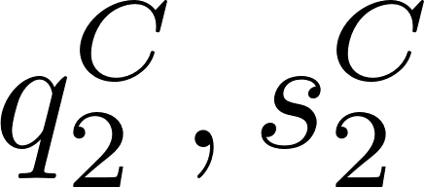






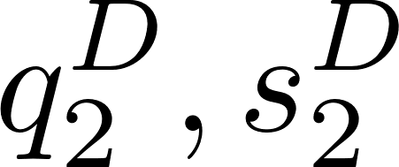


Producer A
Producer C
Producer A
Producer C
TSO
TSO
Producer B
Producer D
Producer B
Producer D

