Slide 1
App
鄭景平、曹峻豪

Slide 2
Implementation-UI
Simple user interface with sufficient functions
Login, Driving, Rating pages…
Using React Native to build app on IOS

Slide 3
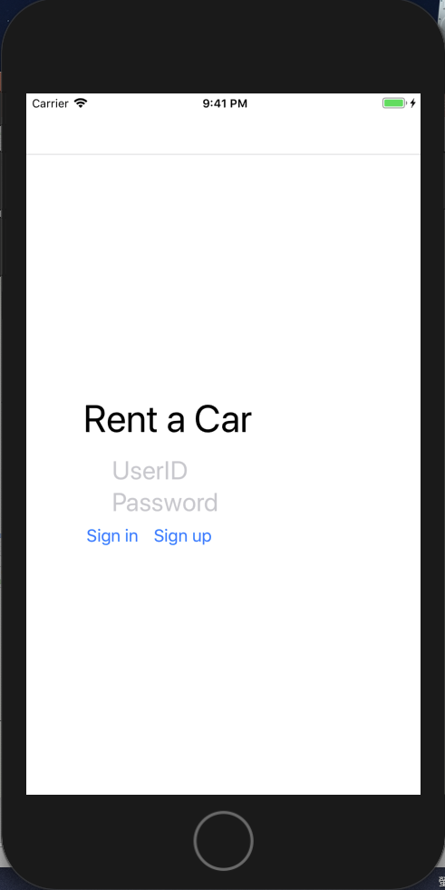
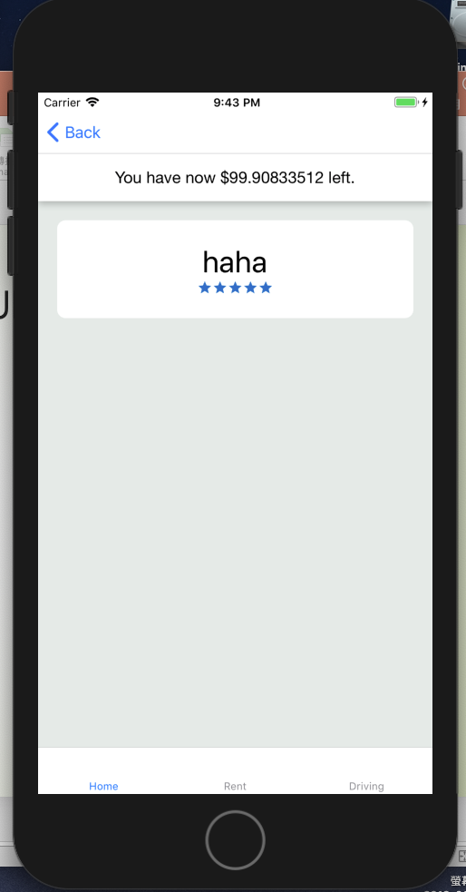
Implementation-UI

Slide 4
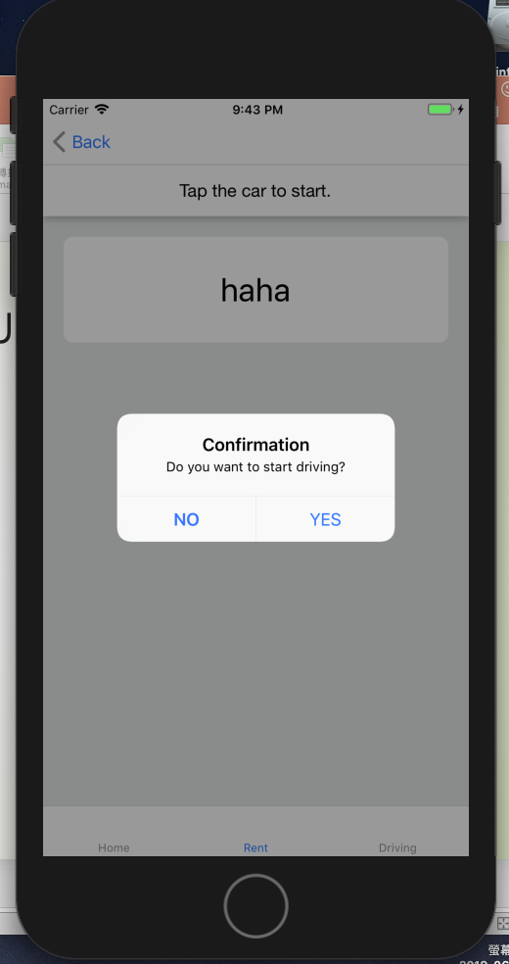
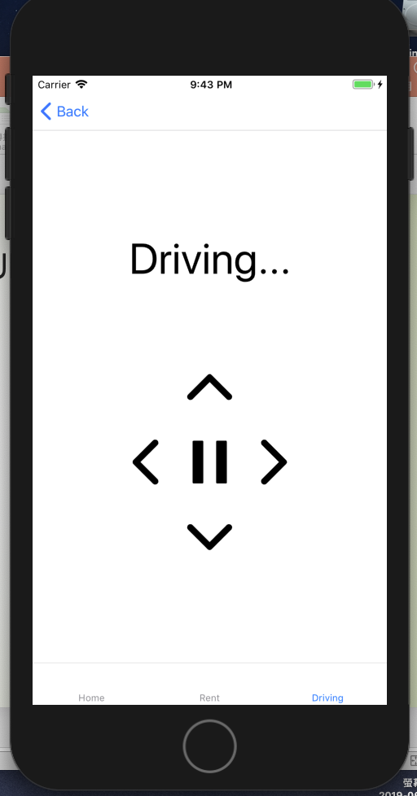
Implementation-UI

Slide 5
Implementation-connection
Sending and receiving HTTP request with smart contract
Sending and receiving messages with cars using TCP sockets

Slide 6
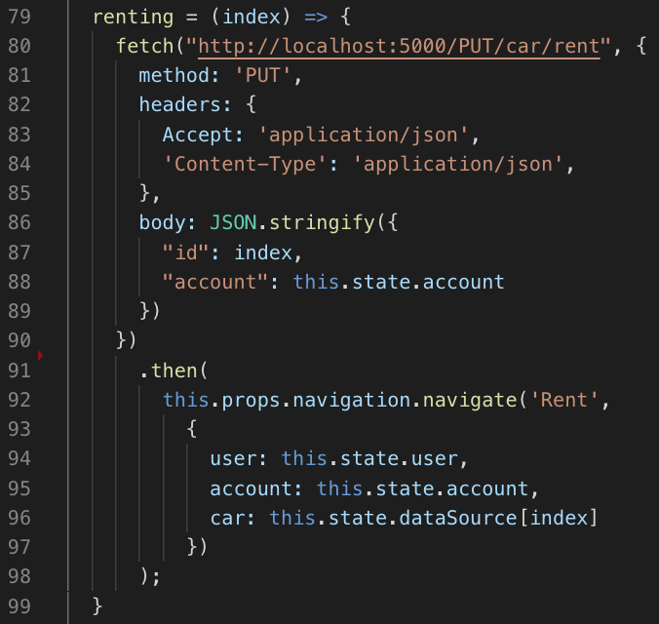
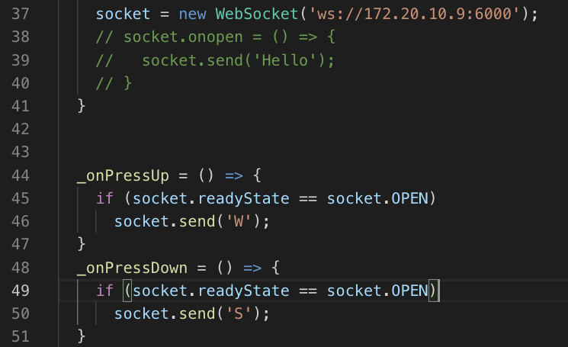
Implementation-connection

