Slide 1

DNA Says (10)
Kareem abdel mesih
John-paul dakran
Shady Nessim

Slide 2
Outline
Introduction
Purpose
Background
Scope
Discussion
Design
Features
Testing
Conclusion
Summary
Demonstration
Questions

Slide 3
Purpose
Develop a functioning and a useful product
Enhance various skills throughout the process
Impress future employers and interviewers
Obtain a grade of 12 in the course
Create a fun game

Slide 4
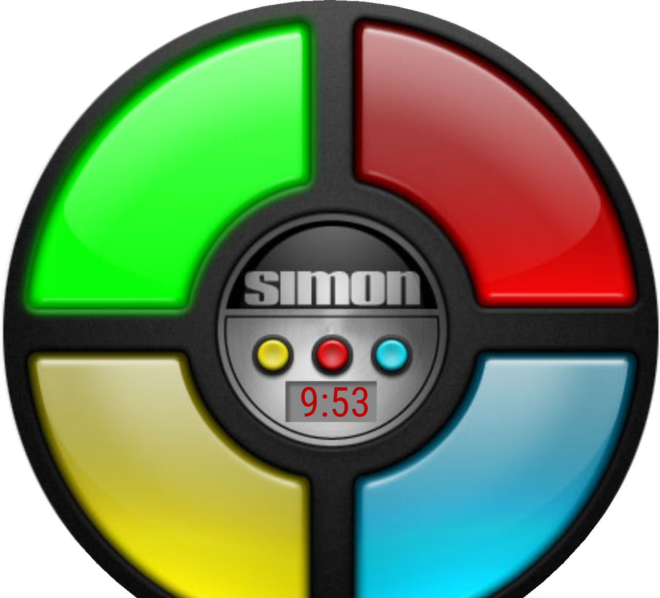
Background
Based on the famous digital game Simon Says
Originally consists of one simple mode
Relies on visual and auditory memory

Slide 5
Scope
Python was to be used along with Pygame to create an innovative version of the original game
Three modes were to be created
Kareem Says
JP Says
Shady Says
Each mode has its own classic yet original and creative features
One goal is to have this project become an example to follow for the following years

Slide 6
Design

Slide 7
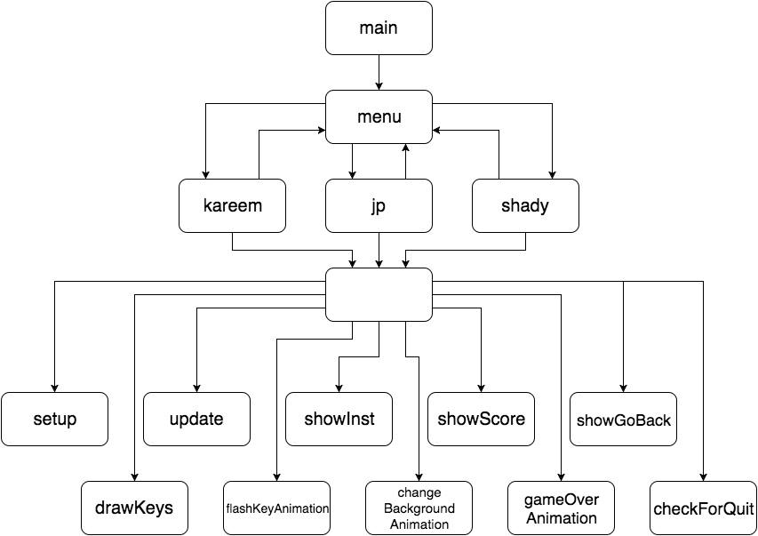
Design – DNA Says

Slide 8
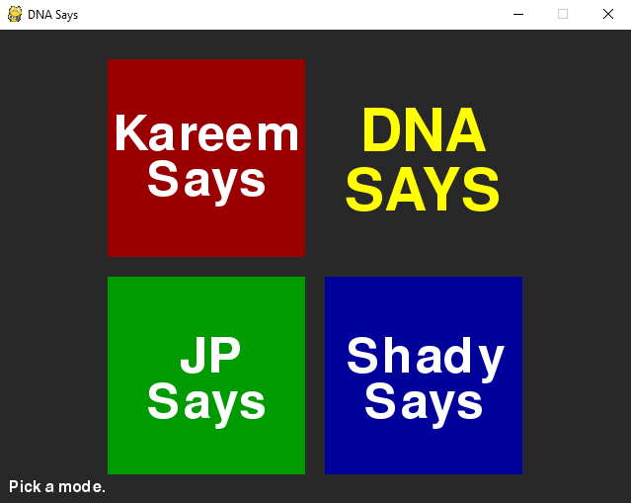
Design – Main Menu

Slide 9
Design – Main Menu
Simple and user-friendly interface
Its only functionality is to select a mode
Instructions always available on the screen

Slide 10
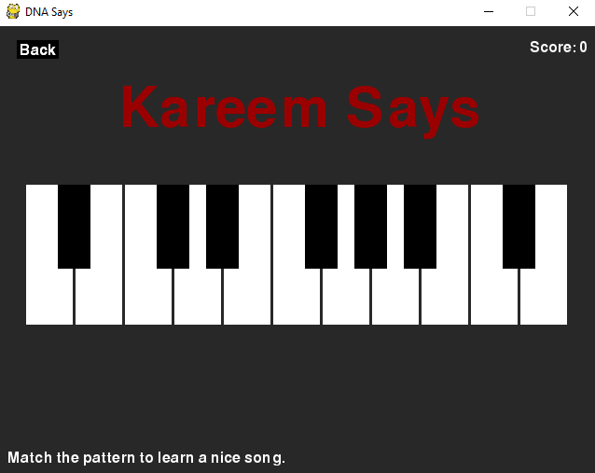
Design – Kareem Says

Slide 11
Design – Kareem Says
The sequence is the song from Love Story
Repeated and easy-to-follow notes
Clear bright red blinking light on played keys
Repeat the notes in order disregarding timing to an extent

Slide 12
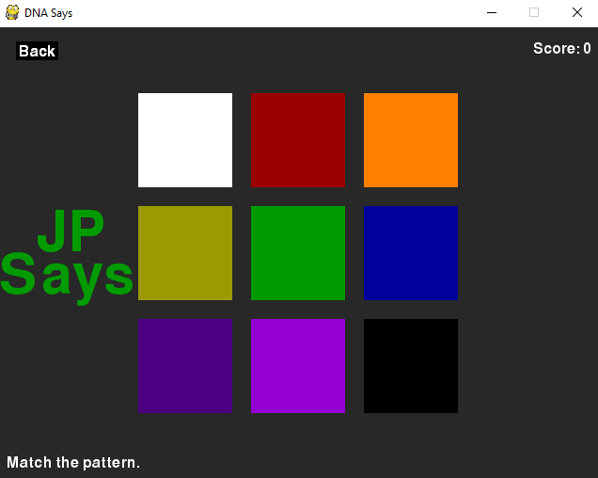
Design – JP Says

Slide 13
Design – JP Says
The sequence is random and unbiased
Played buttons clearly light up
Each button is assigned a unique tone
Repeat the notes in order to advance

Slide 14
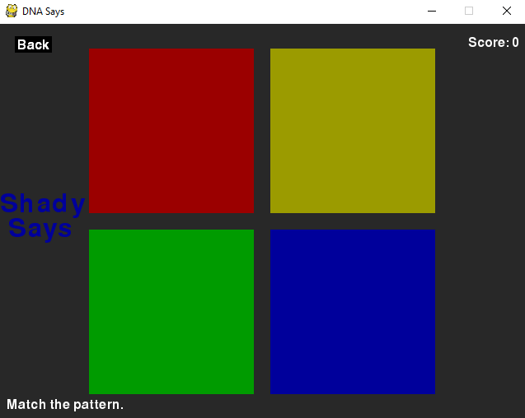
Design – Shady Says

Slide 15
Design – Shady Says
The sequence is random and unbiased
Played buttons clearly light up
Button tones are randomized on every iteration
Repeat the notes in order to advance

Slide 16
Features

Slide 17
Features – Original Sounds
Recorded from a Casio CTK – 6200 keyboard
Recorded on Garageband on an iPhone
Edited on Wavepad on a computer
Freedom of publishing

Slide 18
Features – OS Independent
Runs on any operating system
Requires Python 2.7 or later
Requires compatible Pygame version

Slide 19
Testing

Slide 20
Testing – Manual Testing Functional Requirements
Time allocated to play the game
Especially after every modification
Test Cases
All three modes are ready for selection at all times
Score is updated accordingly (incremented and reset)
User input is ignored only during the playback of the sequence

Slide 21
Testing – Manual Testing Non-Functional Requirements
Performance Requirements
Response instance and timing of accepting the user input
Surveys on Look and Feel Requirements
Sounds
Appearance and colors
Smoothness and flow of animations

Slide 22
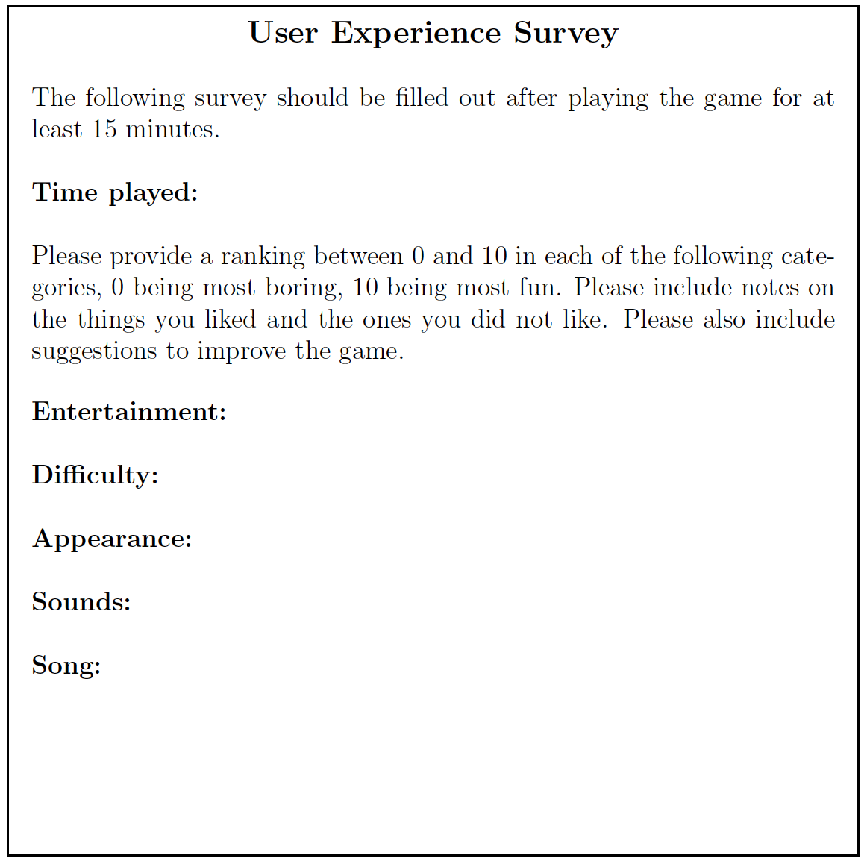
Testing – Survey

Slide 23
Testing – Automated Testing
The computer functioned as expected
The user input was simulated by an unbiased randomizing algorithm
The input provided was based off a set of possible moves
The computer would increment the level if the input was correct
Otherwise the game ends accordingly

Slide 24
Conclusion
Summary
Demonstration
Questions

Slide 25
References
DNA Says Logo
DNA by Abraham from the Noun Project
Simon Says picture
https://facerepo.com/app/faces/details/simon-says-149a4714d63

