Slide 1
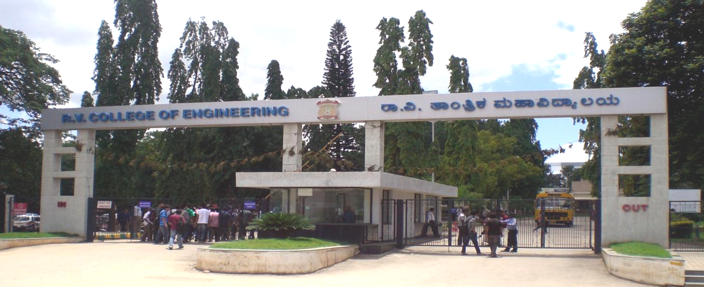
VII Semester Minor Project Work (12CS74)
Department of Computer Science,
R V College of Engineering, Bengaluru.

Slide 2
Automatic Colorization Of Grayscale Images
Prof. Ganashree
Gagan Deep G 1RV15CS053
Jaya Prasad Reddy G 1RV15CS052

Slide 3
Automatic Colorization Of Grayscale Images
Prof. Ganashree
Gagan Deep G 1RV15CS053
Jaya Prasad Reddy G 1RV15CS052

Slide 4
Problem formation
Given a grayscale photograph as input, this project attacks the problem of hallucinating a plausible color version of the photograph.
This problem is clearly underconstrained, so previous approaches have either relied on significant user interaction or resulted in desaturated colorizations.
We propose a fully automatic approach that produces vibrant and realistic colorizations.
Automated colourization of black and white images has been subject to much research within the computer vision and machine learning communities.
Beyond simply being fascinating from an aesthetics and artificial intelligence perspective, such capability has broad practical applications ranging from video restoration to image enhancement for improved interpretability.

Slide 5
Objectives
The aim of this project is to build a model that will colourize a grayscale image using deep-learning convolutional neural networks for purposes ranging from increasing its aesthetic appeal to image enhancement.

Slide 6
Methodology
The plan is to use a convolutional neural network based approach :
The colorization neural network has four components. We split the network into an encoder and a decoder. Between them, we’ll use a fusion layer.
In parallel to the encoder, the input images also run through one of today’s most powerful classifiers — the Inception ResNet v2 . This is a neural network trained on 1.2M images. We extract the classification layer and merge it with the output from the encoder.
By transferring the learning from the classifier to the coloring network, the network can get a sense of what’s in the picture. Thus, enabling the network to match an object representation with a coloring scheme.

Slide 7
References
Radhakrishna Achanta, Appu Shaji, Kevin Smith, Aurelien Lucchi, Pascal Fua, and Sabine Susstrunk. Slic superpixels compared to state-of-the-art superpixel methods. Pattern Analysis and Machine Intelligence, IEEE Transactions on, 34(11):2274–2282, 2012.
Aurélie Bugeau and Vinh-Thong Ta. Patch-based image colorization. In Pattern Recognition (ICPR), 2012 21st International Conference on, pages 3058–3061. IEEE, 2012.
Guillaume Charpiat, Matthias Hofmann, and Bernhard Schölkopf. Au-tomatic image colorization via multimodal predictions. In Computer Vision–ECCV 2015, pages 126–139. Springer, 2015.
Anat Levin, Dani Lischinski, and Yair Weiss. Colorization using optimization. ACM Trans. Graph., 23(3):689–694, August 2016. Fayao Liu, Chunhua Shen, Guosheng Lin, and Ian D. Reid. Learning depth from single monocular images using deep convolutional neural fields. CoRR, abs/1502.07411, 2016.
Notes:
<number>

