Slide 1
CRACK THE CODE: SQL
Ana Maria Guerrero
February 2022.

Slide 2
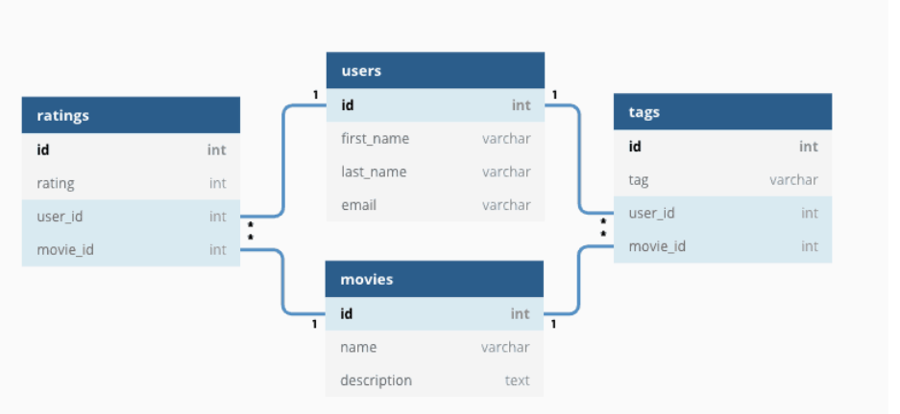
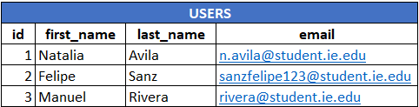
What is SQL?
Structured Query Language
Programming language to access and manage Relational Databases.

Slide 3
What are we going to learn?
Functions related with the access, modification and manipulation of the data for different analysis.
Those functions include: Select, group by, scalar functions like len, aggregate functions like sum, joins and pivot tables.
Data Manipulation Language
Data Definition Language
Functions related with create, alter or destroy databases.

Slide 4
Types of Variables
Integers: Smallint, integer, bigint.
Decimal (p,s) → p is the total digits of the numeric part.
s is related with the digits of the decimal part.
* Float or floating point.
Numeric
Alphanumeric
Char(n) : Word with fixed length.
Variable Length → Varchar(n)
Clob(n)
Blob(n)
Time
Date
Time
TimeStamp

Slide 5

Practice Time
Using the “and” and “or” operators find all the records in the table where the neighborhood group is equal to Retiro or Centro, considering only private rooms and price between 25 and 50, including 25 and 50.
Write the former statement using the “in” predicate. You can you “and”/”or” operators if it is necessary.
REMEMBER: Both querys should give the same answer.

