Slide 1


Train Ticket Generation System
Presented By:
JAYA PRASAD.M
KARTHIK
NAGESHKUMAR
NIGIL RAJU

Slide 2

Contents
Business Requirements
Tech Stack
Process
Frontend Part
Backend Part

Slide 3
Business Requirements
Class Diagram
Ticket
Train
Passenger
Ticket Application
TrainDAO

Slide 4
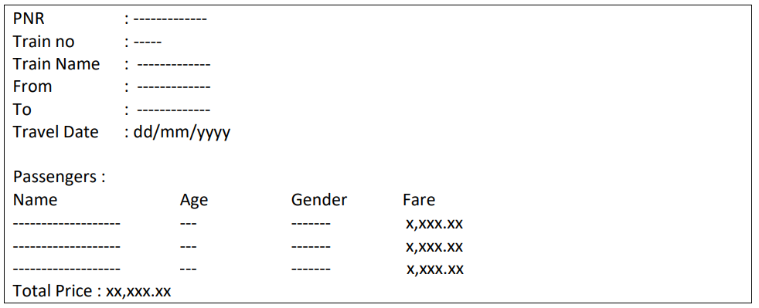
Ticket Format
The Ticket details should be stored in a file as per below format. The passenger’s should written in ascending order based on name.

Slide 5

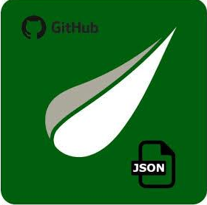



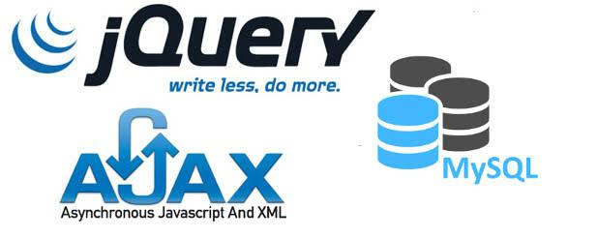
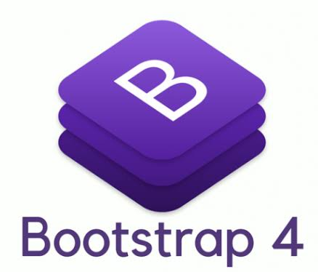
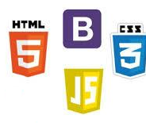

Tech Stack

Slide 6
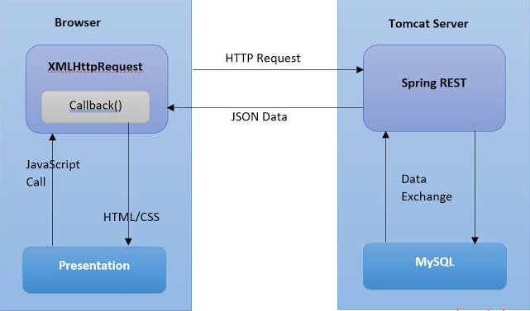
Process

Slide 7
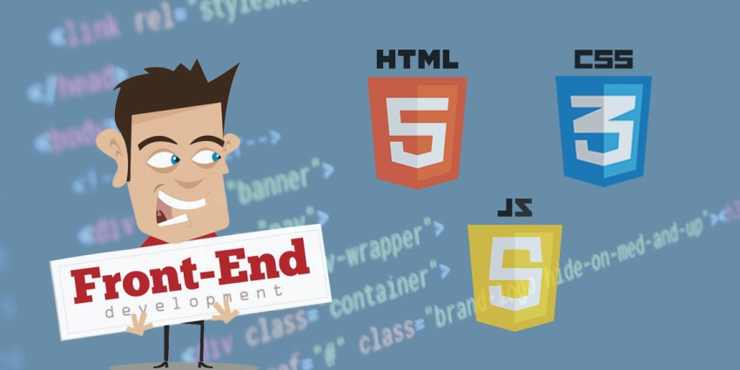
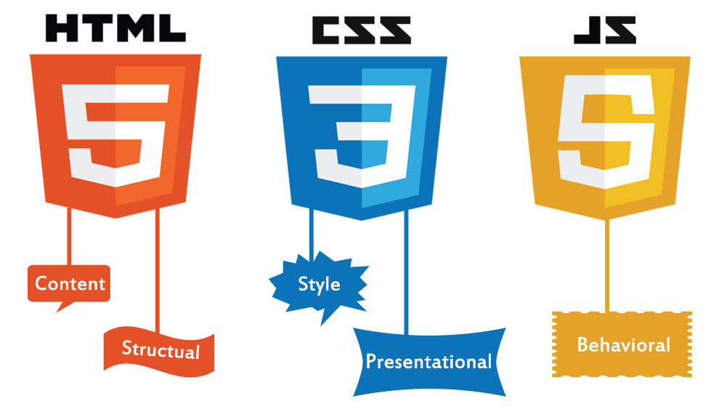



Slide 8


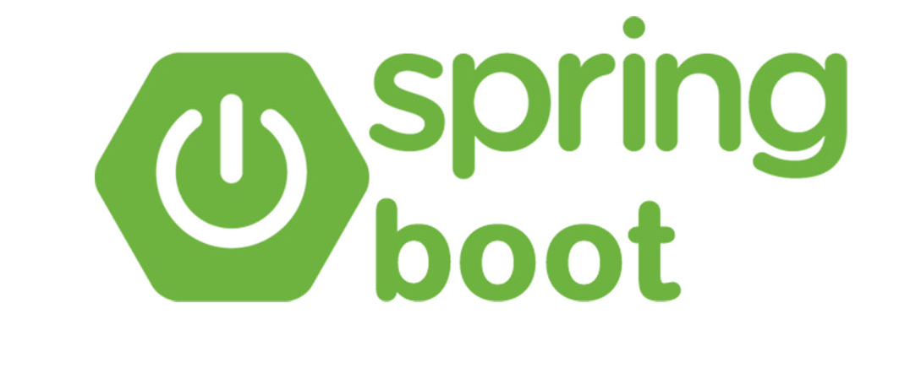

Backend Part
JSONArray
[{"Name":"Ram","Age":"23","Gender":"M"},
{"Name":"Alex","Age":"12","Gender":"M"},
{"Name":"Karan","Age":"76","Gender":"M"}]

Slide 9
generatePNR()
addPassenger()
calcPassengerFare()•
calculateTotalTicketPrice()
generateTicket()
writeTicket()
Class Ticket

Slide 10
Class TrainDAO
FindTrain() method takes trainNo as input and returns a Train object, if train is found, else returns null.

Slide 11
Class TicketApplication
It contains a main method.
It uses a Scanner to get the trainNo, travelDate, number of Passengers, and details of each passenger
It uses TrainDAO to find the train.
It adds passengers to the Ticket.•
It writes the ticket to a file.

Slide 12


Let's move on to Project Demo

