Slide 1
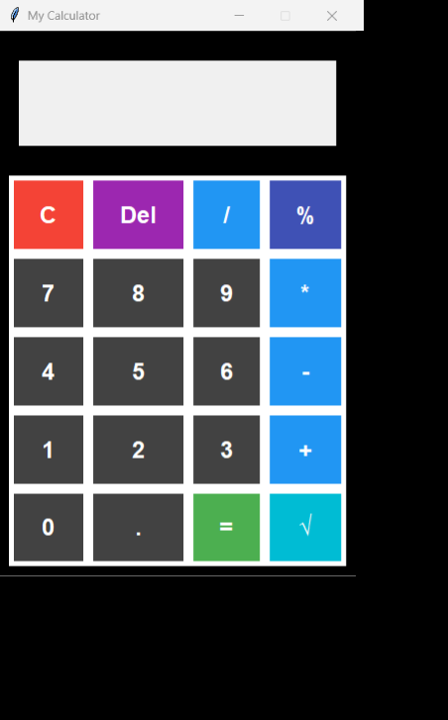
GUI Based Python Calculator
Presented by: Jayesh Pathak.

Slide 2
Introduction:
This is a GUI-based calculator developed using Python's Tkinter library.
The calculator performs basic arithmetic operations like addition, subtraction, multiplication, and division.
It also supports percentage calculation, square root, backspace, clear, and delete functionality.
A "Start" button welcomes users before activating the calculator interface.
Keyboard input is supported for digits and operations, making the tool more user-friendly.
The design mimics a physical calculator with a modern, interactive GUI.

Slide 3
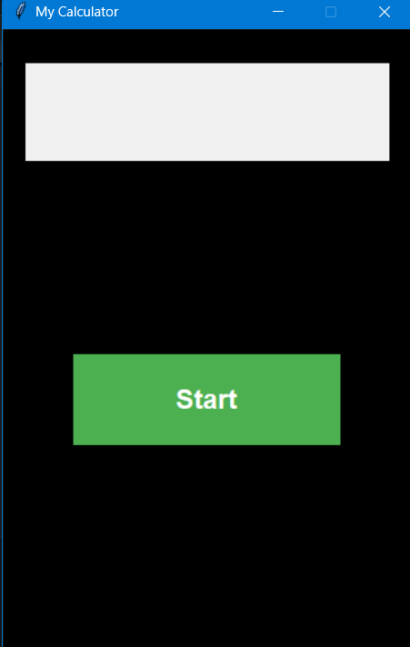
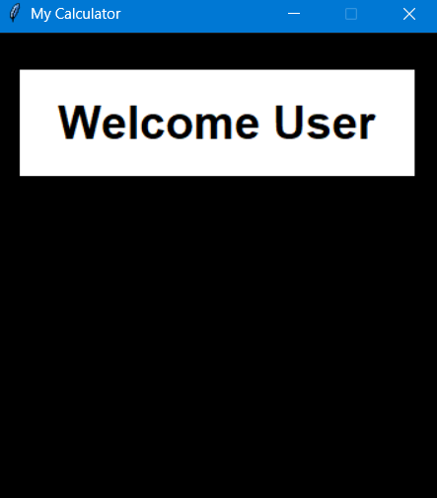
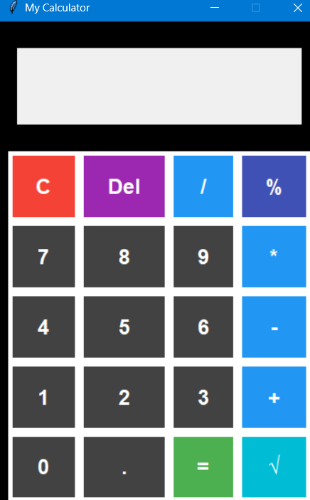
CALCULATOR IMAGES

Slide 4
Code Summary and Libraries Used
🧠 Code Summary:
- GUI created using Tkinter
- Supports %, √, backspace, clear, and delete features
- Includes welcome interface and keyboard support
📚 Libraries Used:
- Tkinter: For GUI design and event handling
- Time: For delay during welcome message
- Math: For operations like square root

Slide 5
Challenges & Solutions
🔧 Problems Faced:
🧩 Difficulty in switching from the "Start" screen to the calculator interface dynamically
🧮 Handling invalid expressions like empty input or division by zero
⌨️ Ensuring both button clicks and keyboard input work seamlessly
✅ Solutions:
🔄 Used widget destruction and re-creation (destroy() and dynamic layout) to switch views
🛡️ Wrapped evaluation logic in try-except blocks to catch errors and display “Error” message
🔗 Used bind() to capture keyboard inputs and synced them with button actions

Slide 6
References
🔗 References Used:
- Python Documentation (tkinter, math)
- YouTube tutorials for beginner GUI projects
- Chat GPT as learning and coding reference

Slide 7
Thank You!

