Slide 1
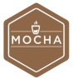








FTP Server
Development
Testing
Building
Deployment

Slide 2

Development
Testing
Building
Deployment
FTP Server

