Slide 1

22: Academic planner
ellen Barss, Daniil pavlov, zihang chen, Rueban rasaselvan

Slide 2
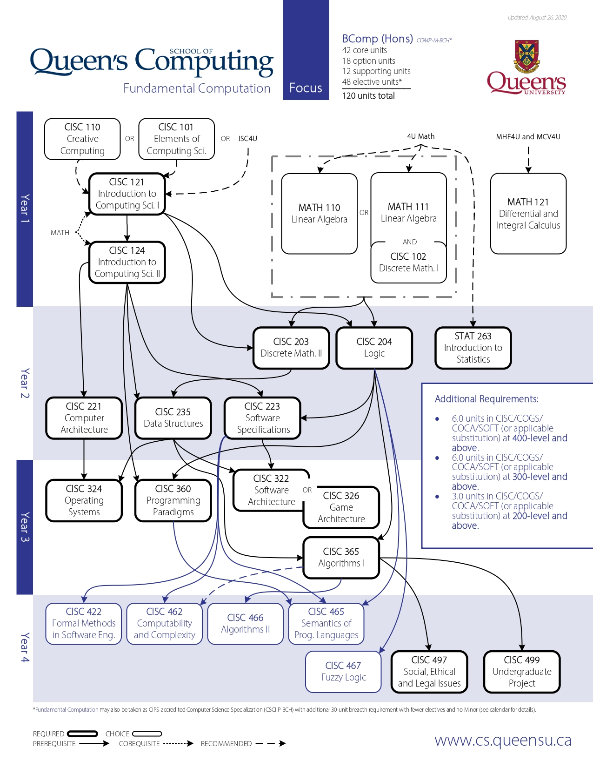
Summary
The modelling problem will help students and university administrators determine class schedules according to an individual’s degree plan. We plan to create an algorithm that checks if a student can or cannot take a specified course, and by extension, whether this student qualifies for graduation.
This problem is modelled around the system that Queen’s currently uses with SOLUS.

Slide 3
Propositions
$y_{i}$: Course required - Where $i$ is a specific course required for graduation (ex. $y$_{CISC101}, $y$_{CISC110}, $y$_{CISC121}…, $y$_{MATH121})
𝑦_𝑖: Course required - Where 𝑖 is a specific course required for graduation (ex. 𝑦_{CISC101}, 𝑦_{CISC110}, 𝑦_{CISC121}…, 𝑦_{MATH121})
True if a course is required for student’s graduation in their plan
$x_{i}$: Course taken - Where $i$is a specific course (ex. $x$_{CISC101}, $x$_{CISC110}, $x$_{CISC121}…, $x$_{MATH121})
𝑥_𝑖: Course taken - Where 𝑖 is a specific course (ex. 𝑥_{CISC101}, 𝑥_{CISC110}, 𝑥_{CISC121}…, 𝑥_{MATH121})
True if a student has taken the course
$z_{i}$: Course can be taken – Where$i$is a specific course (ex. $z$_{CISC101}, $z$_{CISC110}, $z$_{CISC121}…, $z$_{MATH121})
𝑧_𝑖: Course can be taken – Where 𝑖 is a specific course (ex. 𝑧_{CISC101}, 𝑧_{CISC110}, 𝑧_{CISC121}…, 𝑧_{MATH121})
True if the course can be taken

Slide 4

Constraints
Students must choose one course or another
$x_{MATH110} ⊕{(x}_{MATH111}∧x_{CISC102})$
$x_{CISC110}$ $⊕$ $x_{CISC101}$
$x_{CISC322}$ $⊕$ $x_{CISC326}$
Prerequisite – Students must complete prerequisite to take a course
$x_{CISC110} ∧{ x}_{CISC101}\text{→} z_{CISC121}$
${(x}_{CISC110} ⊕{ x}_{CISC101})∧{ x}_{CISC121} \text{→} z_{CISC124}$
${(x}_{MATH110} ⊕(x_{MATH111} ∧{ x}_{CISC102}))∧{ x}_{CISC121} \text{→} z_{CISC204}$
Etc. for each course
Courses with an unfulfilled prerequisite cannot be taken
$x_{CISC101} ∧{ x}_{CISC121} ⟷y_{CISC124}$

Slide 5
Modeling PROGRESS
Instead of having a separate variable for a degree plan, we looked at a specific plan (Fundamental Computation, see picture) and based our constraints and propositions on it to decrease the complexity of our modelling problem.
As a result, we removed the following propositions: “Degree Plan”, “Time Conflict”, “Credit Requirement”, “Course Requested” and added “Course can be taken”. We rearranged our model according to our current propositions. We are still deciding on whether to include certain propositions or not.

Slide 6
FEEDBACK REQUESTS
Should we include “Courses with an unfulfilled prerequisite cannot be taken” as a constraint or is it unnecessary since we have “Prerequisite – Students must complete prerequisite to take a course”?
Should we keep some of the propositions that we removed?

Slide 7
End

