Slide 1

Cue ASAP
- Use in case of emergency

Slide 2


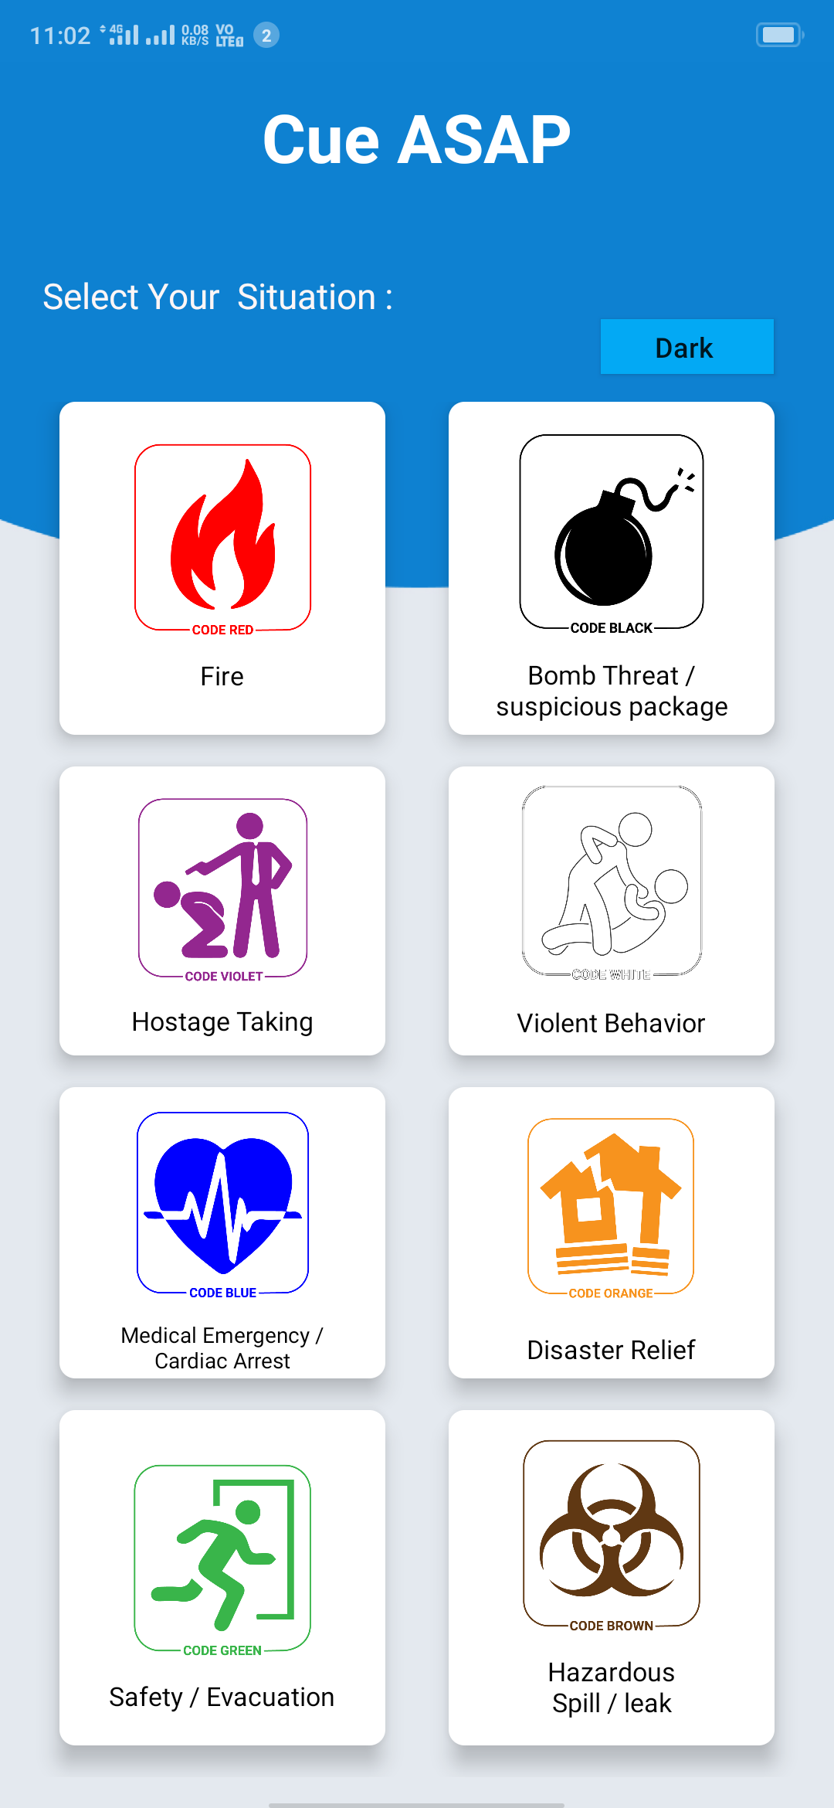
APP- Cue ASAP
APPLICATION – Coding in C++

Slide 3
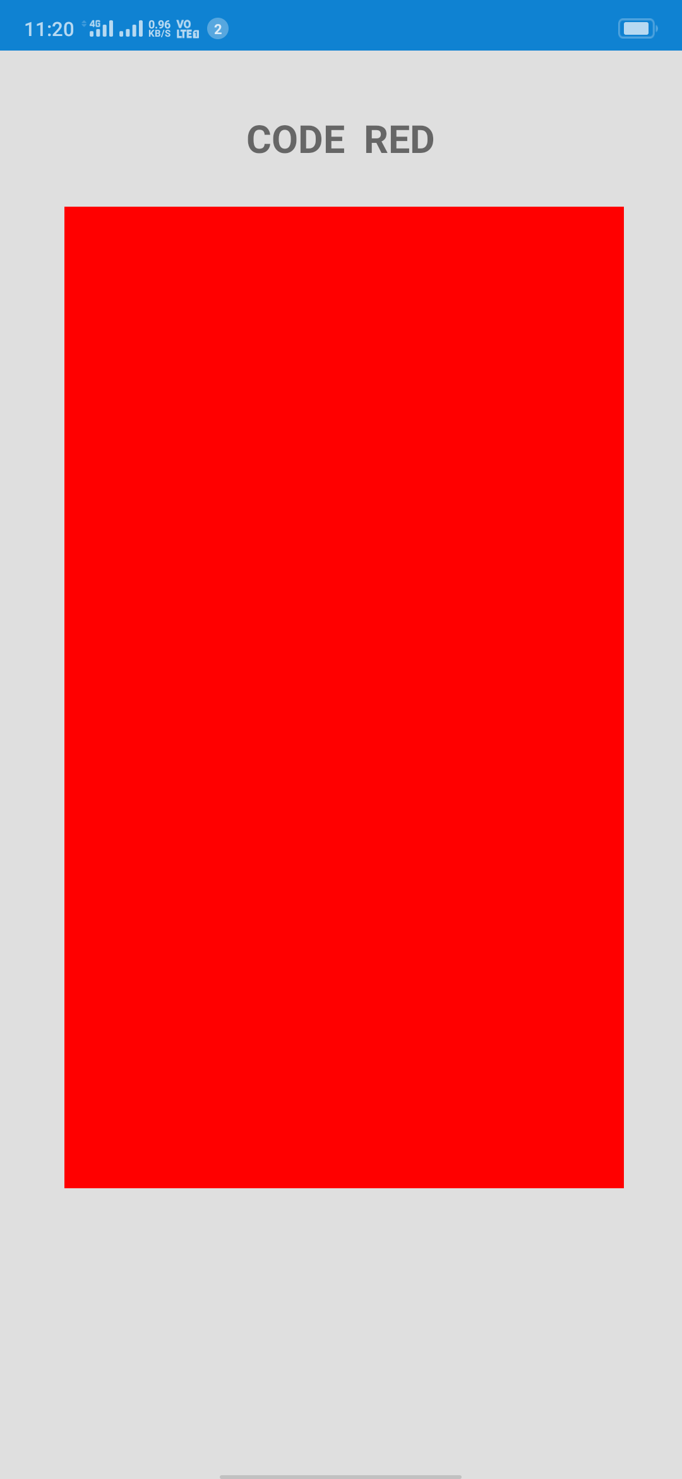
Cue ASAP- COLOR CODE
APPLICATION Coding

Slide 4


Open CV
By Camera
RED
(121, 255, 74)
Cue ASAP

Slide 5



Store
Location of camera
COLOR CODE
Time of detection
SQLite Database/
Firebase

Slide 6







CODE RED
Detected
Problem
Solved
Searching in by fire station…
Firefighter will
be there soon…

Slide 7


App was design in Android Studio
Illustrator for logo & other UI

Slide 8

Coding in Visual Studio
Languages
C++
OpenCV
Python

Slide 9

-- Thank You --
WE PROMISE A BETTER SOCIETY
- Cue ASAP
Joshua Prem Cyril S
Praveen R

