Slide 3
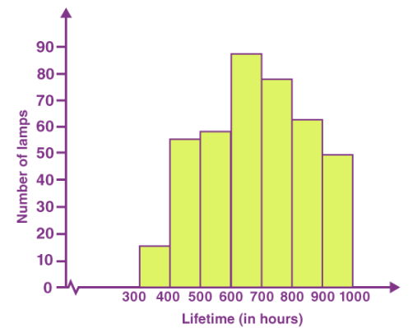
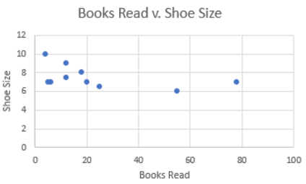
Dropdown list of counties, sorted by state.
Some general settings to modify the output to the user’s liking. These may be things such as font size, color blind mode, what type of output is shown (Histogram/Scatter Plot/Bar Graph, etc.
Opening a specific state would allow the user to view the data on the right (comparing counties of that state).
This is where the main visualization(s) will be housed. I have not 100% locked myself into 1 specific type of graph/chart. In fact, I plan to allow the user to show 2 or 3 different types, as I feel it’d offer a more thorough and robust explanation of the dataset which is being viewed. But, I’ve supplied a few examples below:
Ideally, this tab is resizable or collapsable so that the user can view the main visualization better.
Example:
Alabama ↓
Alaska ↓
Arizona ↓
Arkansas ↓
California ↓
Colorado ↓
etc…

