Slide 1
Templated Android App Architecture
Jeremy Oosterbaan at Performance Electronics, Ltd.

Slide 2
Presentation Roadmap
Problem & opportunity
Overview of the proposed solution
Design & development
User stories, charts, other design diagrams, etc.
Project constraints & challenges
Milestones & progress check.
Expected deliverables by end of semester.
Division of work & effort matrix
Expo demo plans

Slide 3
Problem
To explain the problem my capstone project aims to solve, I first need to give some background on my employer, Performance Electronics, Ltd (PE). I am very lucky to be working there and having development funded by the company this year. PE is an embedded systems company, meaning we have both hardware & software components to our products. The software component(s) is largely comprised of mobile apps which talk to various hardware modules over Bluetooth Low Energy (BLE). Until now, the process of creating new mobile apps for each new project is incredibly tedious. We have to more or less start from scratch each time. There exists little to no reusability in our current mobile app structure, which creates a very inefficient development process.

Slide 4
My Proposed Solution
The ultimate goal is to save development time & costs when creating mobile apps for new projects. The solution I proposed is a sort of “templated” structure where we have one consistent, generic framework or outline app. Additionally, we implement a collection of UI widgets that can be populated at will throughout the app. Each project would be a clone of the template app repository, but with a different “configuration” of widgets & themes. Moreover, we can aim for a less monolithic application and closer follow the microservices architecture, in which the various components of the app are distinct, independent libraries/modules that work together through a generic publisher/subscriber communication protocol.

Slide 5
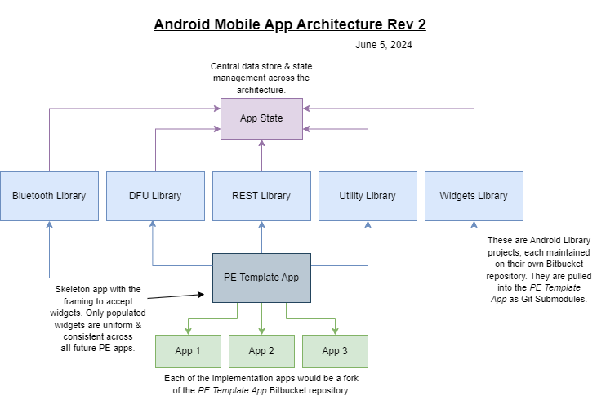
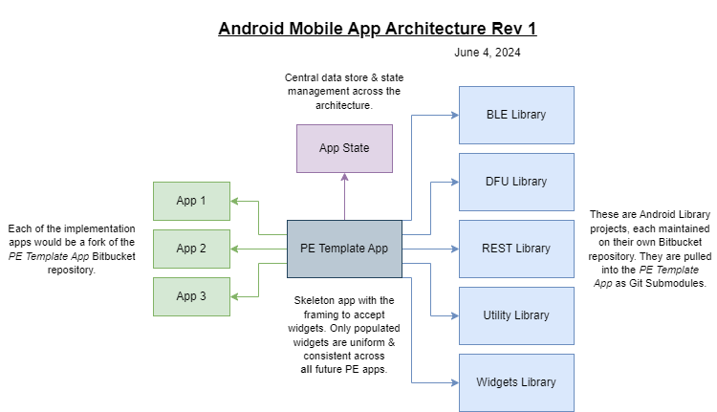
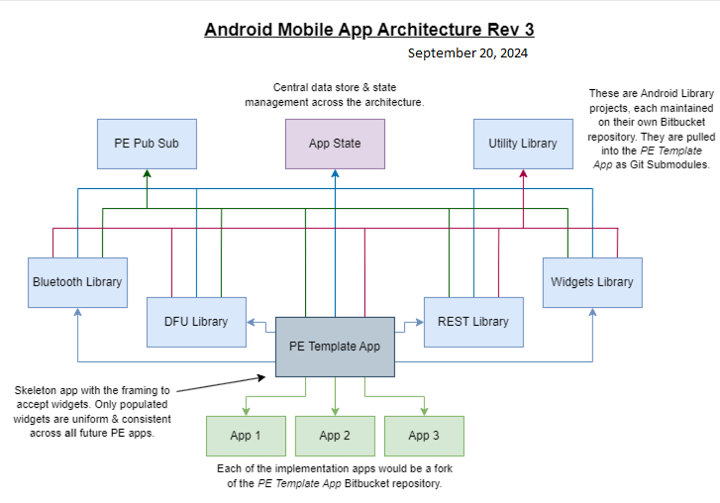
Design Diagrams
Microservices architecture (old revisions)

Slide 6
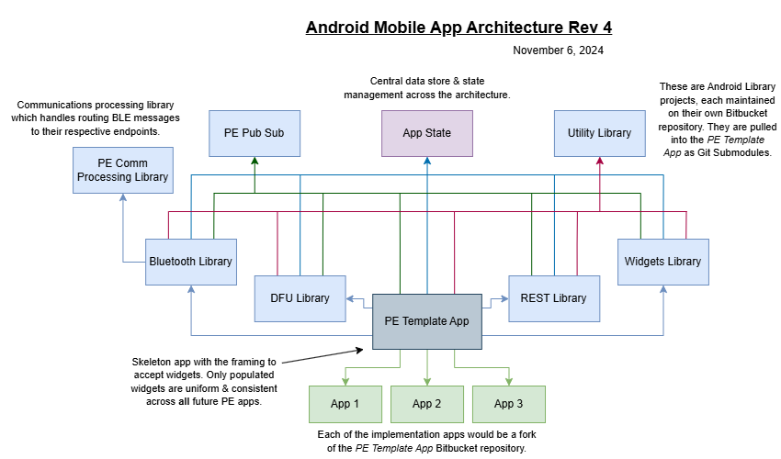
Design Diagrams cont.
Microservices architecture

Slide 7
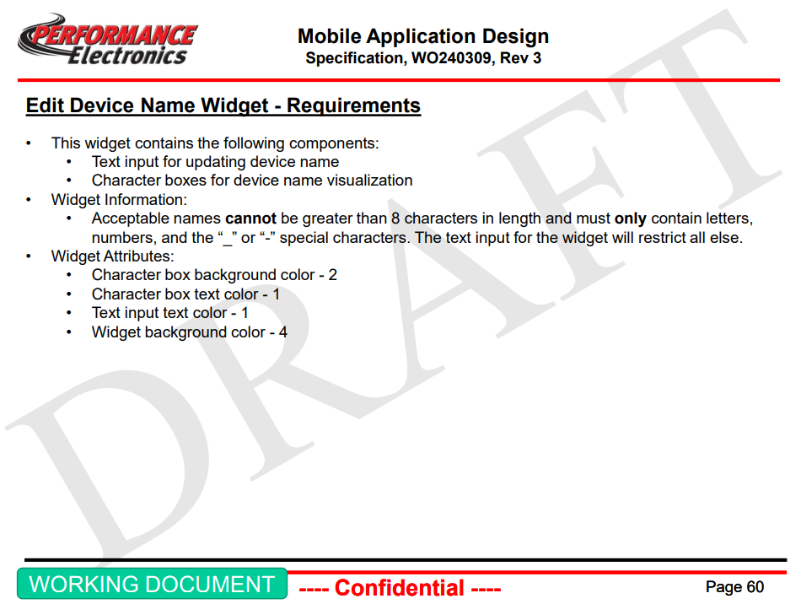
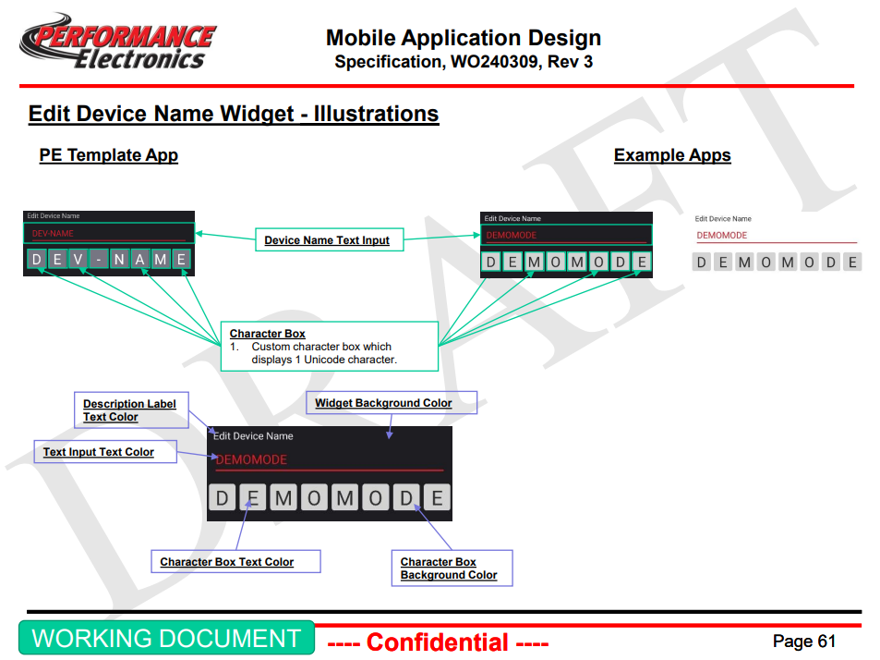
Design Diagrams cont.
UI Specification Document
For this project, I created an extensive, 100+ page UI specification document. This UI spec contains information about each of the widgets, their configurable attributes, images showcasing themes, and more.
The full UI spec is proprietary & not available for public consumption. However, a demo version has been made publicly accessible for the sake of this project. I should hopefully offer a glimpse at the depth to which our design phase went.
Example:
The demo UI specification document can be found on the GitHub repository: https://github.com/JPEG1/Senior-Design/tree/main

Slide 8
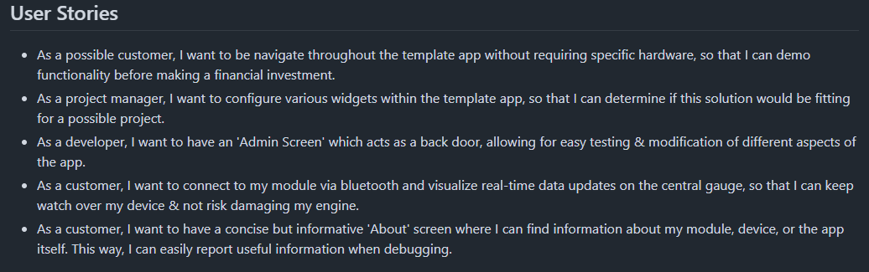
Design Diagrams cont.
User Stories
More design diagrams can be found on the GitHub repository: https://github.com/JPEG1/Senior-Design/tree/main

Slide 9
Project Constraints
Developers & development resources
Small company means much more tedious & careful in resource allocation
Long list of tasks (see TaskList.md on GitHub) for solo developer
Hardware
Products implementing BLE adds a whole layer of complexity
Asynchronicity & independent publisher/subscriber message processing protocol
Collaboration with the hardware department

Slide 10
Project Milestones
Milestone #1: Template App Architecture Design
Designing all aspects of the apps such as communication processing structure, device firmware update (DFU) process, PE pub sub, widgets spec, etc.
Milestone #2: Demo Mode UI App
Template app framework with completed collection of widgets.
Milestone #3: Bluetooth & Connectivity
Communication processing library & BLE library.
Milestone #4: Comprehensive Test Framework
Unit tests for each individual microservice and system tests for entire architecture.
Milestone #5: Finalized Documentation & Deliverables
Final documentation for expo in Spring 2025.
More comprehensive & detailed breakdown of milestones can be found on GitHub.

Slide 11
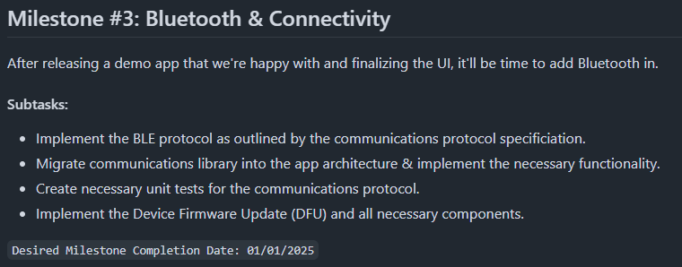
Progress Check
Currently, I am working on project milestone #3. The first implementation app of this Android architecture has a pretty extensive BLE profile, which requires a great deal of effort. As far as the templated structure is concerned, this milestone is complete. However, with PE, I am working on both this capstone project & the first implementation of it simultaneously. I had originally aimed to have this milestone completed by the end of 2024, so this does put me slightly behind schedule. However, I’ve made progress on the future milestones, despite not being fully completed with milestone #3.

Slide 12
End of Semester Deliverables
The final capstone project is due here in early April. With that deadline closing in fast, I am making an effort to prioritize the remaining deliverables. I’m still confident with the status of the project & my ability to deliver a finished product on time. The majority of my time in March will be spent on documentation & testing, as much of the functionality is polished. I plan to spend ~1 week creating an extra implementation of the architecture, so that I can demonstrate how efficient creating new apps is with the architecture.

Slide 13
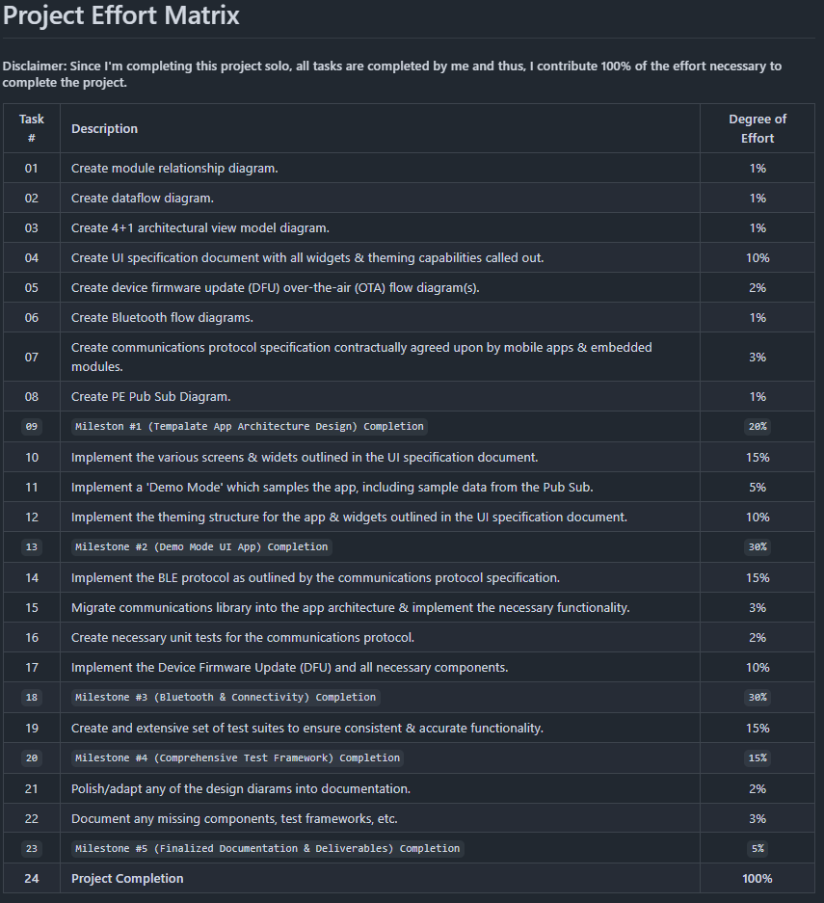
Division of Work
Since I’m completing this project solo, 100% of project effort falls on me.
The effort matrix on the right can be found on GitHub.

Slide 14
Expo Demo
Subject to change
Will need one (or more) mobile apps
Some of which have already been released on Google Play Store
I may bring hardware to communicate with each app being used
i.e. 2 different mobile apps = 2 unique modules
Since the project is the architecture itself, the best demo I can give is showcasing how this architecture is beneficial. Highlighting specific project functionality isn’t necessary. Rather, showing different apps using the same architecture (saving development time) is key.

Slide 15
Thanks for your time!
Check out more documentation on GitHub.

