Slide 1
The Technical Communication
Process
Chapter 3
Copyright © 2014 Wadsworth . All Rights Reserved.
3-<number>

Slide 2
Chapter Contents
Chapter 3 In a Nutshell
An Overview of the Process
Planning Your Document
Drafting and Revising Your Document
Editing or Finishing
  Focus on Groups
Copyright © 2014 Wadsworth. All Rights Reserved.
3-<number>

Slide 3
An Overview of the Process
The goal of technical writing is to enable the reader to act.
    The objectives to this goal is
    to plan by collecting all relevant information about the communication situation.
    to draft and revise by selecting and arranging the elements in the document.
    to finish by editing into final form.
Copyright © 2014 Wadsworth. All Rights Reserved.
3-<number>

Slide 4
Planning Your Document
Planning is key to writing any documents.
Answers to a set of questions will provide important information about your audience and a general idea of the document you will create.
  answers to questions concerning:
        the audience;
        the message;
        the document's format;
        the time available for the project.
Copyright © 2014 Wadsworth. All Rights Reserved.
3-<number>

Slide 5
Planning Your Document: Cont.
  Planning can be brief or lengthy:
  brief-a short email or a few mental notes to use a guide while composing (e.g., sending out a routine announcement to recipients from your address book to confirm date, place, and agenda);
  lengthy-a written document that specifies the audience and explain why they will use the planned document, a detailed style sheet for format, and a production schedule (e.g., for a a proposal or manual).
Copyright © 2014 Wadsworth. All Rights Reserved.
3-<number>

Slide 6
Planning Your Document: Cont.
    Situate Yourself.
    What is your goal-your goal is to direct the audience to a specific experience after reading you document:
    what should the reader know or be able to do;
    how should the reader be helped to that new condition.
    (e.g., “ . . . the reader will be able to assemble the tricycle . . . the reader will understand the results and implications of the experiment”). (see Horton, Chapter 1).
Copyright © 2014 Wadsworth. All Rights Reserved.
3-<number>

Slide 7
Planning Your Document: Cont.
      How much project knowledge do you have-this depends on the relation of the project and the document:
      for completed projects you have the knowledge and need to do little if any research (e.g., you know what happened in an experiment; your know what you found out when you investigated sites for a new retail store.
      for projects about which you know nothing, you must plan how you will research the relevant information (e.g., to create a set of instructions for software, with which you are unfamiliar; writing a proposal for funding a program.
Copyright © 2014 Wadsworth. All Rights Reserved.
3-<number>

Slide 8
Planning Your Document: Cont.
    Is there a model to help you focus your thinking-most technical writing belongs to a genre, a formalized way of handing recurring tasks:
    sets of instruction (most of them look a like, with a title, introduction, sequenced steps).
    style guidelines sheets (some companies have style sheets; the title page must contain specified information such as title, author, recipient, date and project number; chapters begin on a new page, using a font of a certain size.
    documents of previous work done for similar projects.
Copyright © 2014 Wadsworth. All Rights Reserved.
3-<number>

Slide 9
Planning Your Document: Cont.
Create an Audience Profile.
Planning for your audience is key for writing helpful and appropriate documents.
To create an audience profile, answer the audience questions in Chapter 2- rephrased slightly those questions are
        Who is the audience?
        What is their role?
        What is their task?
        What is their knowledge level?
        What personal factors influence the situation (feelings about the subject, sender, expected form of communication)?
        What external factors influence the situation?
Copyright © 2014 Wadsworth. All Rights Reserved.
3-<number>

Slide 10
Planning Your Document: Cont.
Create a document Plan.
    Establish your content needs-determine what you know about the topic and what the audience needs to learn:
      if you know quite a bit, then you understand the content and need only a little more research before deciding the audience needs;
      if you know little or nothing, you need to research all the information before deciding the audience needs.
      See the schemata discussion (Chapter 2, pp. 42-45).
Copyright © 2014 Wadsworth. All Rights Reserved.
3-<number>

Slide 11
Planning Your Document: Cont.
Establish your strategy-determine how to carry out your goal-your “creative concept,” the way you present the material so that your reader can easily grasp and act upon it:
  what design will help the reader build a unique model of the information?
  the reader must see all the parts and then work to join them together;
  the writer needs to lay out those parts and then give the reader what is need to assemble them (e.g., lay out the goal; then, take the reader step-by-step through the process that leads to that goal.
Copyright © 2014 Wadsworth. All Rights Reserved.
3-<number>

Slide 12
Planning Your Document: Cont.
    Decide whether to use an established pattern-If no genre exists, you could try several other options:
  a common rhetorical sequence-a definition followed by an example;
  an organizational progression-from the most vital to the least important (e.g., to treat the components of a computer system from the most to least important, you might start with the central processing unit and end with the electrical cord.
Copyright © 2014 Wadsworth. All Rights Reserved.
3-<number>

Slide 13
Planning Your Document: Cont.
Design You Information.
  The key items are choosing an arrangement and using various cueing devices to help the reader pick out what is important and to assemble relations:
        use context-setting introductions (define the terms, tell what caused you to write, state the purpose of the document);
        place important information at the top;
        use preview lists;
        use repetition and sequencing;
        use coordinate structure;
  See section on drafting, testing and finishing your document (pages 69-71).
3-<number>
Copyright © 2014 Wadsworth. All Rights Reserved.

Slide 14
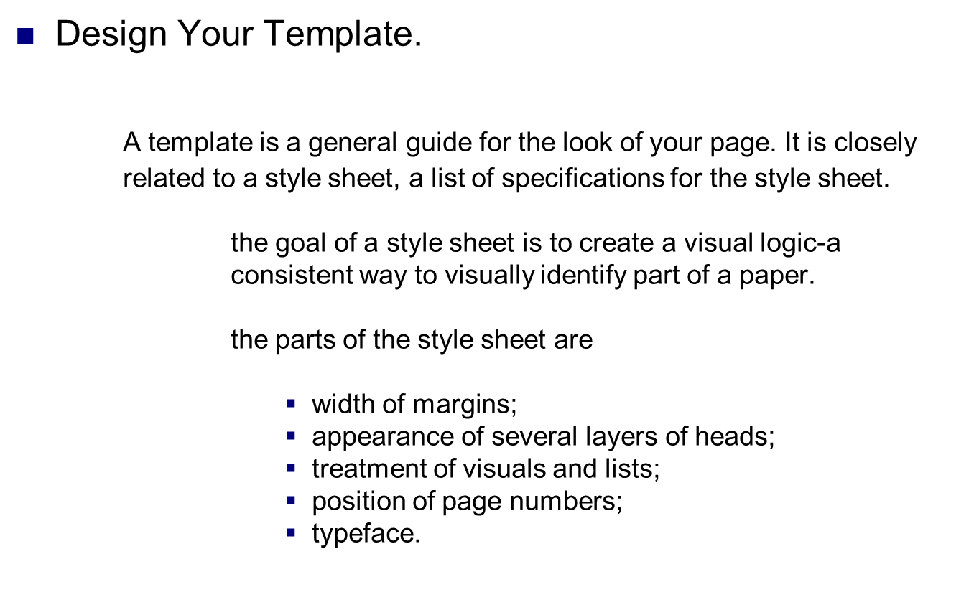
Planning Your Document: Cont.
3-<number>
Copyright © 2014 Wadsworth. All Rights Reserved.

Slide 15
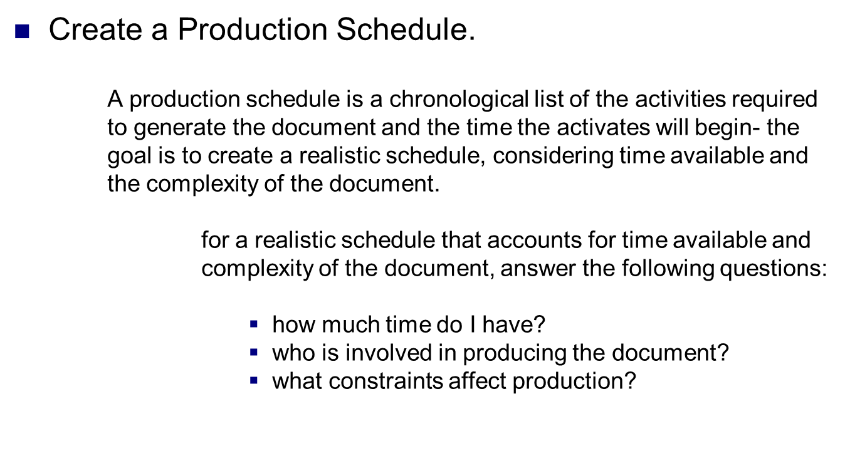
Planning Your Document: Cont.
Copyright © 2014 Wadsworth. All Rights Reserved.
3-<number>

Slide 16
Planning Your Document: Cont.
How much time do I have-determine the end point and then work backwards, considering
how much time it will take to perform each activity;
how long it will take to print the final document;
how much time to allot for the revision and the review stage.
how long it will take to draft the document;
how long it will take to discover the “gist” of the document.
Copyright © 2014 Wadsworth. All Rights Reserved.
3-<number>

Slide 17
Planning Your Document: Cont.
Who is involved in producing the document-the number of people involved in the procedure varies from one (you) to many, especially if there is a review process:
if only you are involved, only your own work needs to be considered;
if other people are involved, deadlines will need to be scheduled for them to receive and return the document.
Copyright © 2014 Wadsworth. All Rights Reserved.
3-<number>

Slide 18
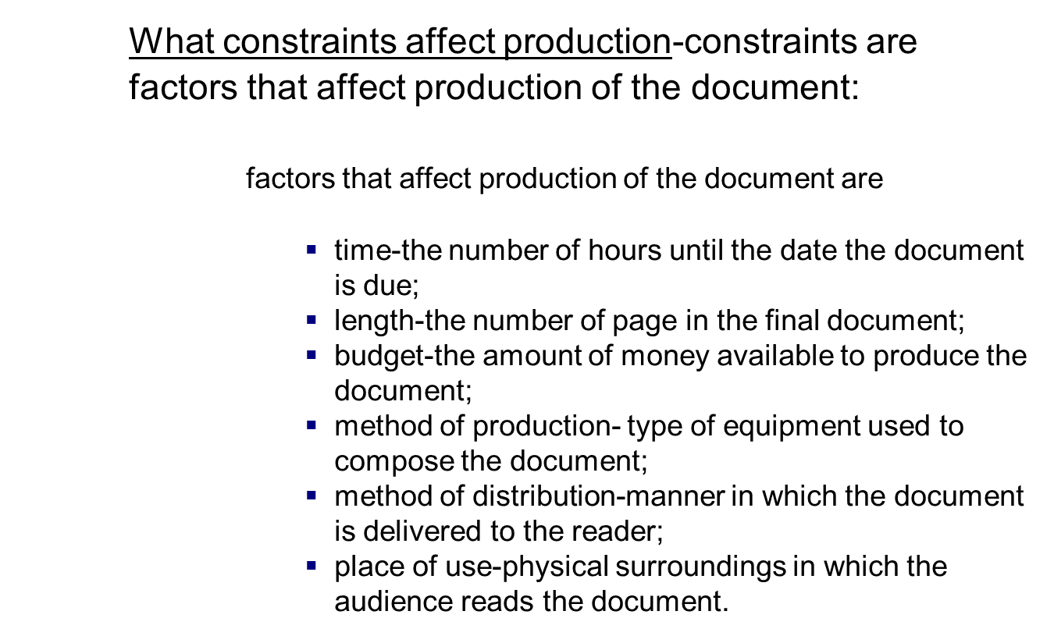
Planning Your Document: Cont.
3-<number>
Copyright © 2014 Wadsworth. All Rights Reserved.

Slide 19
Drafting and Revising
Your Document
Drafting and revising are the actions you take as you create the document. This stage is concerned with “getting it down” and making it easy for your reader to “grasp.”
The drafting stage is a “discovery” stage. In the drafting stage you may think of new ideas and decide to discard much of your tentative plan.
Research to discover information-you may need to spend time researching. See Chapter 5.
Copyright © 2014 Wadsworth. All Rights Reserved.
3-<number>

Slide 20
Drafting and Revising
Your Document: Cont.
Design You Information to Help Your Reader
  To design your information remember that you are creating an experience for your readers, helping them build a model.
  General principles-help create the interactive document the reader needs:
  1. For audiences with little prior knowledge about a topic, use the familiar to explain the unfamiliar. Provide examples, operational definitions, analogies, and illustrations. These devices invite your reader to become imaginatively involved with the topic and make it interesting.
Copyright © 2014 Wadsworth. All Rights Reserved.
3-<number>

Slide 21
Drafting and Revising
Your Document: Cont.
        2. For readers familiar with a topic, don’t belabor the basics. Use accepted terminology.
        3. For all readers, do the following:
        State your purpose explicitly. Researchers have found that most readers want a broad, general statement that helps them comprehend details.
        Make topic of each section and paragraph clear. Use heads. Put topic sentences at the beginning of paragraphs. This top- down method is very effective.
3-<number>
Copyright © 2014 Wadsworth. All Rights Reserved.

Slide 22
Drafting and Revising
Your Document: Cont.
        Use the same terminology throughout. Do not confuse the reader by changing names. If you call it registration packet the first time, don’t switch to sign-up brochure later.
        Choose a structuring method that achieves your goal. If you want your readers to remember main ideas, structure you document hierarchically; if you want them to remember details, use a list format.
3-<number>
Copyright © 2014 Wadsworth. Mifflin. All Rights Reserved.

Slide 23
Drafting and Revising
Your Document: Cont.
        Write clear sentences. You should try to write shorter sentences (under 25 words), rely on the active voice, employ parallelism, and use words the reader understands.
        Make your writing interesting (Dulin; Slater). Use devices that help readers picture the topic. Include helpful comparisons, common examples, brief scenarios, and narratives. Include any graphics that might help, such as
        photographs, drawings, table, or graphs.
        (Dulin; Huckin; Slater; Spyridakis).
3-<number>
Copyright © 2014 Wadsworth. All Rights Reserved.

Slide 24
Drafting and Revising
Your Document: Cont.
Use Context-Setting Introductions.
  Your instruction should supply an overall framework so the the reader can grasp the details that later explain and develop it. Three ways to orient the reader are to
  define terms-include definition of key terms and concepts, especially if your are describing a machine or a process.
  tell what caused you to write-you know why you are writing, by often the reader does not; mention the reason you are writing.
  state the purpose of the document-refer to what the document will accomplish for the reader.
3-<number>
Copyright © 2014 Wadsworth. All Rights Reserved.

Slide 25
Drafting and Revising
Your Document: Cont.
Place Important Material at the Top.
    Placing important material (statements of significance, definitions, key terms) at the top, the beginning of a section or a paragraph, emphasizes its importance. This strategy provides readers the context, so they know what to look for as they read further.
    The following example shows a sentence from the beginning of a paragraph that illustrates how a writer used a statement of significance followed by a list of key terms:
    A bill of materials (BOM) is an essential part of every MRP plan. For each product, the BOM lists each assembly, sub assembly, nut, and blot.
Copyright © 2004 Houghton Mifflin. All Rights Reserved.
3-<number>

Slide 26
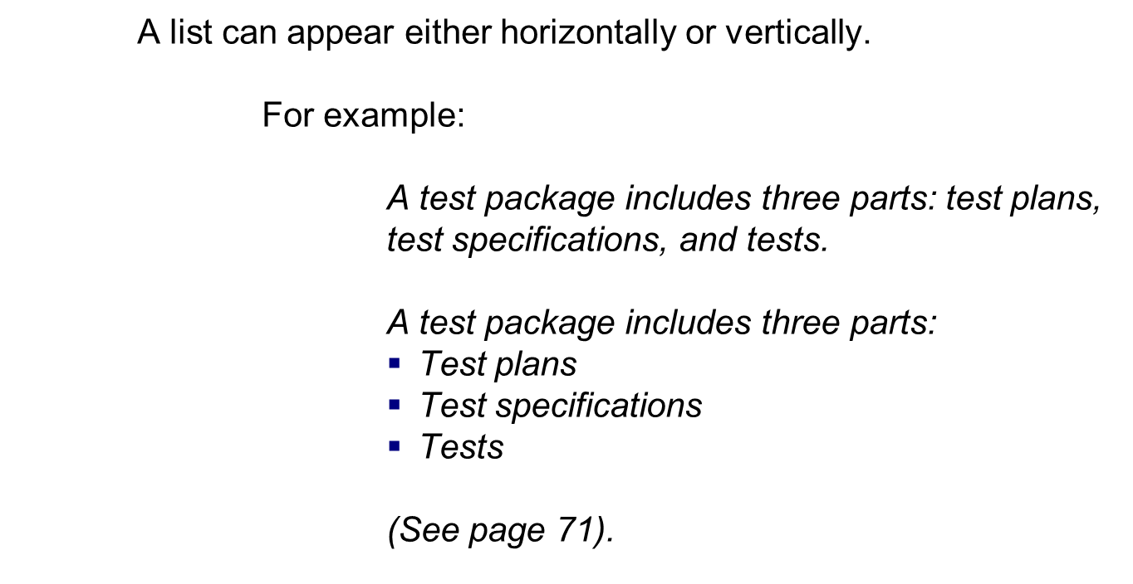
Drafting and Revising
Your Document: Cont.
Copyright © 2004 Houghton Mifflin. All Rights Reserved.
3-<number>

Slide 27
Drafting and Revising
Your Document: Cont.
Use Coordinate Structure.
  Coordinate structure means that each section of a document follows the same organizational pattern.
  The example on then next slide illustrates paragraphs that have the same structure: first, a definition, followed by details that explain the term.
3-<number>
Copyright © 2014 Wadsworth. All Rights Reserved.

Slide 28
Drafting and Revising
Your Document: Cont.
CUTTING PHASE
The cutting phase is the process of cutting the aluminum stock to length. The is the process of boring holes into aluminum stock comes to the cutoff saw in 10-foot lengths and the saw cuts off 6-inch lengths.
MILLING PHASE
The milling phase is the process of shaving off excess aluminum from the stock. The stock comes to the milling machine from the cutoff saw in exact lengths. The milling machine shaves the stock down to exact height and width specifications of 5 inches.
DRILLING/THREADING PHASE
The drilling/threading phase has two steps: drilling and threading. The drilling phase is the process of drilling holes into the aluminum stock in specified positions. After the stock comes from milling, the drilling machine bores a hole in each of the four sides, creating tunnels. These tunnels serve as passageways for oil to flow through the valve.
The threading phase is the process of putting threads into the tunnels. After a tool change to enable threading, the drilling machine cuts threads into the tunnels. The threads allow valve inlets and outlets to be screwed into the finished stock.
(See page 71).
Copyright © 2014 Wadsworth. All Rights Reserved.
3-<number>

Slide 29
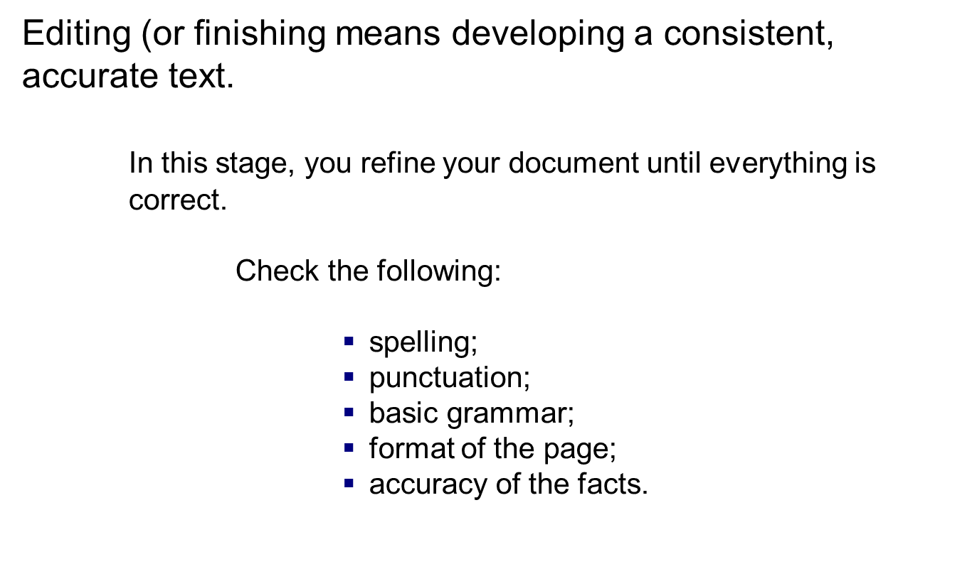
Editing or Finishing
3-<number>
Copyright © 2014 Wadsworth. All Rights Reserved.

Slide 30
Editing or Finishing: Cont.
Create a set of quality benchmarks.
Copyright © 2014 Wadsworth. Mifflin. All Rights Reserved.
3-<number>

Slide 31
Editing or Finishing: Cont.
Style Design
• No spelling or grammar errors.
Information Design
• Title appears.
• Introduction appears. Introduction tells point of document and, if it is long, sections of the document.
• Body sections are structured similarly in type and depth of points.
Page Design
• Fonts are standard roman, and large enough to be easily readable.
• Heads appear and indicate subject of their section.
Visual Design
• Visuals appear to support a point in the text or provide a place for the text to begin.
• Visuals are effectively sized, captioned, and referenced.
Navigation Design
• Every link works.
• Link size and placement indicate the type of content (e.g., return to homepage or major section of document) that it connects to.
• Links provide helpful paths through the work.
3-<number>
Copyright © 2014 Wadsworth. All Rights Reserved.

Slide 32
Editing or Finishing: Cont.
See example of an edited technical report (page 75):
Figure 3.4 Technical Report Original.
Figure 3.5 Technical Report Edited.
Copyright © 2014 Wadsworth. All Rights Reserved.
3-<number>

Slide 33
Editing or Finishing: Cont.
Producing the Document.
      Production of the document involves the physical completion, the typing or printing, of the final document.
      Plan enough time (this stage take energy and time);
      Be prepared for problems (hard drive crashing; printer failing).
      Although physical completion is usually a minor factor in brief papers. In longer documents it often takes more time than the drafting stage.
      See Worksheet for Editing (page 77).
3-<number>
Copyright © 2014 Wadsworth. All Rights Reserved.

Slide 34
Focus on Groups
Many times technical writer must co-write documents. Team member must coordinate their activities in order to produce an effective report.
Before beginning to plan
      select a leader;
      understand effective collaboration;
      develop a method to resolve differences;
      plan the groups activities;
      choose a strategy for drafting;
      choose a strategy for editing;
      chose a strategy for producing the document.
See worksheets for Group Planning; Group Drafting and Revising; and Group Editing (pages 86 & 87).
Copyright © 2014 Wadsworth. All Rights Reserved.
3-<number>

