Slide 1



Sequence assembly and quality
Linda van der Graaf – van Bloois
Faculty of Veterinary Medicine
Department of Biomolecular Health Sciences

Slide 2
Overview
Assembly methods
Assemby quality
Assembly errors
Long-read sequencing

Slide 3
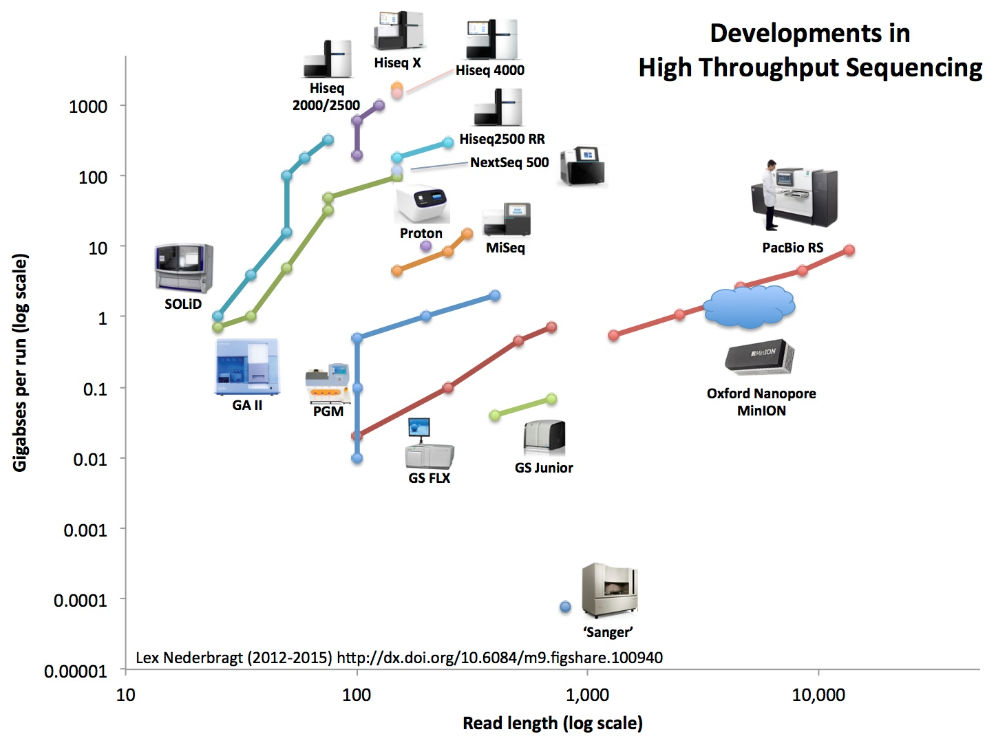
2015
Third generation
- Long reads -
Second generation
- Short reads -
First generation

Slide 4
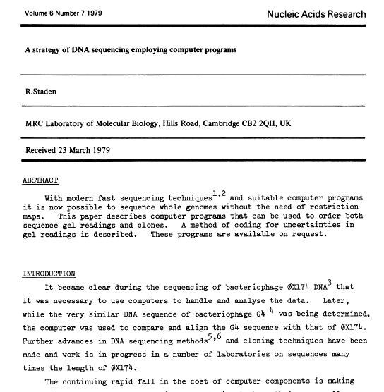

Slide 5
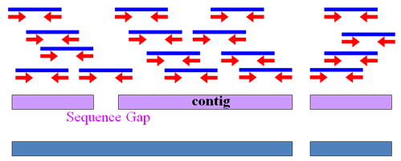
Assembly
Fragmented DNA is sequenced into “reads”
Reads can be organized into read pairs
Read pairs can be puzzled together into “contigs”
Contigs can be ordered according to their expected position into “scaffolds”
Reads
Contigs
Scaffold

Slide 6
Assembly strategies
Reference-guided assembly
Mapping reads to a reference
Infer consensus
Reference genome
Reads
Consensus sequence in contigs

Slide 7
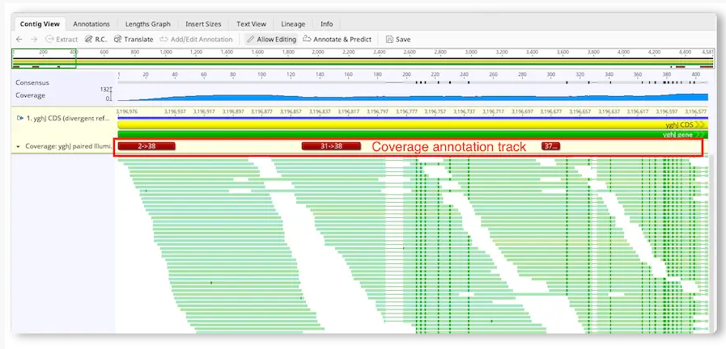

Slide 8
Assembly strategies
2. De novo assembly
Construct genome sequence from overlap between reads
Contigs
Reads

Slide 9
Reference-guided assembly
We need a closely related reference genome:
Same species
Reference genome leads to biases in the assembly
Genome structure
Insertions, deletions, rearrangements
If we only have a distantly related reference:
→ we need to be more permissive when aligning reads
→ this will lead to more possible errors
Notes:
Reference-guided assembly is not considered appropriate for assembly of new species.

Slide 10
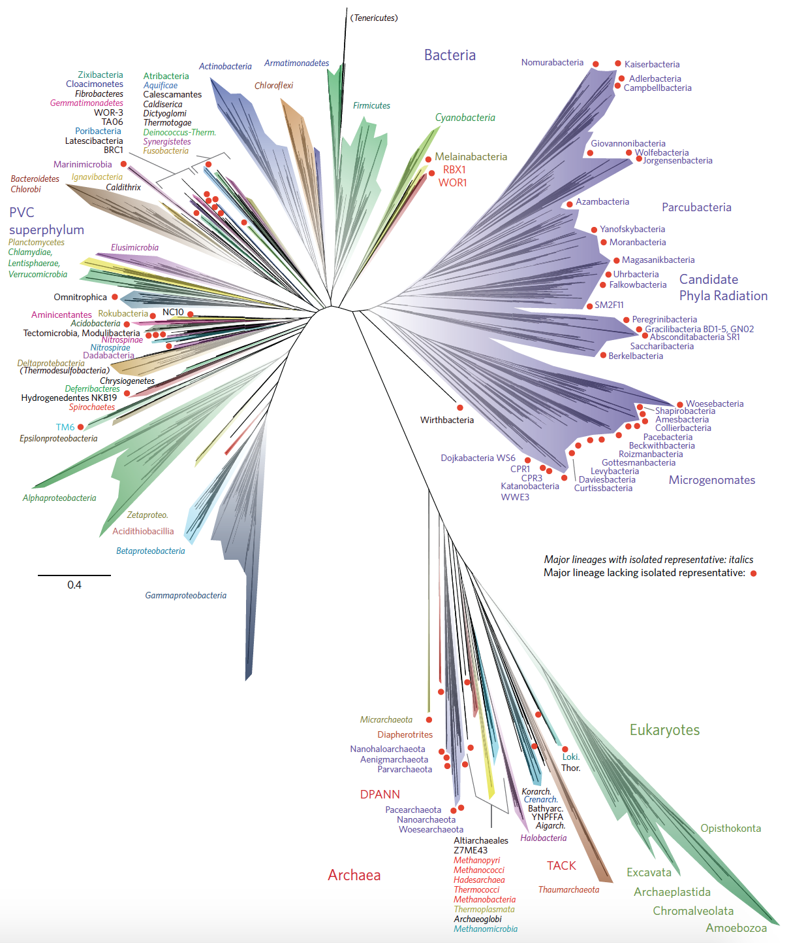
Tree of life
Italic: well-characterized clades
Red dot: clades with no representatives
Hug et al. Nature Microbiol 2016
Notes:
We know from the tree of life that there are many bacterial species that we have not seen before.
Tree of life: made in 2016

Slide 11
Coverage (ambiguous term!)
Depth
Coverage
Coverage
Horizontal coverage
Depth (vertical coverage):
Coverage:
Average number of reads that cover each nucleotide in the assembly
Corresponds to the abundance of a sequence in the sample
Coverage:
Percentage of the target genome that has been (re)covered after the assembly
Horizontal coverage:
Notes:
Depth: Number of times that a nucleotide in a target genome has been sequenced or recovered
Horizontal coverage: percentage of the target in a sequence recovered in the assembled contigs for its scaffolds

Slide 12
De novo sequence assembly
Requires sufficient sequencing (coverage x depth)
Breaks on repeats and low-coverage regions
Algorithms
Greedy extension
Overlap-layout-consensus
De Bruijn graph

Slide 13
De novo sequence assembly
Requires sufficient sequencing (coverage x depth)
Breaks on repeats and low-coverage regions
Algorithms
Greedy extension -> no longer used
Overlap-layout-consensus -> slower – low quality data
De Bruijn graph -> faster – requires high quality data

Slide 14
Overview
Assembly methods
Assemby quality
Assembly errors
Long-read sequencing

Slide 15
How to assess assembly quality?
General assembly performance metrics
Length of longest contig
N50, N80
Percentage of matched paired-end reads
- Length distribution of open reading frames (ORFs)
Notes:
ORFs: 3 in every 64 codons should be a stop codon. If you find ORFs with the length of a real protein; indication that assembly represents real biological sequence. Wrong sequence: much shorter ORFs.

Slide 16
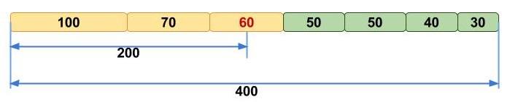
Assembly length statistics: N50 and N80
Contig_1
Contig_N
Sort all contigs from long to short
N50 = length of contig at 50% of cumulative length

Slide 17
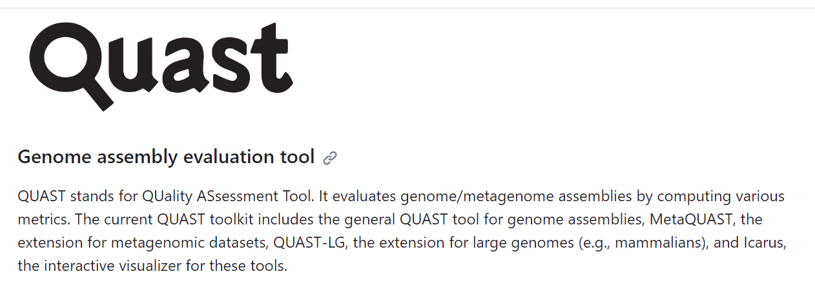
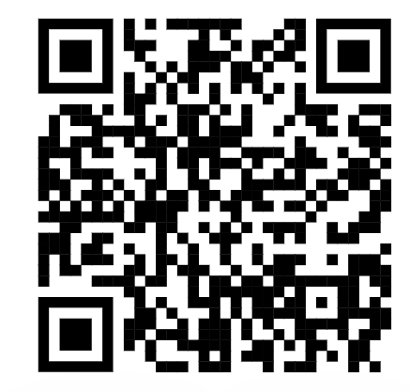
Assembly length statistics: N50 and N80
Contig_1
Contig_N
Sort all contigs from long to short
N50 = length of contig at 50% of cumulative length
N80 = length of contig at 80% of cumulative length
This measure is less meaningful for metagenomes from highly diverse communities

Slide 18
Single-copy marker genes
Completeness
Marker genes are expected to be present in all bacteria
Redundancy
Single-copy genes are expected to be present only once
Speth et al. Nature Comm. 2016

Slide 19

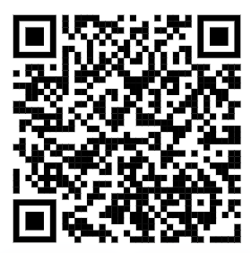
Checkm; tool for assessing the quality of genomes

Slide 20
Overview
Assembly methods
Assemby quality
Assembly errors
Long-read sequencing

Slide 21
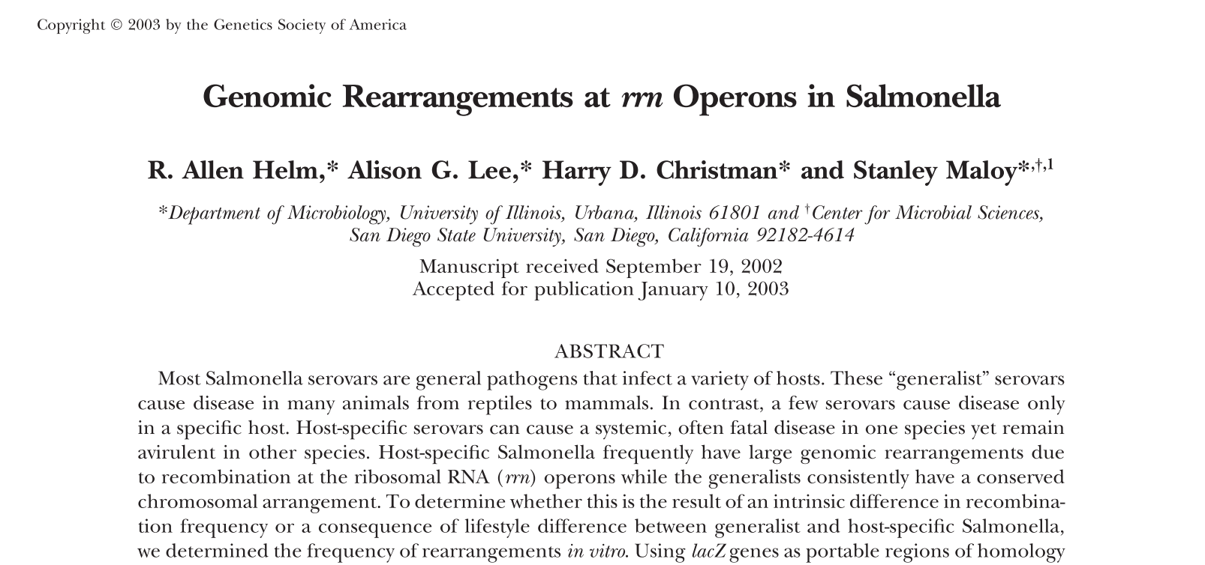
Assembly error: Repeats
16s
Helm et al., Genetics 2003
Notes:
16S present multiple times in single genome.
Not only bioinformatic problem, but also biological, example salmonella who is recombining^RNA operon

Slide 22

Repeats have multiple sinks/sources
16s/transposons/repeats
Helm et al., Genetics 2003
Notes:
16S present multiple times in single genome.
Not only bioinformatic problem, but also biological, example salmonella who is recombining^RNA operon

Slide 23

Assembly error: Homopolymers
CCGTGTCAGCGGCATCGCCGGGGGGCAGGACATGAAGGCG GTGTCAGCGGCATCGCCGGGGGGCAGGACATGAAGGCGGCGTG TGTCAGCGGCATCGCCGGGGG-CAGGACATGAAGGCGAGTTGGGCAACCGG TGTCAGCGGCATCGCCGGGGG-CAGGACATGAAGGCGGCGTGGGCAACCGGTGG
AGCGGCATCGCCGGGGGGCAGGACATGAAGGCGAGTTGGGCAACCGGTGG GCGGCATCGCCGGGGGGCAGGACATGAAGGCGAGTTGGGCAACCGGTGGCA
CATCGCCGGGGG-CAGGACATGAAGGCGAGTTGGGCAACCGGTGGCATTGG GCCGGGGG-CAGGACATGAAGGCGGCGTGGGCAACCGGTGGCATTGCCCTG
Homopolymer: stretch of identical nucleotides
Homopolymer error: length is misidentified
When longer than 3-5 nucleotides
Problem with long-read sequencing
Longer homopolymer tracks: more errors

Slide 24
Overview
Assembly methods
Assemby quality
Assembly errors
Long-read sequencing

Slide 25
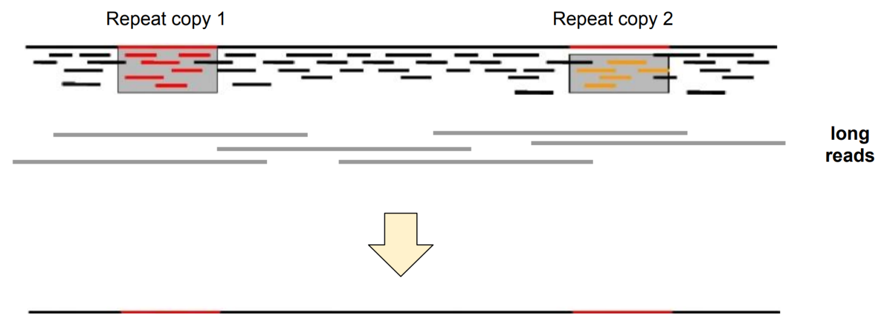
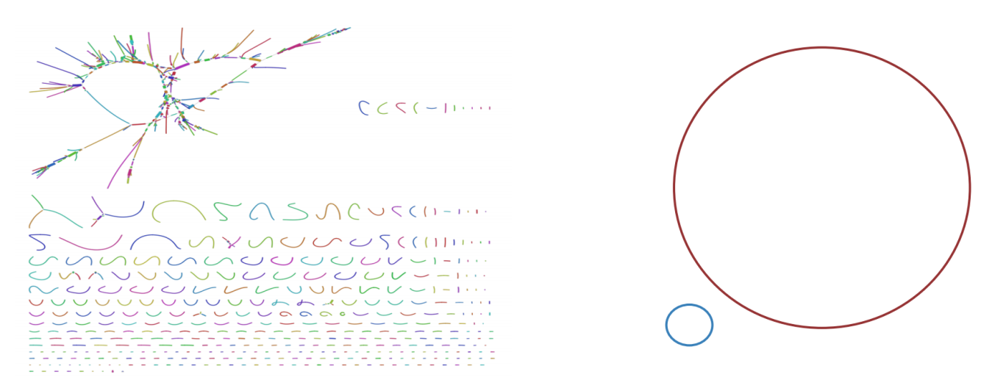

Long-read sequencing
short reads: contig breaks
long reads span repeats
resulting in complete assemblies
Recognizing what is plasmid
and what is chromosomal DNA
short read assembly
long read assembly

Slide 26
Hybrid assembly
Repeat region
Long read
Short reads
Long-read assembly is used as scaffold
Short-reads are used to polish the long-read assembly
(SNPs, homopolymer tracts etc)

Slide 27
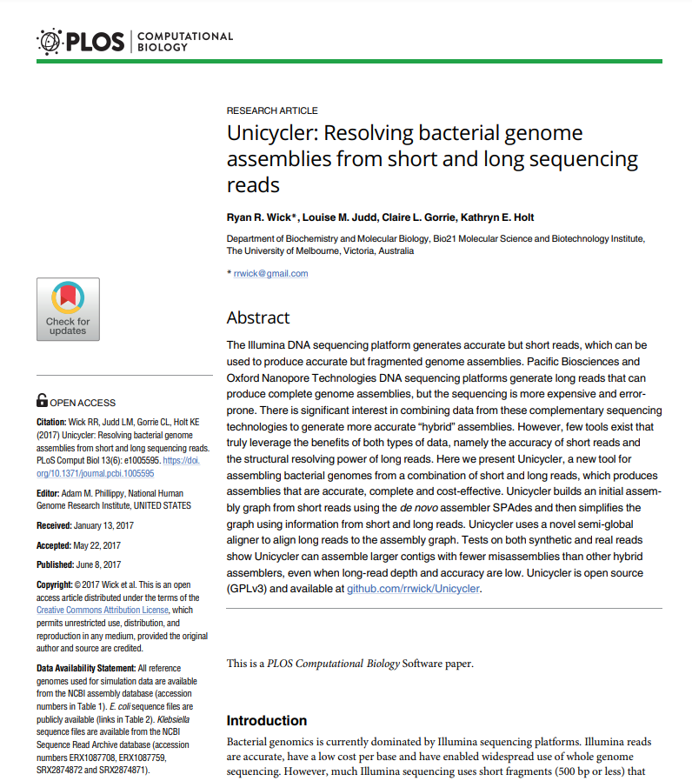
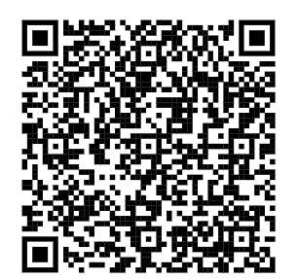
Hybrid assembly tool: UniCycler
Use of Unicycler:
De novo assembly with only long-reads (miniasm assembly)
Other assemblers: Flye, Canu
De novo assembly with both long- and short-reads
Most powerful as hybrid assembler:
Use long-read assembly as scaffold, and correct sequence with Illumina short-reads
Racon polishing
Polishing always necessary

Slide 28
Summary
Assembly methods
Reference-based
De-novo assembly
Assemby quality
Coverage and depth
N50
Checkm
Assembly errors
Repeats
Homopolymers
Long-read sequencing
Hybrid assembly

