Slide 1



DNA sequencing, accuracy and errors
Linda van der Graaf – van Bloois
Faculty of Veterinary Medicine
Department of Biomolecular Health Sciences

Slide 2
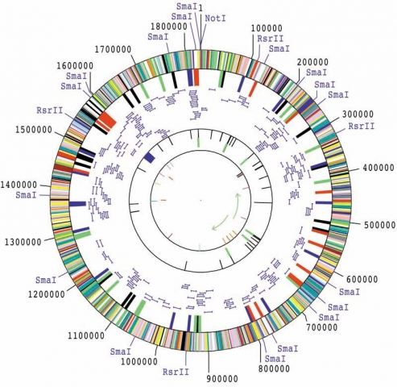

First microbial genome
1995
Entirely done by Sanger sequencing
Estimated cost: $0.48/base
> 1M€ per genome in todays money
Haemophilus influenzae
Fleischmann et al Science. 1995 Jul 28;269(5223):496-512.
Notes:
I’ve sequenced Lactococcus lactis in 2002-2004. Took 2 years.

Slide 3
Microbial sequencing projects
NCBI GenBank & SRA microbial genomes >10 million
Sanger sequencing
Next generation sequencing (NGS)
Pyrosequencing
(454)
Rapid sequencing during EHEC outbreak
The global
ocean sampling
for metagenomics
First mulicellular
organism: C. elegans
Microbial Sequencing projects
1000 genomes
6 weeks
<100 €/ genome
First bacteria:
H. influenzae
1 genome
2 years
100k €/ genome
2015
2020
2016
Complete genomes
Draft genomes

Slide 4
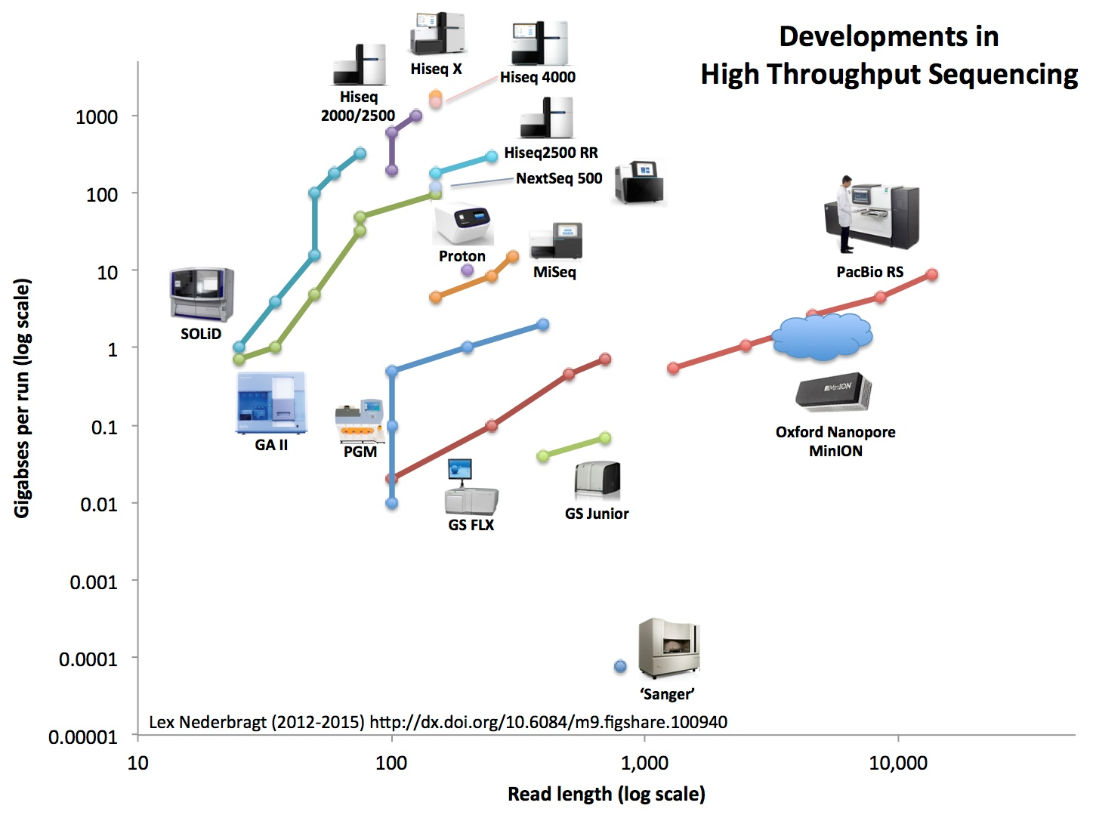
2015
Third generation
Second generation
First generation

Slide 5
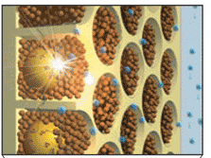
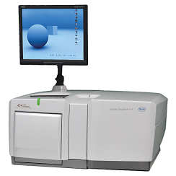
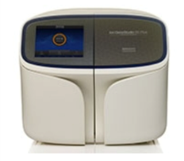
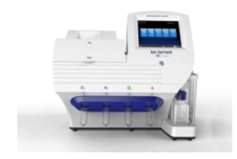
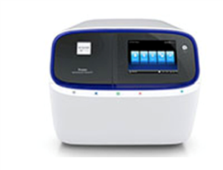
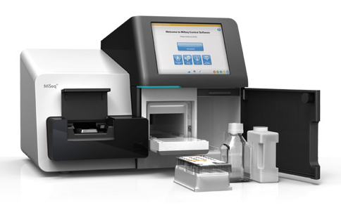
Second generation (Short-read) sequencing methods
Roche 454
IonTorrent
Illumina
Discontinued
1st next-generation system: pyrosequencing
cheap, fast, sequence errors,
200-400 bp reads
Ion Gene S5
Ion PGM
Ion Proton
cheap, precise, slow, high-throughput, 50-300 bp reads
ISeq – MiniSeq - MiSeq
NextSeq – HiSeq – HiSeqX - NovaSeq

Slide 6
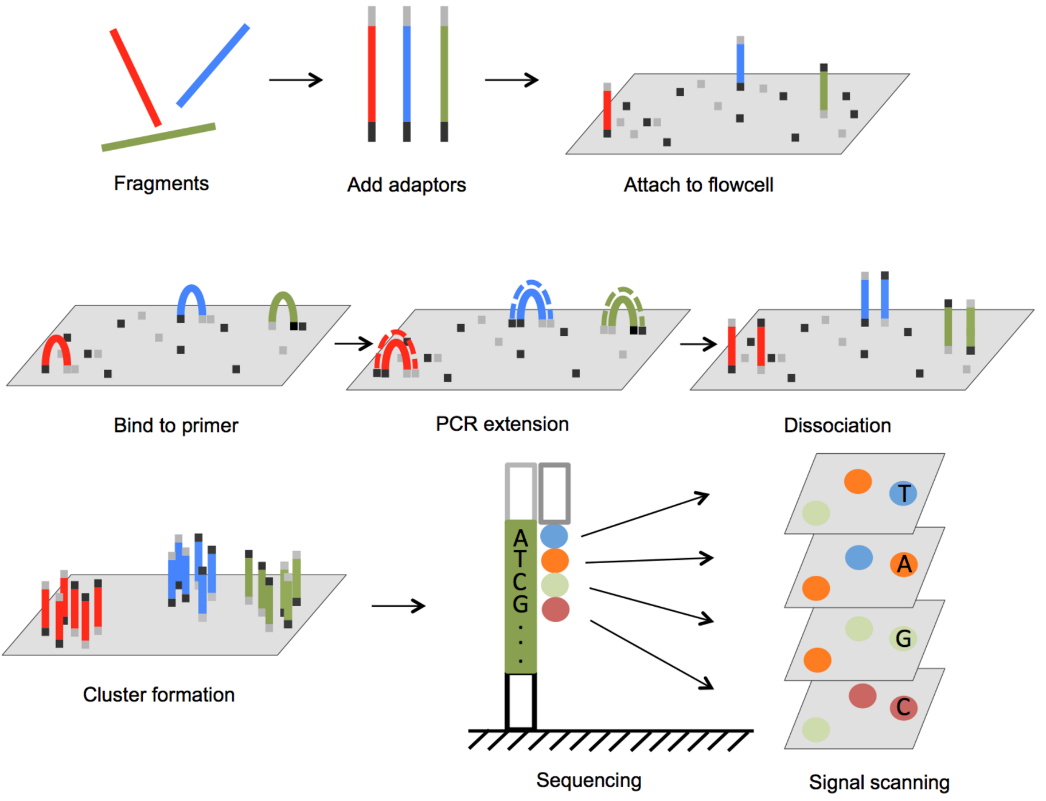
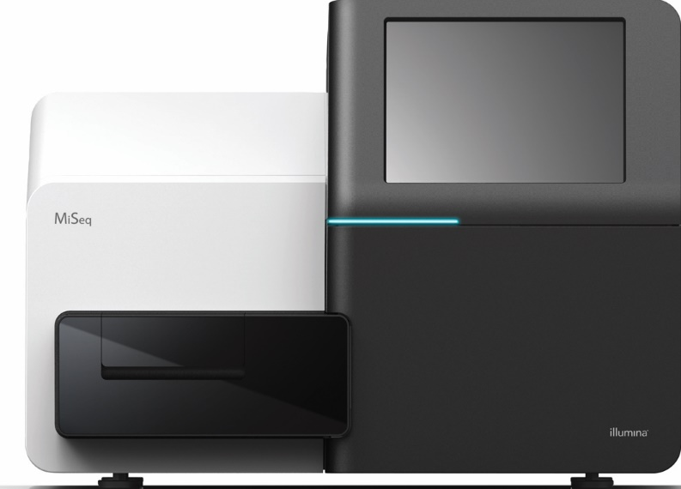
Illumina sequencing
DNA sequencing depends on “reading” A/C/G/T signal
Signals: differently colored fluorophores

Slide 7
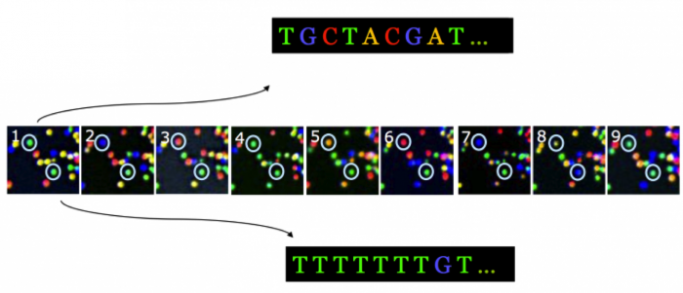
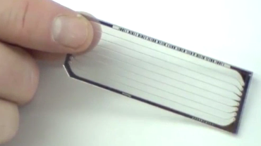
Illumina sequencing
Color signal of a cluster is not always 100% unambiguous

Slide 8
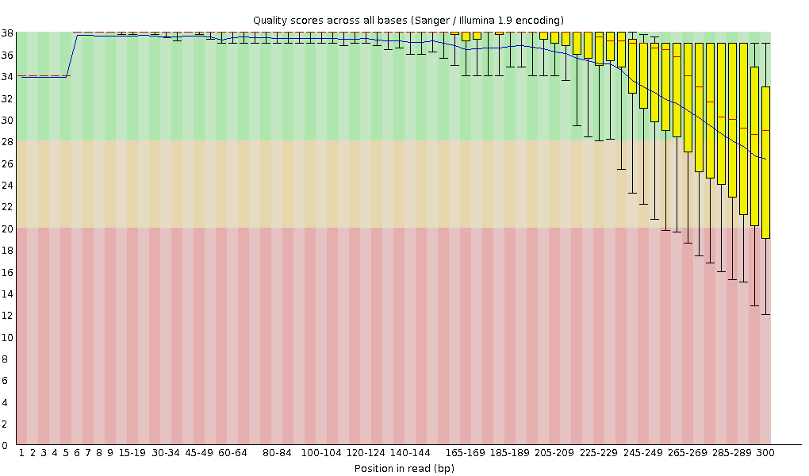
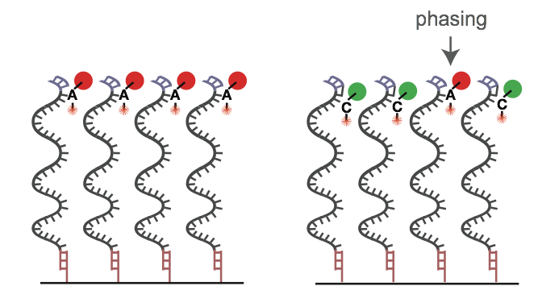
Illumina sequencing – quality scores bases
Phasing:
The blocker of a nucleotide is not correctly removed after signal detection
A nucleotide has a defect terminator cap (prephasing) and two nucleotides can bind in one cycle
Main reason for decreasing sequence quality:
Phasing
Decrease of fluorescent signal over time

Slide 9
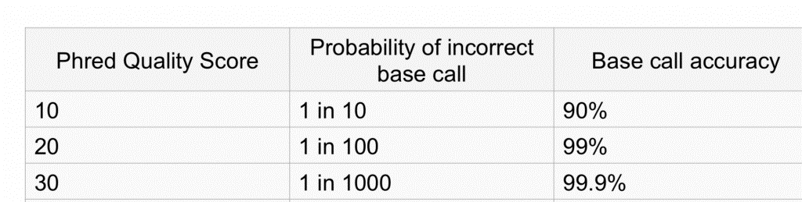
Quality scores
Phred 10: 10⁻¹ chance that the base is wrong
90% accuracy; 10% error rate
Phred 20: 10⁻² chance that the base is wrong
99% accuracy ; 1% error rate
Phred 30: 10⁻³ chance that the base is wrong
99.9% accuracy ; 0.1% error rate
Notes:
9

Slide 10
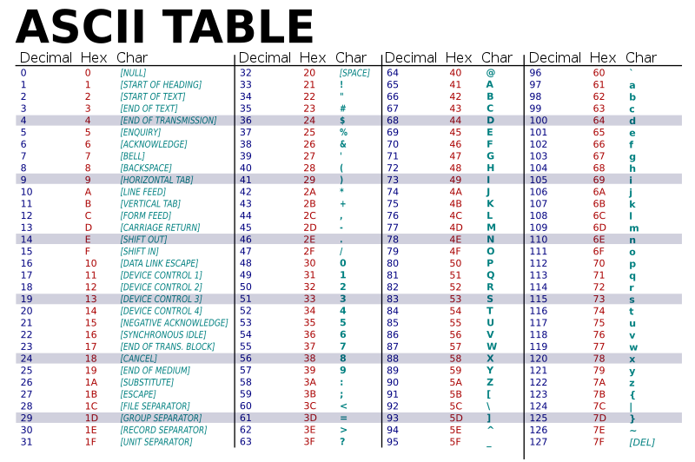
Phred score in ASCII text
Fastq quality score = Phred score -> converted to ASCII text

Slide 11
Fastq files
Sequence and quality scores are stored in Fastq files
Every new entry starts with an “@” sign at the start of a line followed by an ID.
The sequence is given on the second line.
@NS500413:192:HCVY7AFXX:1:11101:10153:1038 1:N:0:AGTCAA
TGCACCCGCGTGATCGCGGTTTCCTGGGGCGCCACGGCGGCGGTCATCGGGCTGAACTGG
+
JJJJJJJFF/EAEEEAAAEEEE//EEEE/A<//<<<<6/<</<A<<AEAEE//AA6/<//
@NS500413:192:HCVY7AFXX:1:11101:19723:1039 1:N:0:AGTCAA
GGAAATGGAGTACGGATCGATTTTGTTTGG
+
JJJJJJJJJJJJJJJJ7FAEA715511E00
Third, there is a line starting with +. This line can optionally contain the ID again.
Fourth, the string of quality scores for each nucleotide is given on the fourth line.

Slide 12
Phred scores in fastq files
The sequence is given on the second line.
@NS500413:192:HCVY7AFXX:1:11101:10153:1038 1:N:0:AGTCAA
TGCACCCGCGTGATCGCGGTTTCCTGGGGCGCCACGGCGGCGGTCATCGGGCTGAACTGG
+
JJJJJJJFF/EAEEEAAAEEEE//EEEE/A<//<<<<6/<</<A<<AEAEE//AA6/<//
@NS500413:192:HCVY7AFXX:1:11101:19723:1039 1:N:0:AGTCAA
GGAAATGGAGTACGGATCGATTTTGTTTGG
+
JJJJJJJJJJJJJJJJ7FAEA715511E00
Phred score per base:
J = 74
74 – 33 = 41 → phred score
Fourth, the string of quality scores for each nucleotide is given on the fourth line.

Slide 13
Fastq files
The ID may contain information such as the run and the position of the cluster on the sequencing slide.
Paired sequence and quality lines should be equally long.
@NS500413:192:HCVY7AFXX:1:11101:10153:1038 1:N:0:AGTCAA
TGCACCCGCGTGATCGCGGTTTCCTGGGGCGCCACGGCGGCGGTCATCGGGCTGAACTGG
+
JJJJJJJFF/EAEEEAAAEEEE//EEEE/A<//<<<<6/<</<A<<AEAEE//AA6/<//
@NS500413:192:HCVY7AFXX:1:11101:19723:1039 1:N:0:AGTCAA
GGAAATGGAGTACGGATCGATTTTGTTTGG
+
JJJJJJJJJJJJJJJJ7FAEA715511E00
Sometimes the sample barcode is also listed.
Illumina reads are all the same length when they come off the sequencer. If the sequences have different lengths, they have probably been processed.

Slide 14

Fasta files
Sequences are stored in Fasta files
Fasta files are plain text files (open e.g. in )
Every new entry starts with a “>” sign at the start of a line followed by an ID
There can be extra attributes or comments on the same line, but after the first space
Each ID is unique in the file. The ID is the part until a space, so no spaces allowed in the ID itself
>dna_sequence_A length=36 source=human_gut
CCGATCATATGACTAGCATGTCGACTAGCATTTAGA
>dna_sequence_B length=43 source=human_gut
GACTAGCATGCAATCGCGATAGCTATCGACTAGCATTTAGCGA
>dna_sequence_C length=86 source=human_gut
GCGGCGGCTAACGCATCGATCTTTGTACGATGATTGGCGGCGGC TATTATGCATTGGGAATGCATCGATCGACATCGATCGAAGCTAT
While the description has to be on a single line, the sequence can be on one or more lines until the next “>” at the start of a line

Slide 15
2015
Third generation
Second generation
First generation

Slide 16
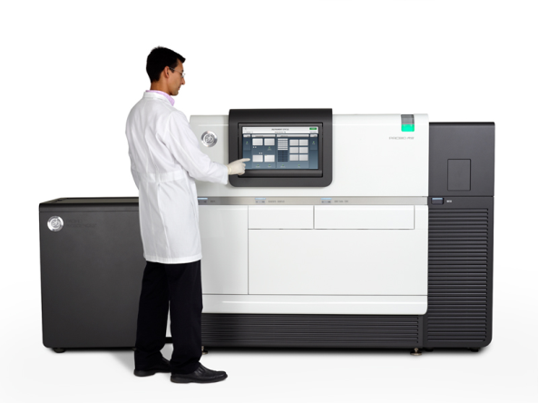
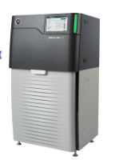
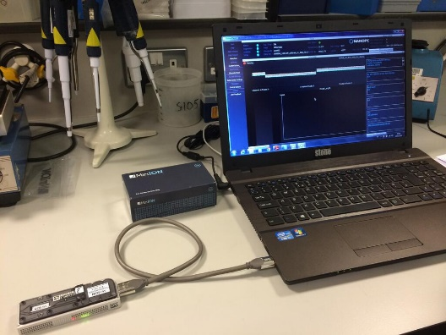

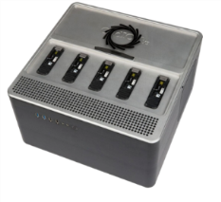
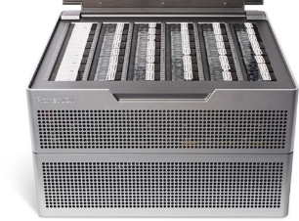
Third generation (Long-read) sequencing methods
Pacific Biosystems
(PacBio)
Oxford Nanopore
Technologies
Long reads (20 kb)
Perfect for genome assembly
Moderate to high error rate
Tiny (minION)
Long reads (>50 kb)
Perfect for genome assembly
High error rate
GridION
PromethION
SmidgION

Slide 17
Oxford Nanopore
−
−
−
−
−
−
−
−
−
−
−
−
−
−
−
−
−
−
−
−
−
−
−
−
−
−
−
−
+
+
+
+
+
+
+
+
+
+
+
+
Open channel
DNA with molecular motor captured by nanopore
Translocation of 5’ adaptor
Translocation of template strand
Translocation of hairpin
Translocation of complement strand
Translocation of 3’ adaptor
Open channel
+
+
+
+
Jain et al. Nat Meth 2015
Notes:
Nucleotides have different sizes, which gives different currents in the nanopore

Slide 18
Nanopore accuracy
% identity to reference
By themselves, Nanopore sequences have relatively low accuracy (1D)
By measuring double stranded DNA, the same sequence can be measured twice (2D)
This decreases the error rate / increases accuracy
Seemann, SlideShare 2015

Slide 19
Homopolymer errors
CCGTGTCAGCGGCATCGCCGGGGGGCAGGACATGAAGGCG
GTGTCAGCGGCATCGCCGGGGGGCAGGACATGAAGGCGGCGTG
TGTCAGCGGCATCGCCGGGGG-CAGGACATGAAGGCGAGTTGGGCAACCGG
TGTCAGCGGCATCGCCGGGGG-CAGGACATGAAGGCGGCGTGGGCAACCGGTGG
AGCGGCATCGCCGGGGGGCAGGACATGAAGGCGAGTTGGGCAACCGGTGG
GCGGCATCGCCGGGGGGCAGGACATGAAGGCGAGTTGGGCAACCGGTGGCA
CATCGCCGGGGG-CAGGACATGAAGGCGAGTTGGGCAACCGGTGGCATTGG
GCCGGGGG-CAGGACATGAAGGCGGCGTGGGCAACCGGTGGCATTGCCCTG
Homopolymer: stretch of identical nucleotides
Homopolymer error: length is misidentified
When longer than 3-5 nucleotides
Problem with long-read sequencing
Longer homopolymer tracks: more errors

Slide 20
Consensus correction
Long reads (Nanopore, Pacbio) can be corrected with shorter reads, or with contigs (e.g. Illumina)

Slide 21
Summary
Second generation sequencing (Illumina)
Sequencing errors
Phred scores, fastq files
Third generation sequencing (Nanopore)
Homopolymer errors
Consensus correction

