Slide 1
A Feature-Driven Tensor Semantics for Minimalist Grammars
John Paulson
Dept. of Linguistics
University of Utah
john.paulson@utah.edu
Aniello De Santo
Dept. of Linguistics
University of Utah
aniello.desanto@utah.edu
Jon Rawski
Dept. of Linguistics and Language Development
San Jose State University
jon.rawski@sjsu.edu

Slide 2
Talk in one slide
This work bridges distributional approaches to semantics and “mainstream” generative grammar.
We incorporate Minimalist Grammars into vector-based semantic models
The resulting vector semantic models can build the meaning of larger expressions compositionally, by combining the meaning of smaller expressions
This compositionality is guided by the Minimalist Grammar syntax

Slide 3
Distributionality and Compositionality
Computational linguistics often makes use of distributional semantics, describing the meanings of expressions through co-occurrence in corpora
Embedding the meanings of expressions into vector spaces is a popular way of implementing distributional models
In contrast, traditional/formal semantics research often analyzes meaning compositionally, building up the meaning of expressions from subparts
An approach that uses vector space operations to combine the meanings of smaller expressions into meanings for larger expressions can bridge these two approaches

Slide 4
Distributionality and Compositionality
Computational linguistics often makes use of distributional semantics, describing the meanings of expressions through co-occurrence in corpora
Embedding the meanings of expressions into vector spaces is a popular way of implementing distributional models
In contrast, traditional/formal semantics research often analyzes meaning compositionally, building up the meaning of expressions from subparts
An approach that uses vector space operations to combine the meanings of smaller expressions into meanings for larger expressions can bridge these two approaches

Slide 5
Distributionality and Compositionality
Computational linguistics often makes use of distributional semantics, describing the meanings of expressions through co-occurrence in corpora
Embedding the meanings of expressions into vector spaces is a popular way of implementing distributional models
In contrast, traditional/formal semantics research often analyzes meaning compositionally, building up the meaning of expressions from subparts
An approach that uses vector space operations to combine the meanings of smaller expressions into meanings for larger expressions can bridge these two approaches

Slide 6
Distributionality and Compositionality
Computational linguistics often makes use of distributional semantics, describing the meanings of expressions through co-occurrence in corpora
Embedding the meanings of expressions into vector spaces is a popular way of implementing distributional models
In contrast, traditional/formal semantics research often analyzes meaning compositionally, building up the meaning of expressions from subparts
An approach that uses vector space operations to combine the meanings of smaller expressions into meanings for larger expressions can bridge these two approaches

Slide 7
Distributionality and Compositionality
Computational linguistics often makes use of distributional semantics, describing the meanings of expressions through co-occurrence in corpora
Embedding the meanings of expressions into vector spaces is a popular way of implementing distributional models
In contrast, traditional/formal semantics research often analyzes meaning compositionally, building up the meaning of expressions from subparts
An approach that uses vector space operations to combine the meanings of smaller expressions into meanings for larger expressions can bridge these two approaches

Slide 8
Formal Grammars and Distributional Semantics
In particular, having composition be guided by a formal grammar can bridge semantic and syntactic approaches, motivating how such operations should be applied
There is already successful work integrating Combinatory Categorial Grammars (CCGs; Steedman, 2001; Steedman and Baldridge, 2011) with distributional semantics in this way (Coecke et al., 2010; Maillard et al., 2014)
This work integrates such a model distributional semantics with Minimalist Grammars (MGs; Stabler, 1996), which formalize the (broad strokes) syntactic approach of the Minimalist Program

Slide 9
Formal Grammars and Distributional Semantics
In particular, having composition be guided by a formal grammar can bridge semantic and syntactic approaches, motivating how such operations should be applied
There is already successful work integrating Combinatory Categorial Grammars (CCGs; Steedman, 2001; Steedman and Baldridge, 2011) with distributional semantics in this way (Coecke et al., 2010; Maillard et al., 2014)
This work integrates such a model distributional semantics with Minimalist Grammars (MGs; Stabler, 1996), which formalize the (broad strokes) syntactic approach of the Minimalist Program

Slide 10
Formal Grammars and Distributional Semantics
In particular, having composition be guided by a formal grammar can bridge semantic and syntactic approaches, motivating how such operations should be applied
There is already successful work integrating Combinatory Categorial Grammars (CCGs; Steedman, 2001; Steedman and Baldridge, 2011) with distributional semantics in this way (Coecke et al., 2010; Maillard et al., 2014)
This work integrates such a model distributional semantics with Minimalist Grammars (MGs; Stabler, 1996), which formalize the (broad strokes) syntactic approach of the Minimalist Program

Slide 11
Why MGs?
MGs are a mildly context-sensitive grammar formalism which are thought to be able to capture all of natural language syntax
MGs formalize “Minimalist Program-like” syntax
In this way, incorporating distributional semantics into MGs provides a link to “mainstream” syntactic theory
MGs have also been useful in analyzing sentence processing (Kobele et al., 2012; De Santo, 2020, 2025)
There is also a vector-based analysis for the syntax of MGs (beim Graben & Gerth, 2012)
It’s not just CCGs!

Slide 12
Why MGs?
MGs are a mildly context-sensitive grammar formalism which are thought to be able to capture all of natural language syntax
MGs formalize “Minimalist Program-like” syntax
In this way, incorporating distributional semantics into MGs provides a link to “mainstream” syntactic theory
MGs have also been useful in analyzing sentence processing (Kobele et al., 2012; De Santo, 2020, 2025)
There is also a vector-based analysis for the syntax of MGs (beim Graben & Gerth, 2012)
It’s not just CCGs!

Slide 13
Why MGs?
MGs are a mildly context-sensitive grammar formalism which are thought to be able to capture all of natural language syntax
MGs formalize “Minimalist Program-like” syntax
In this way, incorporating distributional semantics into MGs provides a link to “mainstream” syntactic theory
MGs have also been useful in analyzing sentence processing (Kobele et al., 2012; De Santo, 2020, 2025)
There is also a vector-based analysis for the syntax of MGs (beim Graben & Gerth, 2012)
It’s not just CCGs!

Slide 14
Why MGs?
MGs are a mildly context-sensitive grammar formalism which are thought to be able to capture all of natural language syntax
MGs formalize “Minimalist Program-like” syntax
In this way, incorporating distributional semantics into MGs provides a link to “mainstream” syntactic theory
MGs have also been useful in analyzing sentence processing (Kobele et al., 2012; De Santo, 2020, 2025)
There is also a vector-based analysis for the syntax of MGs (beim Graben & Gerth, 2012)
It’s not just CCGs!

Slide 15
Why MGs?
MGs are a mildly context-sensitive grammar formalism which are thought to be able to capture all of natural language syntax
MGs formalize “Minimalist Program-like” syntax
In this way, incorporating distributional semantics into MGs provides a link to “mainstream” syntactic theory
MGs have also been useful in analyzing sentence processing (Kobele et al., 2012; De Santo, 2020, 2025)
There is also a vector-based analysis for the syntax of MGs (beim Graben & Gerth, 2012)
It’s not just CCGs!

Slide 16
Why MGs?
MGs are a mildly context-sensitive grammar formalism which are thought to be able to capture all of natural language syntax
MGs formalize “Minimalist Program-like” syntax
In this way, incorporating distributional semantics into MGs provides a link to “mainstream” syntactic theory
MGs have also been useful in analyzing sentence processing (Kobele et al., 2012; De Santo, 2020, 2025)
There is also a vector-based analysis for the syntax of MGs (beim Graben & Gerth, 2012)
It’s not just CCGs!

Slide 17
Minimalist Grammars

Slide 18
Minimalist Grammars
Lexical Item | Feature String
what | [D, wh⁺]
eat | [=D, V]
∅_{v} (little v) | [=V, =D, v]
Alice | [D, nom⁻]
∅_{T} (T head) | [=v, nom⁺, T]
did | [=T, wh⁺, C]
Trees built from a lexicon and the operations Merge and Move
Each tree (including lexical items) has a string of features dictating which operations can be used
Merge features:
Selectee features (f)
Selector features (=f)
Move features:
Licensee features (f⁻)
Licensor features (f⁺)

Slide 19
Minimalist Grammars
Merge is a (partial) binary operation. It takes one tree with a selectee feature (f) and one with a matching selector feature (=f), combines them into one tree, checking (deleting) both features

Slide 20
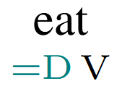
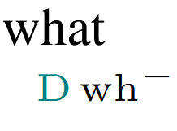
Minimalist Grammars
Merge is a (partial) binary operation. It takes one tree with a selectee feature (f) and one with a matching selector feature (=f), combines them into one tree, checking (deleting) both features

Slide 21
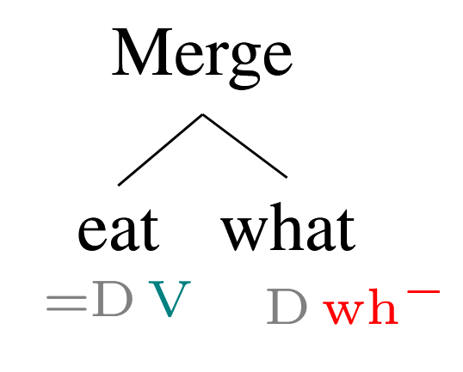
Minimalist Grammars
Merge is a (partial) binary operation. It takes one tree with a selectee feature (f) and one with a matching selector feature (=f), combines them into one tree, checking (deleting) both features

Slide 22
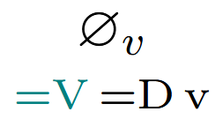
Minimalist Grammars

Slide 23
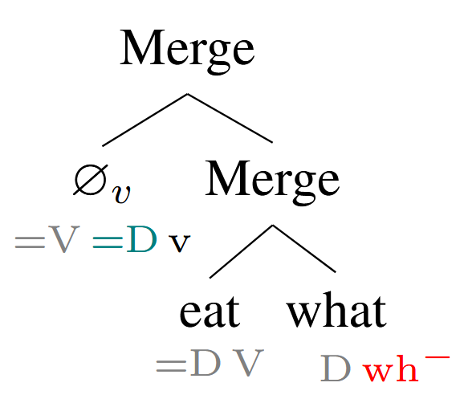
Minimalist Grammars

Slide 24
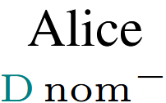

Minimalist Grammars

Slide 25
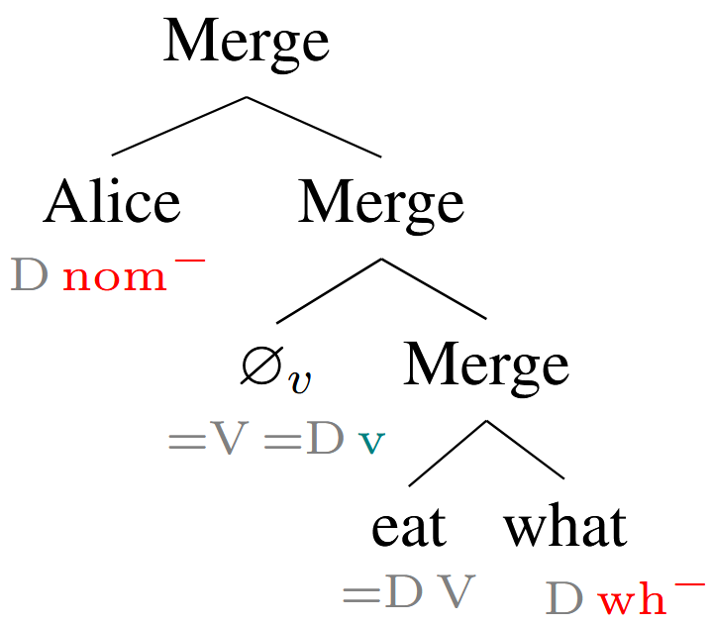
Minimalist Grammars

Slide 26
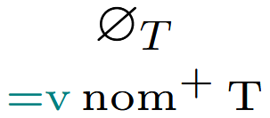
Minimalist Grammars

Slide 27
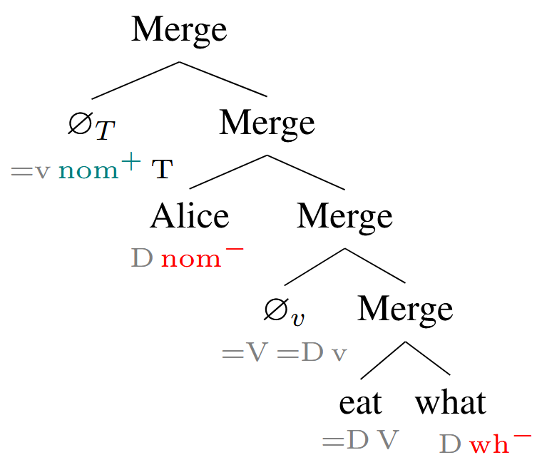
Minimalist Grammars

Slide 28
Minimalist Grammars
Move is a (partial) unary operation. It takes a tree with an active licensor (f⁺) feature and exactly one matching licensee feature (f⁻) and checks (deletes) both.

Slide 29
Minimalist Grammars
Move is a (partial) unary operation. It takes a tree with an active licensor (f⁺) feature and exactly one matching licensee feature (f⁻) and checks (deletes) both.

Slide 30
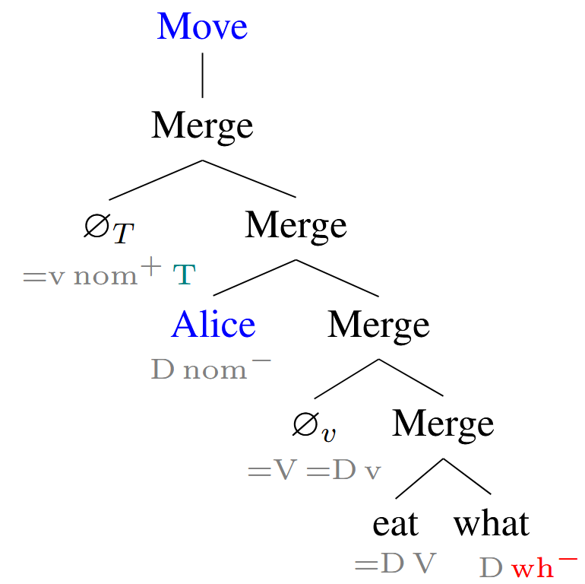
Minimalist Grammars
Move is a (partial) unary operation. It takes a tree with an active licensor (f⁺) feature and exactly one matching licensee feature (f⁻) and checks (deletes) both.

Slide 31
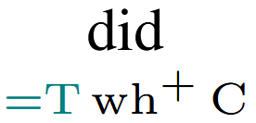
Minimalist Grammars
Only feature remaining is C, so this tree is accepted by the grammar.

Slide 32
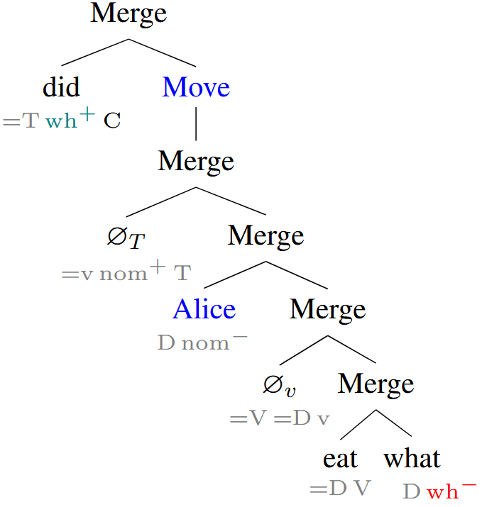
Minimalist Grammars
Only feature remaining is C, so this tree is accepted by the grammar.

Slide 33
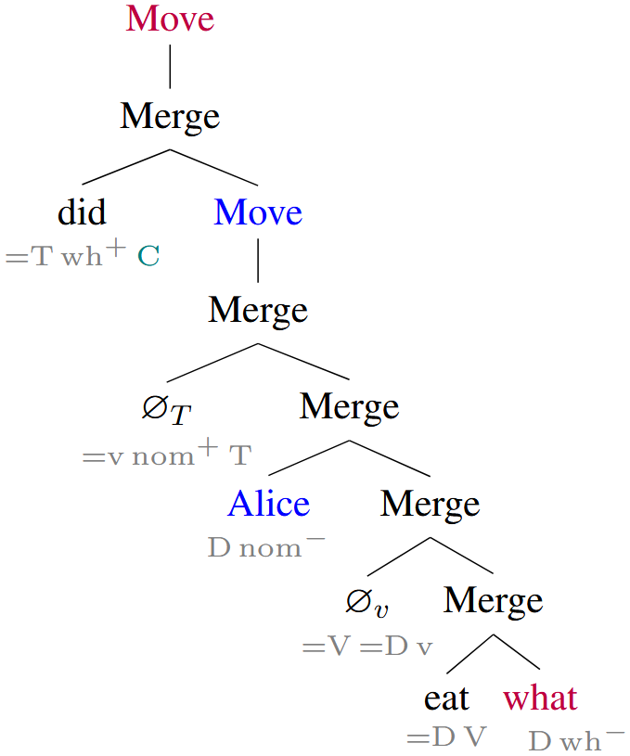
Minimalist Grammars
Only feature remaining is C, so this tree is accepted by the grammar.

Slide 34
Minimalist Grammars
Only feature remaining is C, so this tree is accepted by the grammar.

Slide 35
Tensor Semantics for MGs

Slide 36
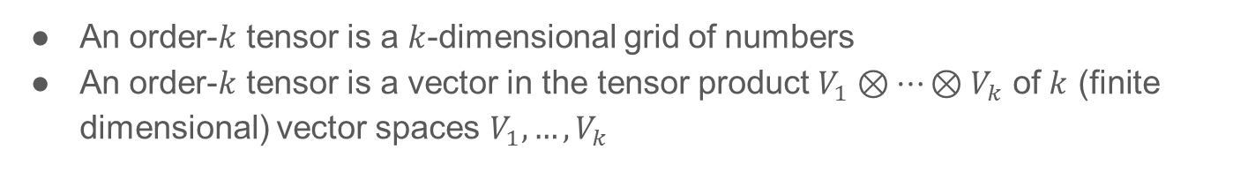
Tensors
An order-$k$ tensor is a $k$-dimensional grid of numbers
An order-$k$ tensor is a vector in the tensor product $V_{1}⊗…⊗V_{k}$ of $k$ (finite dimensional) vector spaces $V_{1},…,V_{k}$
Order 1 tensor (vector)
Order 2 tensor (matrix)
Order 3 tensor
0
0
0
1
1
0
0
0
0
1
0
0
1
0
0
0
1
0
0
0
5
-6
-7
8
1
2
3
4
-1
-2
-3
-4
1
2
3
4

Slide 37
Tensor Contraction
5
6
7
8
0
0
0
1
0
1
0
0
1
0
0
0
5
-6
-7
8
-1
-2
-3
-4
1
2
3
4

Slide 38
Tensor Contraction
5
6
7
8
0
0
0
1
1
0
0
0
0
1
0
0
5
-6
-7
8
-1
-2
-3
-4
1
2
3
4

Slide 39
Tensor Contraction
0
0
0
1
5
0
1
0
0
5
-6
-7
8
-1
-2
-3
-4
1
2
3
4

Slide 40
Tensor Contraction
0
0
0
1
0
1
0
0
5
-6
-7
8
5
-1
-2
-3
-4
1
2
3
4

Slide 41
Tensor Contraction
5
6
7
8
0
0
0
1
0
1
0
0
5
-6
-7
8
5
-1
-2
-3
-4
1
2
3
4

Slide 42
Tensor Contraction
6
0
0
0
1
5
-6
-7
8
5
-1
-2
-3
-4
1
2
3
4

Slide 43
Tensor Contraction
0
0
0
1
6
5
-6
-7
8
5
-1
-2
-3
-4
1
2
3
4

Slide 44
Tensor Contraction
5
6
7
8
0
0
0
1
6
5
-6
-7
8
5
-1
-2
-3
-4
1
2
3
4

Slide 45
Tensor Contraction
8
6
5
-6
-7
8
5
-1
-2
-3
-4
1
2
3
4

Slide 46
Tensor Contraction
8
6
5
-6
-7
8
5
-1
-2
-3
-4
1
2
3
4

Slide 47
Tensor Contraction
5
6
7
8
1
2
3
4
8
6
5
-6
-7
8
5
-1
-2
-3
-4

Slide 48
Tensor Contraction
70
8
6
5
-6
-7
8
5
-1
-2
-3
-4

Slide 49
Tensor Contraction
8
6
5
-6
-7
8
5
-1
-2
-3
-4
70

Slide 50
Tensor Contraction
5
6
7
8
-1
-2
-3
-4
8
6
5
-6
-7
8
5
70

Slide 51
Tensor Contraction
-70
8
6
5
-6
-7
8
5
70

Slide 52
Tensor Contraction
8
6
5
-6
-7
8
5
-70
70

Slide 53
Tensor Contraction
5
6
7
8
5
-6
-7
8
8
6
5
-70
70

Slide 54
Tensor Contraction
4
8
6
5
-70
70

Slide 55
Tensor Contraction
8
6
5
4
-70
70

Slide 56






Tensor Contraction
$$ℝ^{4}$$
$$ℝ^{2}⊗ℝ^{3}⊗ℝ^{4}$$
$$∈$$
$$ℝ^{2}⊗ℝ^{3}$$
$$∈$$
$$∈$$
5
0
0
0
1
8
0
1
0
0
6
6
1
0
0
0
5
4
5
-6
-7
8
-1
-2
-3
-4
7
-70
1
2
3
4
70
8

Slide 57
Tensor Semantics for MGs
Selectee Features in our MG | Corresponding Vector Space
D | 𝗗
V | 𝗩
v | 𝗨
T | 𝗧
C | 𝗖
D
=D
V

Slide 58
Tensor Semantics for MGs
Selectee Features in our MG | Corresponding Vector Space
D | 𝗗
V | 𝗩
v | 𝗨
T | 𝗧
C | 𝗖
[
D
wh⁻
]
=D
V

Slide 59
Tensor Semantics for MGs
𝗗
Selectee Features in our MG | Corresponding Vector Space
D | 𝗗
V | 𝗩
v | 𝗨
T | 𝗧
C | 𝗖
[
D
wh⁻
]
=D
V

Slide 60
Tensor Semantics for MGs
𝗗
Selectee Features in our MG | Corresponding Vector Space
D | 𝗗
V | 𝗩
v | 𝗨
T | 𝗧
C | 𝗖
what
[
D
wh⁻
]
=D
V

Slide 61
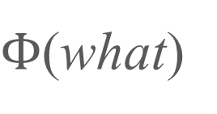

Tensor Semantics for MGs
$Φ$(what)
$$∈$$
𝗗
Selectee Features in our MG | Corresponding Vector Space
D | 𝗗
V | 𝗩
v | 𝗨
T | 𝗧
C | 𝗖
what
[
D
wh⁻
]
=D
V

Slide 62
Tensor Semantics for MGs
$Φ$(what)
$$∈$$
𝗗
Selectee Features in our MG | Corresponding Vector Space
D | 𝗗
V | 𝗩
v | 𝗨
T | 𝗧
C | 𝗖
what
[
D
wh⁻
]
[
=D
V
]

Slide 63
Tensor Semantics for MGs
$Φ$(what)
$$∈$$
𝗗
Selectee Features in our MG | Corresponding Vector Space
D | 𝗗
V | 𝗩
v | 𝗨
T | 𝗧
C | 𝗖
what
[
D
wh⁻
]
𝗩
[
=D
V
]

Slide 64

Tensor Semantics for MGs
$Φ$(what)
$$∈$$
𝗗
Selectee Features in our MG | Corresponding Vector Space
D | 𝗗
V | 𝗩
v | 𝗨
T | 𝗧
C | 𝗖
what
[
D
wh⁻
]
𝗩
$⊗$ 𝗗
[
=D
V
]

Slide 65
Tensor Semantics for MGs
$Φ$(what)
$$∈$$
𝗗
Selectee Features in our MG | Corresponding Vector Space
D | 𝗗
V | 𝗩
v | 𝗨
T | 𝗧
C | 𝗖
what
[
D
wh⁻
]
𝗩
$⊗$ 𝗗
eat
[
=D
V
]

Slide 66
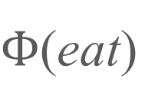

Tensor Semantics for MGs
$Φ$(what)
$$∈$$
𝗗
Selectee Features in our MG | Corresponding Vector Space
D | 𝗗
V | 𝗩
v | 𝗨
T | 𝗧
C | 𝗖
what
[
D
wh⁻
]
$Φ$(eat)
$$∈$$
𝗩
$⊗$ 𝗗
eat
[
=D
V
]

Slide 67





Tensor Semantics for MGs
𝗩 $⊗$ 𝗗
𝗗
$$∈$$
$$∈$$
$Φ$(eat)
$Φ$(what)
eat
what

Slide 68
Tensor Semantics for MGs
𝗩 $⊗$ 𝗗
𝗗
$$∈$$
$$∈$$
$Φ$(eat)
$Φ$(what)
eat
what
merge(eat, what)

Slide 69

Tensor Semantics for MGs
𝗩 $⊗$ 𝗗
𝗗
𝗩
$$∈$$
$$∈$$
$$∈$$
$Φ$(eat)
$Φ$(what)
eat
what
merge(eat, what)

Slide 70
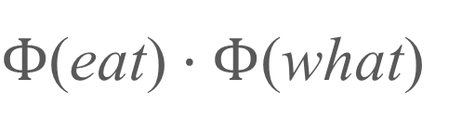
Tensor Semantics for MGs
𝗩 $⊗$ 𝗗
𝗗
𝗩
$$∈$$
$$∈$$
$$∈$$
$Φ$(eat)
$Φ$(what)
$Φ$(eat) $⋅Φ$(what)
eat
what
merge(eat, what)

Slide 71
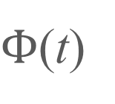
Tensor Semantics for MGs
$Φ$(t)
t

Slide 72
Tensor Semantics for MGs
$Φ$(t)
t
move(t)

Slide 73
Tensor Semantics for MGs
$Φ$(t)
t
move(t)

Slide 74
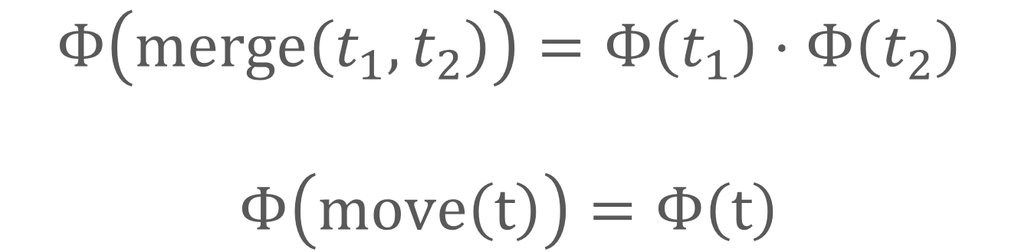
Tensor Semantics for MGs
$$Φ\left(\text{merge}\left(t_{1},t_{2}\right)\right)=Φ\left(t_{1}\right)⋅Φ\left(t_{2}\right)$$
$$Φ\left(\text{move}\left(t\right)\right)=Φ\left(t\right)$$

Slide 75
Example
Lexical Item | Feature String | Space of Tensor
what | [D, wh⁺] | 𝗗
eat | [=D, V] | 𝗩⨂𝗗
∅_{v} (little v) | [=V, =D, v] | 𝗨⨂𝗗⨂𝗩
Alice | [D, nom⁻] | 𝗗
∅_{T} (T head) | [=v, nom⁺, T] | 𝗧⨂𝗨
did | [=T, wh⁺, C] | 𝗖⨂𝗧

Slide 76
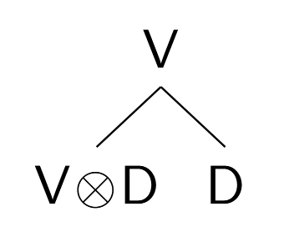
Example

Slide 77
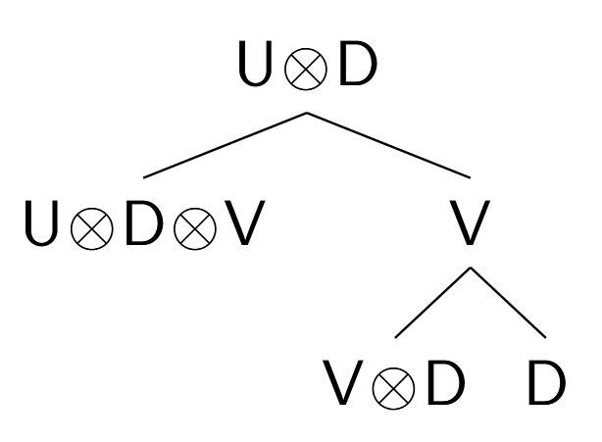
Example

Slide 78
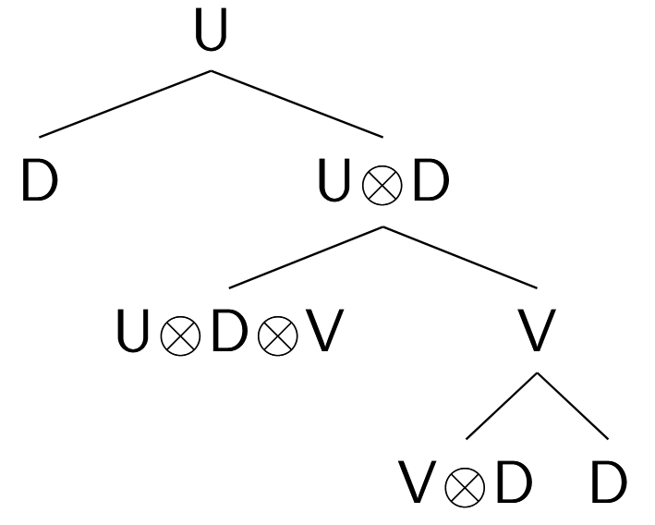
Example

Slide 79
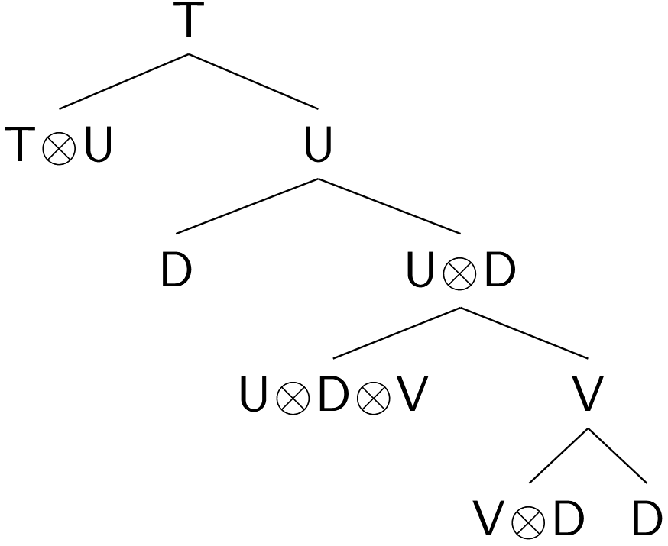
Example

Slide 80
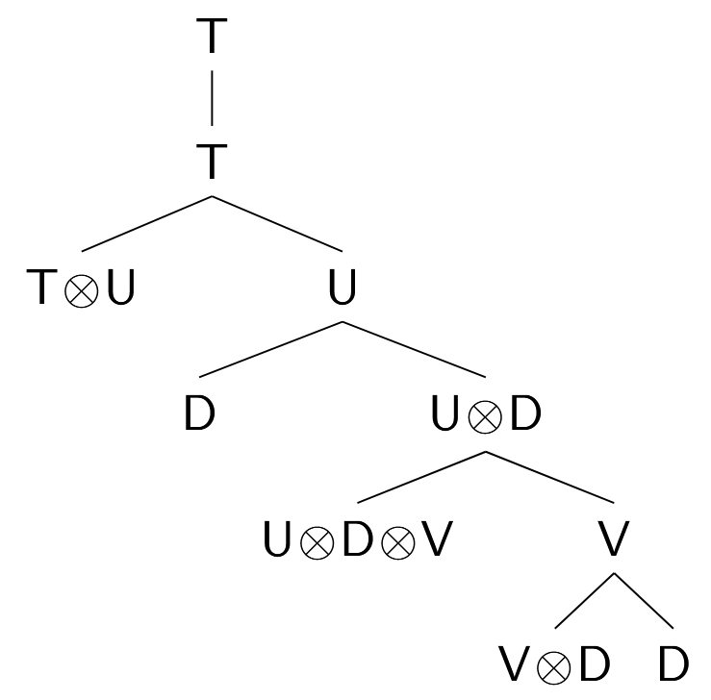
Example

Slide 81
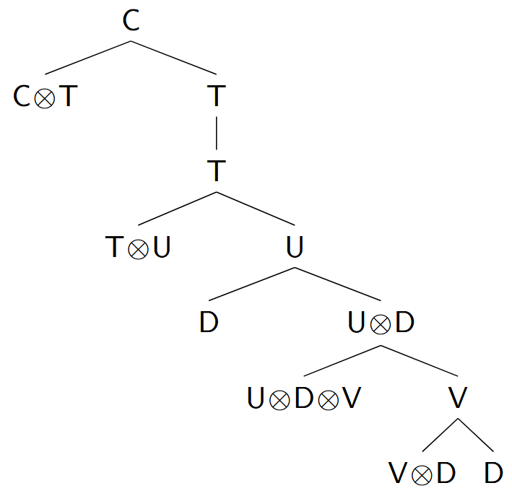
Example

Slide 82
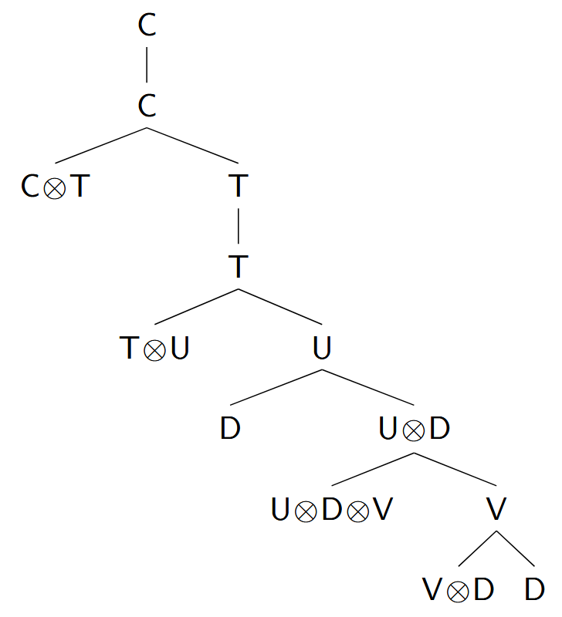
Example

Slide 83
Discussion and Conclusion
We have constructed a tensor semantics for MGs, showing how their combinatory operations can be used to incorporate compositionality into distributional semantics
Our approach is directly compatible with existing tensor-based approaches to MG syntax (beim Graben & Gerth, 2012)
Ideas for future work
See how the tensor embeddings can be learned from data
Versions of Move which are not semantically inert and incorporate semantic ideas such as variable binding, etc.

Slide 84
Discussion and Conclusion
We have constructed a tensor semantics for MGs, showing how their combinatory operations can be used to incorporate compositionality into distributional semantics
Our approach is directly compatible with existing tensor-based approaches to MG syntax (beim Graben & Gerth, 2012)
Ideas for future work
See how the tensor embeddings can be learned from data
Versions of Move which are not semantically inert and incorporate semantic ideas such as variable binding, etc.

Slide 85
Discussion and Conclusion
We have constructed a tensor semantics for MGs, showing how their combinatory operations can be used to incorporate compositionality into distributional semantics
Our approach is directly compatible with existing tensor-based approaches to MG syntax (beim Graben & Gerth, 2012)
Ideas for future work
See how the tensor embeddings can be learned from data
Versions of Move which are not semantically inert and incorporate semantic ideas such as variable binding, etc.

Slide 86
Discussion and Conclusion
We have constructed a tensor semantics for MGs, showing how their combinatory operations can be used to incorporate compositionality into distributional semantics
Our approach is directly compatible with existing tensor-based approaches to MG syntax (beim Graben & Gerth, 2012)
Ideas for future work
See how the tensor embeddings can be learned from data
Versions of Move which are not semantically inert and incorporate semantic ideas such as variable binding, etc.

Slide 87
Discussion and Conclusion
We have constructed a tensor semantics for MGs, showing how their combinatory operations can be used to incorporate compositionality into distributional semantics
Our approach is directly compatible with existing tensor-based approaches to MG syntax (beim Graben & Gerth, 2012)
Ideas for future work
See how the tensor embeddings can be learned from data
Versions of Move which are not semantically inert and incorporate semantic ideas such as variable binding, etc.

Slide 88
Discussion and Conclusion
We have constructed a tensor semantics for MGs, showing how their combinatory operations can be used to incorporate compositionality into distributional semantics
Our approach is directly compatible with existing tensor-based approaches to MG syntax (beim Graben & Gerth, 2012)
Ideas for future work
See how the tensor embeddings can be learned from data
Versions of Move which are not semantically inert and incorporate semantic ideas such as variable binding, etc.

Slide 89
Discussion and Conclusion
We have constructed a tensor semantics for MGs, showing how their combinatory operations can be used to incorporate compositionality into distributional semantics
Our approach is directly compatible with existing tensor-based approaches to MG syntax (beim Graben & Gerth, 2012)
Ideas for future work
See how the tensor embeddings can be learned from data
Versions of Move which are not semantically inert and incorporate semantic ideas such as variable binding, etc.
Overall, this is a step towards unifying connectionist and symbolic approaches to linguistic representations.

Slide 90
Thank you very much!

Slide 91
References
Peter beim Graben and Sabrina Gerth. 2012. Geometric representations for minimalist grammars. Journal of logic, language, and information, 21(4):393–432.
Bob Coecke, Mehrnoosh Sadrzadeh, and Stephen Clark. 2010. Mathematical foundations for a compositional distributional model of meaning. Linguistic Analysis, 36:345–384.
Aniello De Santo. 2020. Structure and memory: A computational model of storage, gradience, and priming. Ph.D. thesis, State University of New York at Stony Brook.
Aniello De Santo. 2025. Capturing online SRC/ORC effort with memory measures from a minimalist parser. In Proceedings of the Workshop on Cognitive Modeling and Computational Linguistics, pages 24–35, Albuquerque, New Mexico, USA. Association for Computational Linguistics.
Gregory M. Kobele, Sabrina Gerth, and John Hale. 2012. Memory resource allocation in top-down minimalist parsing. In Formal Grammar - 17th and 18th International Conferences, FG 2012, Opole, Poland, August 2012, Revised Selected Papers, FG 2013, Düsseldorf, Germany, August 2013. Proceedings, Lecture Notes in Computer Science, pages 32–51. Springer.
Jean Maillard, Stephen Clark, and Edward Grefenstette. 2014. A type-driven tensor-based semantics for CCG. In Proceedings of the EACL 2014 Workshop on Type Theory and Natural Language Semantics (TTNLS), pages 46–54, Gothenburg, Sweden. Association for Computational Linguistics.
Mark Steedman. 2001. The syntactic process. MIT press.
Mark Steedman and Jason Baldridge. 2011. Combinatory categorial grammar. In Robert D. Borsley and Kersti Börjars, editors, Non-Transformational Syntax, chapter 5, pages 181–224. John Wiley & Sons, Ltd.

