Slide 1


A Feature-Driven Tensor Semantics for Minimalist Grammars
John Paulson
Dept. of Linguistics
University of Utah
john.paulson@utah.edu
Aniello De Santo
Dept. of Linguistics
University of Utah
aniello.desanto@utah.edu
Jon Rawski
Dept. of Linguistics and Language Development
San Jose State University
jon.rawski@sjsu.edu

Slide 2
Talk in one slide
This work bridges distributional approaches to semantics and “mainstream” generative grammar.
We incorporate Minimalist Grammars into vector-based semantic models
The resulting vector semantic models can build the meaning of larger expressions compositionally, by combining the meaning of smaller expressions
This compositionality is guided by the Minimalist Grammar syntax

Slide 3
Distributionality and Compositionality
Computational linguistics often makes use of distributional semantics, describing the meanings of expressions through co-occurrence in corpora
Embedding the meanings of expressions into vector spaces is a popular way of implementing distributional models
In contrast, traditional/formal semantics research often analyzes meaning compositionally, building up the meaning of expressions from subparts
An approach that uses vector space operations to combine the meanings of smaller expressions into meanings for larger expressions can bridge these two approaches

Slide 4
Formal Grammars and Distributional Semantics
In particular, having composition be guided by a formal grammar can bridge semantic and syntactic approaches, motivating how such operations should be applied
There is already successful work integrating Combinatory Categorial Grammars (CCGs; Steedman, 2001; Steedman and Baldridge, 2011) with distributional semantics in this way (Coecke et al., 2010; Maillard et al., 2014)
This work integrates such a model distributional semantics with Minimalist Grammars (MGs; Stabler, 1996), which formalize the (broad strokes) syntactic approach of the Minimalist Program

Slide 5
Why MGs?
MGs are a mildly context-sensitive grammar formalism which are thought to be able to capture all of natural language syntax
MGs formalize “Minimalist Program-like” syntax
  In this way, incorporating distributional semantics into MGs provides a link to “mainstream” syntactic theory
MGs have also been useful in analyzing sentence processing (Kobele et al., 2012; De Santo, 2020, 2025)
There is also a vector-based analysis for the syntax of MGs (beim Graben & Gerth, 2012)
It’s not just CCGs!

Slide 6
Minimalist Grammars

Slide 7
Minimalist Grammars
Lexical Item | Feature String
what | [D, wh⁺]
eat | [=D, V]
∅_{v} (little v) | [=V, =D, v]
Alice | [D, nom⁻]
∅_{T} (T head) | [=v, nom⁺, T]
did | [=T, wh⁺, C]
Trees built from a lexicon and the operations Merge and Move
Each tree (including lexical items) has a string of features dictating which operations can be used
  Merge features:
    Selectee features (f)
    Selector features (=f)
  Move features:
    Licensee features (f⁻)
    Licensor features (f⁺)

Slide 8
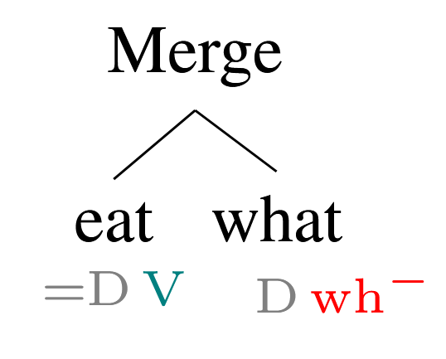
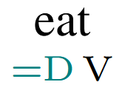
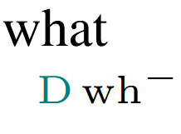
Minimalist Grammars
Merge is a (partial) binary operation. It takes one tree with a selectee feature (f) and one with a matching selector feature (=f), combines them into one tree, checking (deleting) both features

Slide 9
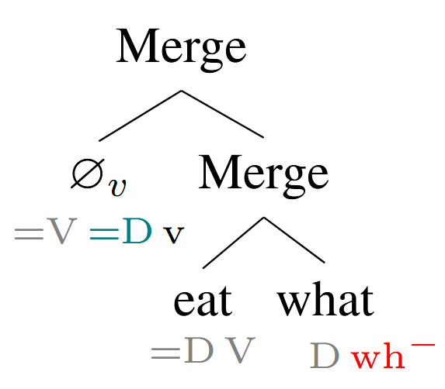
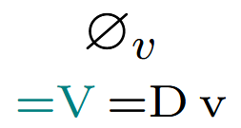
Minimalist Grammars

Slide 10
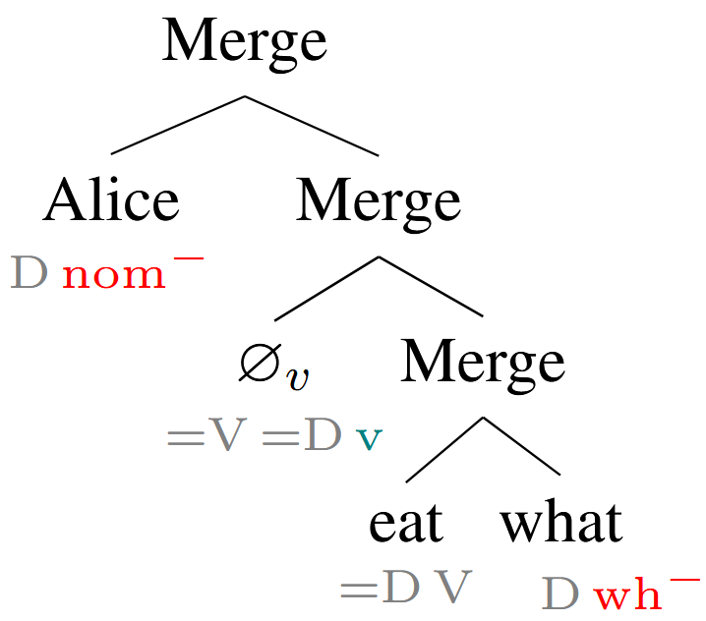
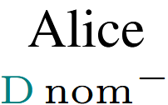
Minimalist Grammars

Slide 11
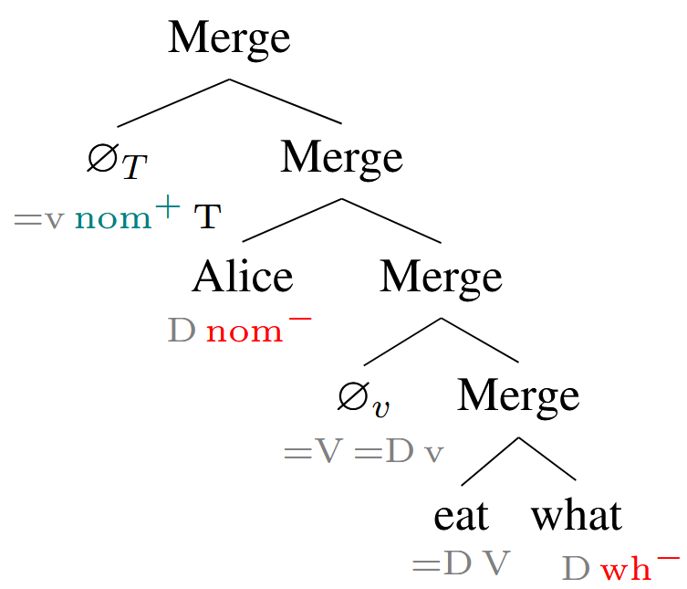
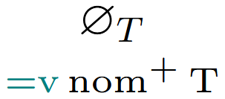
Minimalist Grammars

Slide 12
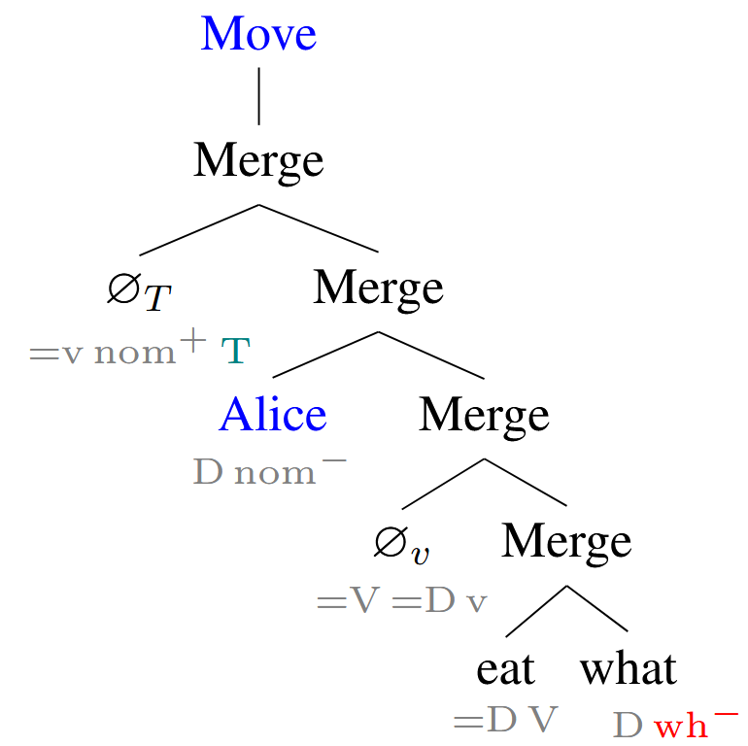
Minimalist Grammars
Move is a (partial) unary operation. It takes a tree with an active licensor (f⁺) feature and exactly one matching licensee feature (f⁻) and checks (deletes) both.

Slide 13
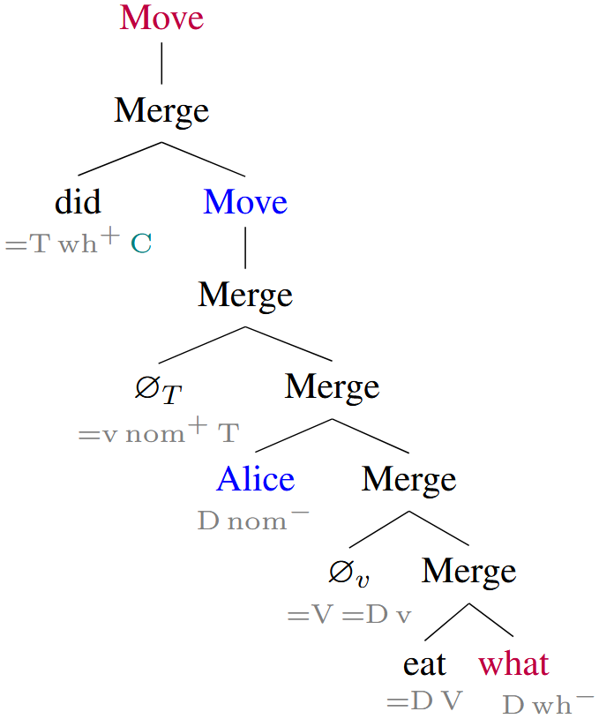
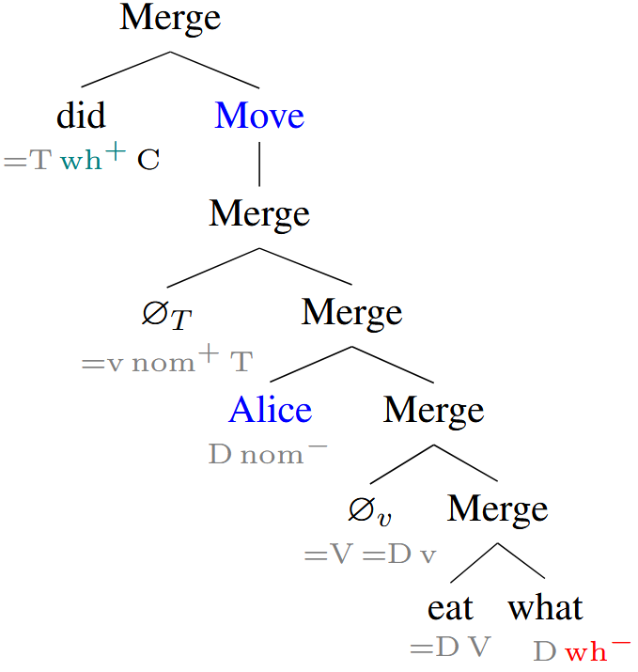
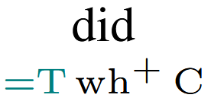
Minimalist Grammars
Only feature remaining is C, so this tree is accepted by the grammar.

Slide 14
Tensor Semantics for MGs

Slide 15
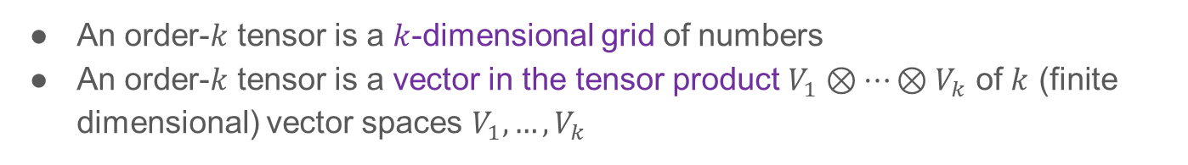
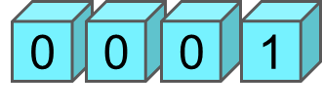
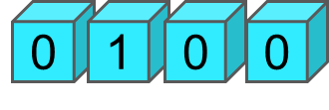

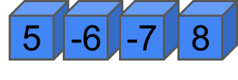
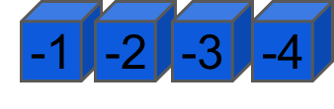

Tensors
Order 1 tensor (vector)
Order 2 tensor (matrix)
Order 3 tensor
1
0
0
0
1
0
0
0
1
2
3
4

Slide 16









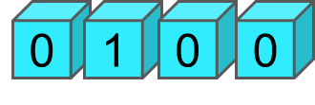



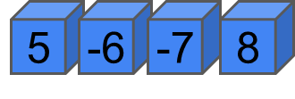

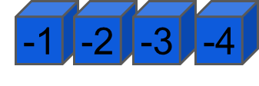

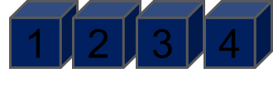

Tensor Contraction
6
5
8
70
4
-70

Slide 17
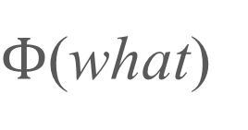

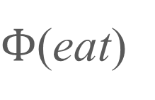


Tensor Semantics for MGs
𝗗
Selectee Features in our MG | Corresponding Vector Space
D | 𝗗
V | 𝗩
v | 𝗨
T | 𝗧
C | 𝗖
what
[
D
wh⁻
]
𝗩
eat
[
=D
V
]

Slide 18






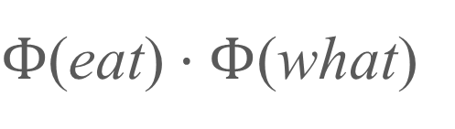
Tensor Semantics for MGs
𝗗
𝗩
eat
what
merge(eat, what)

Slide 19
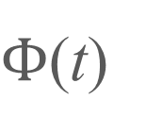
Tensor Semantics for MGs
t
move(t)

Slide 20
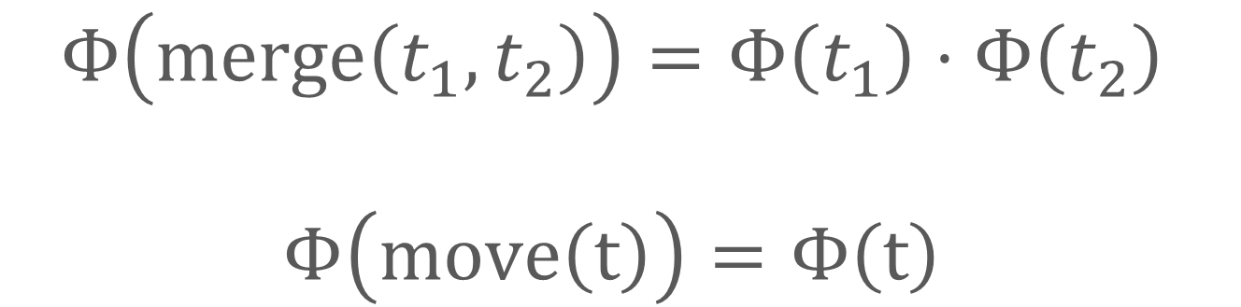
Tensor Semantics for MGs

Slide 21
Example
Lexical Item | Feature String | Space of Tensor
what | [D, wh⁺] | 𝗗
eat | [=D, V] | 𝗩⨂𝗗
∅_{v} (little v) | [=V, =D, v] | 𝗨⨂𝗗⨂𝗩
Alice | [D, nom⁻] | 𝗗
∅_{T} (T head) | [=v, nom⁺, T] | 𝗧⨂𝗨
did | [=T, wh⁺, C] | 𝗖⨂𝗧

Slide 22
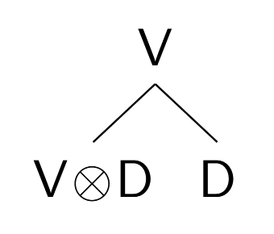
Example

Slide 23
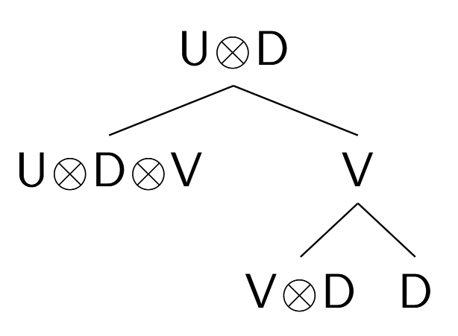
Example

Slide 24
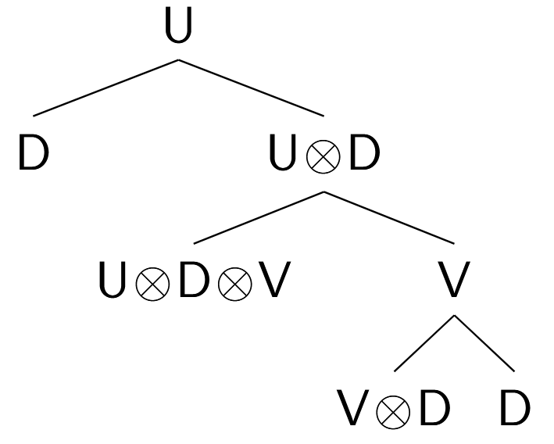
Example

Slide 25
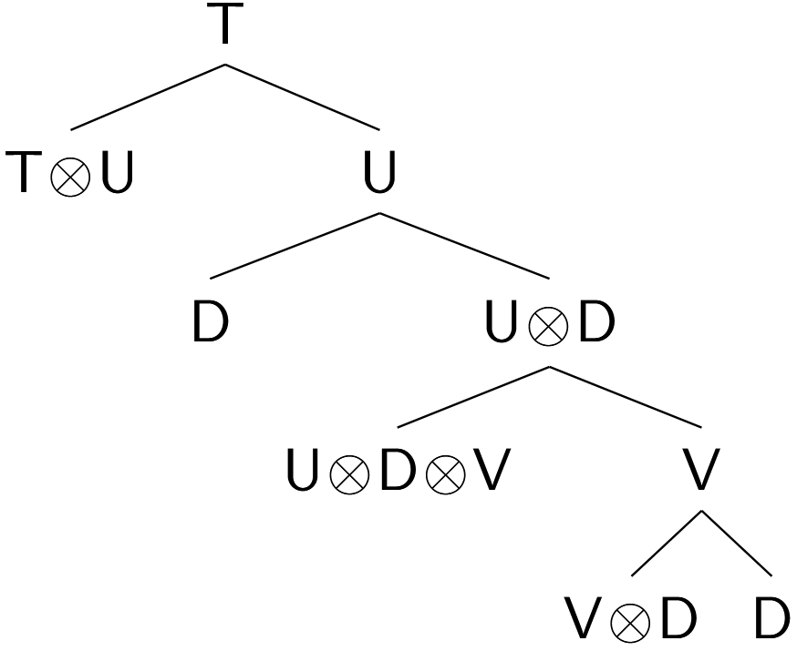
Example

Slide 26
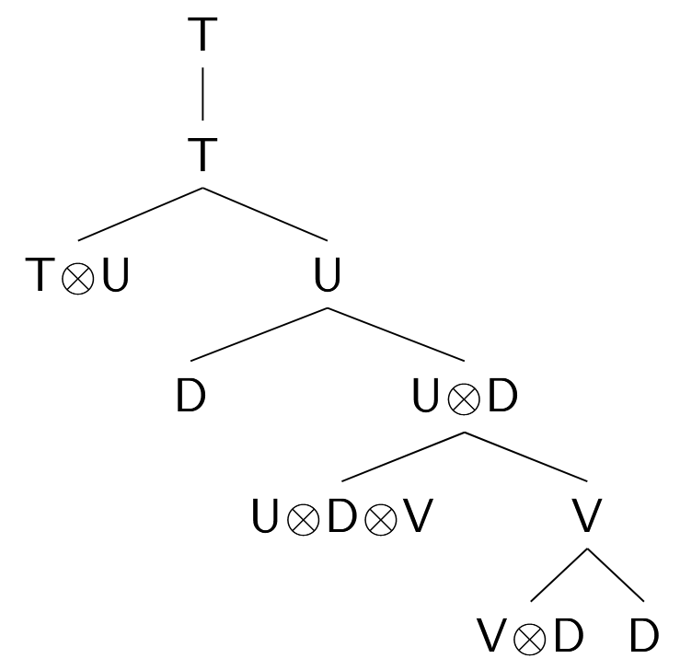
Example

Slide 27
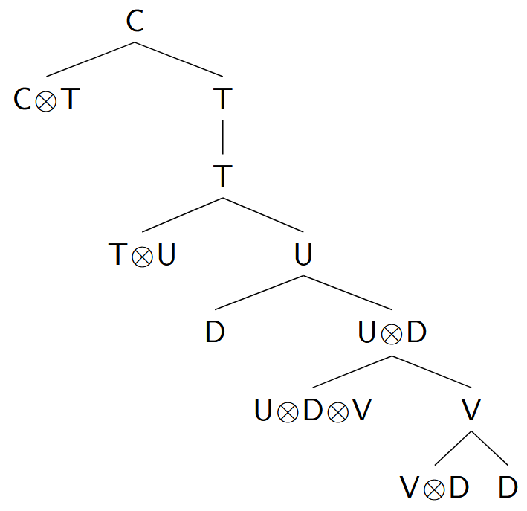
Example

Slide 28
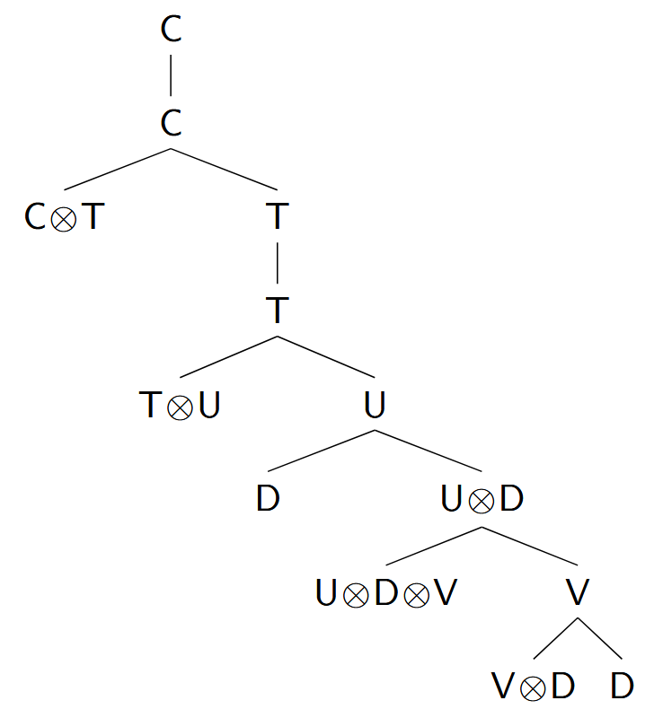
Example

Slide 29
Discussion and Conclusion
We have constructed a tensor semantics for MGs, showing how their combinatory operations can be used to incorporate compositionality into distributional semantics
Our approach is directly compatible with existing tensor-based approaches to MG syntax (beim Graben & Gerth, 2012)
Ideas for future work
  See how the vector embeddings can be learned from data
  Versions of Move which are not semantically inert and incorporate semantic ideas such as variable binding, etc.
Overall, this is a step towards unifying connectionist and symbolic approaches to linguistic representations.

Slide 30


Thank you very much!
Paper:
Slides:
https://openpublishing.library.umass.edu/scil/article/id/4032/
https://github.com/JPJ280/jpj280.github.io/tree/master/publications/SCIL_2026_MG_Tensors/slides

Slide 31
References
Peter beim Graben and Sabrina Gerth. 2012. Geometric representations for minimalist grammars. Journal of logic, language, and information, 21(4):393–432.
Bob Coecke, Mehrnoosh Sadrzadeh, and Stephen Clark. 2010. Mathematical foundations for a compositional distributional model of meaning. Linguistic Analysis, 36:345–384.
Aniello De Santo. 2020. Structure and memory: A computational model of storage, gradience, and priming. Ph.D. thesis, State University of New York at Stony Brook.
Aniello De Santo. 2025. Capturing online SRC/ORC effort with memory measures from a minimalist parser. In Proceedings of the Workshop on Cognitive Modeling and Computational Linguistics, pages 24–35, Albuquerque, New Mexico, USA. Association for Computational Linguistics.
Gregory M. Kobele, Sabrina Gerth, and John Hale. 2012. Memory resource allocation in top-down minimalist parsing. In Formal Grammar - 17th and 18th International Conferences, FG 2012, Opole, Poland, August 2012, Revised Selected Papers, FG 2013, Düsseldorf, Germany, August 2013. Proceedings, Lecture Notes in Computer Science, pages 32–51. Springer.
Jean Maillard, Stephen Clark, and Edward Grefenstette. 2014. A type-driven tensor-based semantics for CCG. In Proceedings of the EACL 2014 Workshop on Type Theory and Natural Language Semantics (TTNLS), pages 46–54, Gothenburg, Sweden. Association for Computational Linguistics.
Mark Steedman. 2001. The syntactic process. MIT press.
Mark Steedman and Jason Baldridge. 2011. Combinatory categorial grammar. In Robert D. Borsley and Kersti Börjars, editors, Non-Transformational Syntax, chapter 5, pages 181–224. John Wiley & Sons, Ltd.

Slide 32
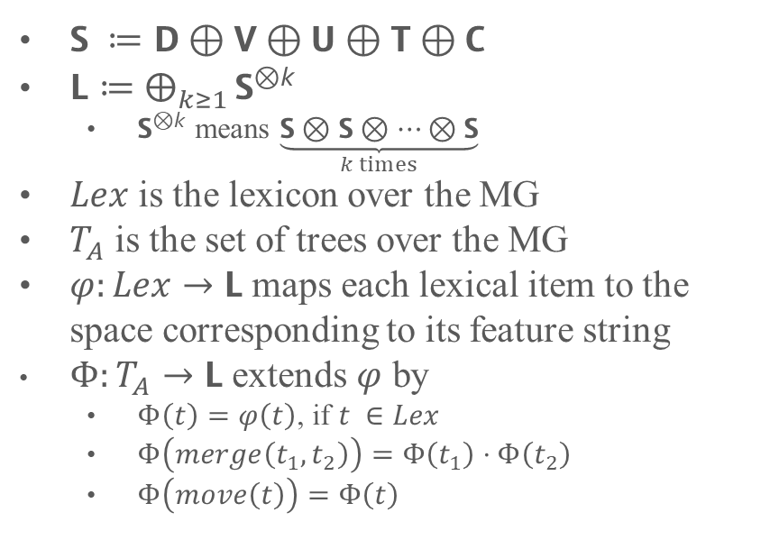
Selectee Features in our MG | Corresponding Vector Space
D | 𝗗
V | 𝗩
v | 𝗨
T | 𝗧
C | 𝗖

Slide 33
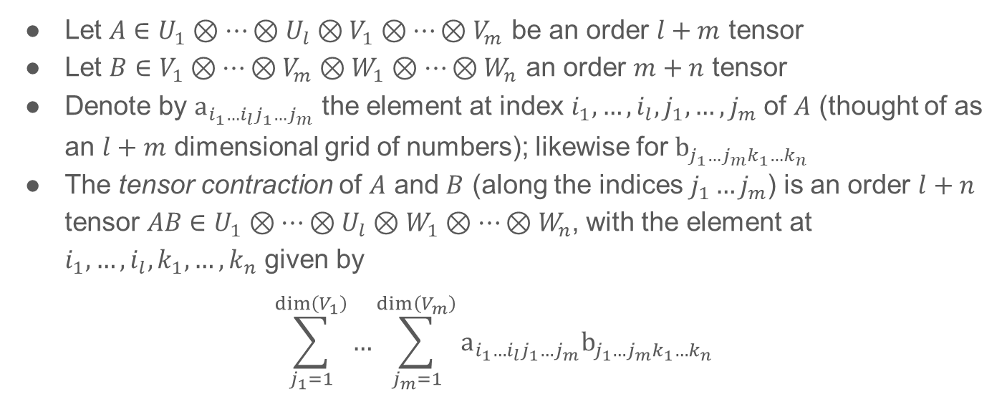
Tensor Contraction (General)

Slide 34
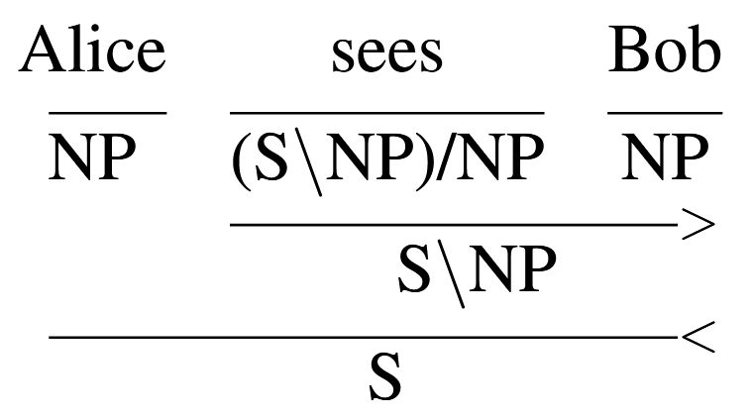
Combinatory Categorial Grammar (CCG)
Mildly Context Sensitive formalism
Thought to be capable of expressing all human syntax
Steedman (2001), Steedman and Baldridge (2011)

Slide 35
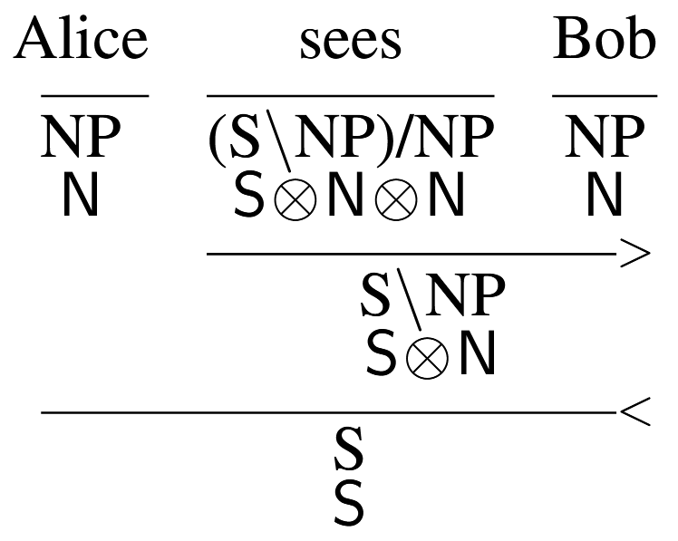
CCG and Tensor Semantics
Approach due to Maillard et al. (2014), Coecke et al. (2010), a.o.

Slide 36
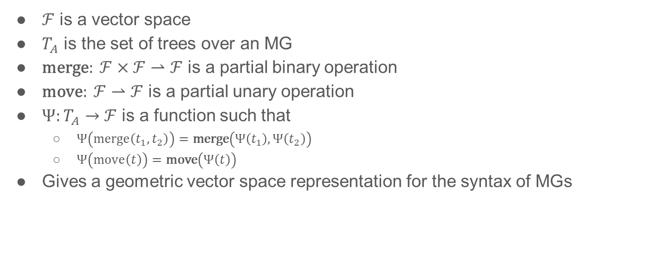
beim Graben and Gerth (2012)

Slide 37
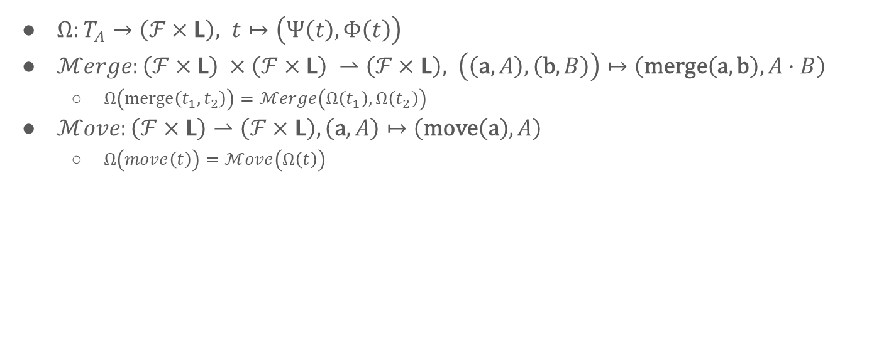
Our Semantics with bG&G’s Syntax

