Slide 1
SSCAE Project Usage Integrity Checker for MagicDraw 17.0.2
Nicolas F Rouquette
May 2013

Slide 2
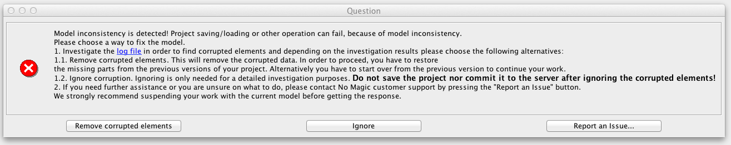
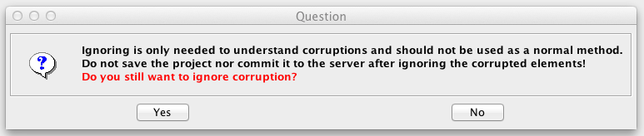
Showstopper problems in Europa (Dec 17, 2012)
Such problems seem to propagate from a corrupted Teamwork model to other Teamwork models that use it…

Slide 3
Europa Modeling Team Meeting (Dec 19, 2012)
T. Bayer’s Summary:
The problem, detected this week when preparing the Enhanced Clipper model for iteration 5 work, is that under certain circumstances MagicDraw has actually deleted some model elements.
Though the definitive cause is not knowable without seeing MagicDraw source code, the deletions are clearly correlated with MagicDraw's attempts to resolve local knowledge of data in a mounted module (known as proxies) with the actual data in that mounted module. The problem is exacerbated with chains and trees of module mounts because then multiple modules have proxy information about the same mounted modules, all of which must be reconciled by MD. (Modules are an important component of Europa's approach to modeling - they allow us to divvy up the model, and responsibility for managing it, into related elements (subsystems, payloads, style sheets, etc))
In both OpsRev's and IMCE's experience, taking steps to prevent and/or detect and quickly fix these proxy issues has prevented issues like the one we saw this week
Resolution approach:
In order to avoid introducing any more problems, Europa modeling work should stop for the time being. Hold off on making further changes to the models
Go through the current Europa model and fix all the proxy issues.
Determine what additional near term steps (process changes, tooling updates, etc) are needed
Determine what longer term fixes, tooling, and process are needed, by when, and by whom

Slide 4
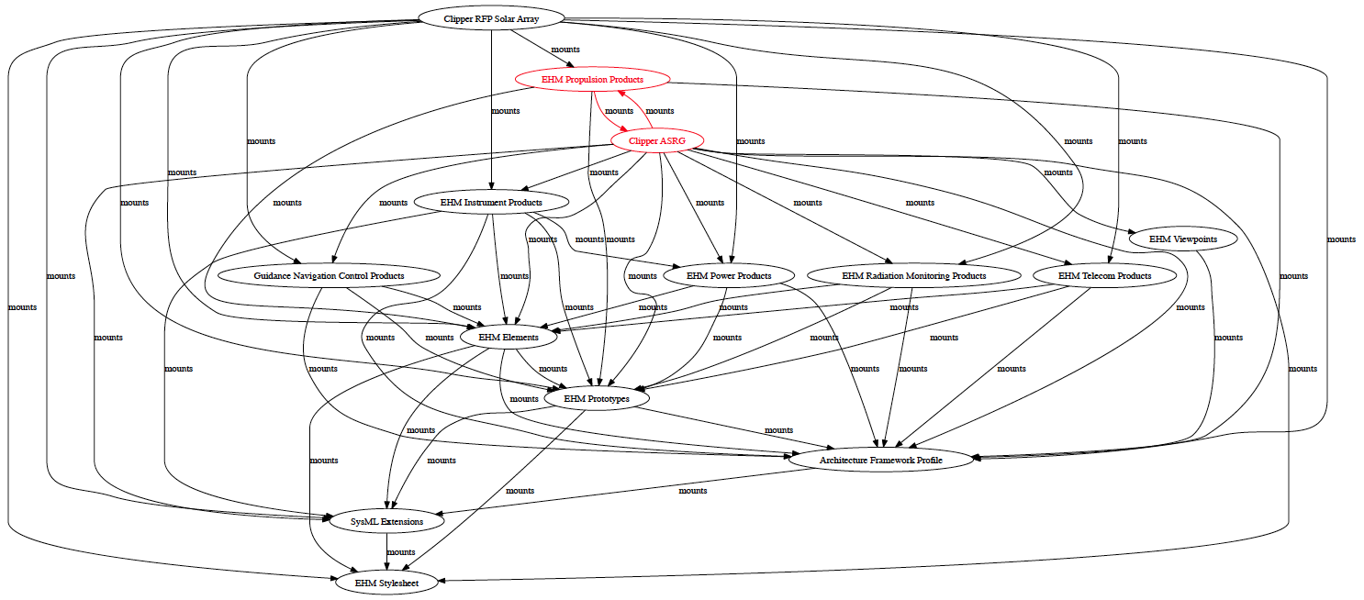
Before Project Usage Integrity Checker
Analysis of mount relationships among Teamwork projects only
Detects circular mounts (shown in red)

Slide 5
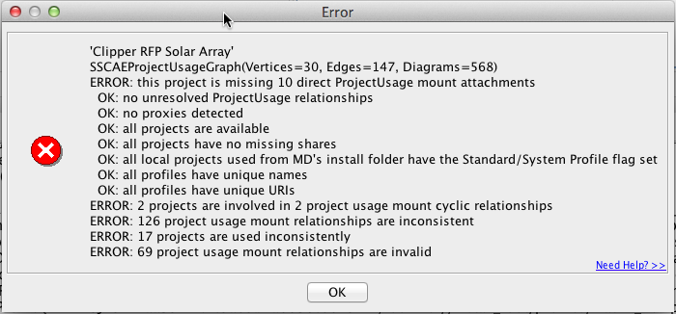
After Project Usage Integrity Checker
Europa’s “Clipper RFP Solar Array”
(version #198 of Dec 15, 2012)

Slide 6
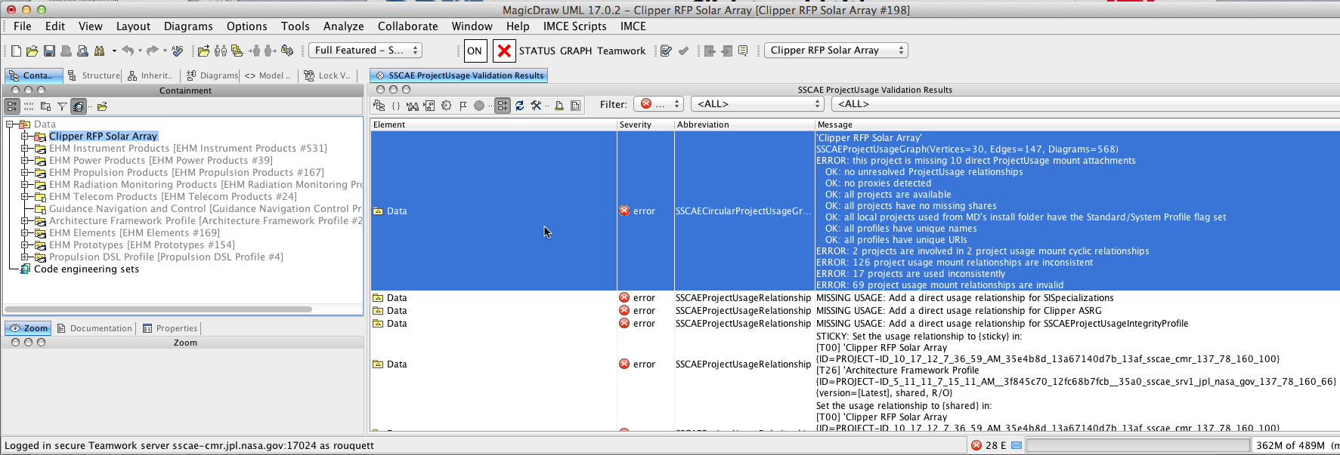
Project Usage Integrity Validation
“active”-like Project Usage Integrity Validation
Not a genuine Active Validation per MD Open API
An enhanced active-like validation
Runs on ProjectEventListenerAdapter.projectOpened() callback (instant feedback avoids confusing lag of Active Validation suites)
Validation triggered by UI refresh (instead of listeners)

Slide 7
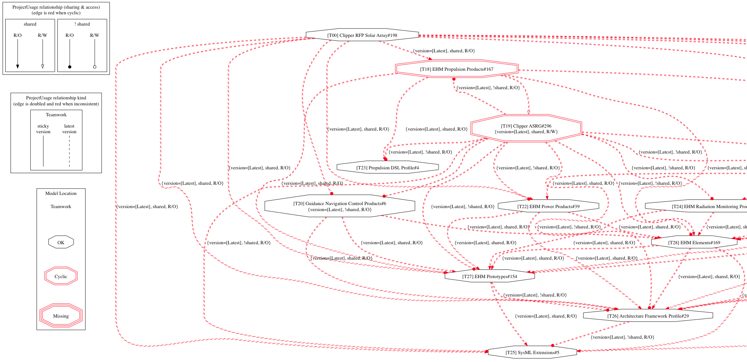
Project Usage Integrity Graphs
Europa’s “Clipper RFP Solar Array”
(version #198 of Dec 15, 2012)

Slide 8
Timeline of SSCAE’s intervention
Dec 17, 2012: Europa contacts SSCAE
Analysis & repair of EHM models; raise issues
Jan 7, 2013: JPL / NoMagic telecon (critical-path issues for Europa)
Jan 23, 2013: 1st release of SSCAE’s Project Usage Integrity Checker
(provides workarounds for these issues)
Jan 30, 2013: 2nd release (Adds SSCAE perspective with SSCAE toolbar)
Feb 1, 2013: 3rd release (Adds 2-phase teamwork commit protocol)
Feb 3, 2013: 4th release (Adds support for exporting local modules)
Feb 11, 2013: 5th release (JPL fixes for 7 issues)
Mar 7, 2013: JPL / NoMagic telecon (JPL’s 3 rules for MD shared models)
Feb 25, 2013: NoMagic 17.0.2 SP3 release 22 visible fixes (19 from JPL; 7 for Europa)
Mar 11, 2013: (Added support for JPL’s 3 rules from Mar 7 telecon)
3 bugs identified 8 bugs scheduled for fixing (17.0.2 SP3) 1 bug fixed (17.0.2 SP3)
11 issues in progress (NoMagic) 8 issues in discussions (JPL/NoMagic) 7 issues closed (no fix needed)
18 issues
27 issues
28 issues
29 issues
36 issues
39 issues

Slide 9
Project Integrity Checker Requirements
Provide feedback about the validity status of a project
Provide status as soon as project is opened
Update status on change until project is closed
Project status must reflect compliance with project integrity rules
No proxies (of any kind)
No cycles of module usage relationships
All modules used must be accessible
All module usages must be “re-shared” (vs. “private”) and “read-only” (vs. “read-write”)
Teamwork usage relationships should be configured for “historical, sticky” versions
A project must have an explicit usage relationship for each module used (directly or indirectly)
All usages of a given module must have consistent relationship settings
All packages and profiles with a URI must have unique names and unique URIs (no prefixes)
Simplify the process of complying with project integrity rules
Wherever possible, provide repair actions users can easily invoke to fix compliance problems
Where necessary, provide clues for fixing compliance problems that require human judgment
resolving proxies; choosing a “historical, sticky” version (to fix a non-compliant “latest” usage relationship)
Prevent reuse of invalid MagicDraw modules in other modules/projects
If checker is ON: save/commit allowed if and only if project status is valid
User must be able to turn checker OFF and save/commit (prevent data loss)

Slide 10
Who uses the Project Usage Integrity Checker?(as of March 12, 2013)
The JPL user community has not yet been briefed about it
MagicDraw issues have kept us busy!
Some issues have been showstoppers to several projects/communities
Europa, Reference Bus, OPALS, IMCE
“SSCAE Clean” 2-phase teamwork commits (since Feb 1)
17024: 306
Dubos: 76; Coren: 75; Tirona: 62; Chung: 39; Rouquette: 27; Wagner: 16; Delp: 7
17022: 46
Wilkerson: 31; Grimes: 15
17021: 5
Kerhzner: 4
SSCAE needs to educate the JPL community at large

Slide 11
What does Project Usage Integrity Matter?
Managing MagicDraw’s models is complicated
This information has “state” in MD
Information Units
Model Diagram
Open Diagram
Closed Diagram
Model Package
Shared Package
Private Package
Managing reuse of MagicDraw models is even more complex!
These relationship have “state” in MD
Usage Relationship
Re-Shared Usage
Private Usage
Local/Teamwork
Non-Standard/System Profile Usage
Standard/System Profile Usage
Local-only
Latest Usage
Latest
Sticky Usage
Historical Sticky Usage
Teamwork-only

Slide 12


Re-Shared vs. Private Usage Relationships (local and teamwork)
Semantics of Re-Shared Usage
A Shared Package from the used module
A Shared Package for the using module
Semantics of Private Usage
A Shared Package from the used module
A Private Package for the using module
OK
Invalid!
If a Shared package is used privately, then its contents become effectively private!
A private package can only be accessed by opening the module as a project!
MD does this by default; however, NoMagic recognizes this can be dangerous
See: MDUMLCS-9214 & enhancement: MDUML-64128

Slide 13
Latest, Sticky & Historical Usage Relationships (teamwork only)
Semantics of Latest Usage
Any Model Element can change
Any Model Diagram can change
Any Usage Relation can change
Semantics of Latest Sticky Usage
All Model Elements are frozen
All Model Diagrams are frozen
Any Usage Relation can change
Semantics of Historical Sticky Usage
Everything is frozen
Invalid!
Invalid!
OK
See: MDUMLCS-8857 (partial)

Slide 14
Why is Open vs Closed Diagram part of the state of an MD model?
MagicDraw represents Elements & Diagrams separately!
Opening a MagicDraw model only opens:
Shared & Private Model Elements
Opened Diagrams
For each usage relationship:
Shared Model Elements
If something changed, it is possible that some references are stale!
In a Closed Diagram
In a Private Model Element
For each usage relationship
Private Model Elements
Private Model Diagrams
Opening all diagrams forces MD to “resolve” symbols
This can be useful for locating proxies shown in diagrams
The MD log has warnings about “lost” elements (unresolved symbols)

Slide 15
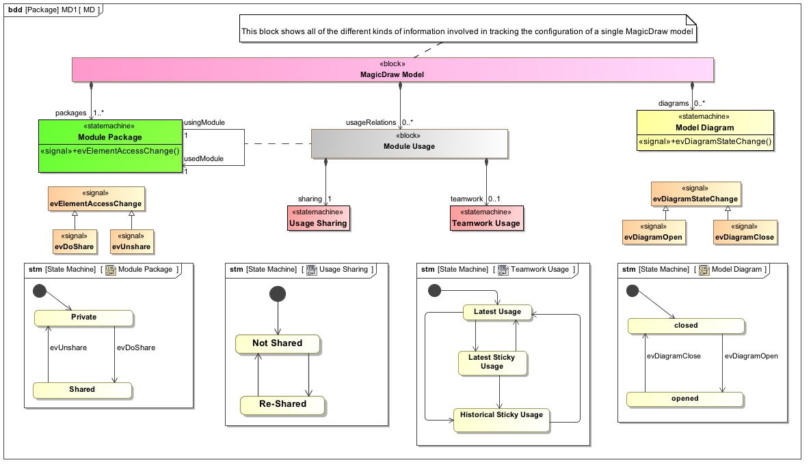
Putting all together…

Slide 16
Project Integrity Checker: Next Steps
Analyzing the MD log is important
The Europa troubleshooting involved extensive analysis of MD logs
Some “data loss” happens silently without any indication in the UI
But there are telltale indications in the MD log!
Interpreting the MD log is tricky
The messages are intended for MagicDraw developers, not end users
Analyzing the MD log is necessary for proxy-related “data loss”
Unresolved proxy elements that have been deleted but were shown on a diagram are logged
(See: MDUMLCS-8720, MDUMLCS-8722)
The contents of the MD log evolves and will evolve in subsequent releases
NoMagic made suggested improvements in 17.0.2 SP3 released February 23, 2013
Goal: Automated MD log analysis
Currently, the checker includes a simplified version of MSL’s LogChecker
Collaboration with K. Havelund
Analyzing MD logs involves similar challenges to those in MSL
The challenge will be developing rules for analyzing such logs
JPL need assurances from NoMagic about the meaning of the log messages used for analysis

Slide 17
Project Integrity Checker: Lesson Learned From Europa
Before the Project Integrity Checker:
JPL over-estimated MagicDraw’s ability to handle changes in agile collaborative model-based systems engineering
NoMagic under-estimated MagicDraw’s potential for jeopardizing users’ models and hiding data loss
After the Project Integrity Checker:
The key recommendation, “use (historical) sticky version mounts”, is the tip of the “explicit change management” iceberg
Effective change management is critical for MBSE
Change is an intrinsic aspect of any engineering model as a reusable asset
How do we manage SysML reusable assets?
Managing reusable modeling assets involves more than versioning them
We have reasonably good support for versioning (SVN, GIT, Teamwork, …)
Managing such assets is more than versioning them
Is it OK to update from one version to another?
How do we coordinate the update of multiple modules?

Slide 18
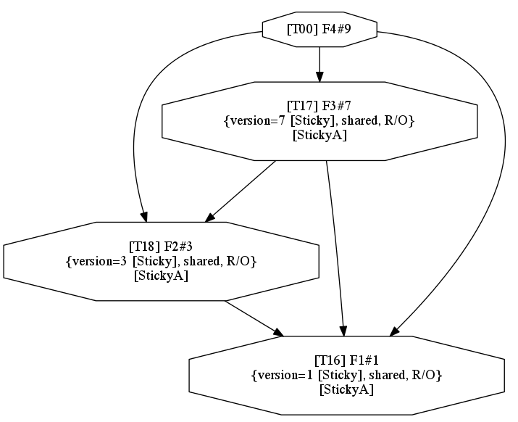
Managing Reusable Modeling Assets: Version Management Example
Teamwork projects # versions:
F4#9
F3#7
F2#3
F1#1
Current recommendation: “bottom-up” version update
https://jplwiki.jpl.nasa.gov:8443/display/SSCAEMBSE/Proposed+strategy+for+Pessimistic+Assurance+Listener
What if a user needs changes made in a high level module?

Slide 19
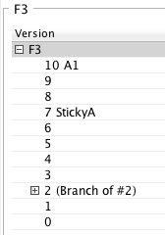
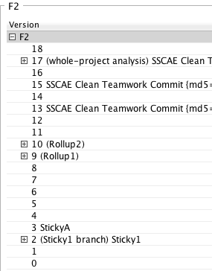
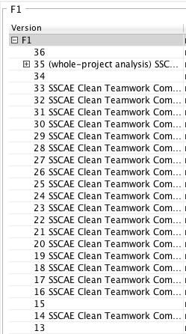
Version Management Challenge: Tracking version compatibility requirements
Example
(current versions)
Which combinations are OK?

Slide 20
Simple is not necessarily easy: Top-down version update
What if we change this…
… to this version?

Slide 21
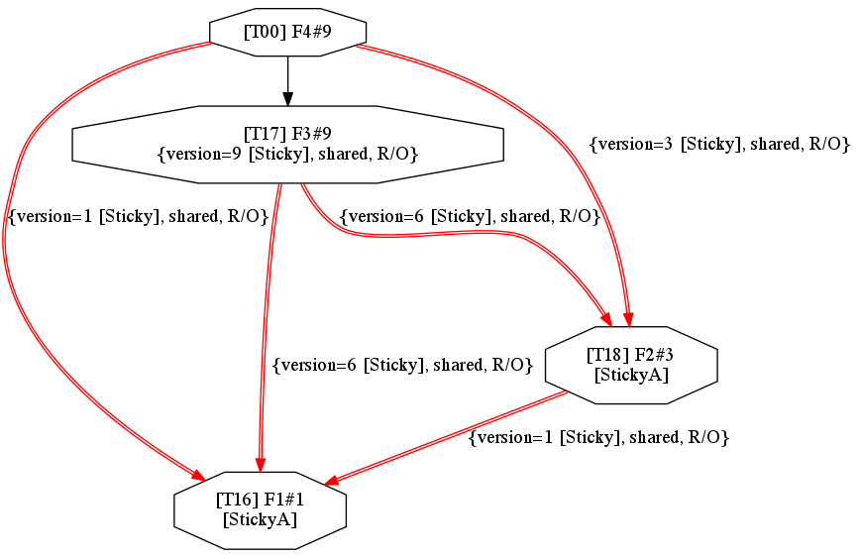
Top-Down Update = A recipe for disaster
We got what
we wanted…
… at the price of introducing 3 pairwise inconsistencies!

Slide 22
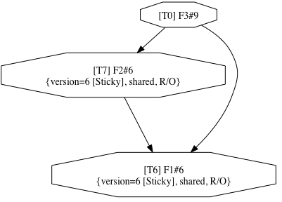
Bottom-Up Update = Plan the updates
Analyze update requirements to switch …
… to this version
Project’s usage graph signature
F1#1 => F1#6
F2#3 => F2#6
F3#7 => F3#9
Compatibility
Analysis
Update Plan

Slide 23
Bottom-Up Update = Perform the updates
➔
F1#1 => F1#6
F2#3 => F2#6
F3#7 => F3#9

Slide 24
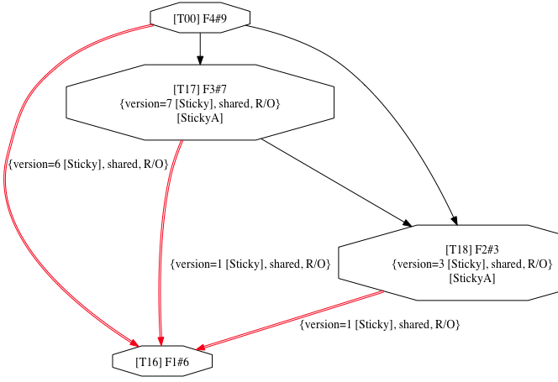
Bottom-Up Update = Perform the updates
✔
F1#1 => F1#6
F2#3 => F2#6
F3#7 => F3#9
➔
✔

Slide 25
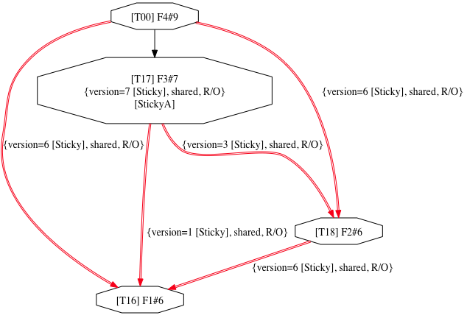
Bottom-Up Update = Perform the updates
✔
F1#1 => F1#6
F2#3 => F2#6
F3#7 => F3#9
✔
➔
✔
✔

Slide 26
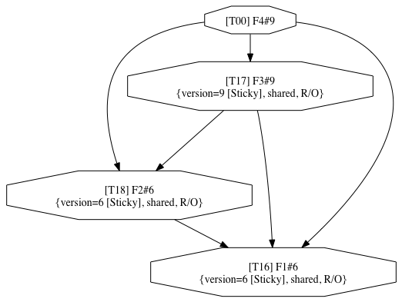
Bottom-Up Update = Perform the updates
✔
F1#1 => F1#6
F2#3 => F2#6
F3#7 => F3#9
✔
✔
✔
✔
✔
Planning any version update is important!
Helps avoid incompatible changes (and proxies)
MagicDraw cannot do this; users must plan for it!

Slide 27
Managing reusable MBSE modeling assets
The true lesson learned from Europa:
Project Integrity Checking is a necessity
Integrity criteria is a combination of:
Constraints due to the static semantics of UML/SysML
Constraints due to MagicDraw’s implementation
Constraints due to Project Management policies
Managing versioned MBSE assets is a must!
Recommendation:
1) Decide what to update & when
2) Analyze the compatibility of proposed updates
3) Execute planned updates (and repair if needed)

Slide 28
Pros/Cons
Latest module mounts for agile collaboration
What:
The model is “up-to-date” each time it is opened w.r.t the contents of modules mounted “latest”.
Pros:
A good thing for agile teams who want to minimize the overhead of sharing collaborative work on multiple teamwork modules
Cons:
The latest version of a module may break a using module; if multiple modules are mounted “latest”, it becomes difficult if not impossible to tell which module change caused a breakage
Alternative agile collaborative practice (with the checker ON):
Consolidate the scope of the agile modeling work in a common teamwork model
Move the contents to a package within the common model
Import teamwork modules into the common model
All agile modelers open the same common teamwork model (as a project)
Each agile modeler locks a package within this common teamwork model
Use the MD Package dependency checker to verify the integrity of the package partitioning during agile refactoring operations
At the end, move or export the packages back into their respective teamwork modules

